Slide 1
Financial Stability 2024/2
Charts
25 September 2024

Slide 2
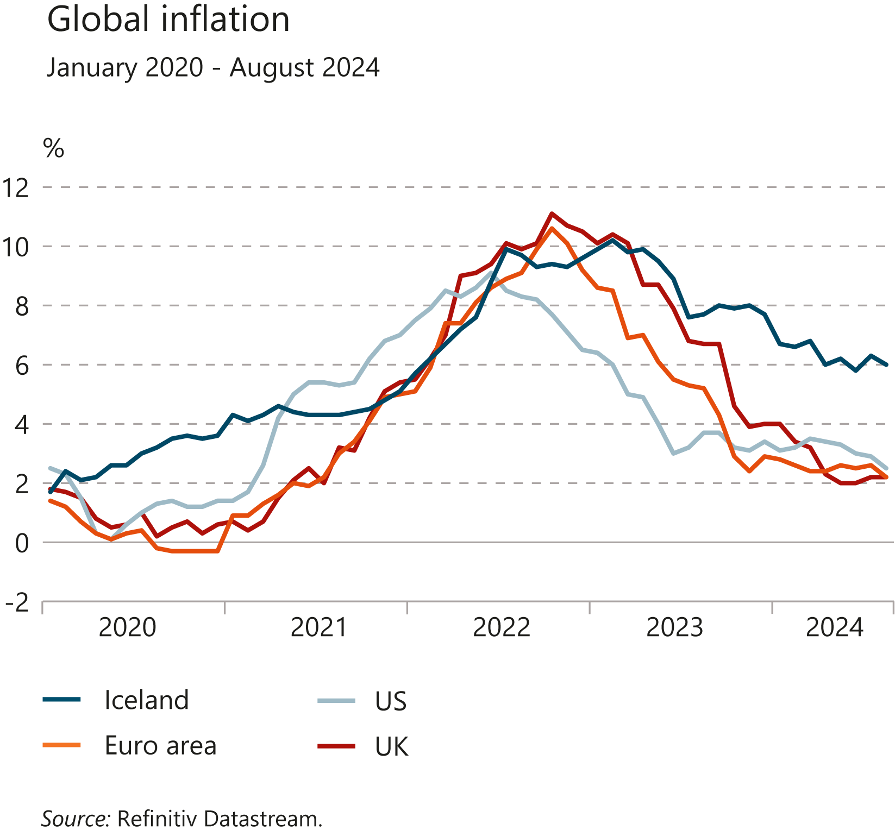
I Financial Stability: Developments and prospects

Slide 3
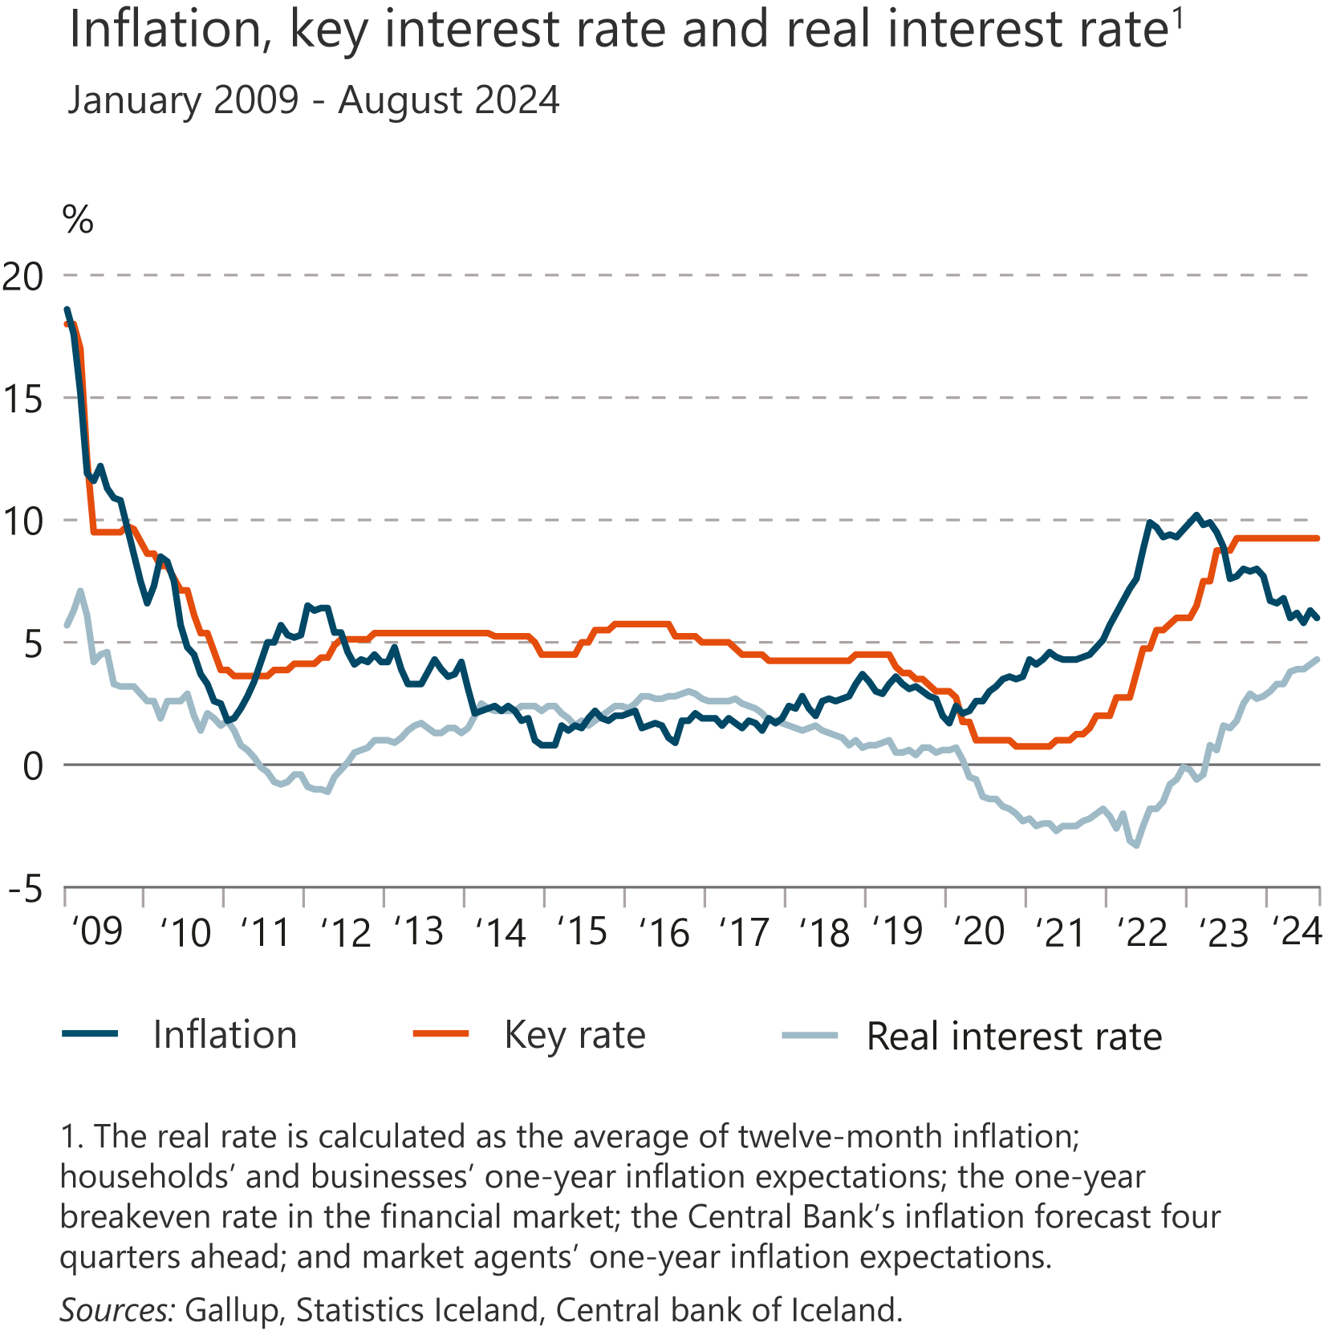
I Financial Stability: Developments and prospects

Slide 4
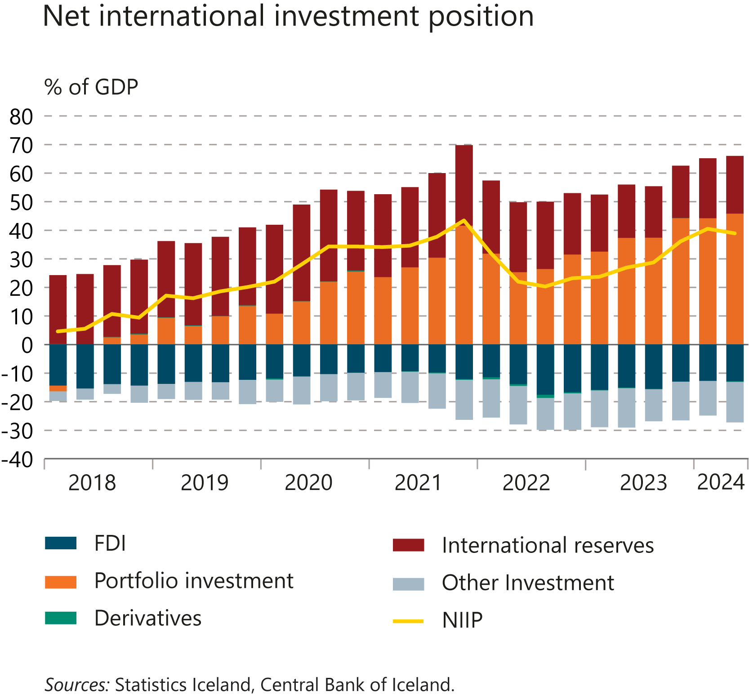
I Financial Stability: Developments and prospects

Slide 5
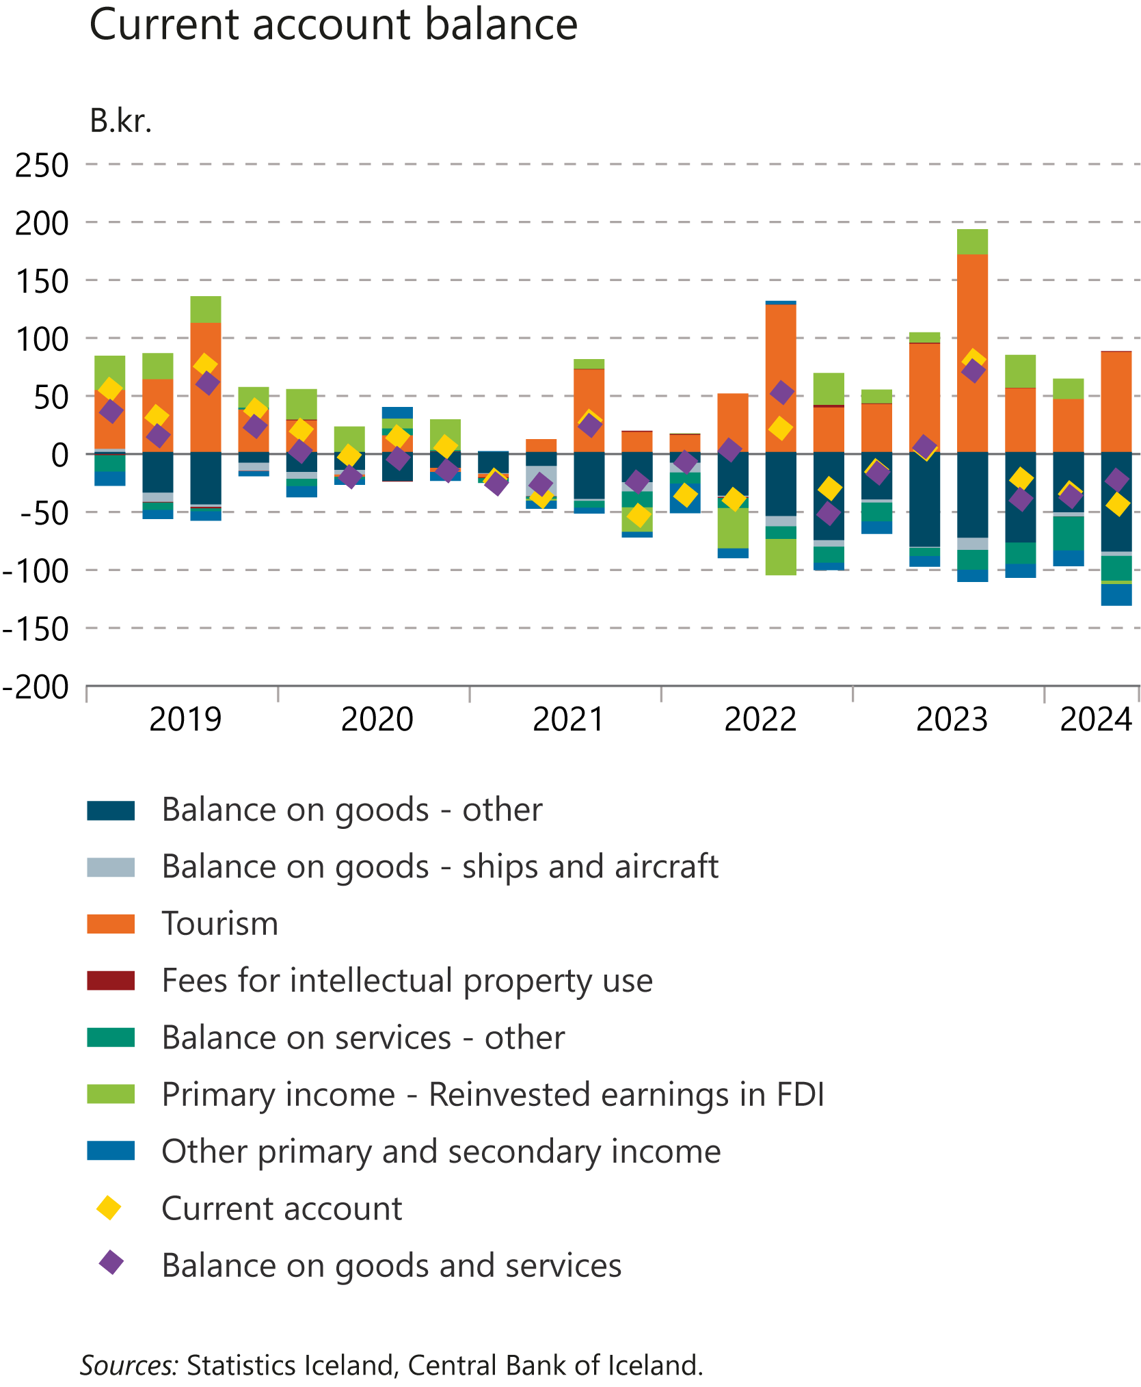
I Financial Stability: Developments and prospects

Slide 6
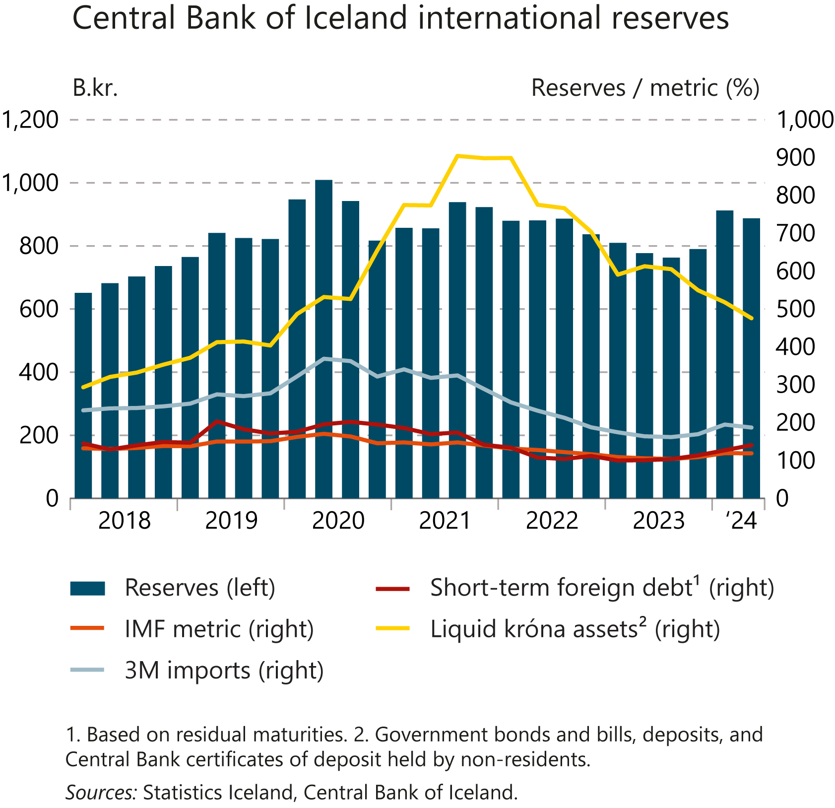
I Financial Stability: Developments and prospects

Slide 7
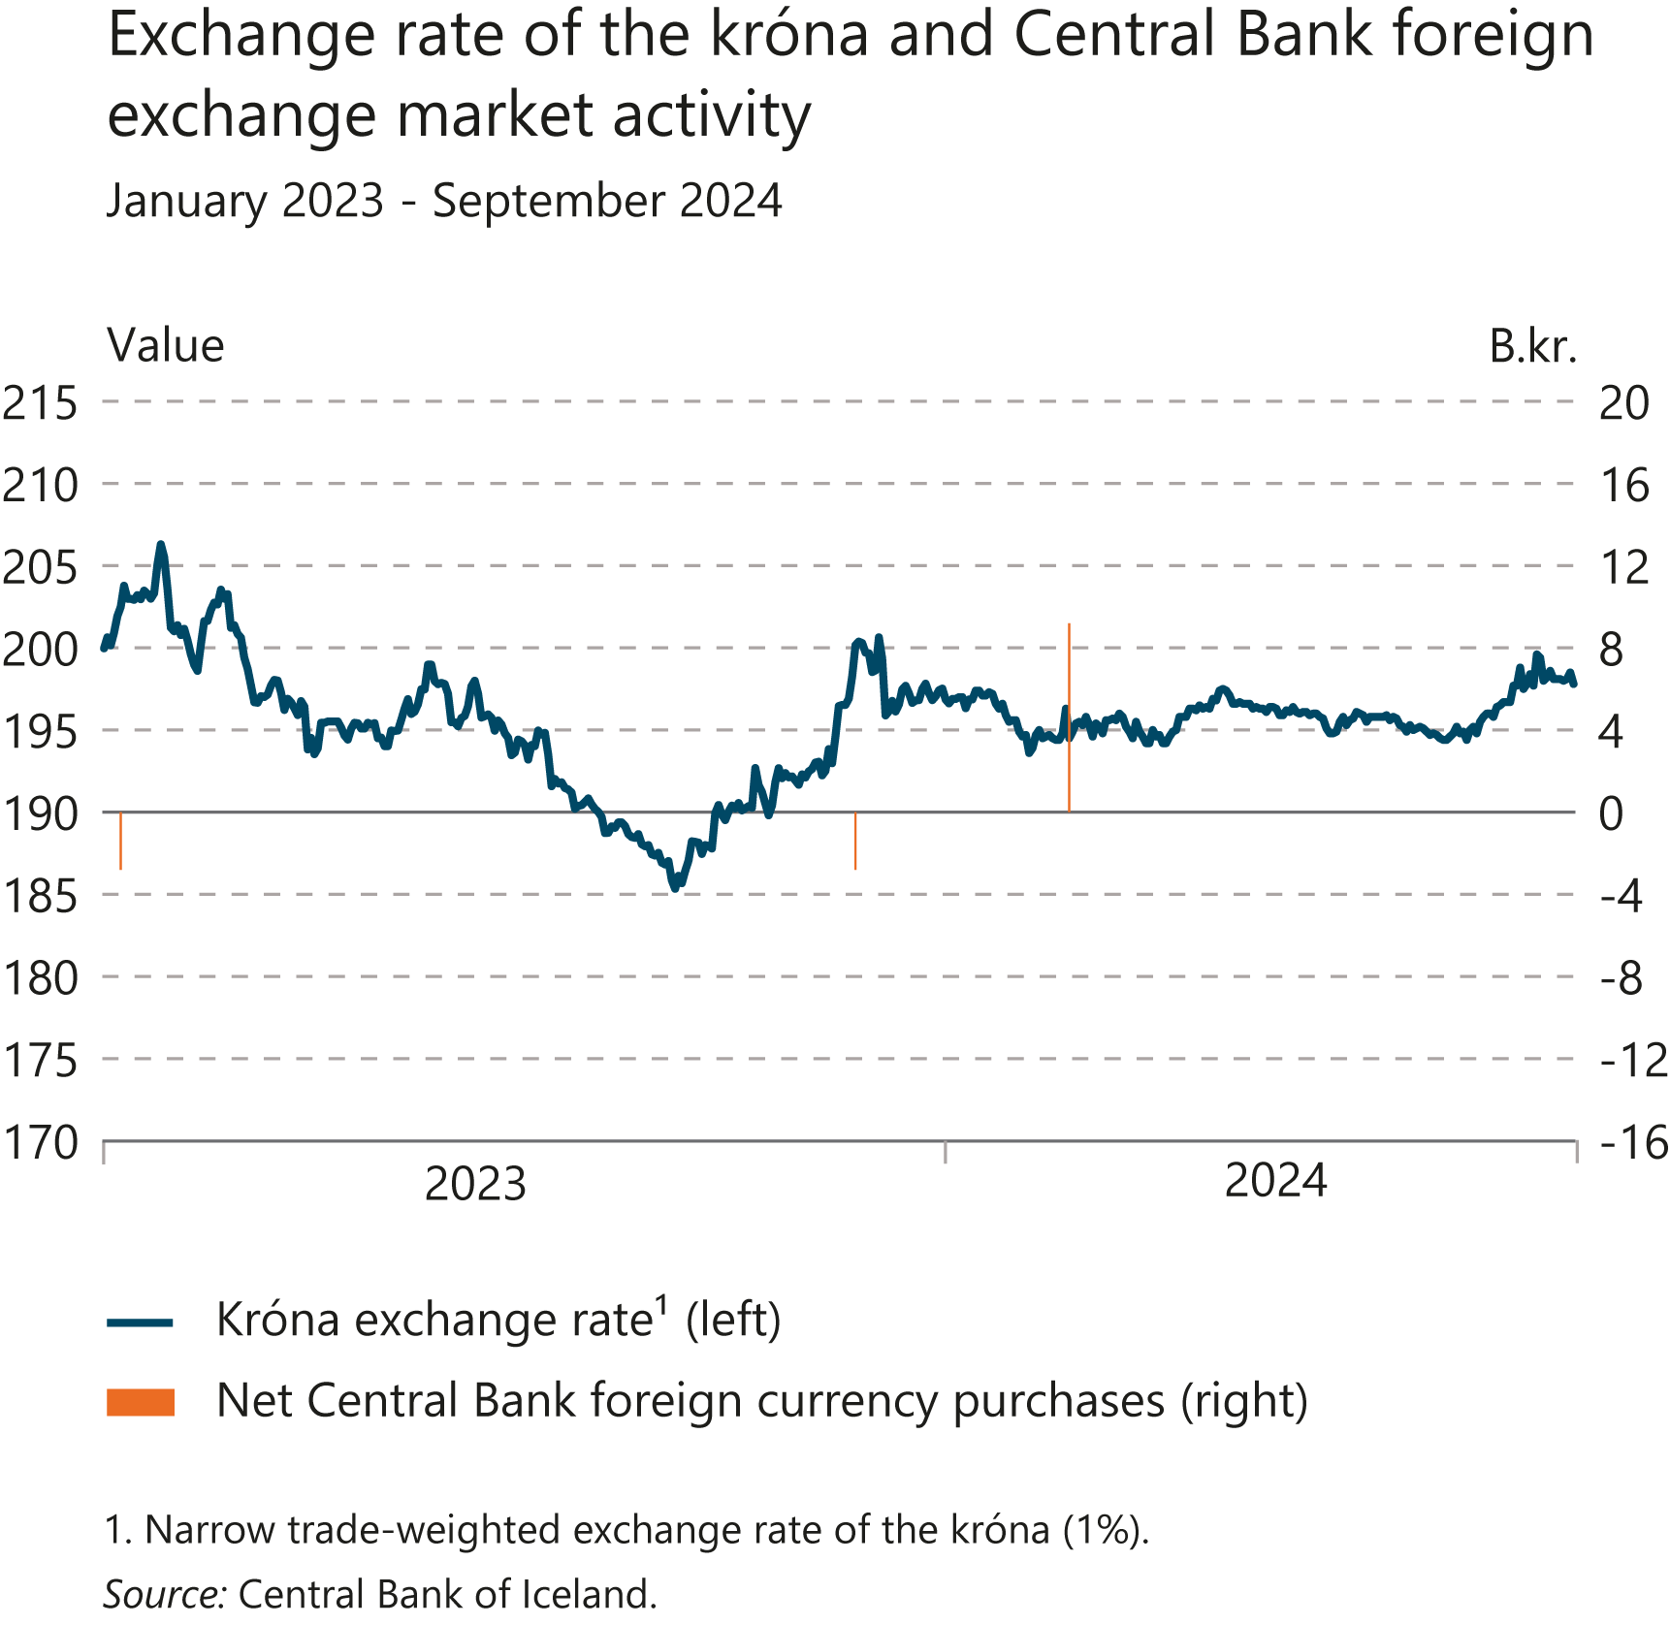
I Financial Stability: Developments and prospects

Slide 8
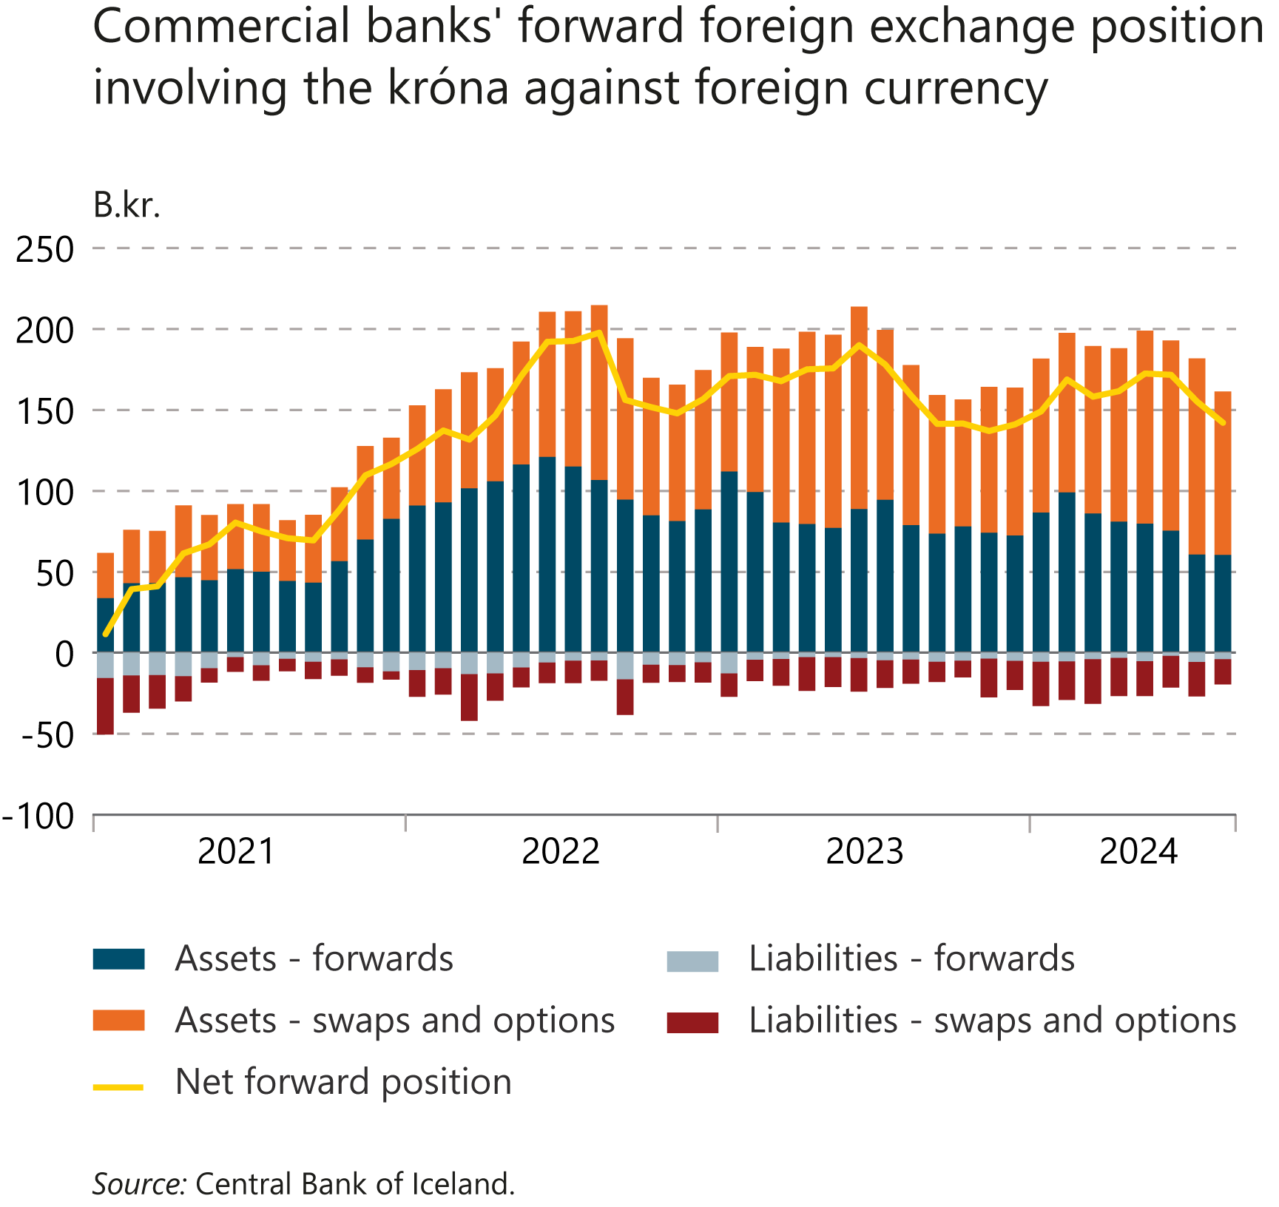
I Financial Stability: Developments and prospects

Slide 9
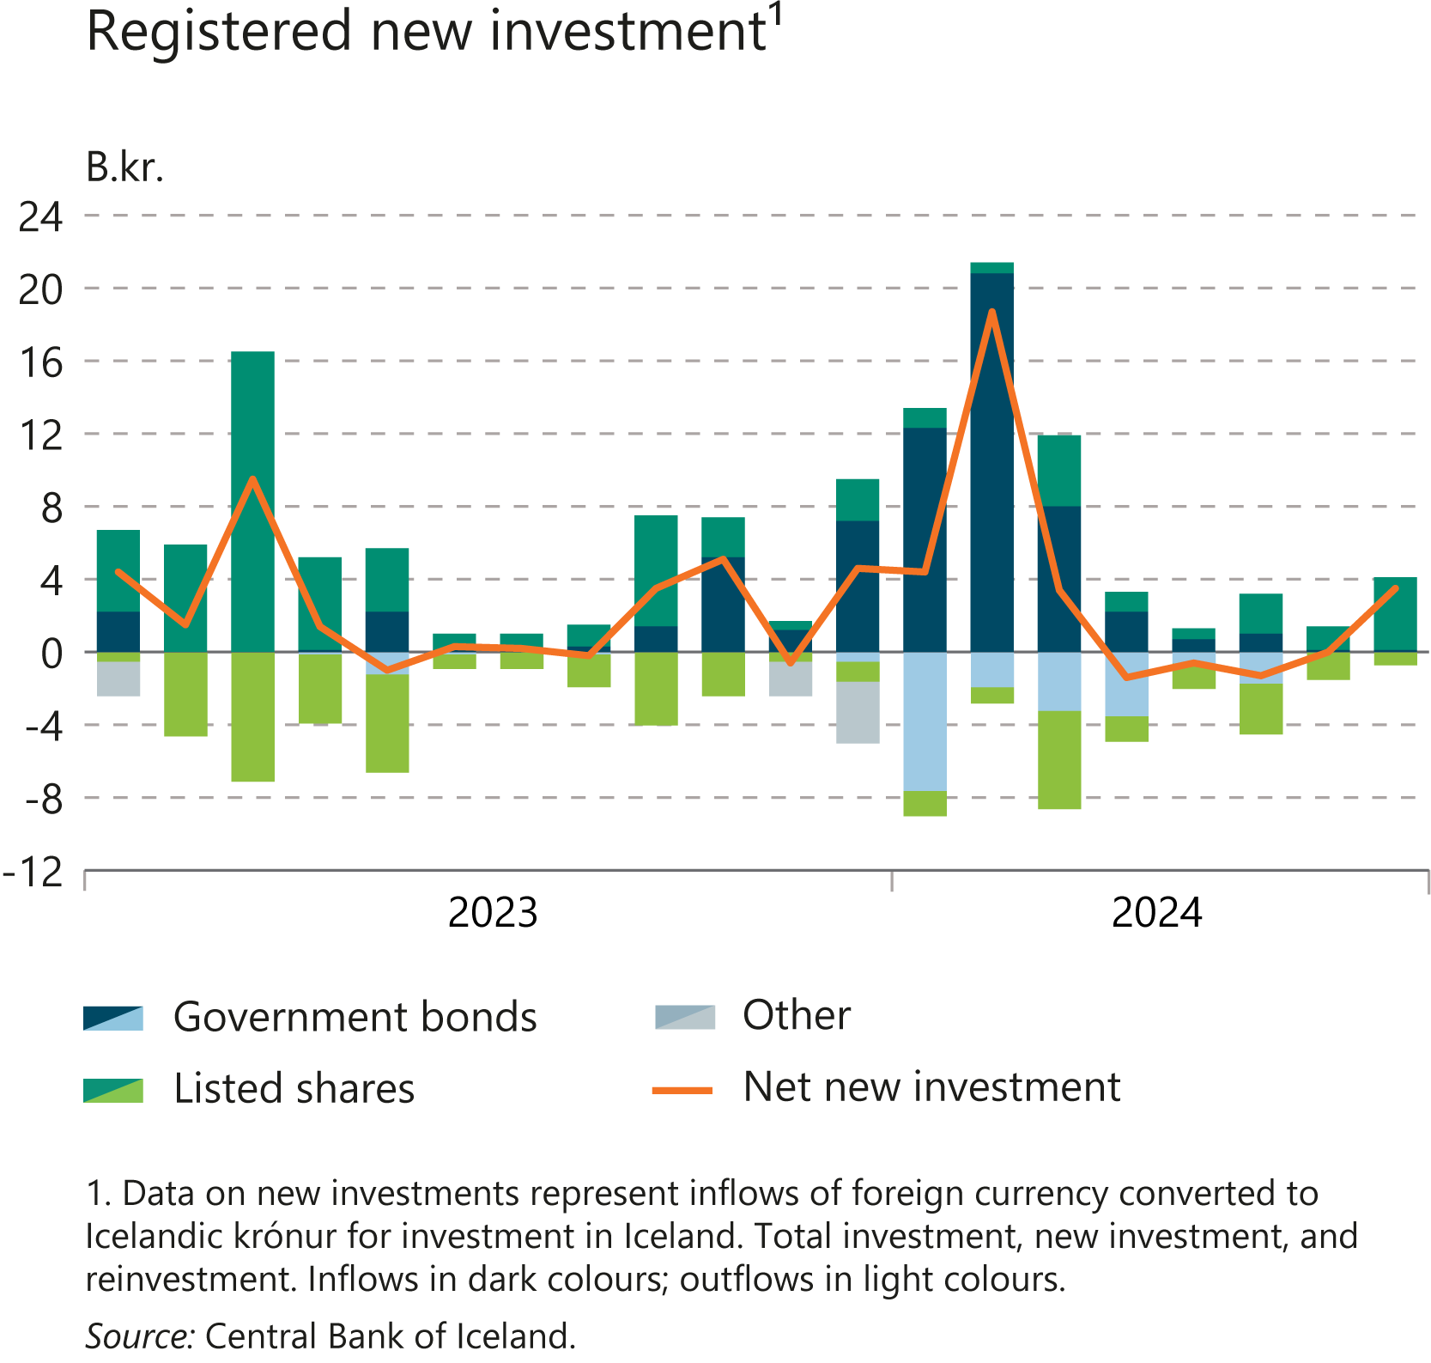
I Financial Stability: Developments and prospects

Slide 10
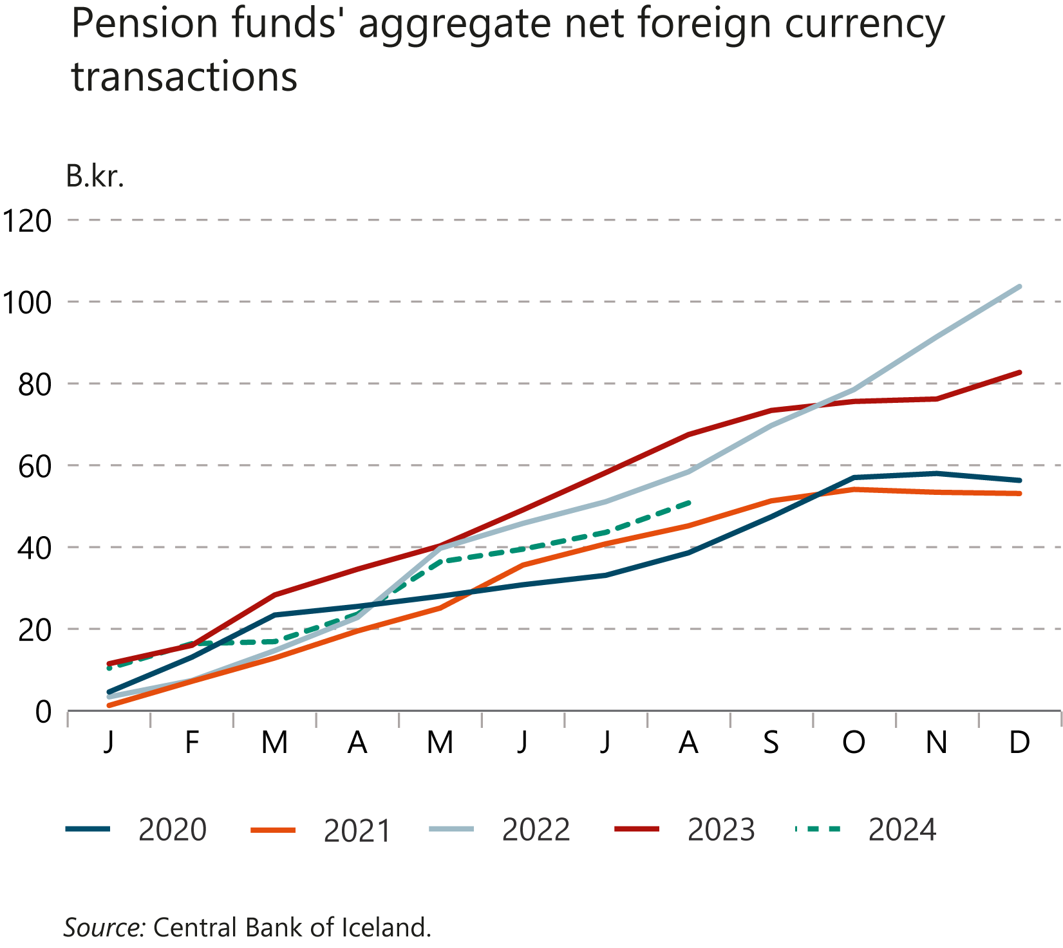
I Financial Stability: Developments and prospects

Slide 11
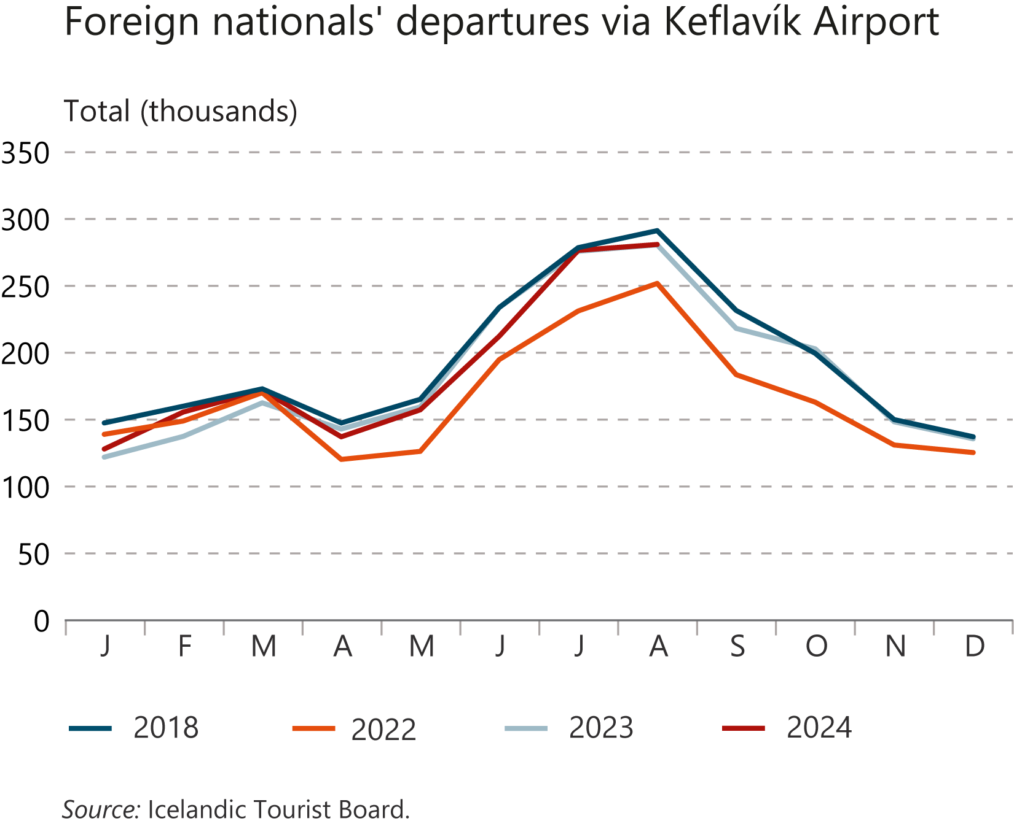
I Financial Stability: Developments and prospects

Slide 12
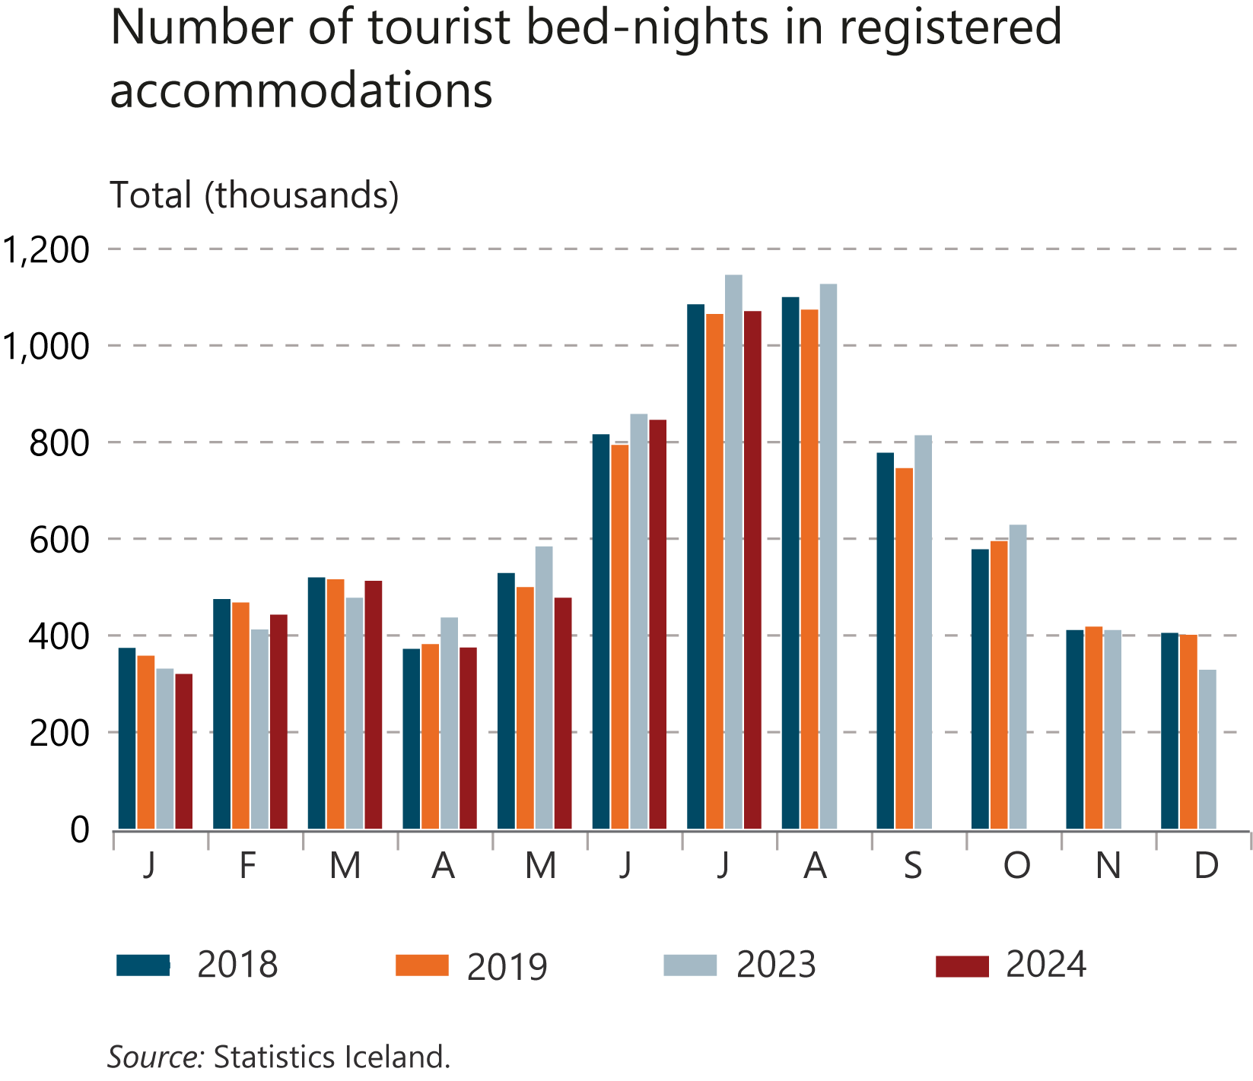
I Financial Stability: Developments and prospects

Slide 13
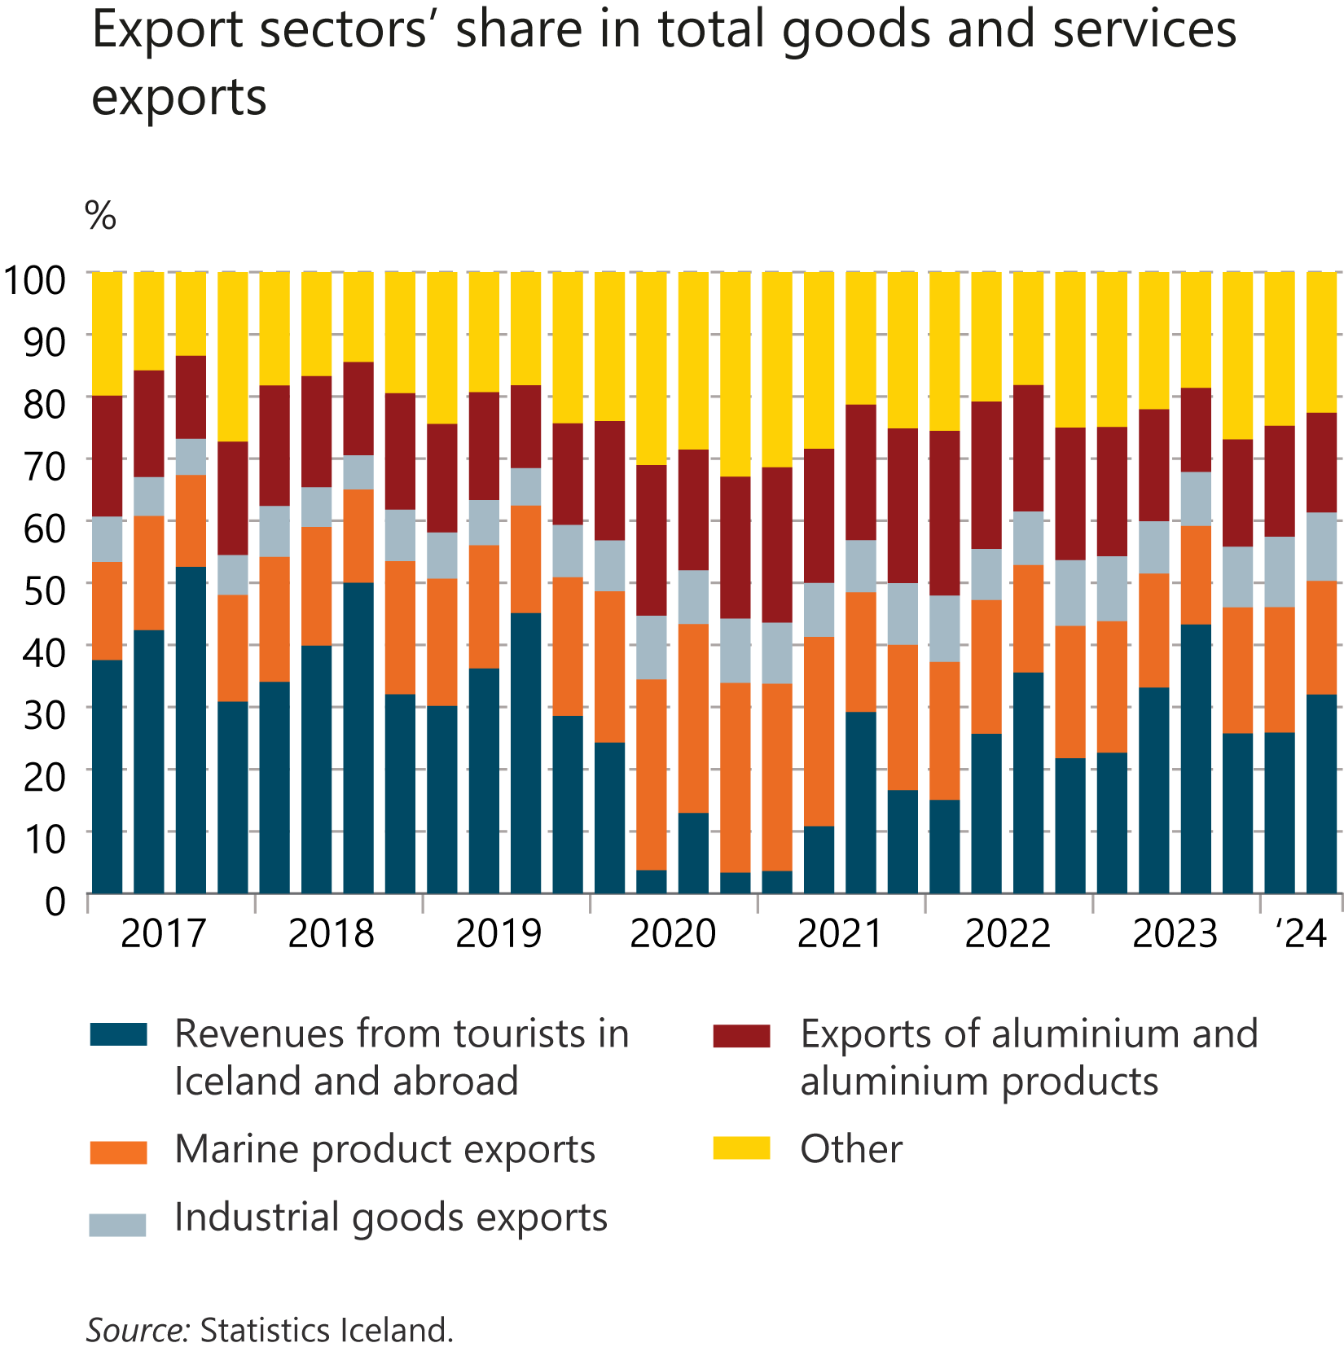
I Financial Stability: Developments and prospects

Slide 14
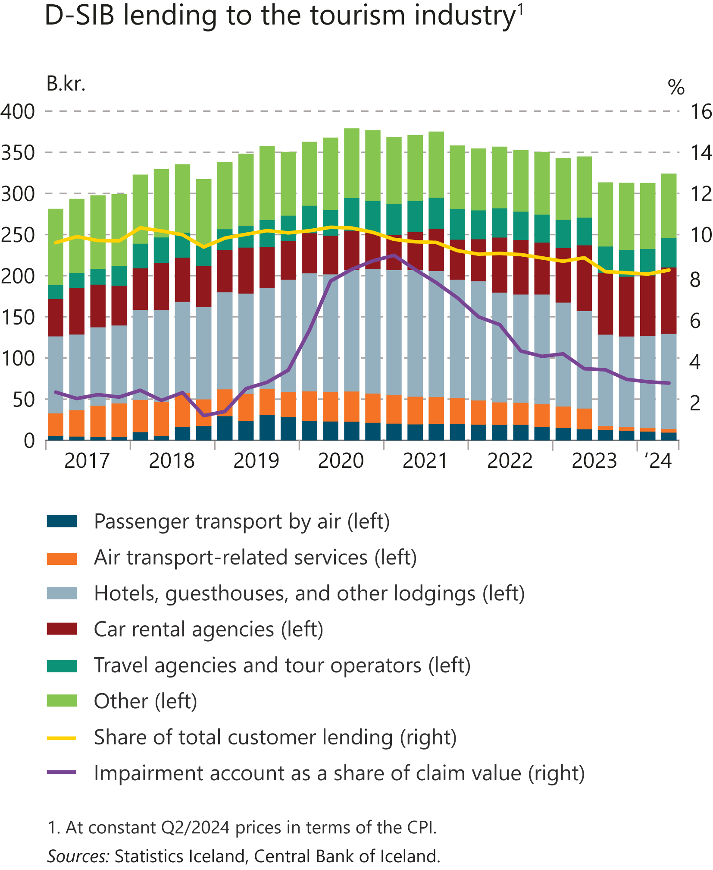
I Financial Stability: Developments and prospects

Slide 15
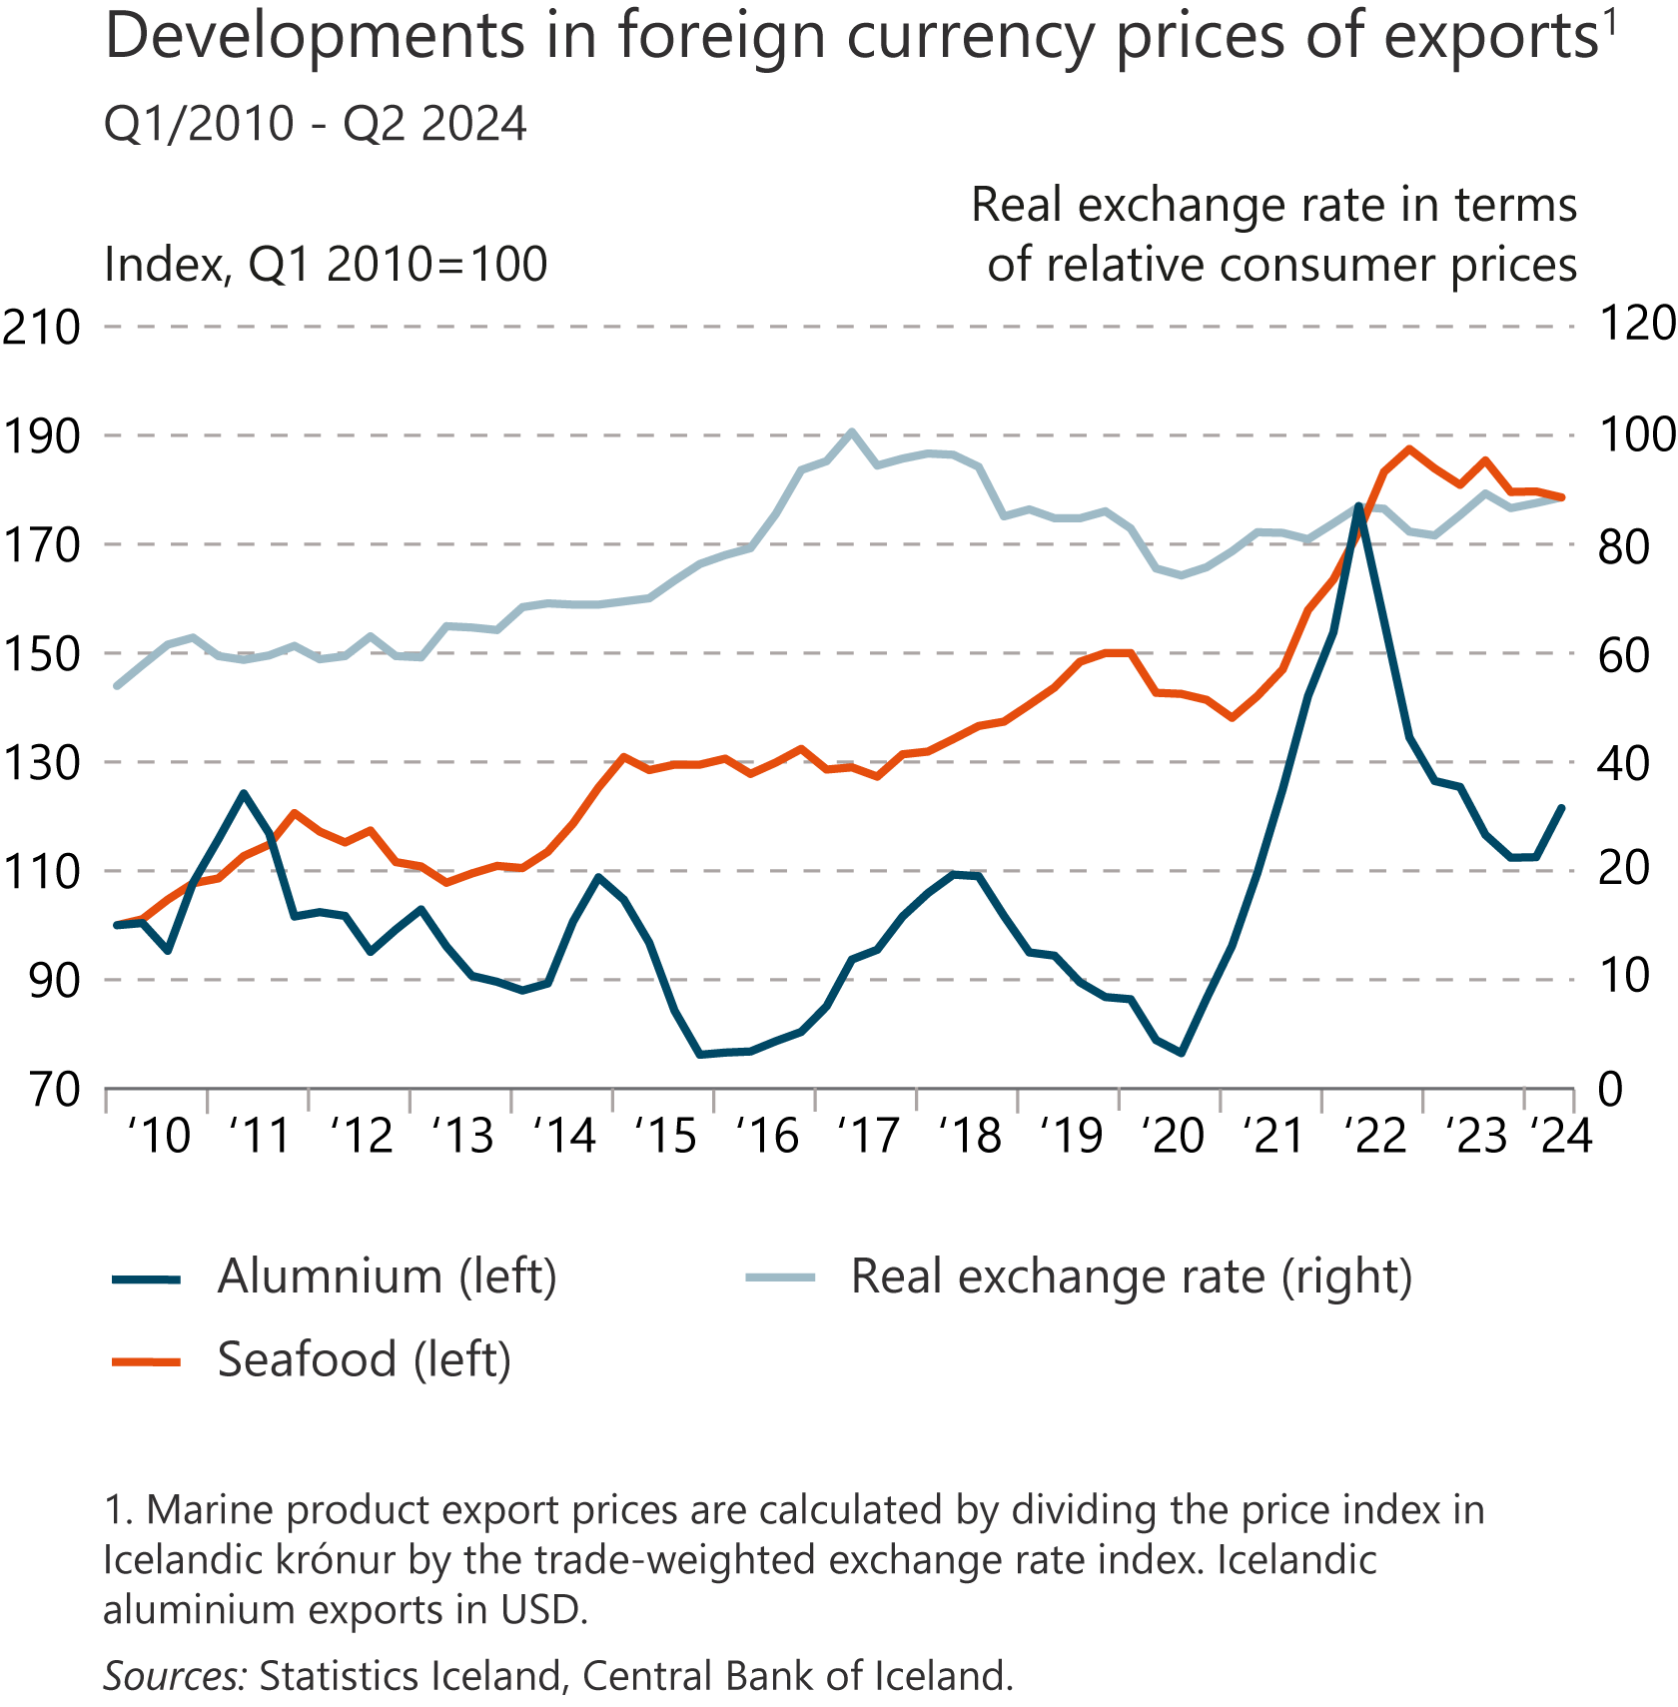
I Financial Stability: Developments and prospects

Slide 16
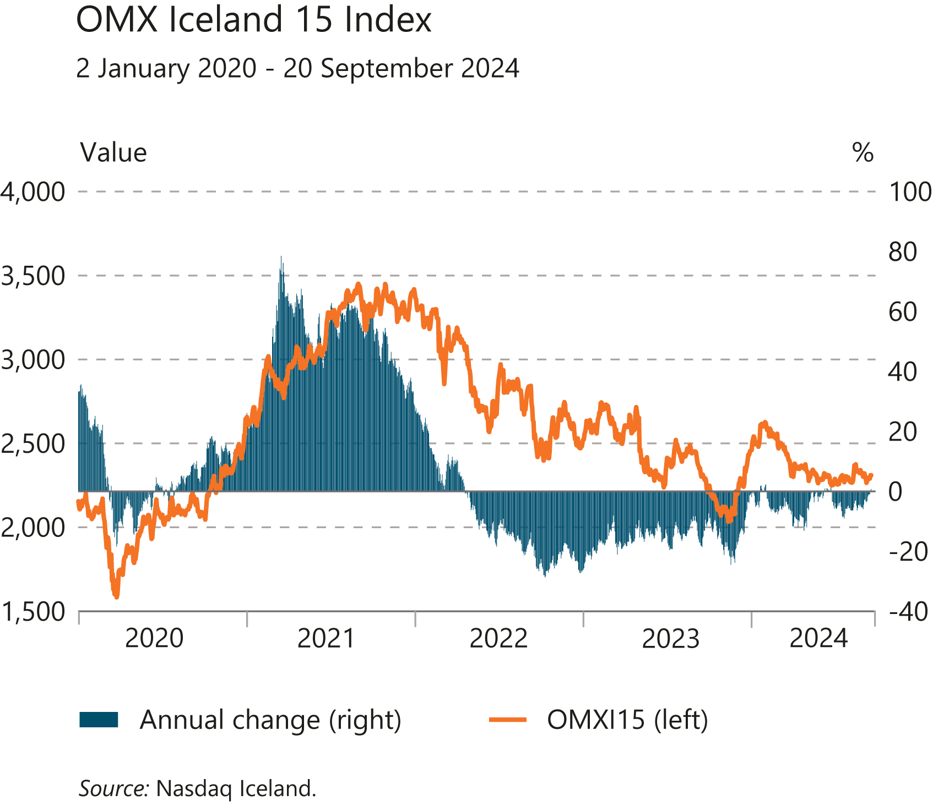
I Financial Stability: Developments and prospects

Slide 17
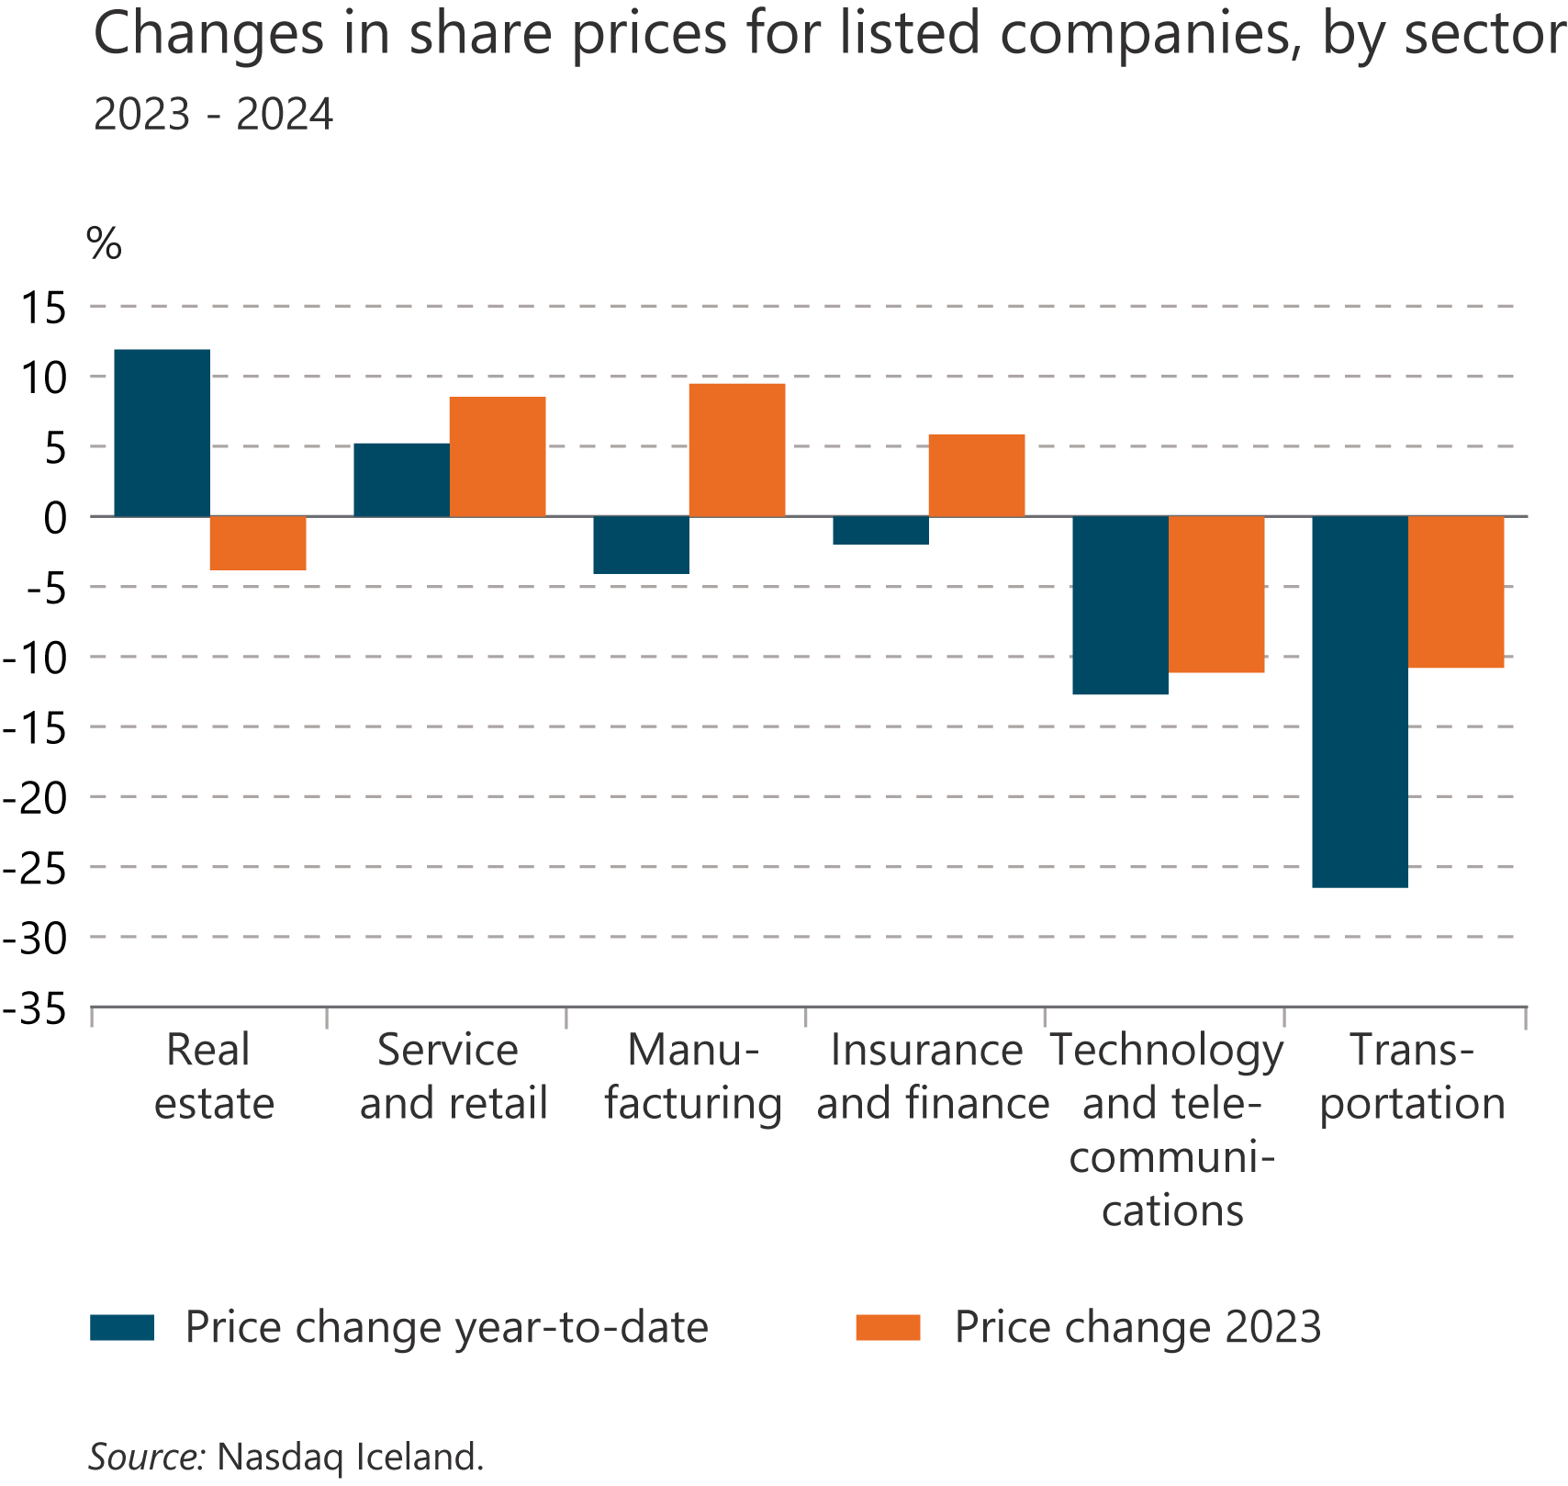
I Financial Stability: Developments and prospects

Slide 18
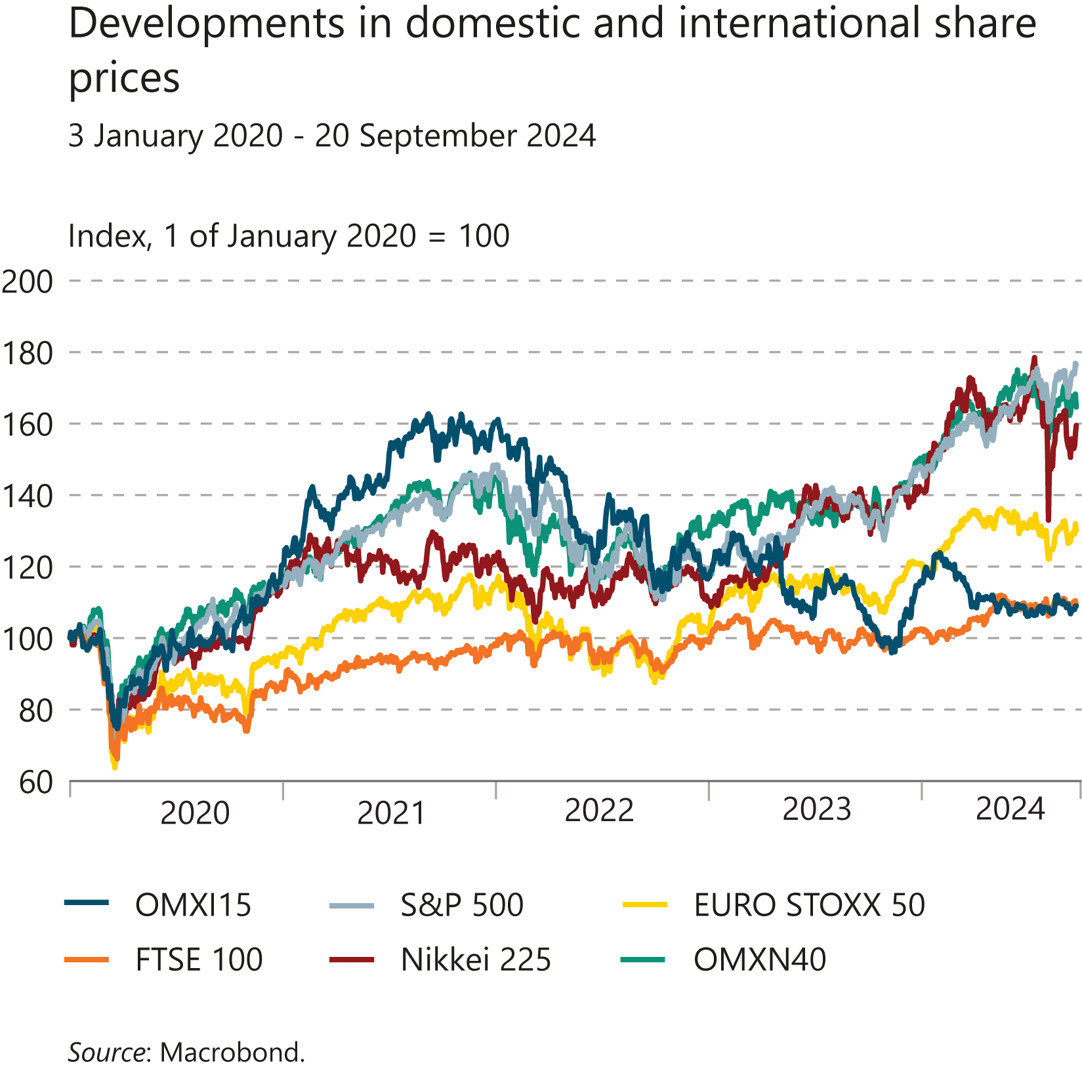
I Financial Stability: Developments and prospects

Slide 19
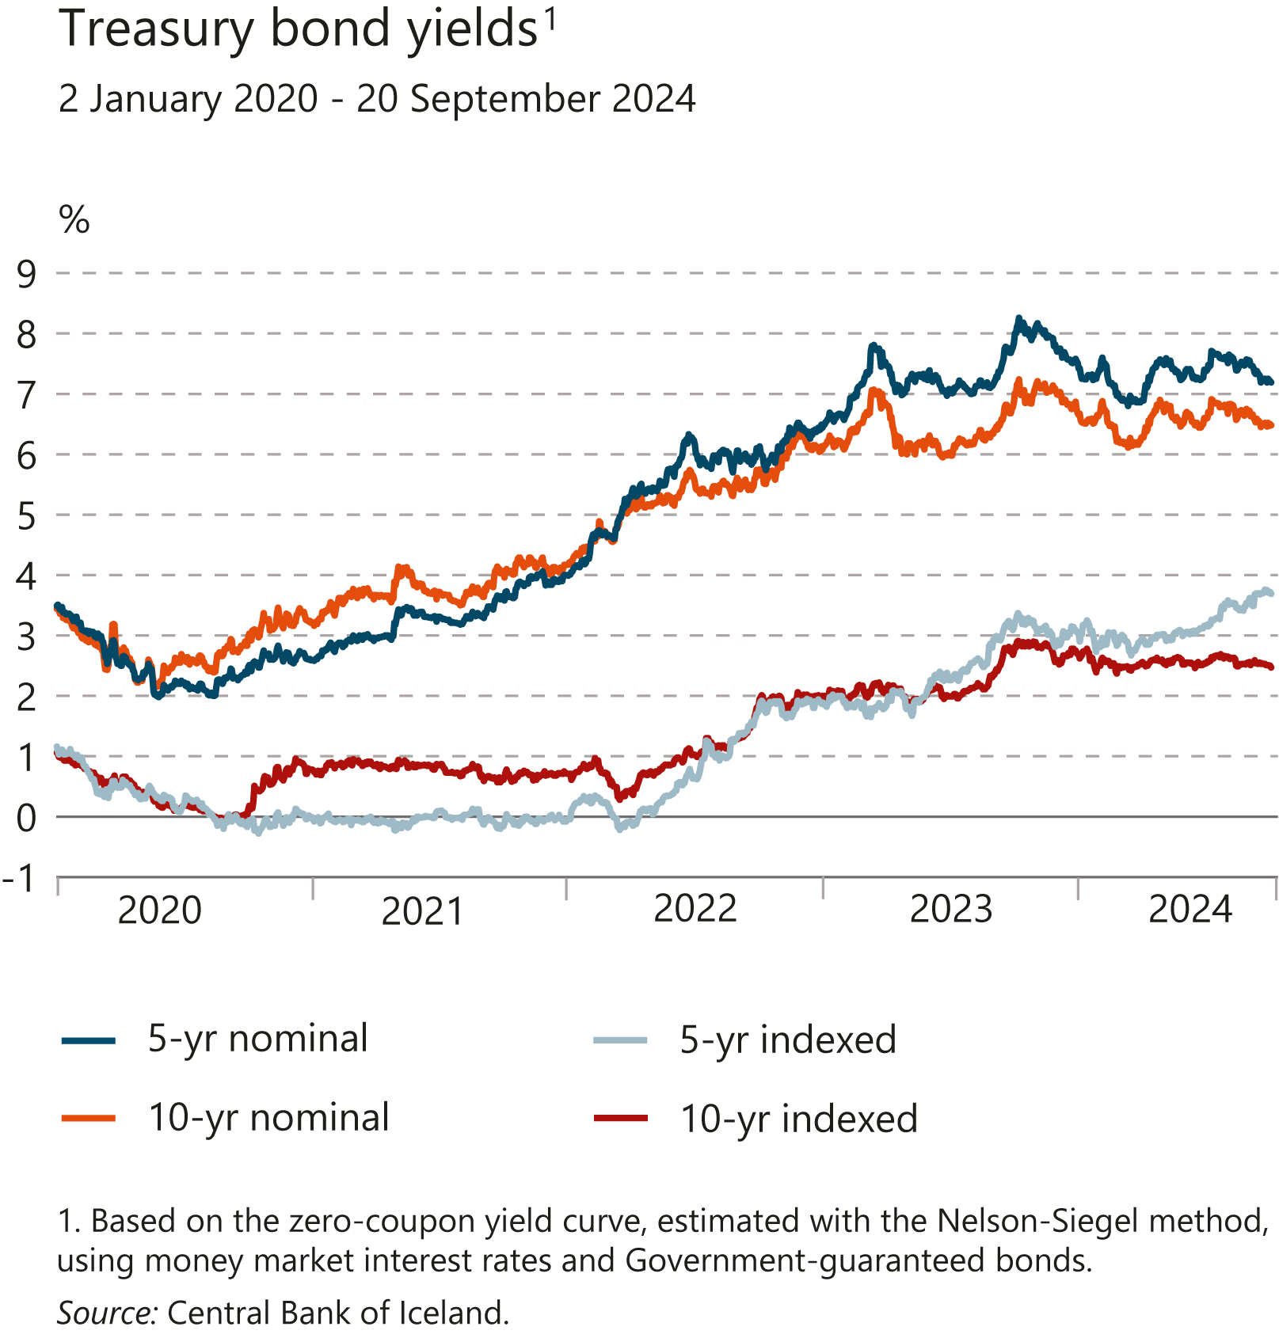
I Financial Stability: Developments and prospects

Slide 20
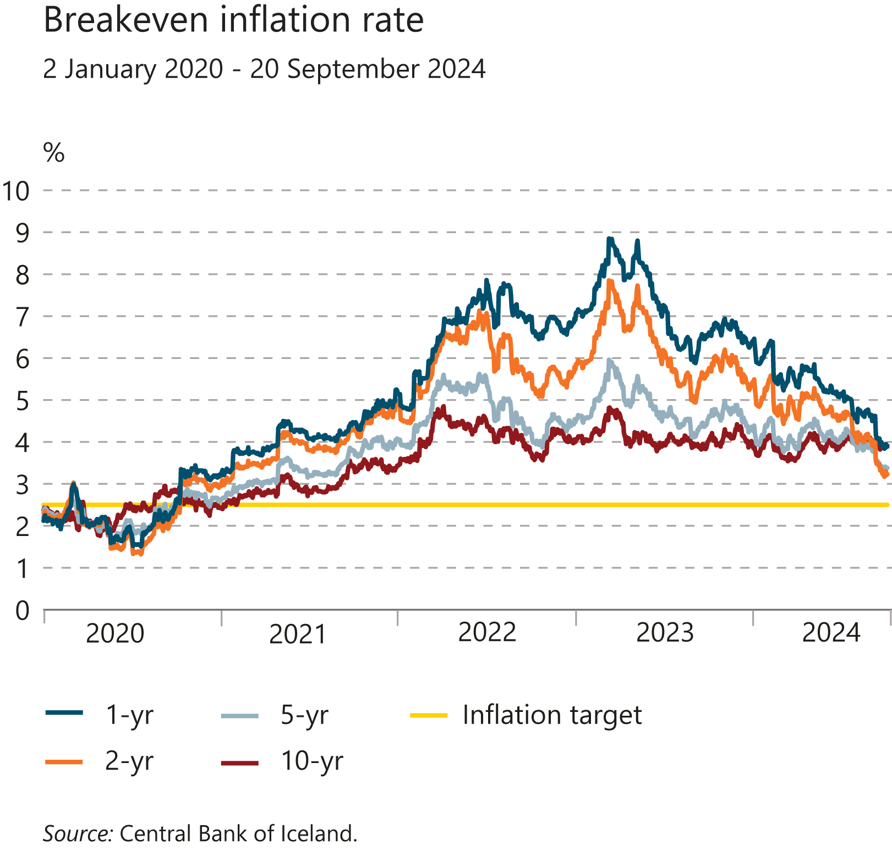
I Financial Stability: Developments and prospects

Slide 21
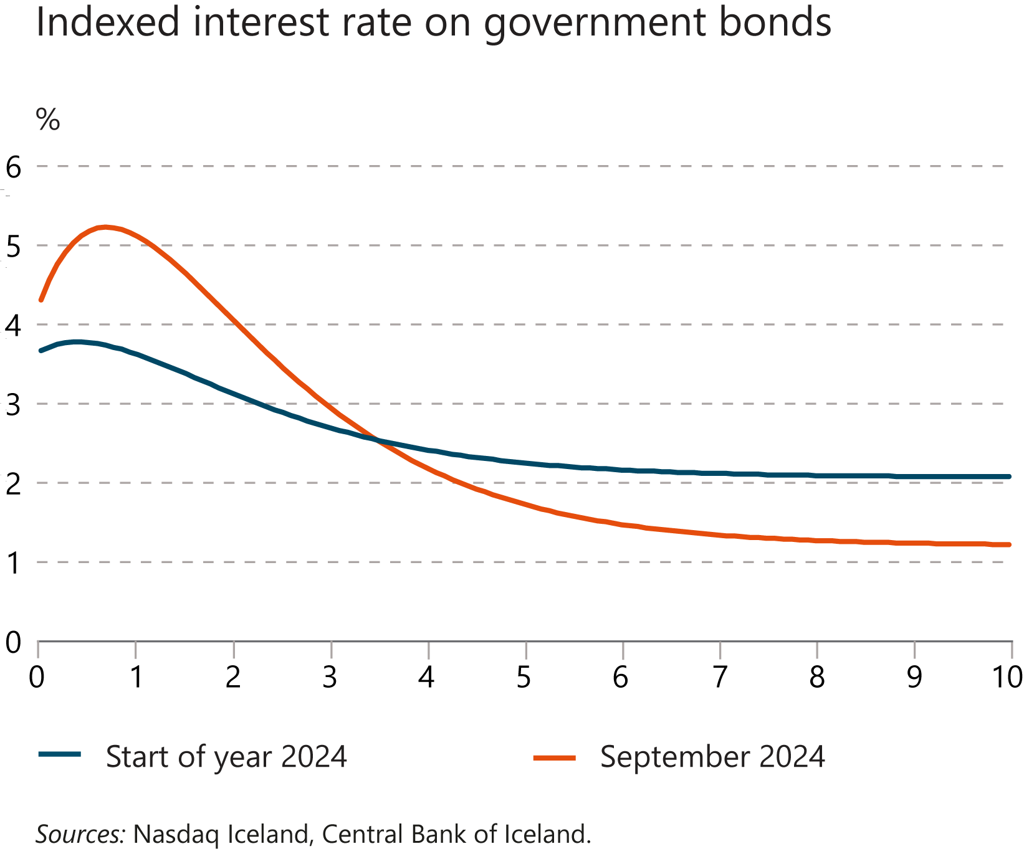
I Financial Stability: Developments and prospects

Slide 22
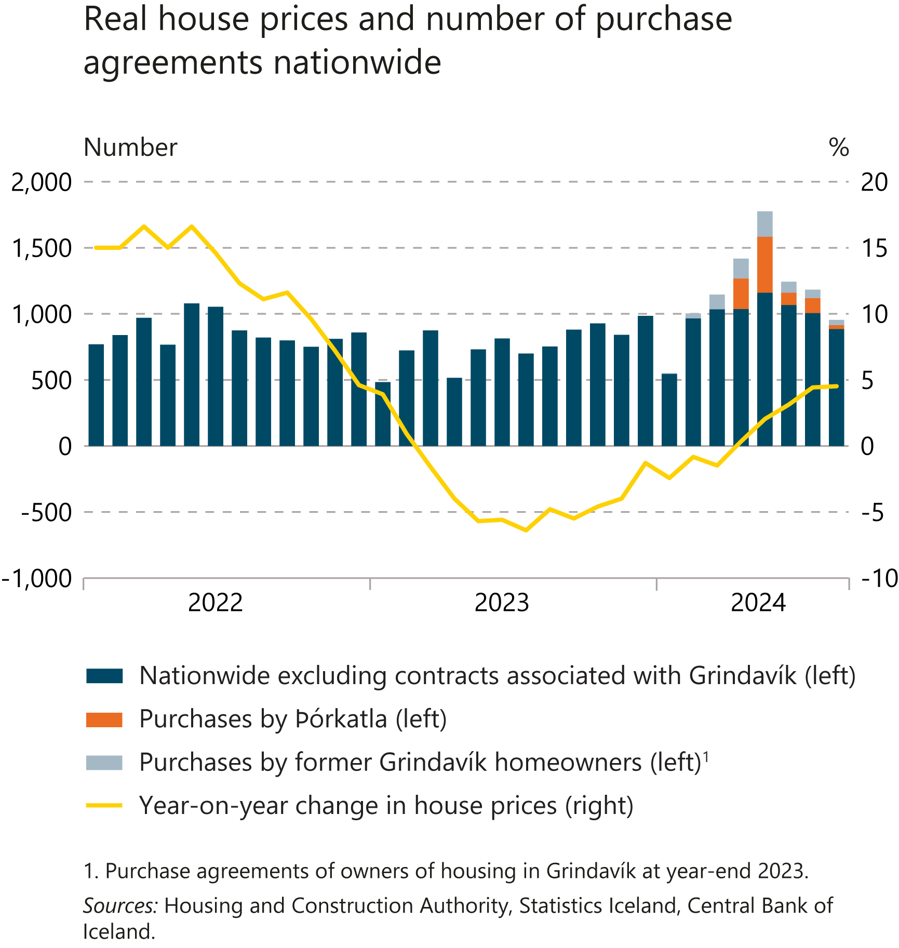
I Financial Stability: Developments and prospects

Slide 23
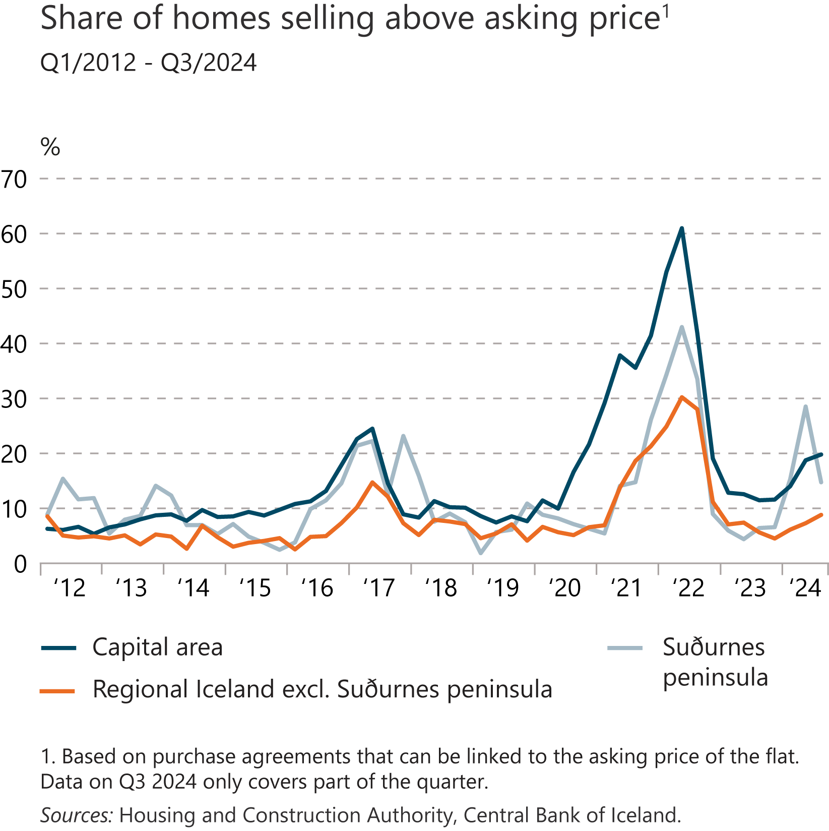
I Financial Stability: Developments and prospects

Slide 24
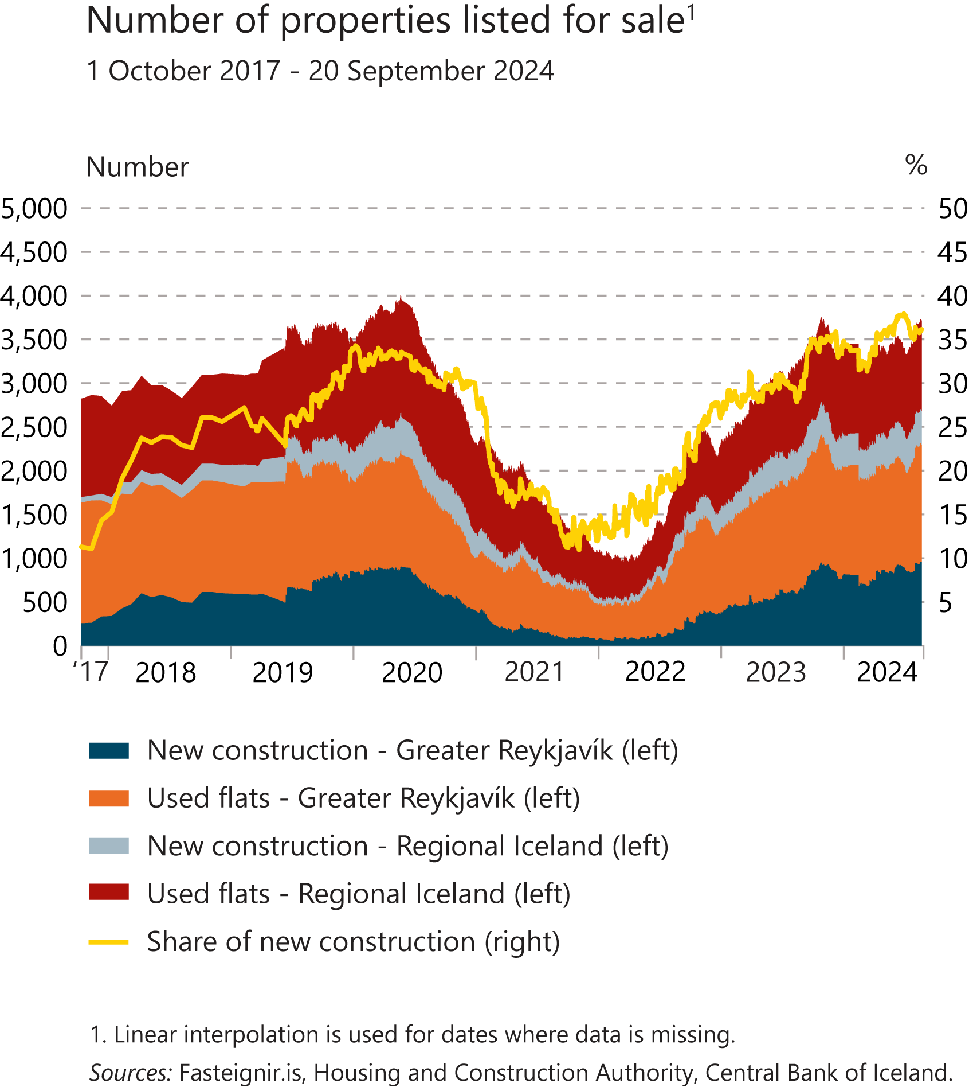
I Financial Stability: Developments and prospects

Slide 25
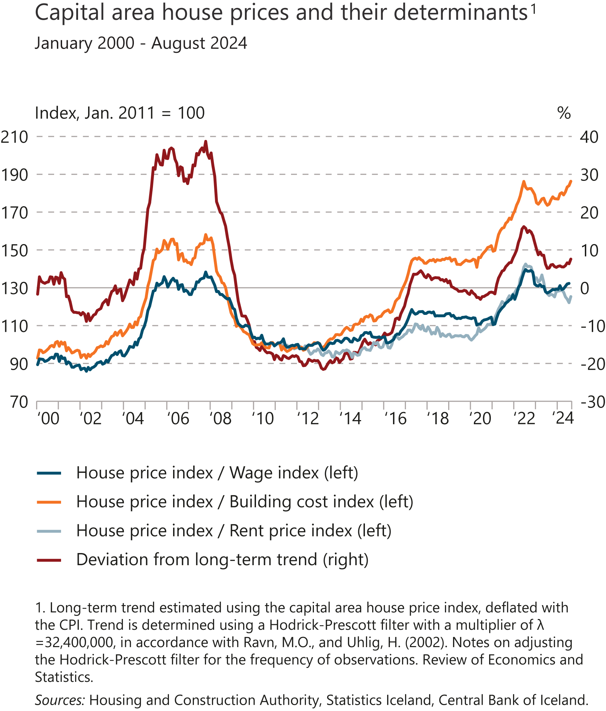
I Financial Stability: Developments and prospects

Slide 26
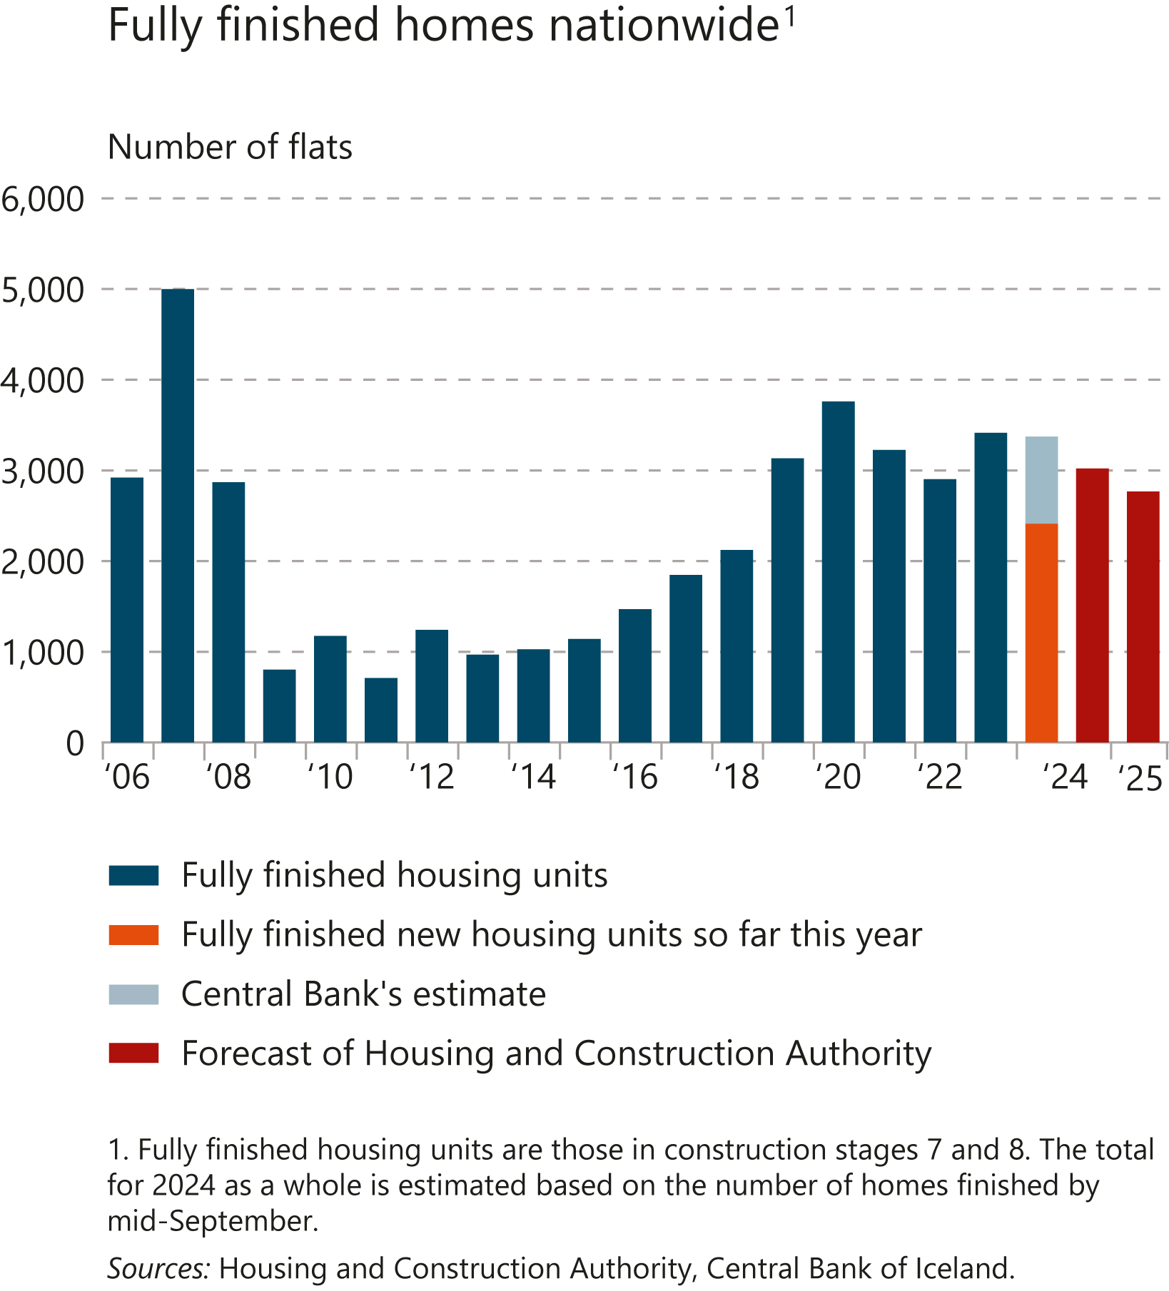
I Financial Stability: Developments and prospects

Slide 27
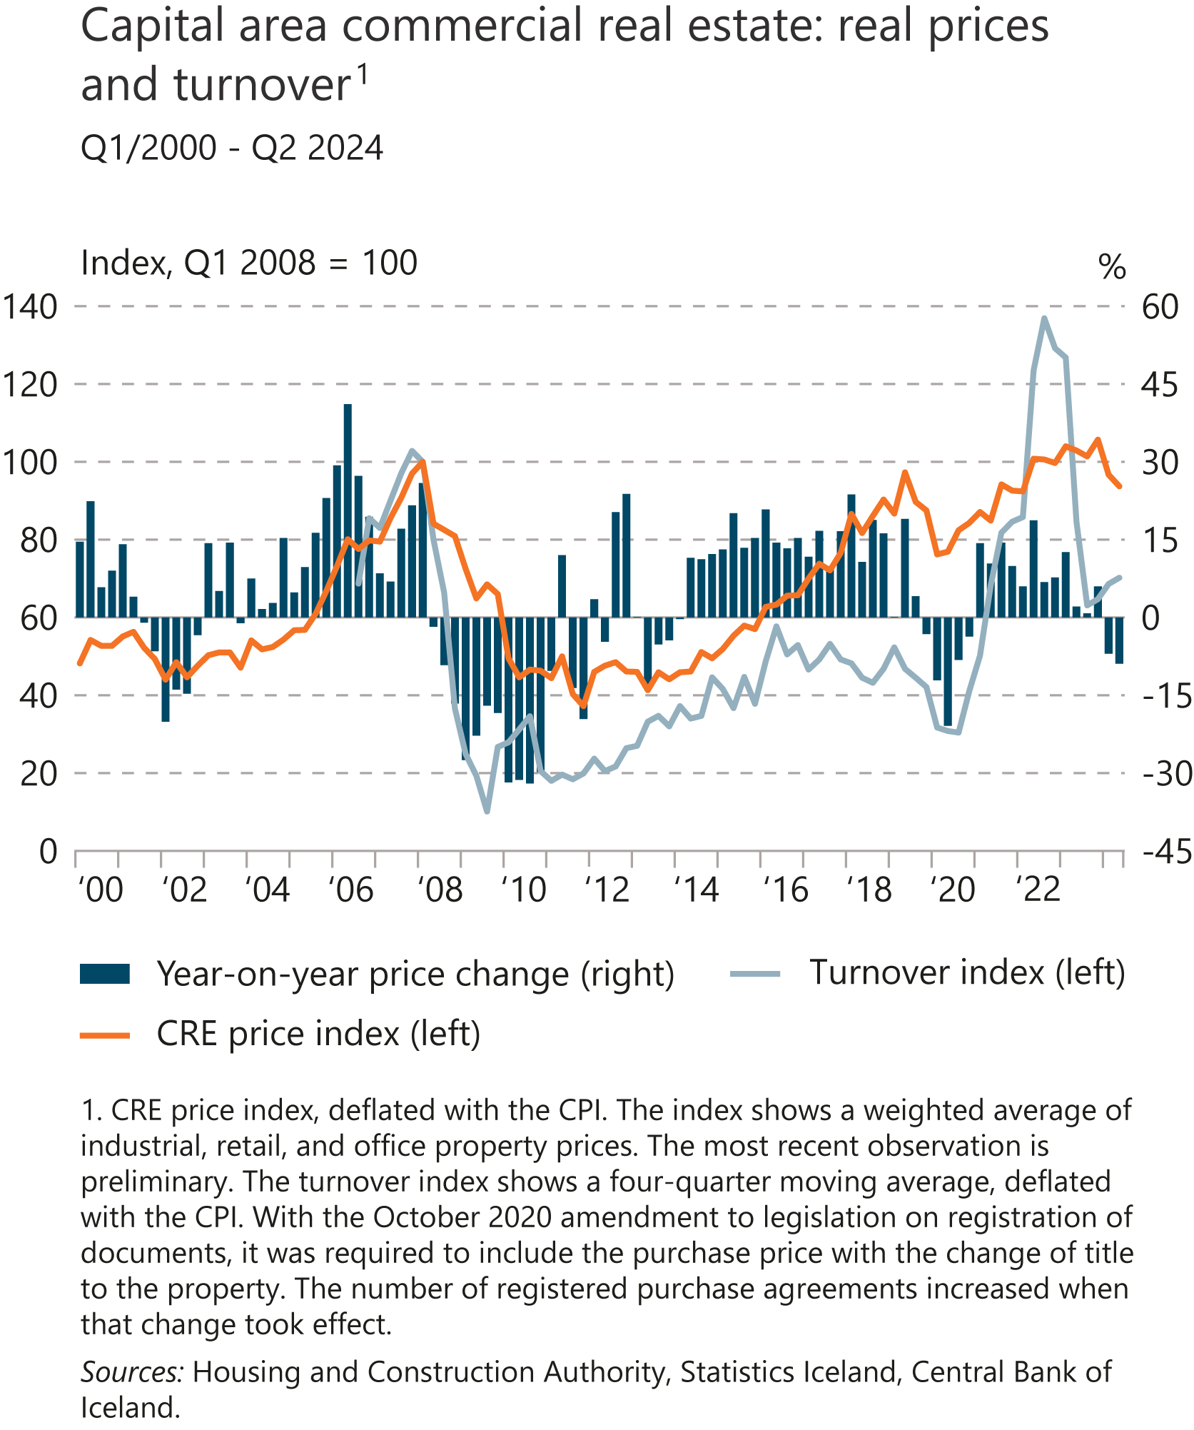
I Financial Stability: Developments and prospects

Slide 28
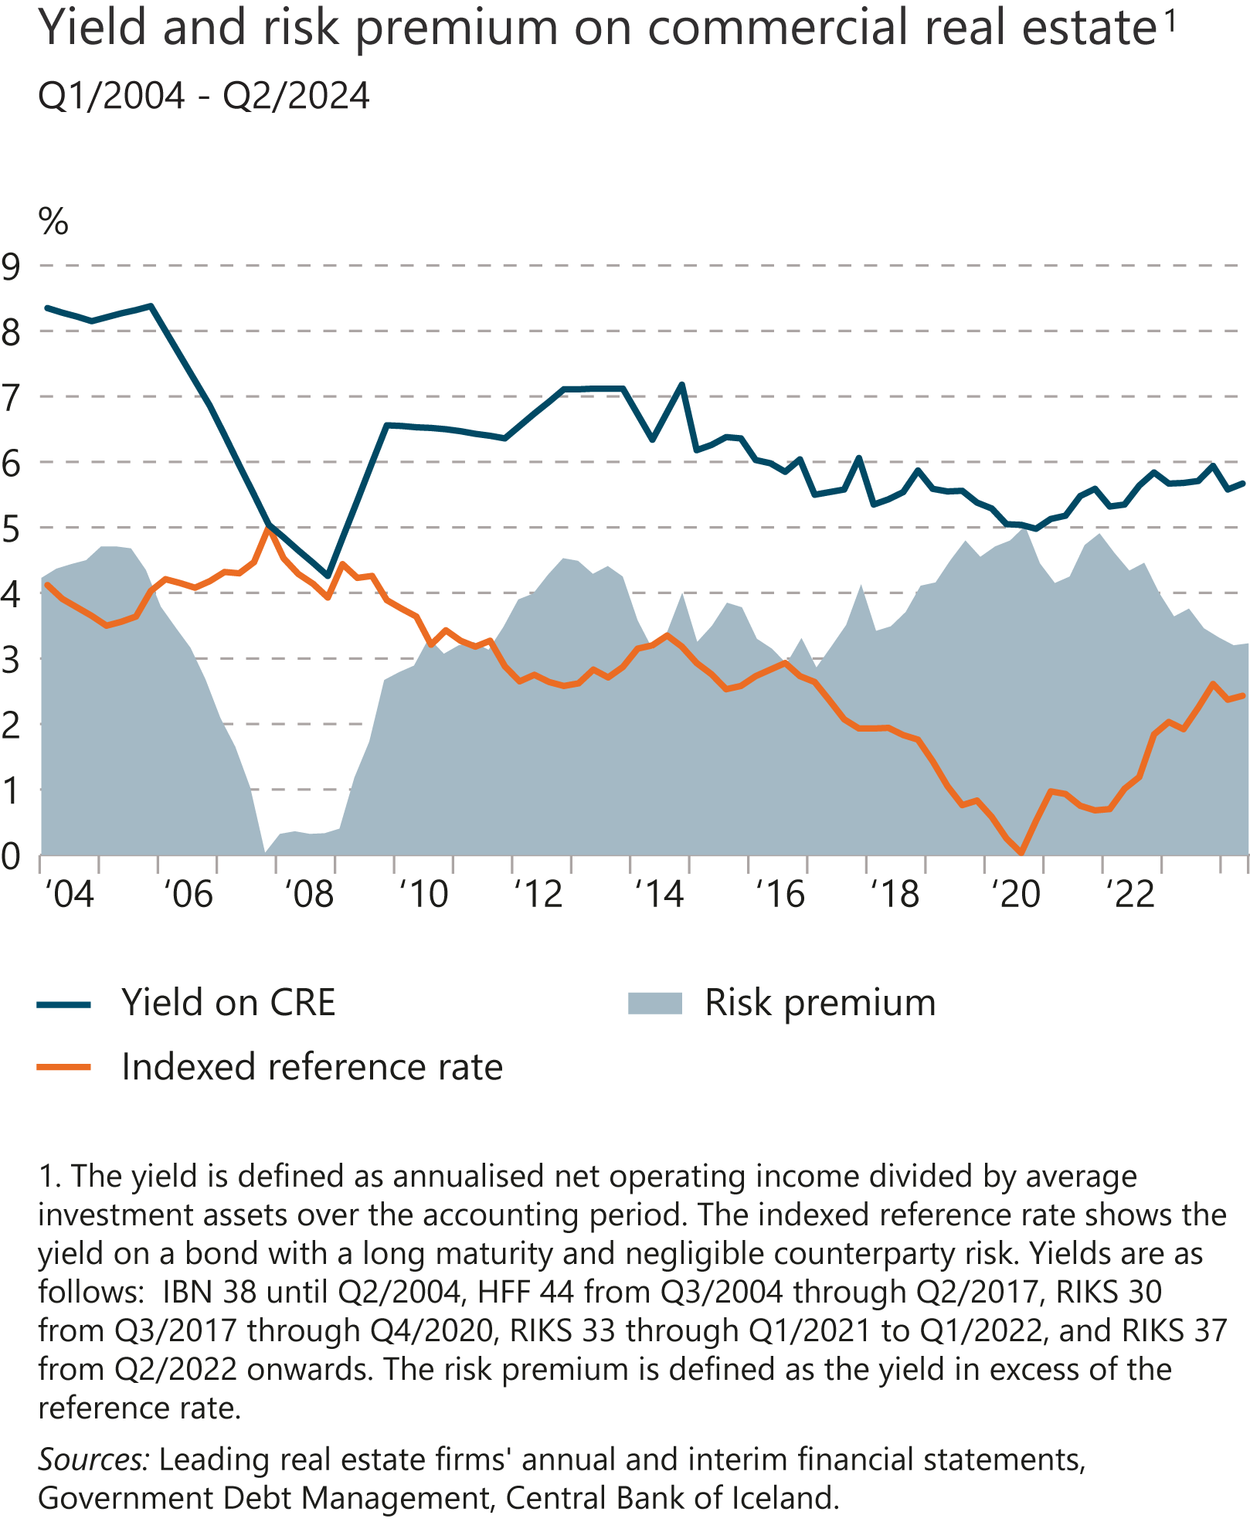
I Financial Stability: Developments and prospects

Slide 29
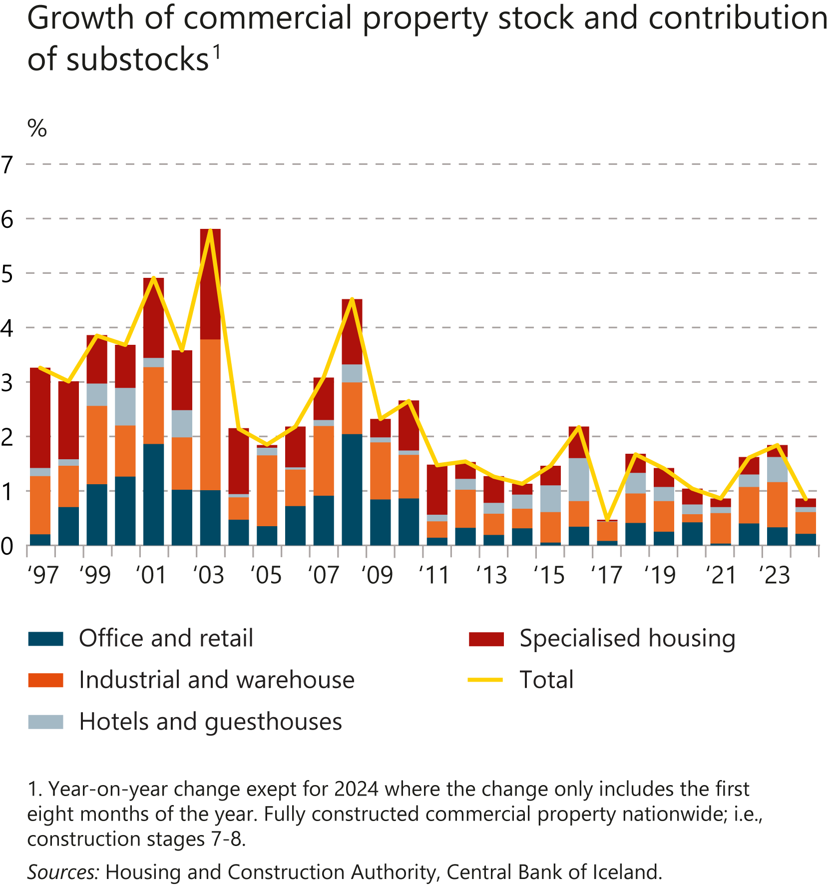
I Financial Stability: Developments and prospects

Slide 30
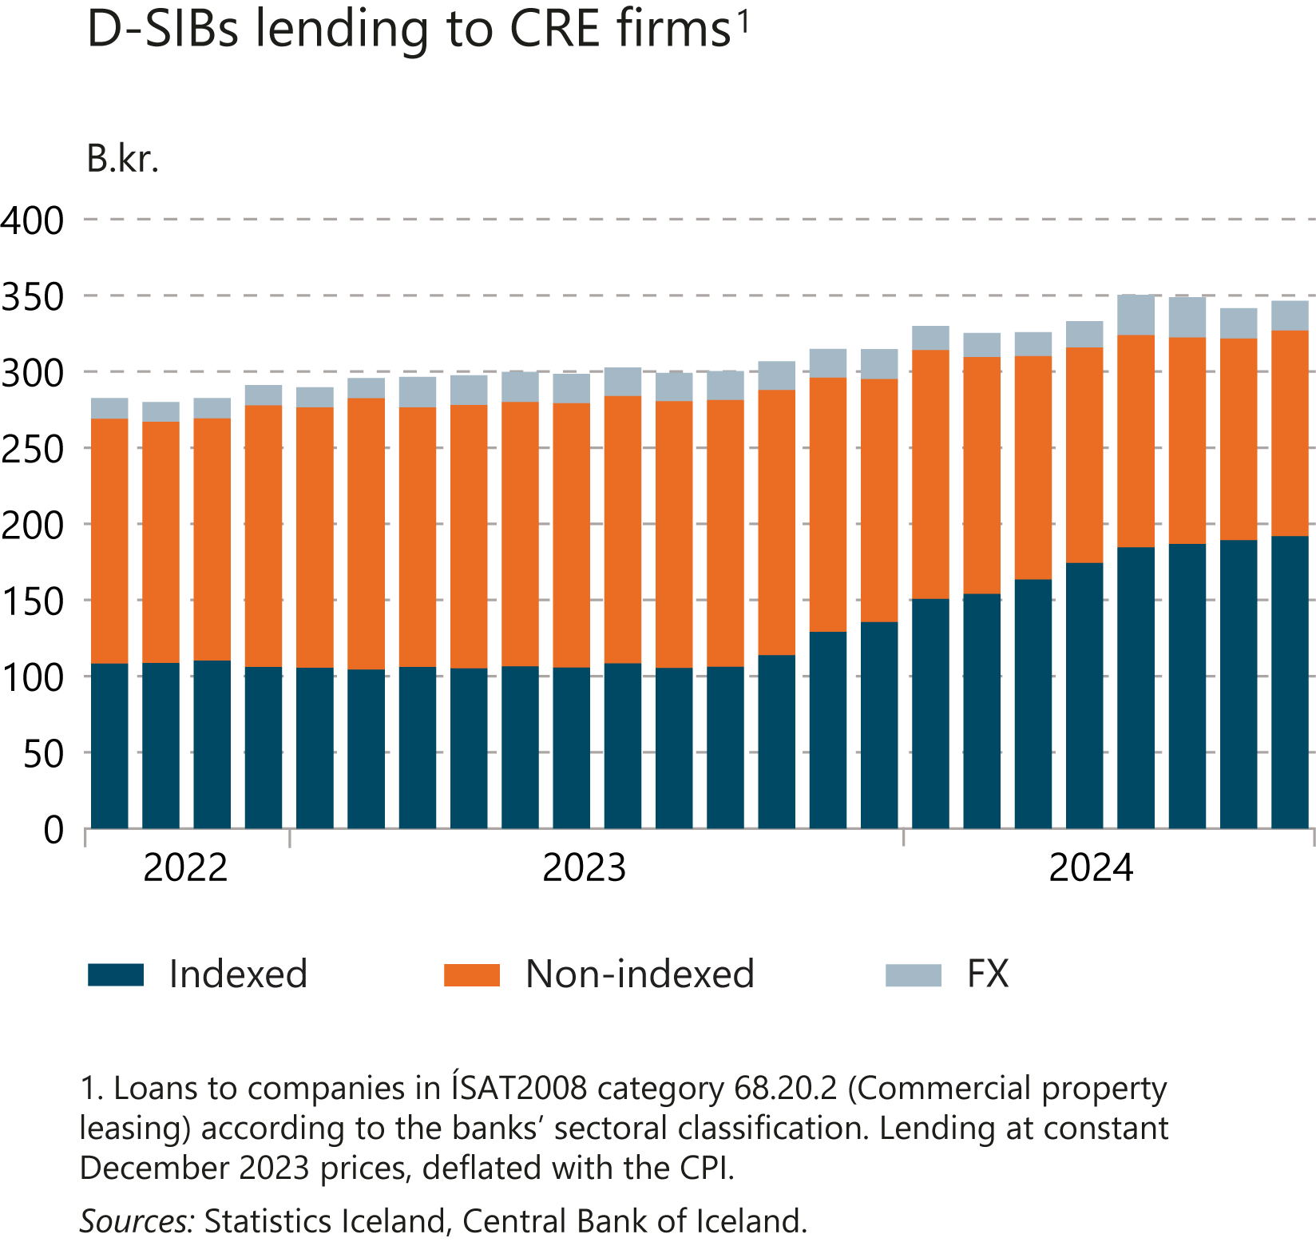
I Financial Stability: Developments and prospects

Slide 31
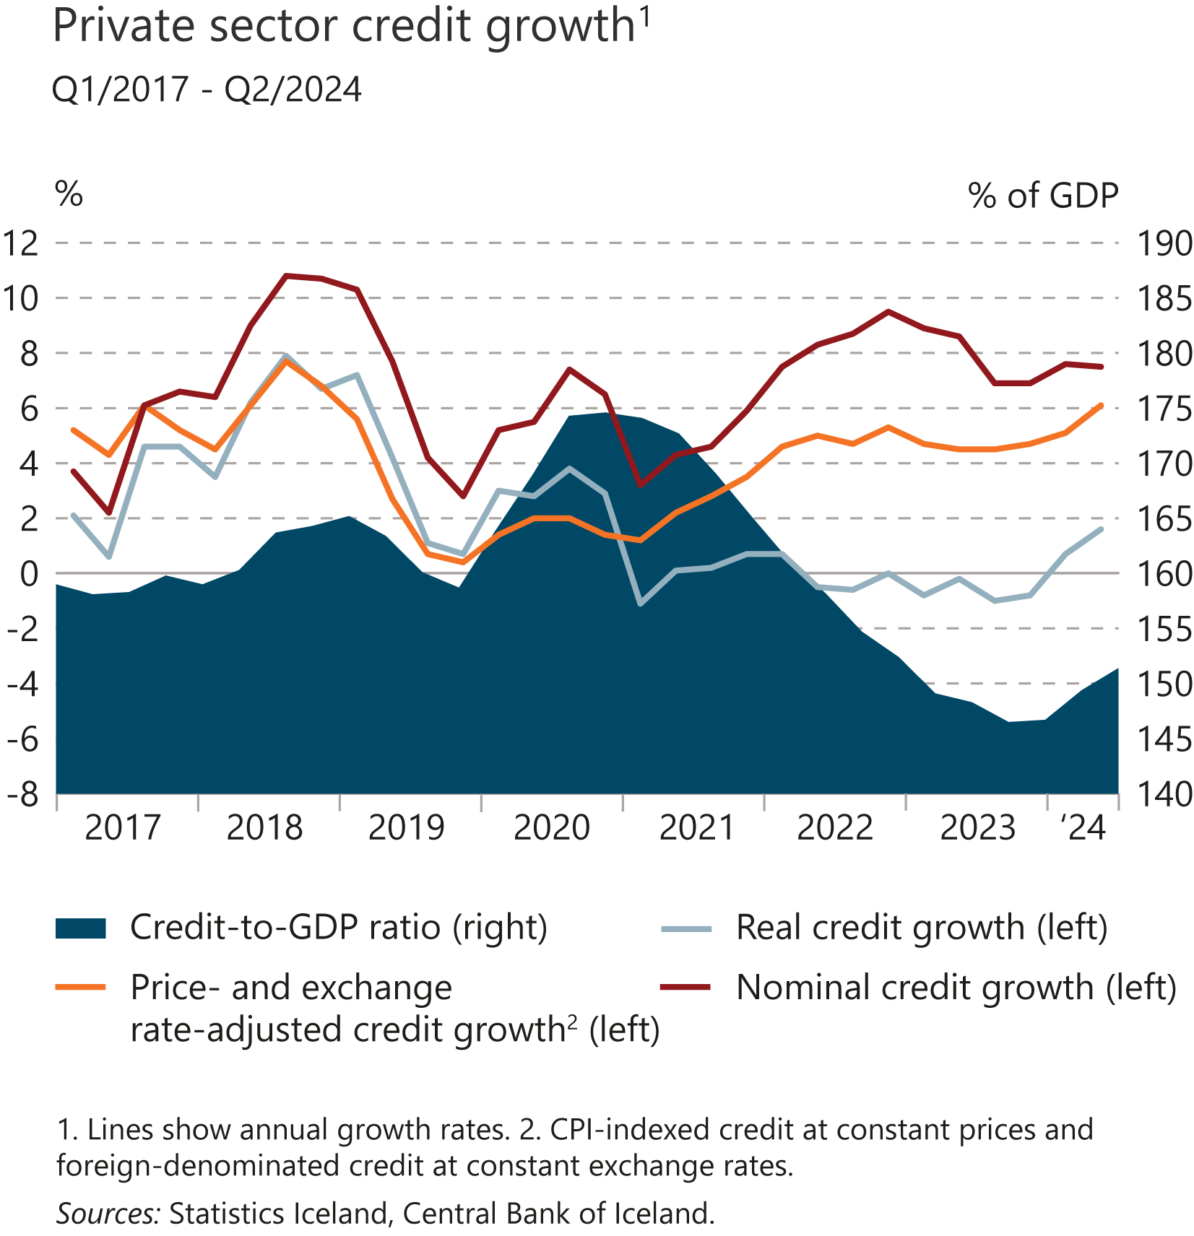
I Financial Stability: Developments and prospects

Slide 32
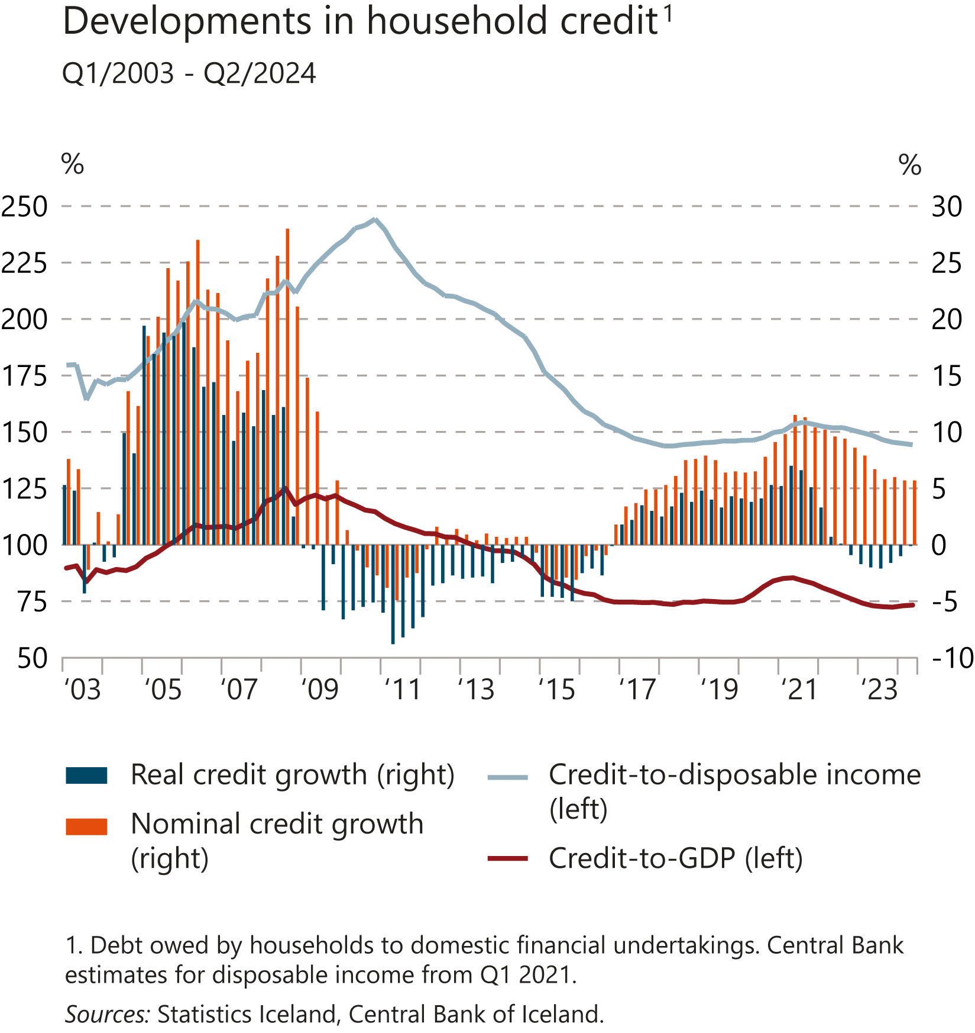
I Financial Stability: Developments and prospects

Slide 33
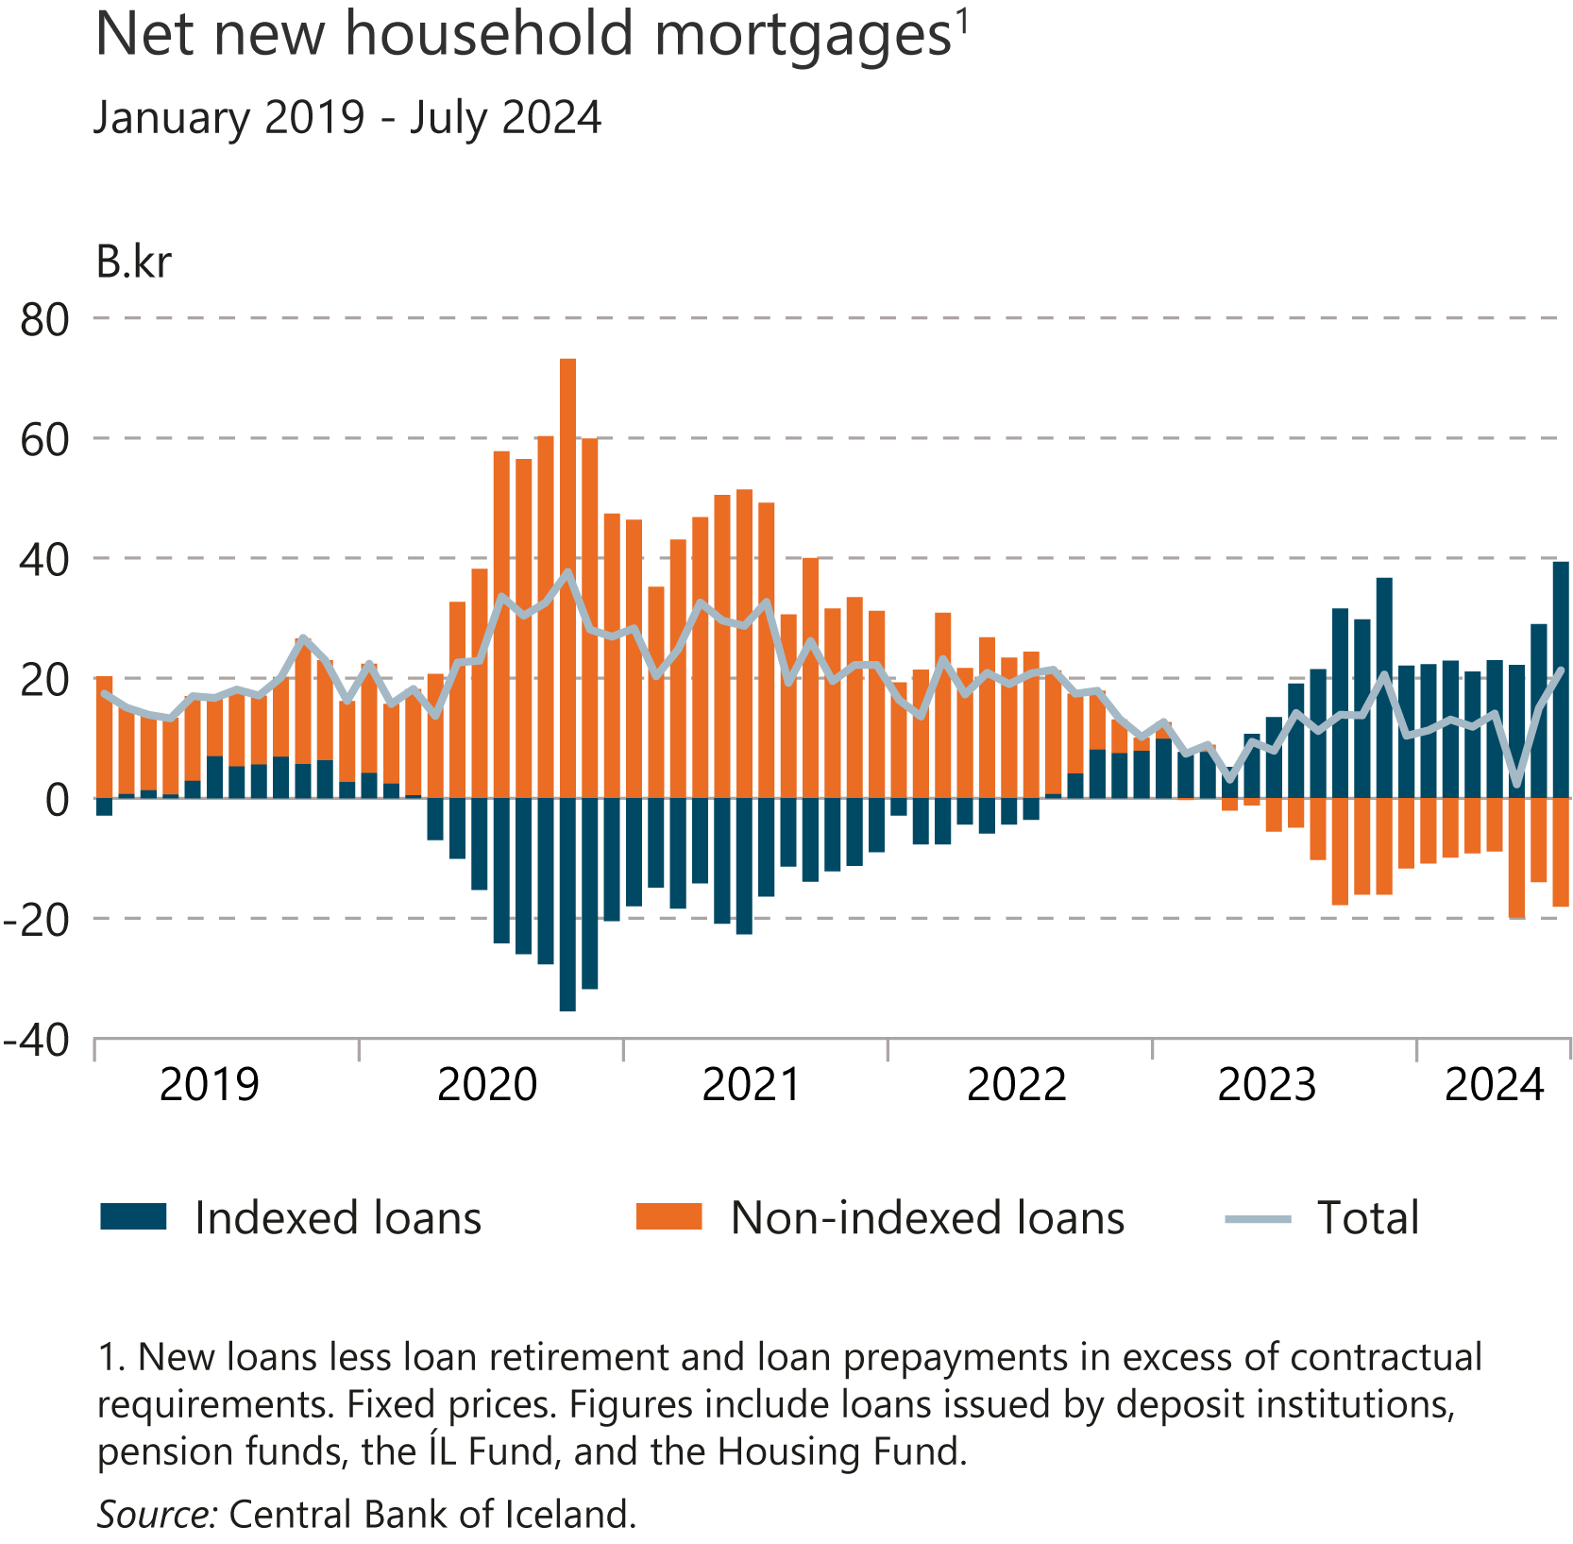
I Financial Stability: Developments and prospects

Slide 34
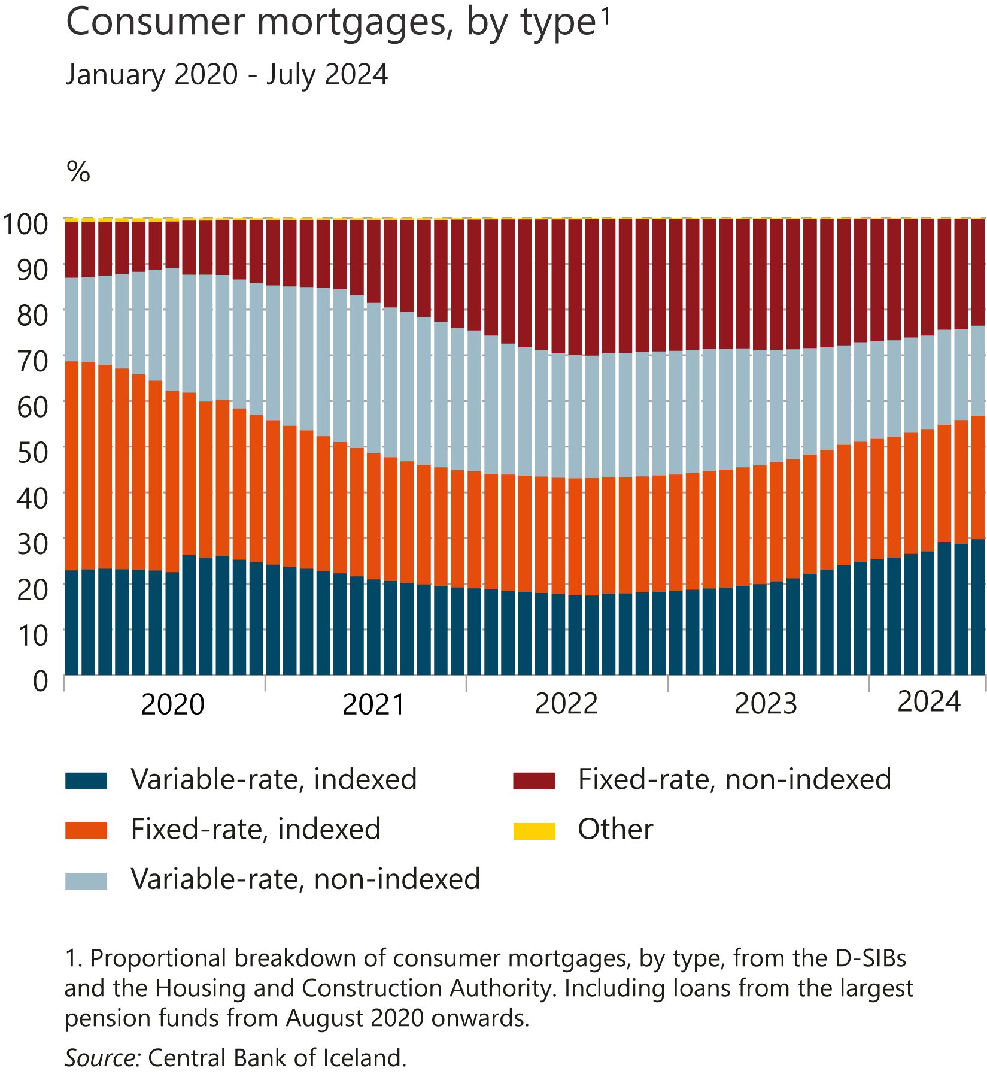
I Financial Stability: Developments and prospects

Slide 35
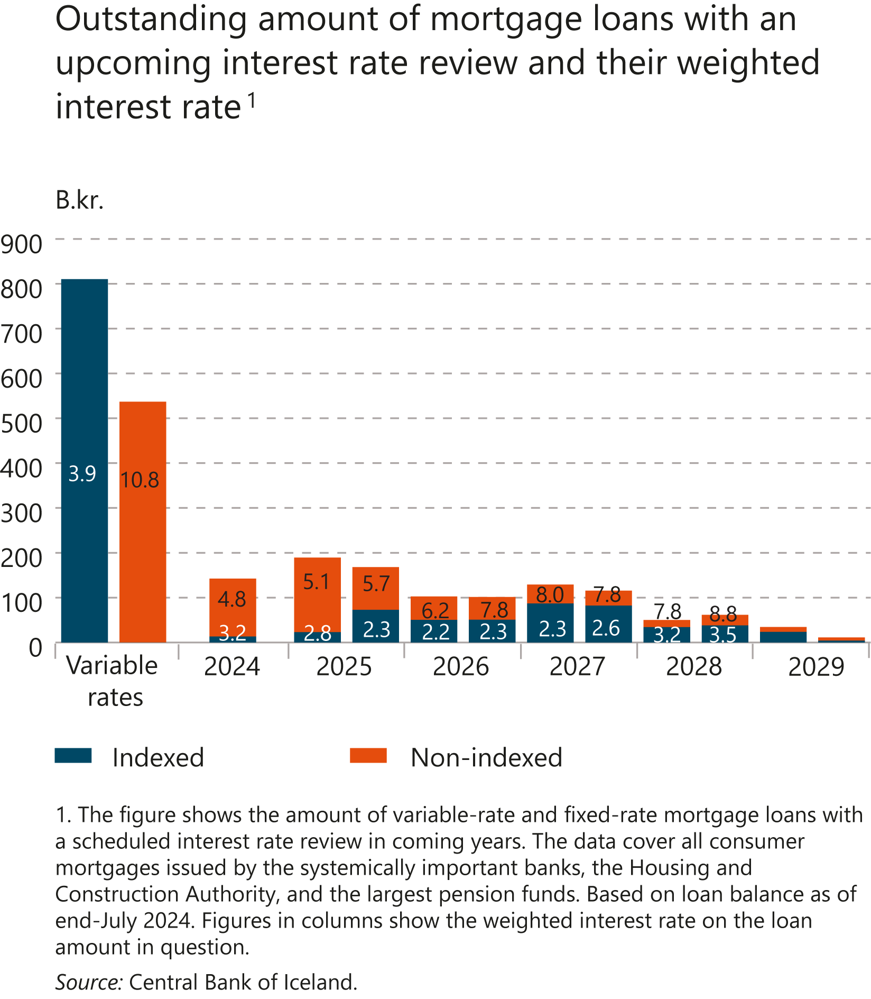
I Financial Stability: Developments and prospects

Slide 36
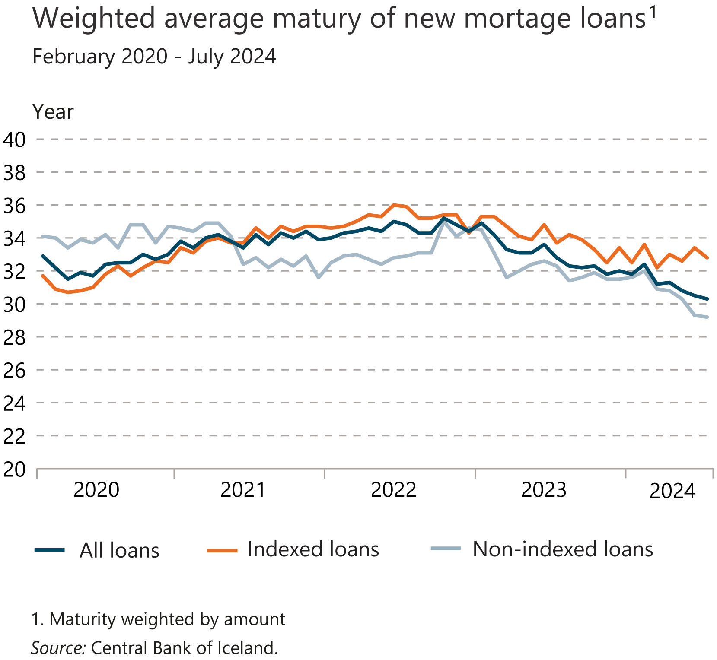
I Financial Stability: Developments and prospects

Slide 37
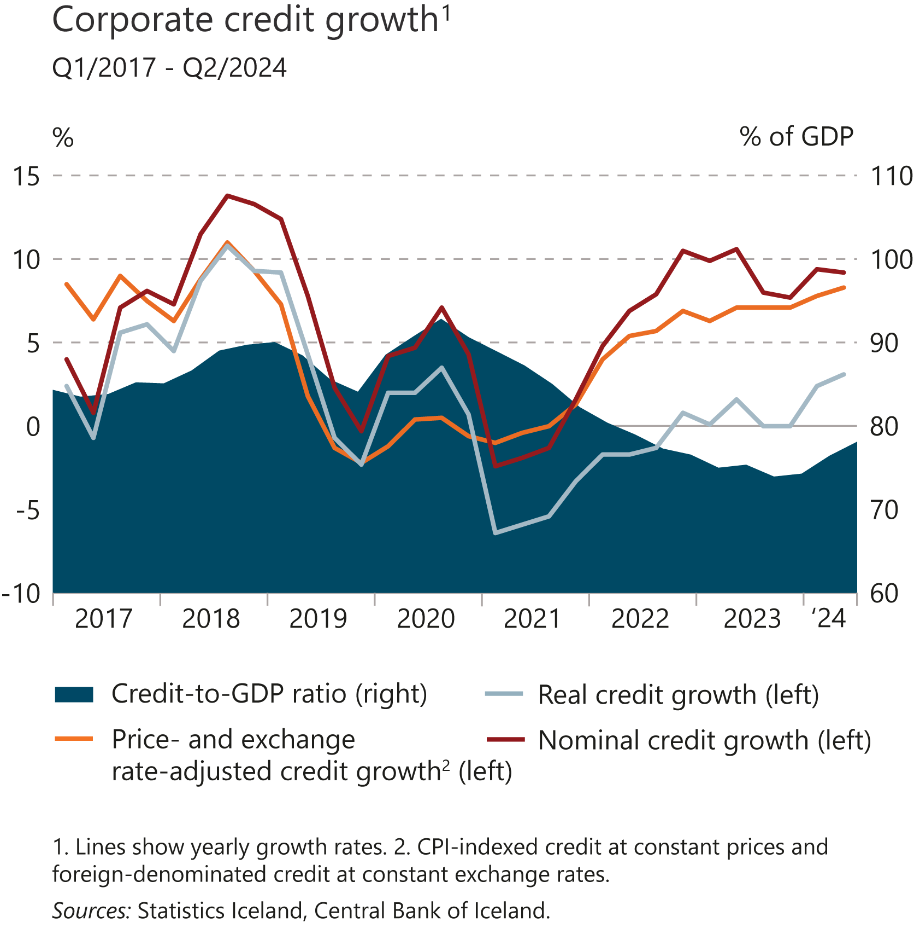
I Financial Stability: Developments and prospects

Slide 38
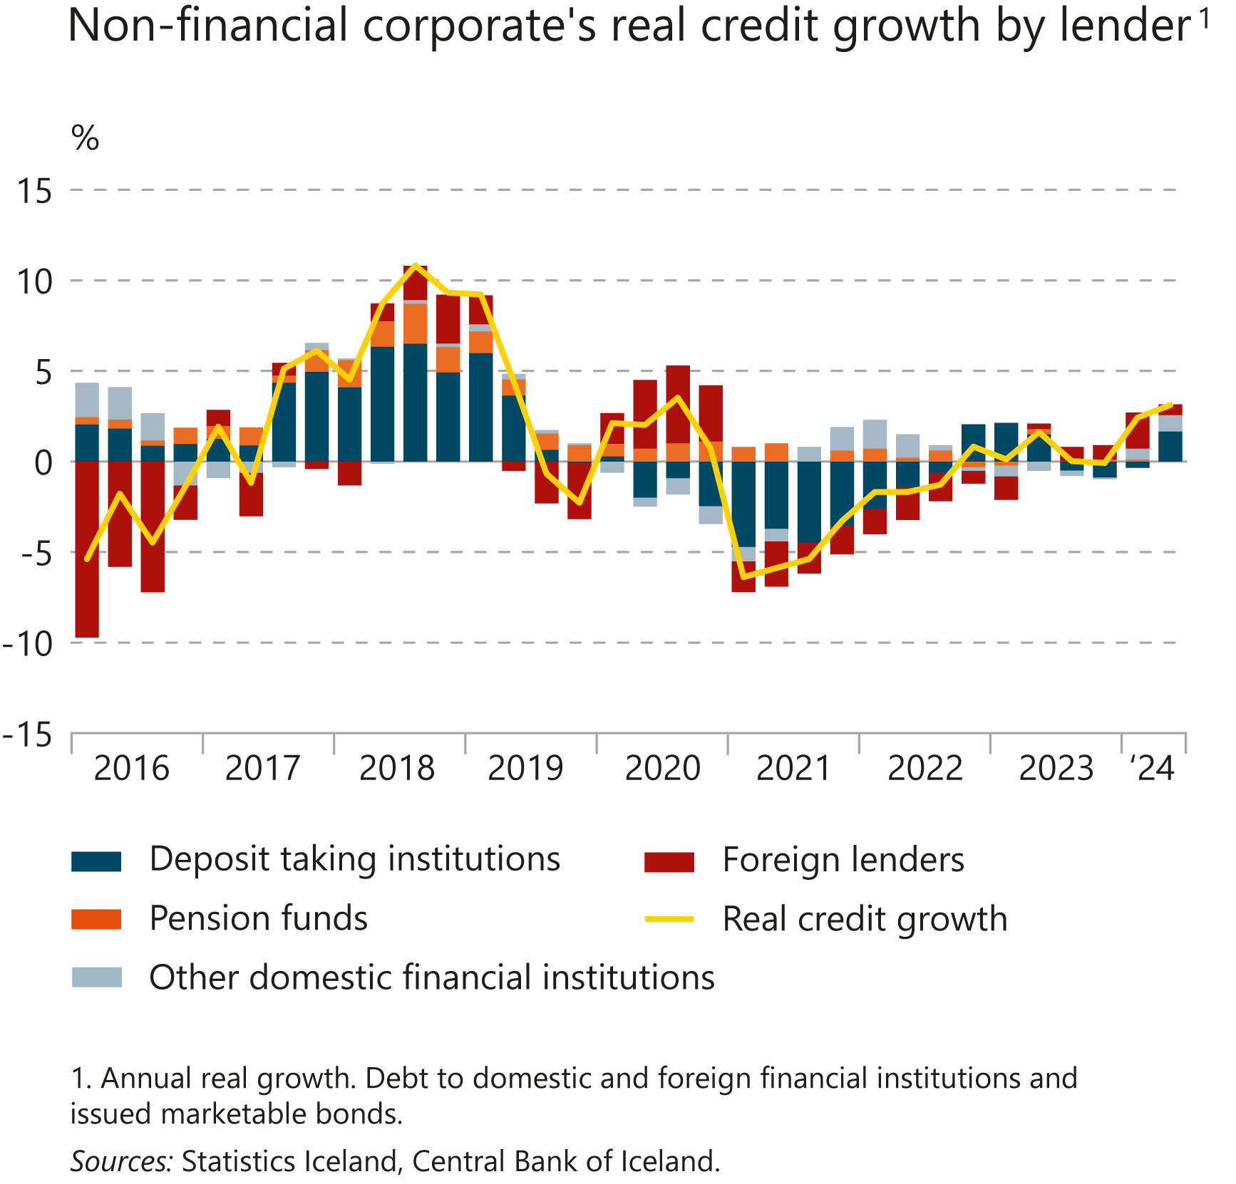
I Financial Stability: Developments and prospects

Slide 39
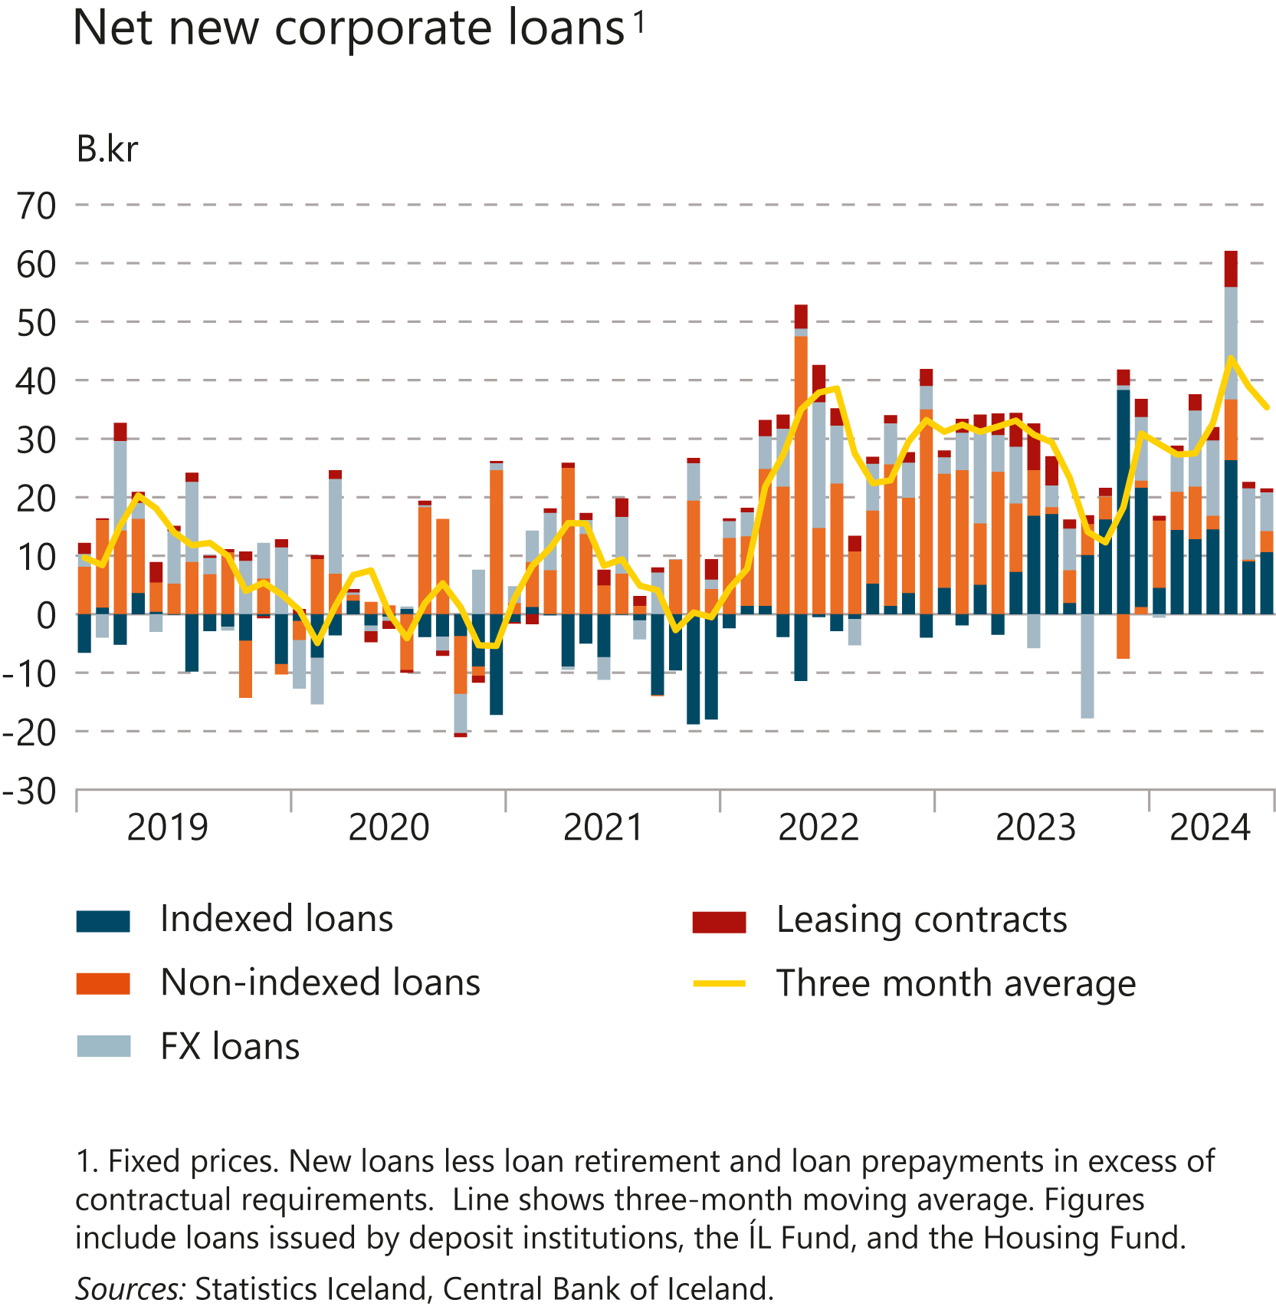
I Financial Stability: Developments and prospects

Slide 40
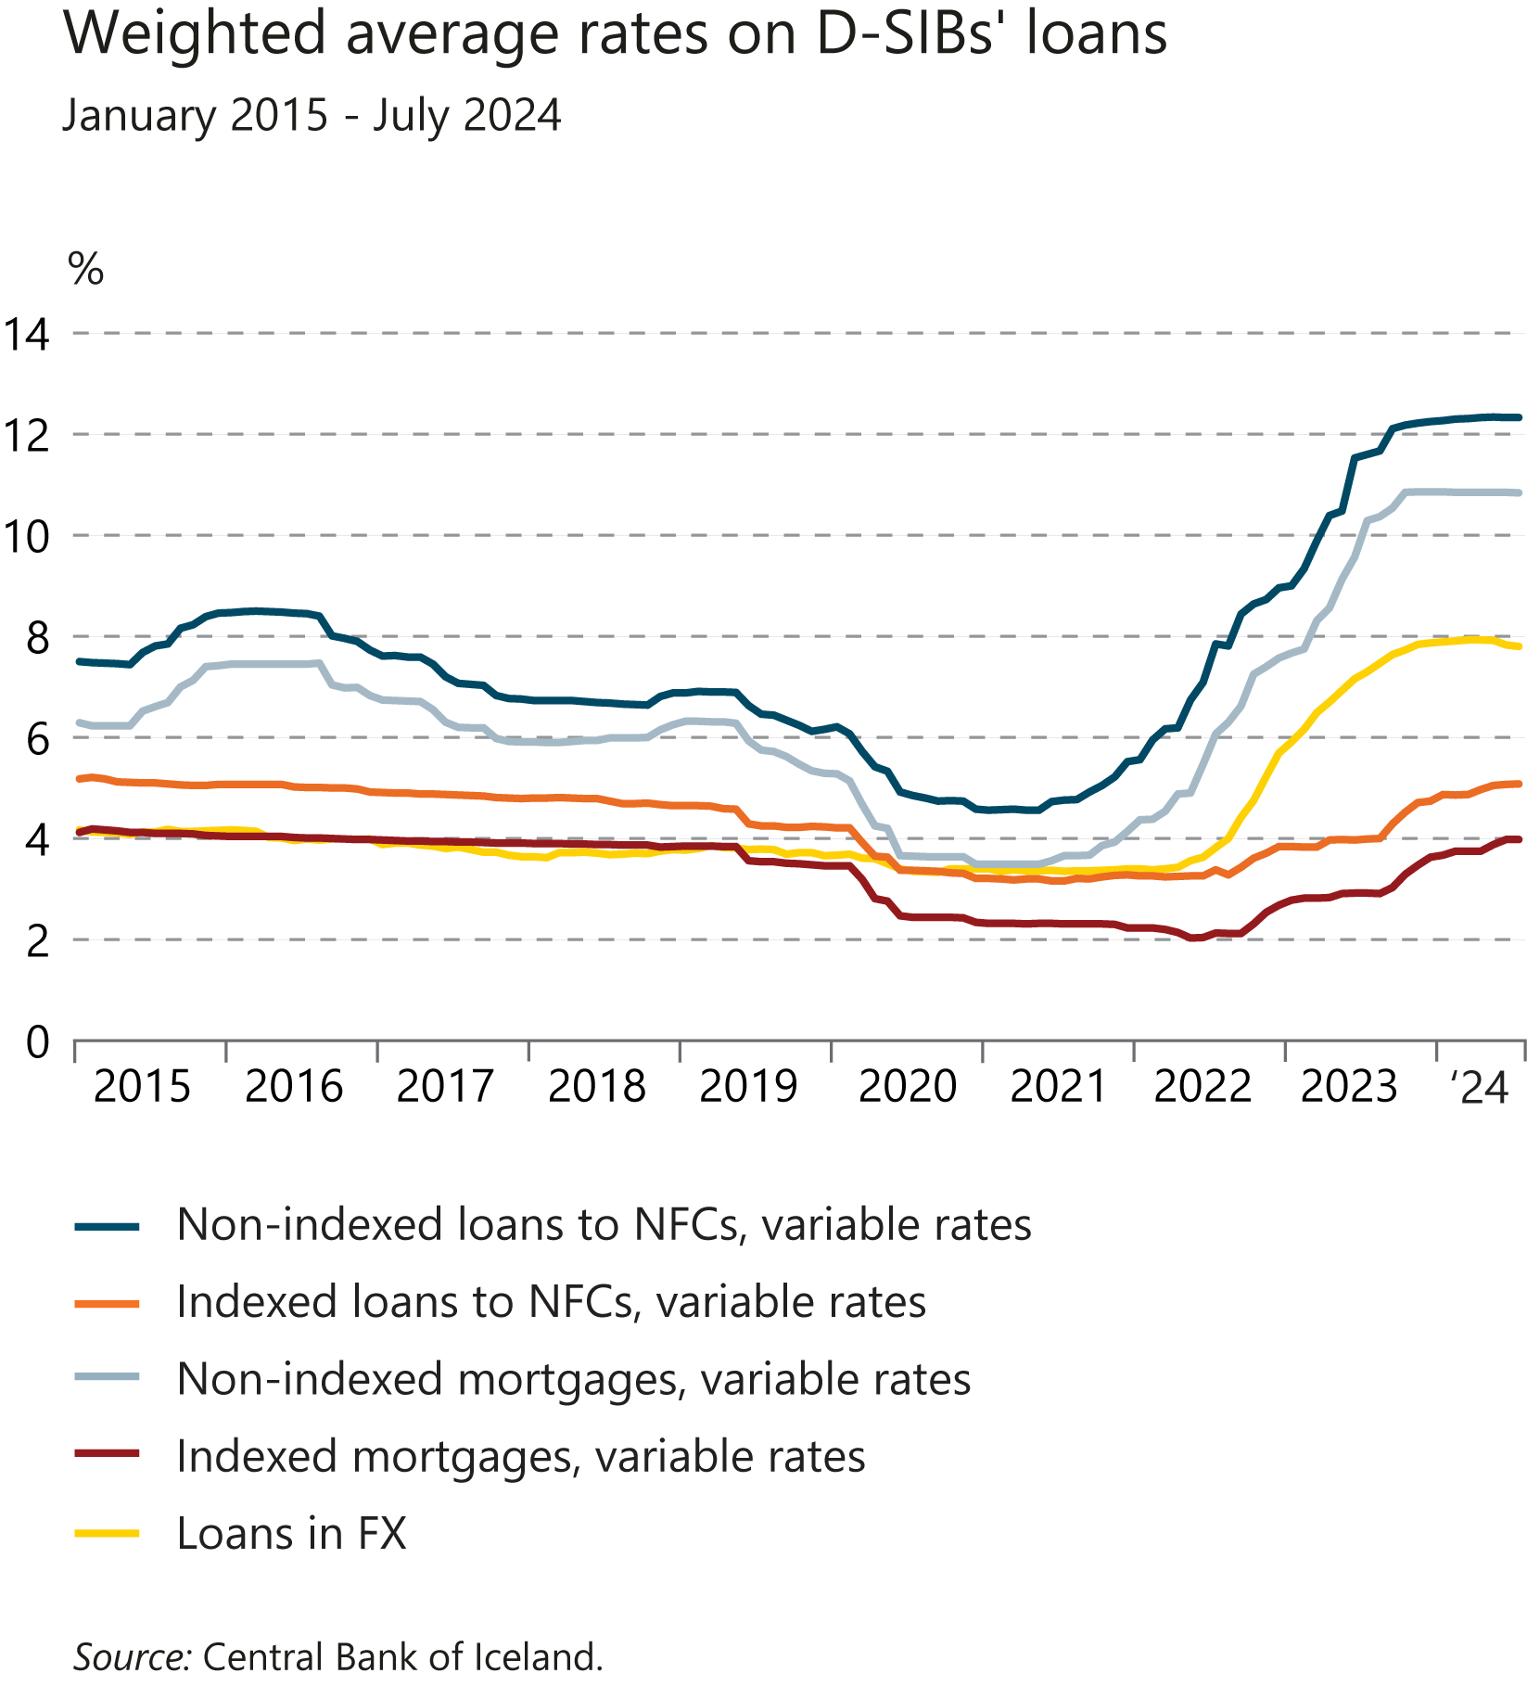
I Financial Stability: Developments and prospects

Slide 41
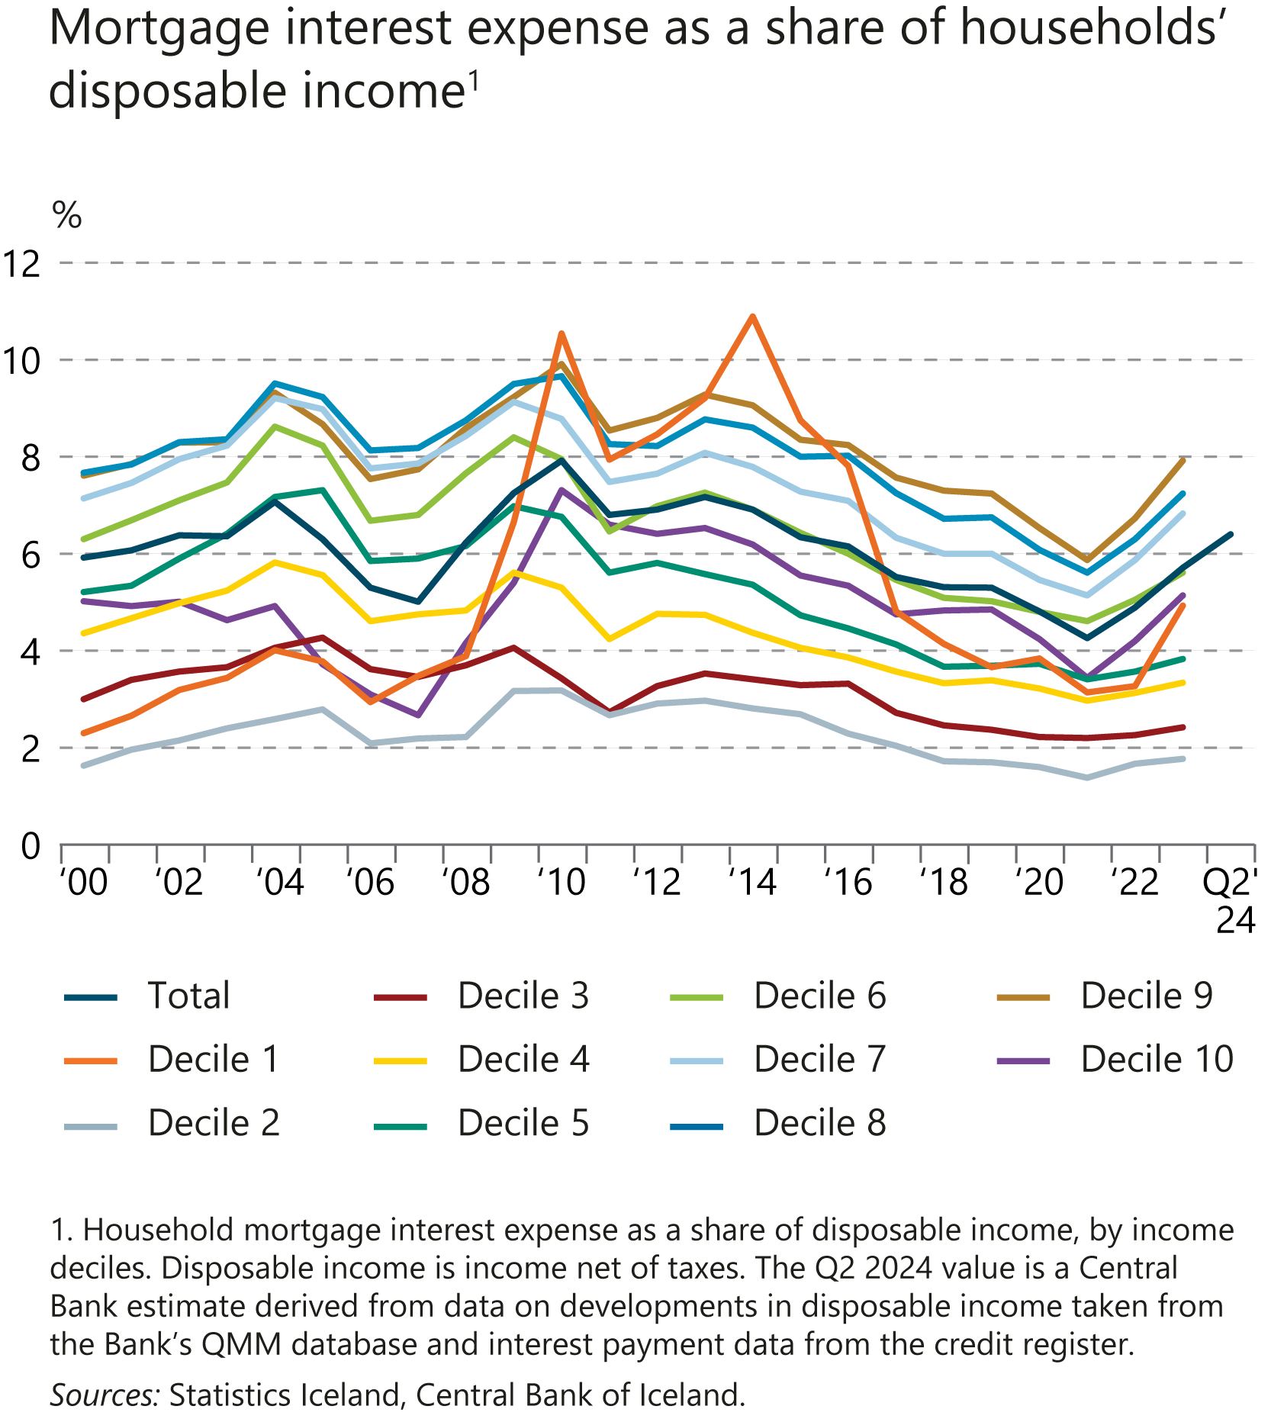
I Financial Stability: Developments and prospects

Slide 42
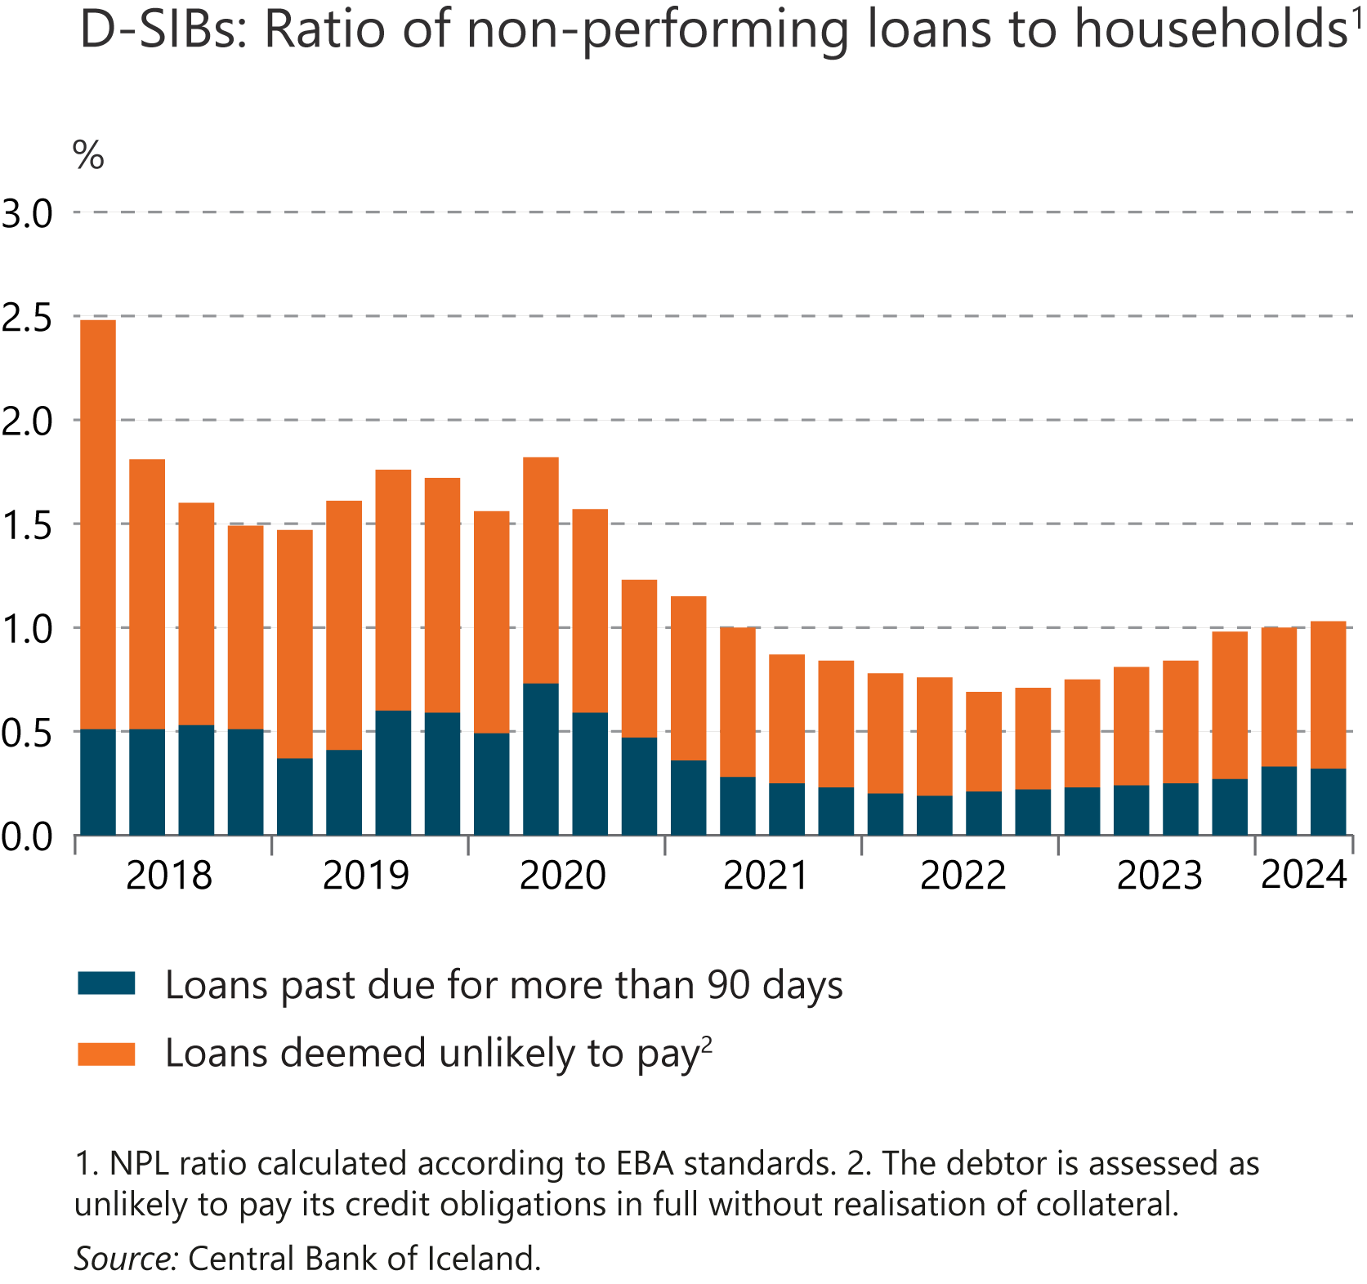
I Financial Stability: Developments and prospects

Slide 43
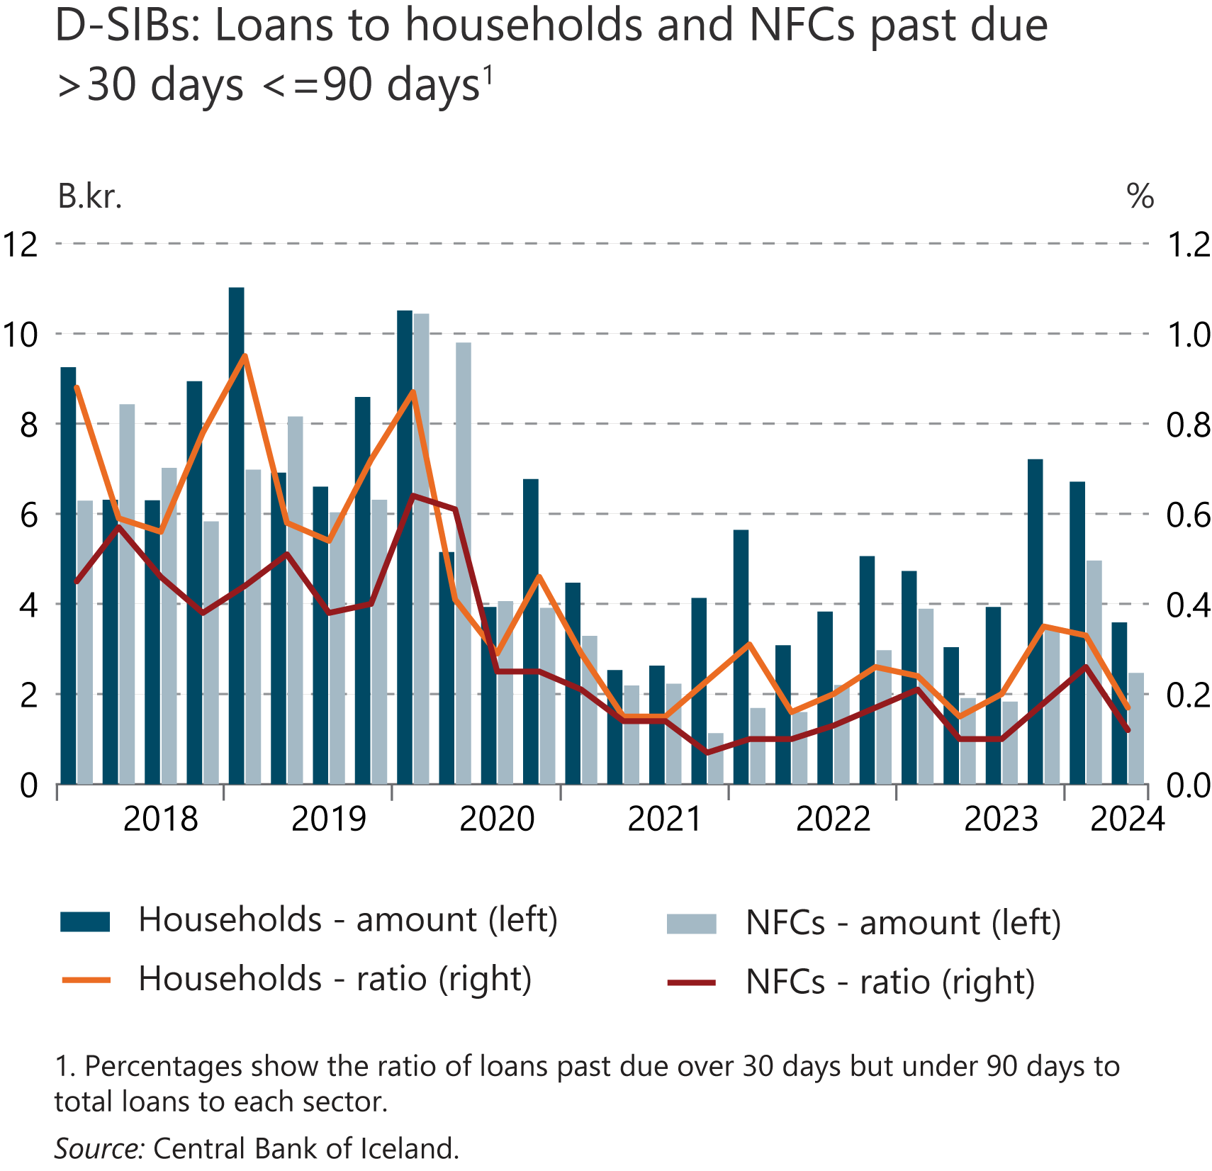
I Financial Stability: Developments and prospects

Slide 44
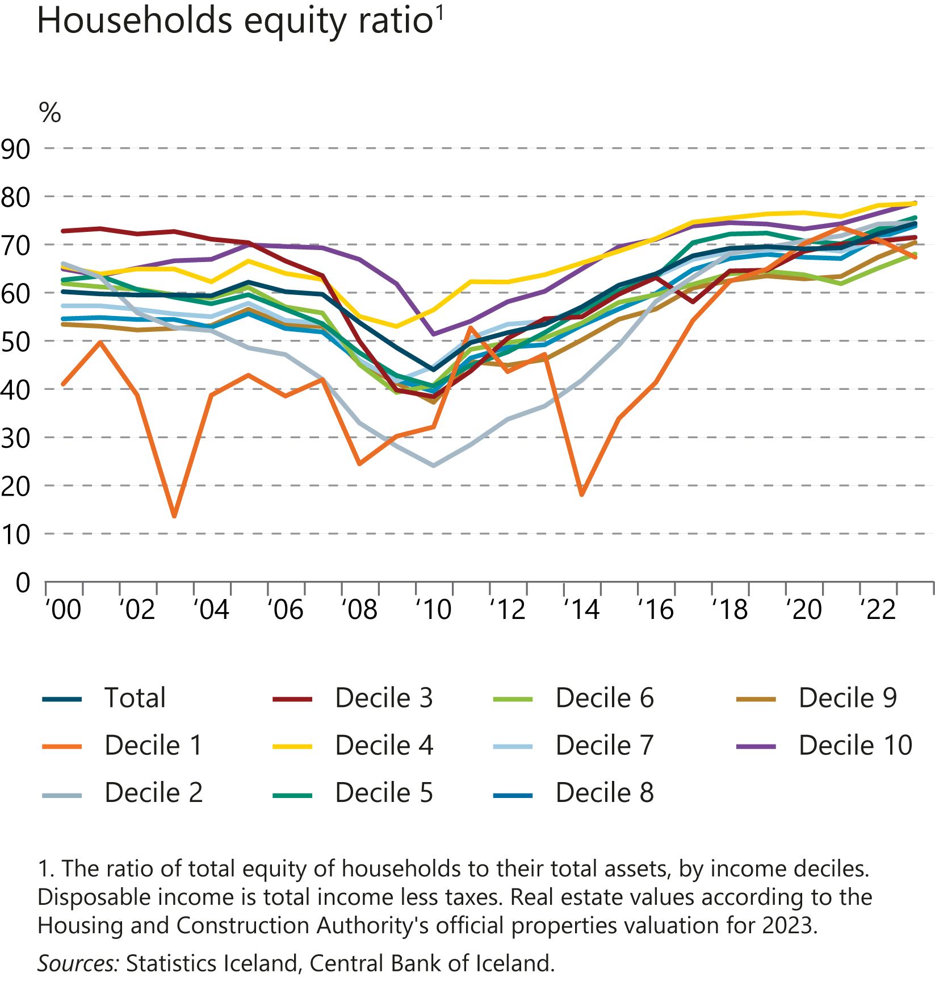
I Financial Stability: Developments and prospects

Slide 45
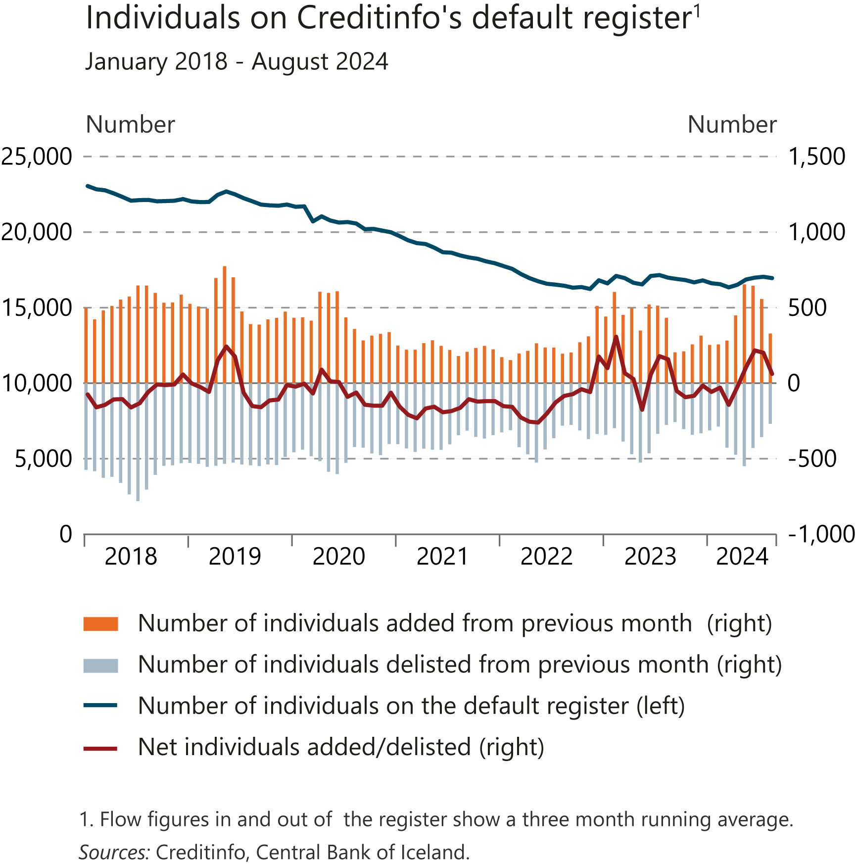
I Financial Stability: Developments and prospects

Slide 46
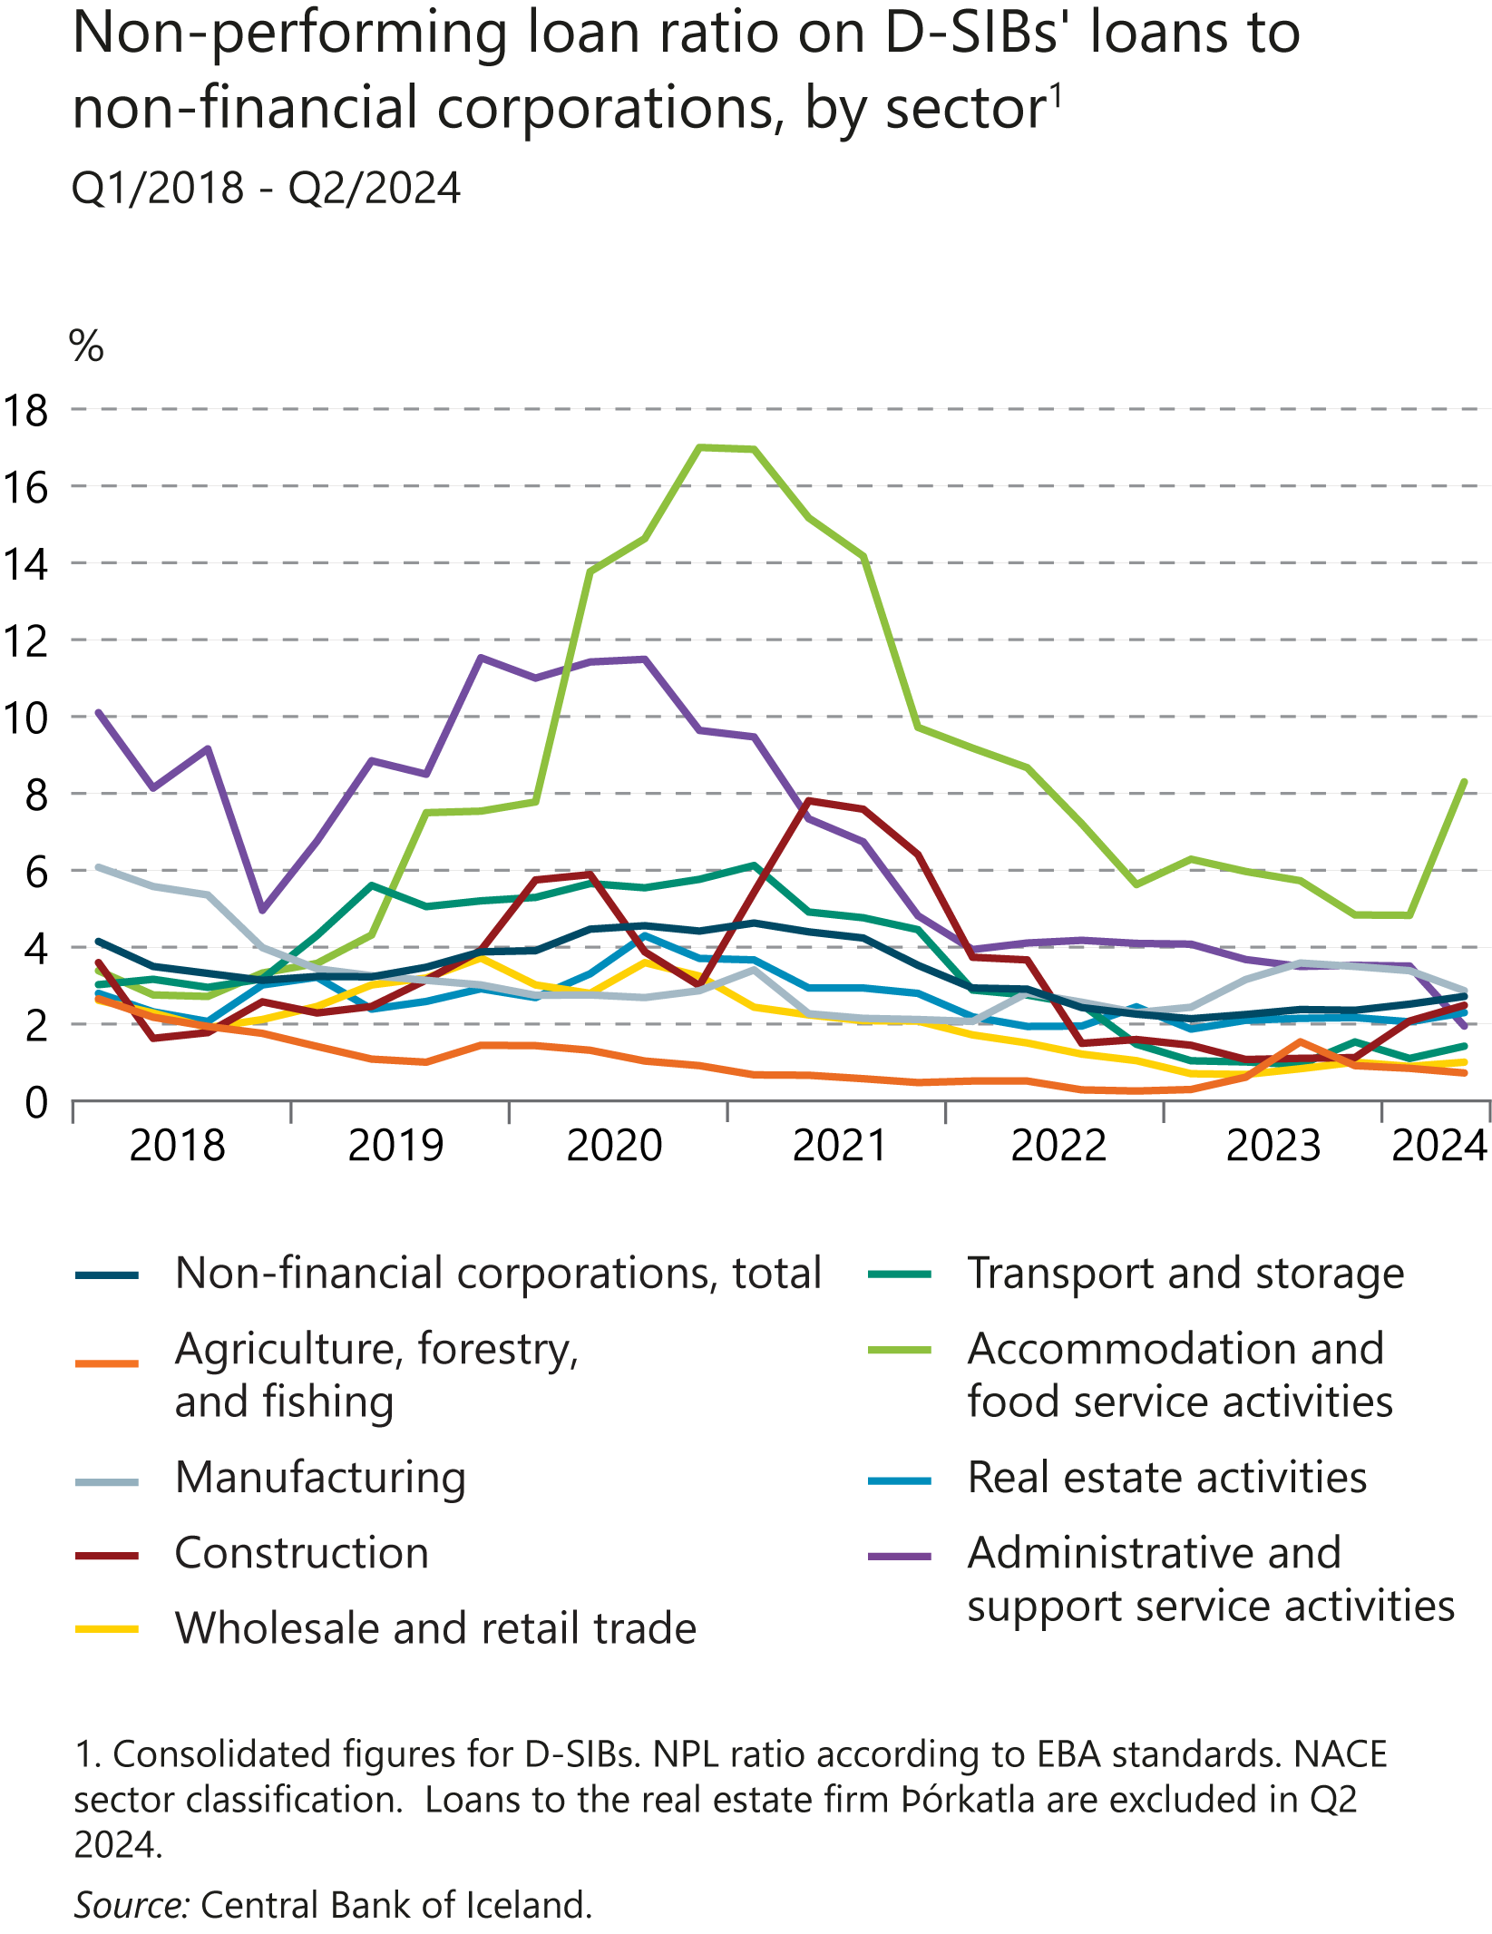
I Financial Stability: Developments and prospects

Slide 47
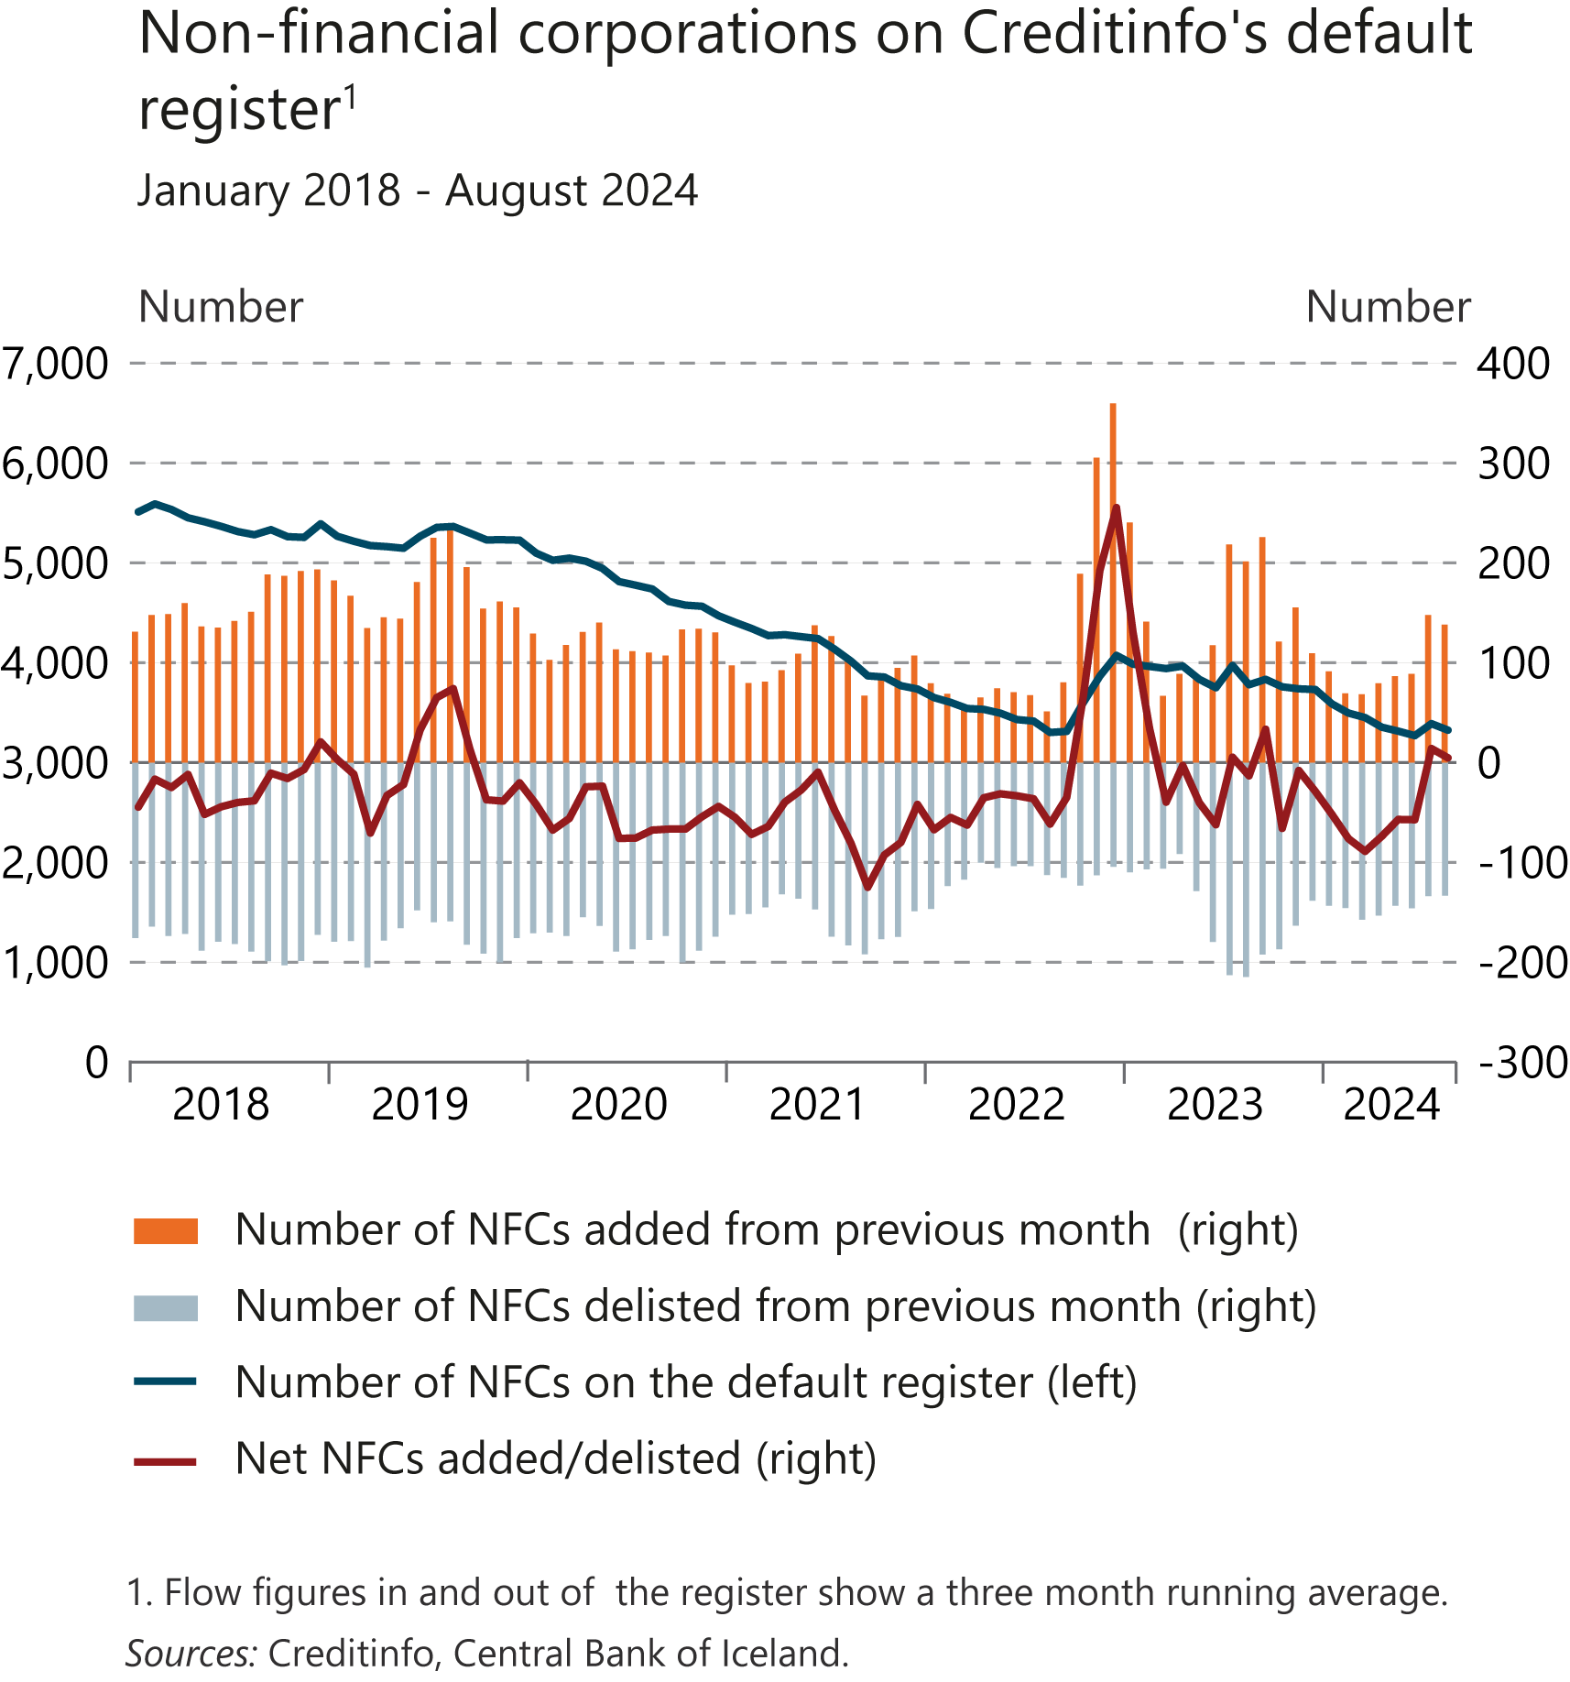
I Financial Stability: Developments and prospects

Slide 48
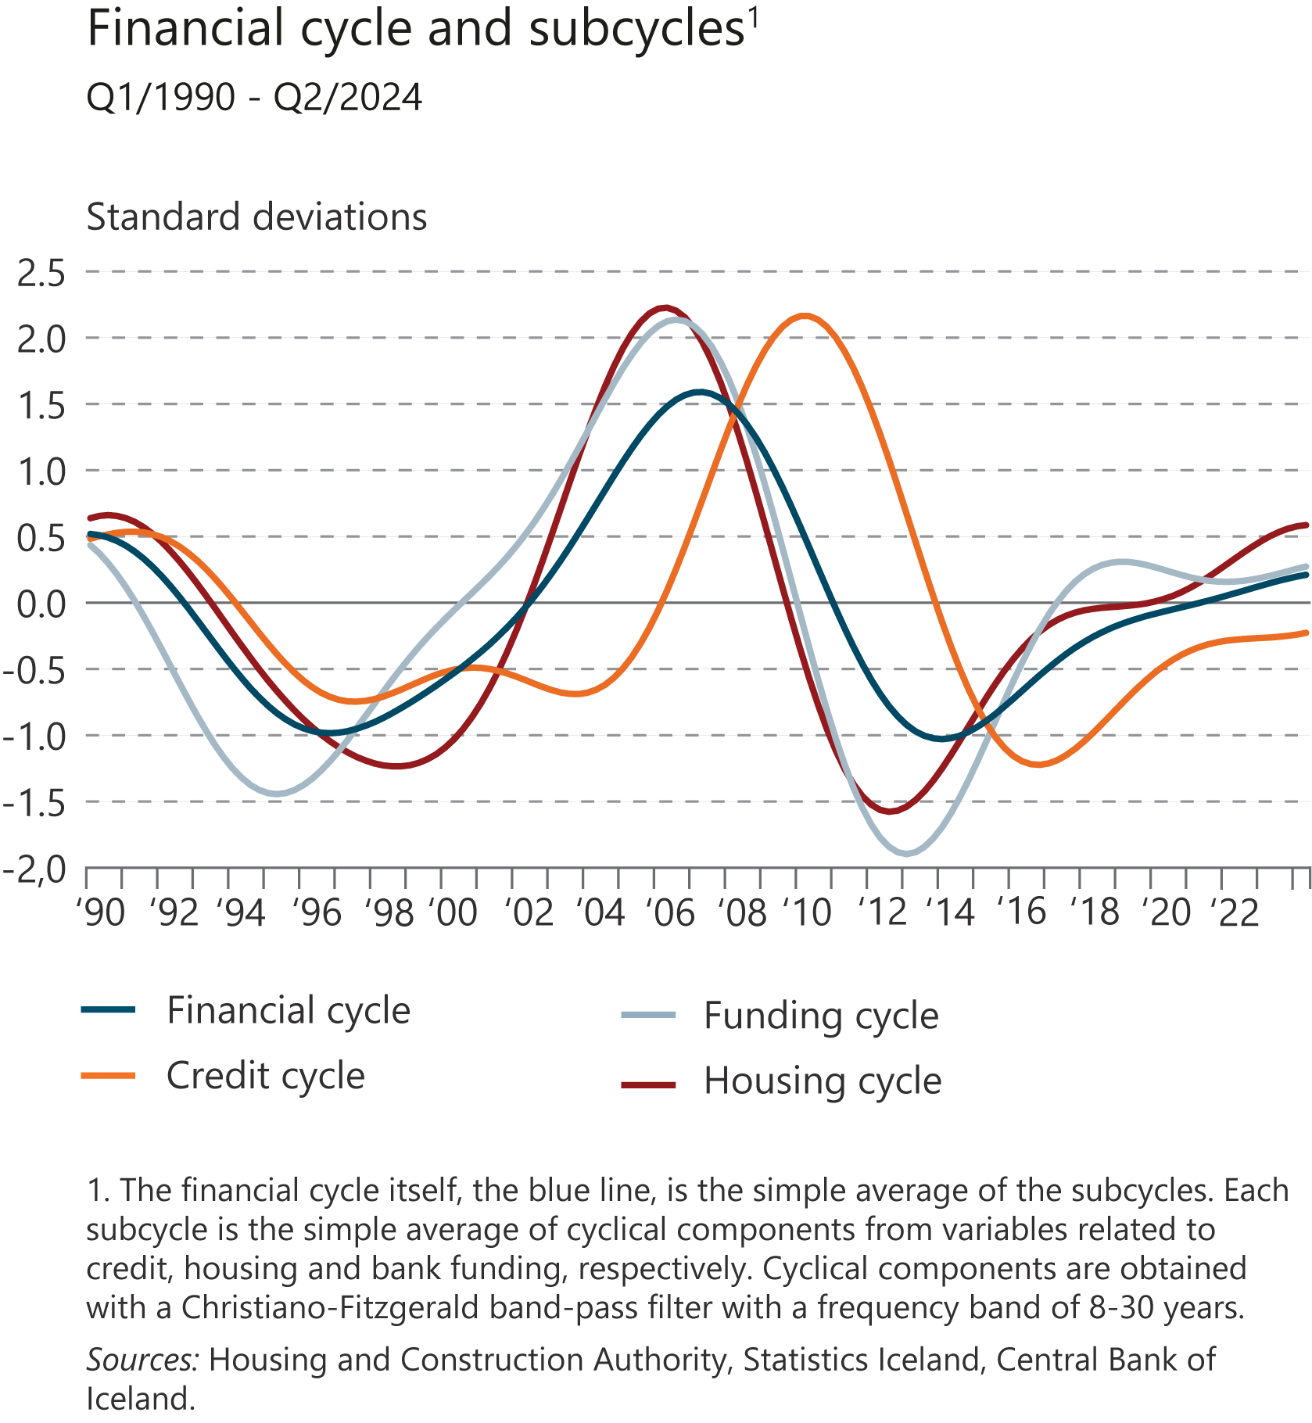
I Financial Stability: Developments and prospects

Slide 49
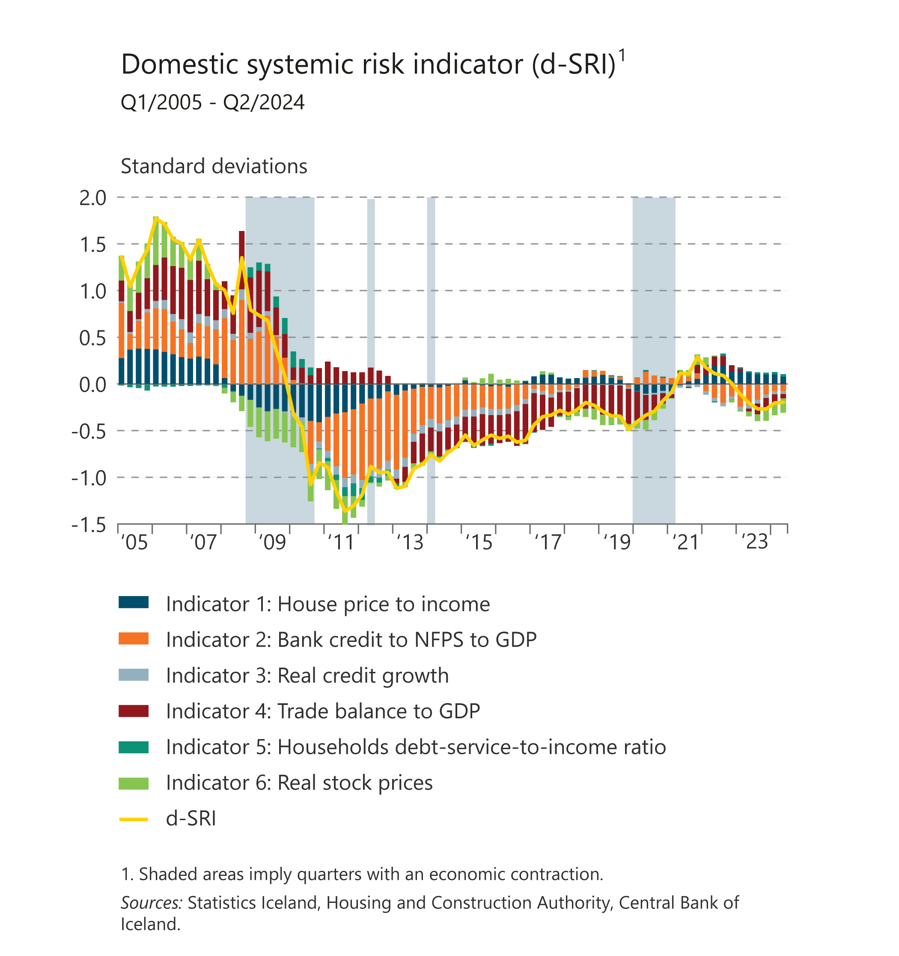
I Financial Stability: Developments and prospects

Slide 50
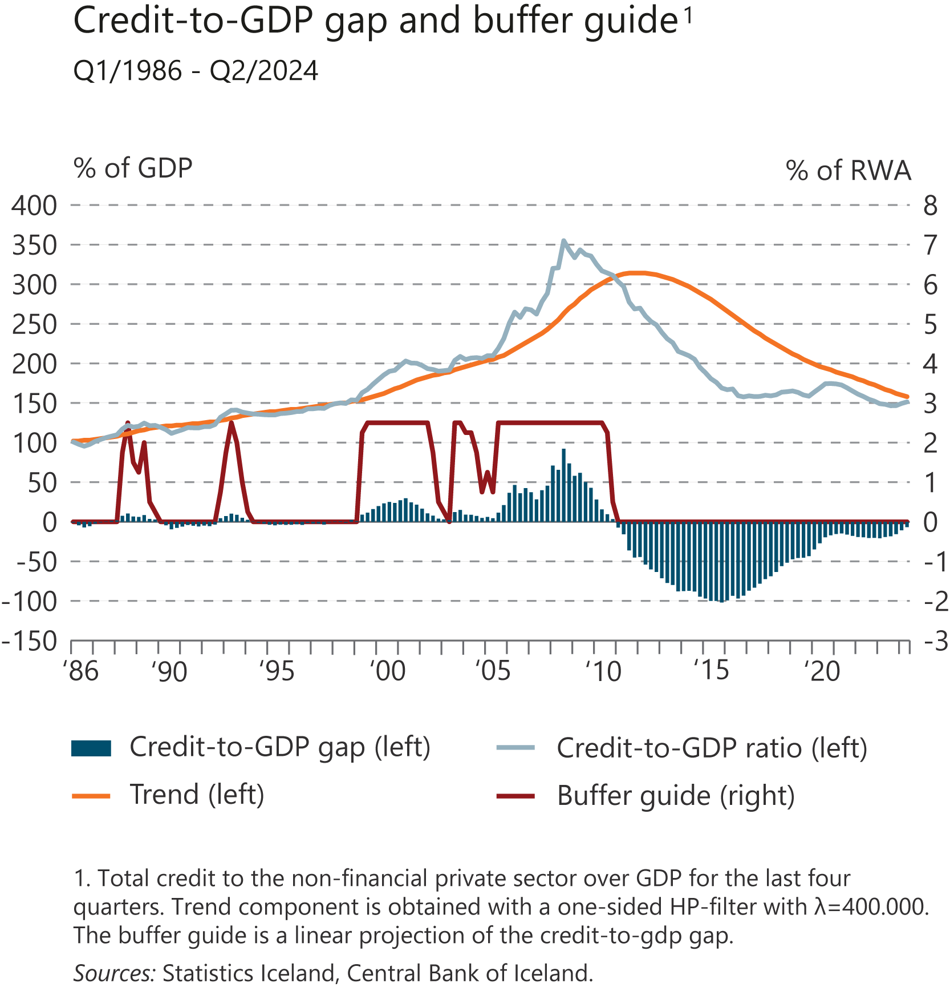
I Financial Stability: Developments and prospects

Slide 51
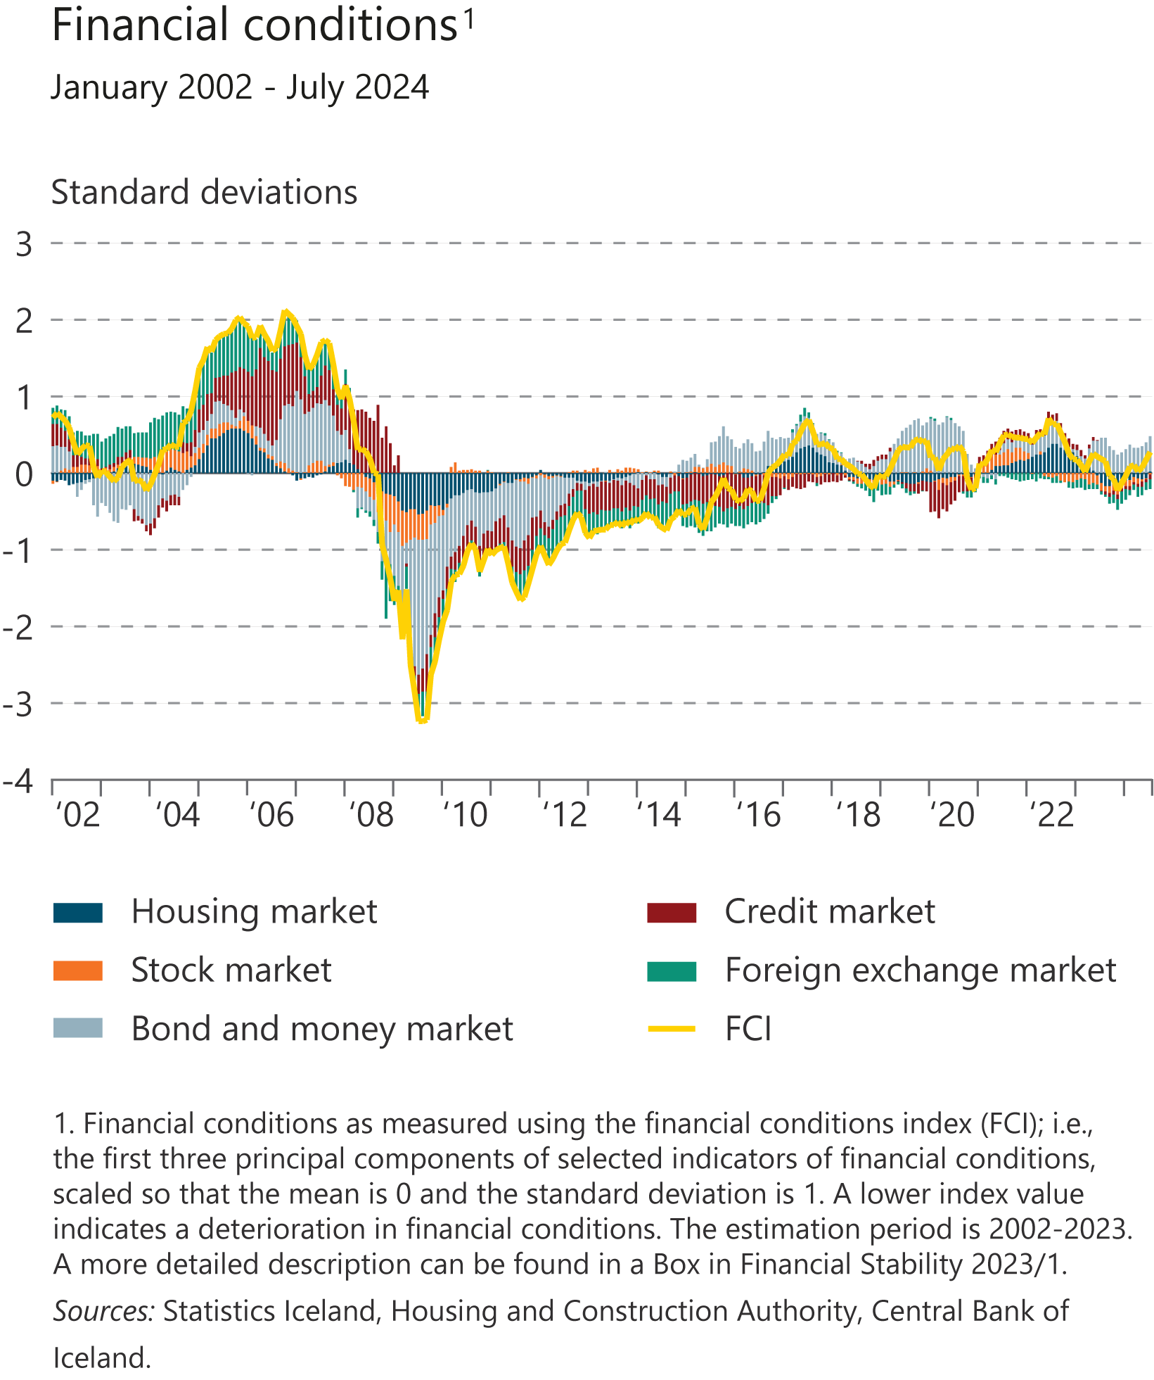
I Financial Stability: Developments and prospects

Slide 52
II The financial system

Slide 53
II The financial system

Slide 54
II The financial system

Slide 55
II The financial system

Slide 56
II The financial system

Slide 57
II The financial system

Slide 58
II The financial system

Slide 59
II The financial system

Slide 60
II The financial system

Slide 61
II The financial system

Slide 62
II The financial system

Slide 63
II The financial system

Slide 64
II The financial system

Slide 65
II The financial system

Slide 66
II The financial system

Slide 67
II The financial system

Slide 68
III Central Bank stress test 2024

Slide 69
III Central Bank stress test 2024

Slide 70
III Central Bank stress test 2024

Slide 71
III Central Bank stress test 2024

Slide 72
III Central Bank stress test 2024

Slide 73
III Central Bank stress test 2024

Slide 74
III Central Bank stress test 2024

Slide 75
III Central Bank stress test 2024

Slide 76
III Central Bank stress test 2024

Slide 77
IV Financial infrastructure

Slide 78
IV Financial infrastructure

Slide 79
IV Financial infrastructure

Slide 80
IV Financial infrastructure

Slide 81
IV Financial infrastructure

Slide 82
IV Financial infrastructure

Slide 83
IV Financial infrastructure

Slide 84
IV Financial infrastructure

Slide 85
IV Financial infrastructure

Slide 86
IV Financial infrastructure

Slide 87
IV Financial infrastructure

Slide 88
IV Financial infrastructure

Slide 89
IV Financial infrastructure

Slide 90
IV Financial infrastructure

Slide 91
IV Financial infrastructure

Slide 92
IV Financial infrastructure

Slide 93
IV Financial infrastructure

Slide 94
IV Financial infrastructure

Slide 95
IV Financial infrastructure

Slide 96
IV Financial infrastructure

Slide 97
IV Financial infrastructure

Slide 98
IV Financial infrastructure

Slide 99
IV Financial infrastructure

Slide 100
IV Financial infrastructure

Slide 101
IV Financial infrastructure

Slide 102
IV Financial infrastructure

Slide 103
IV Financial infrastructure

Slide 104
IV Financial infrastructure

Slide 105
IV Financial infrastructure

Slide 106
IV Financial infrastructure

Slide 107
Box

Slide 108
Box

