Slide 1
Monetary Bulletin 2014/4
Powerpoint charts

Slide 2
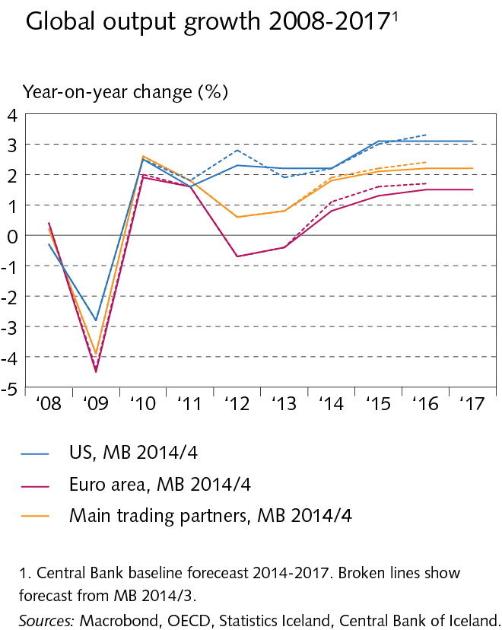
I Economic outlook and key uncertainties

Slide 3
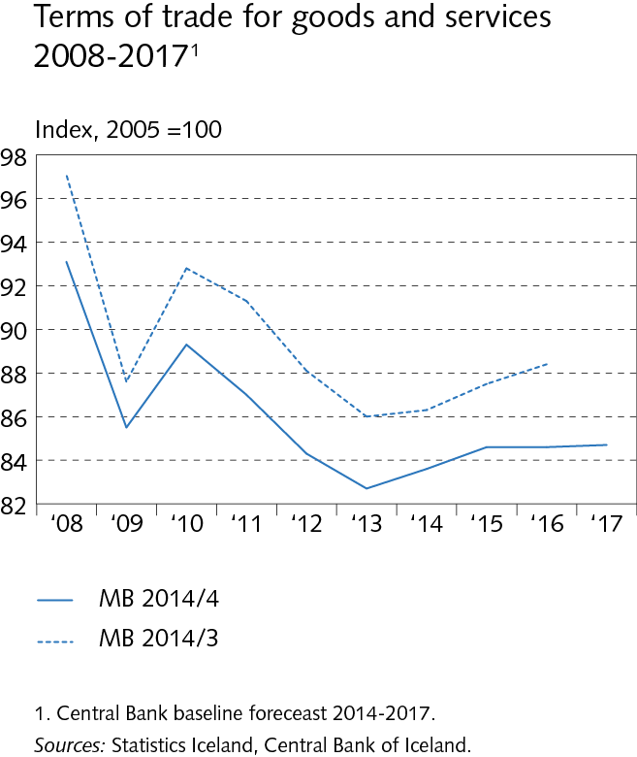
I Economic outlook and key uncertainties

Slide 4
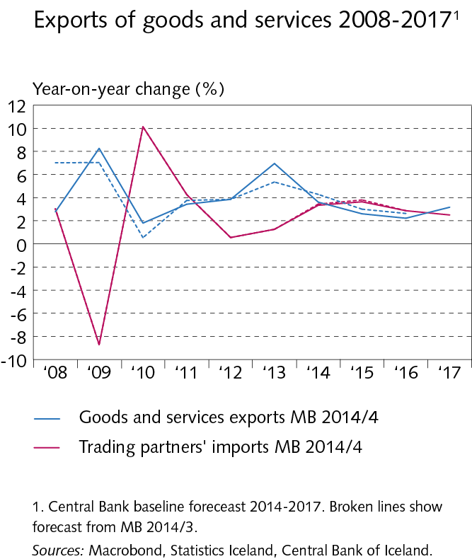
I Economic outlook and key uncertainties

Slide 5
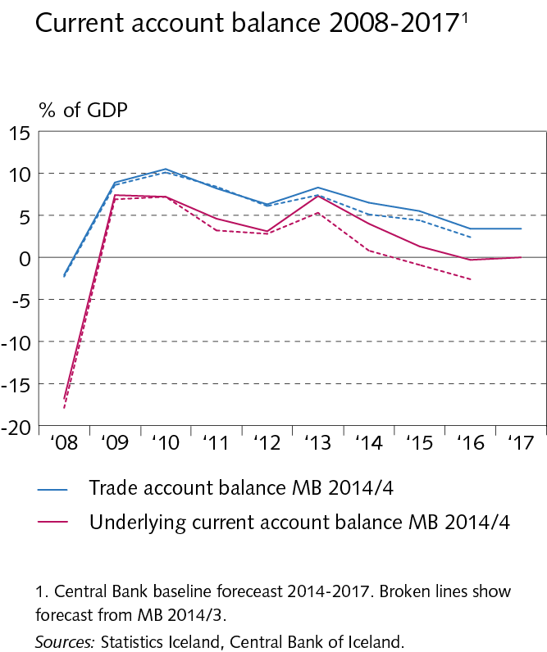
I Economic outlook and key uncertainties

Slide 6
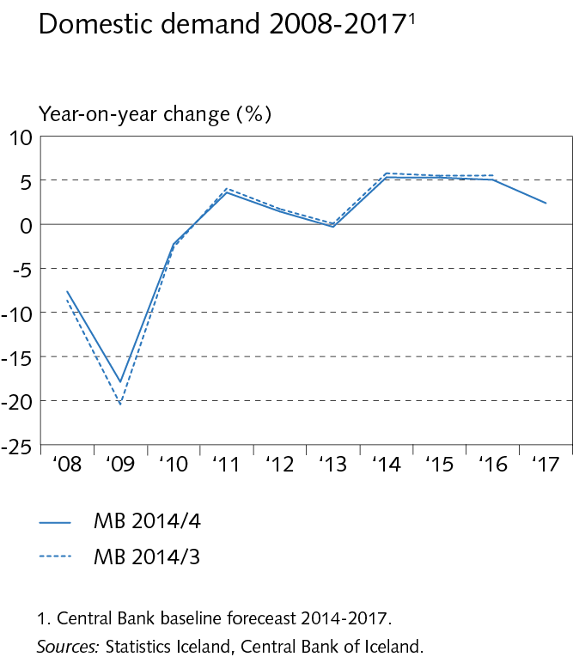
I Economic outlook and key uncertainties

Slide 7
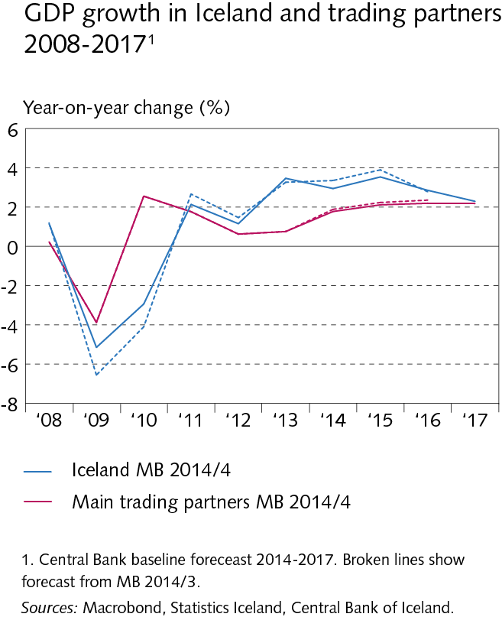
I Economic outlook and key uncertainties

Slide 8
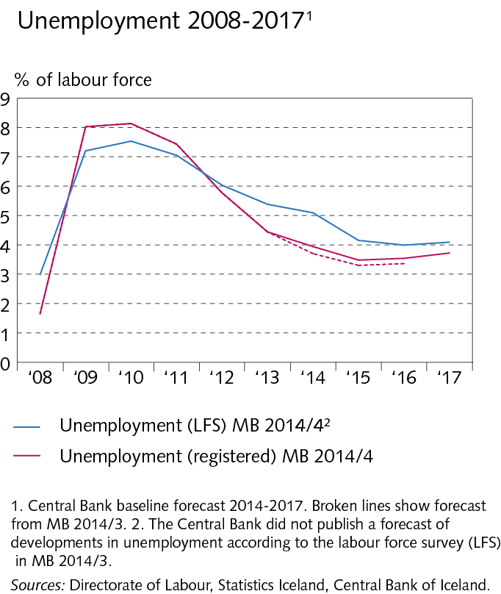
I Economic outlook and key uncertainties

Slide 9
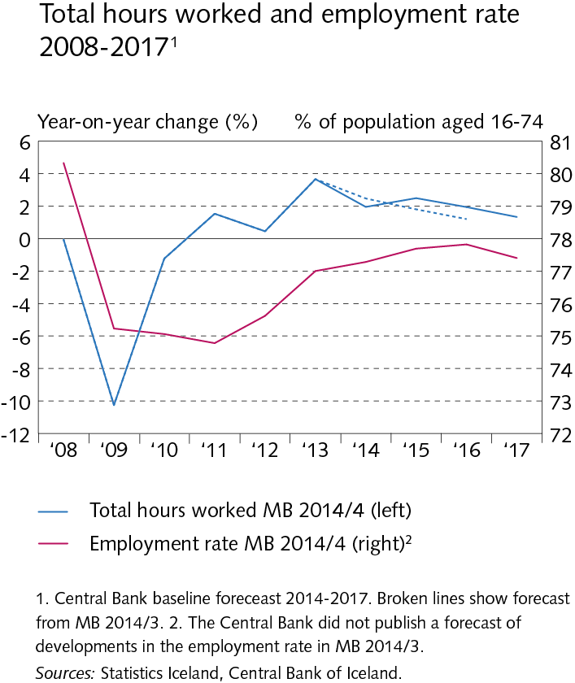
I Economic outlook and key uncertainties

Slide 10
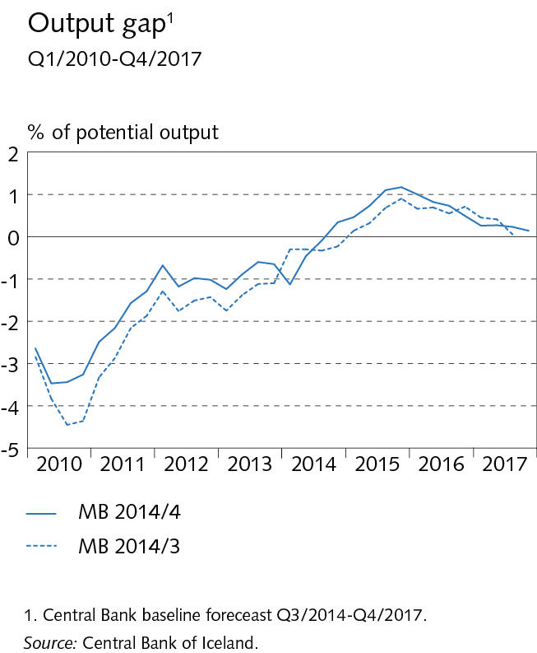
I Economic outlook and key uncertainties

Slide 11
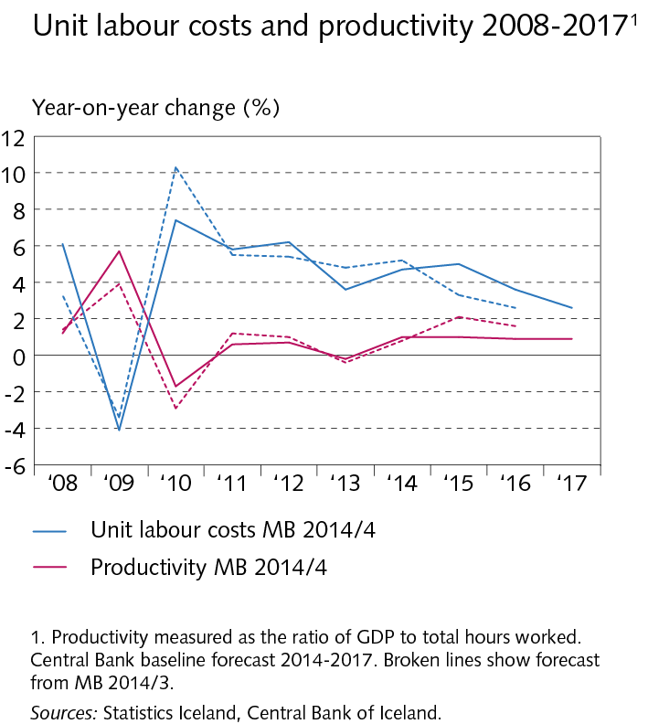
I Economic outlook and key uncertainties

Slide 12
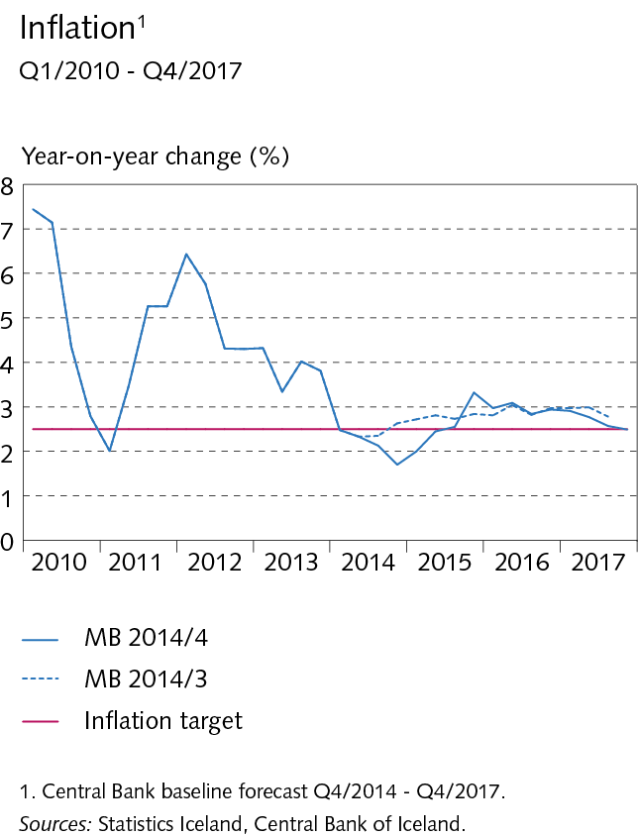
I Economic outlook and key uncertainties

Slide 13
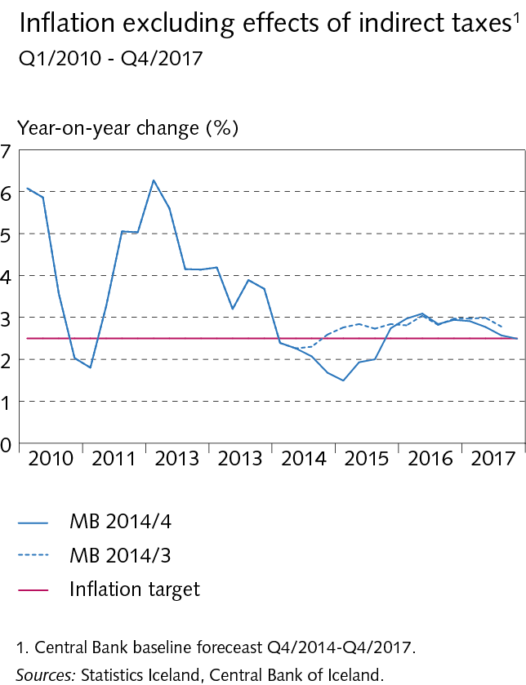
I Economic outlook and key uncertainties

Slide 14
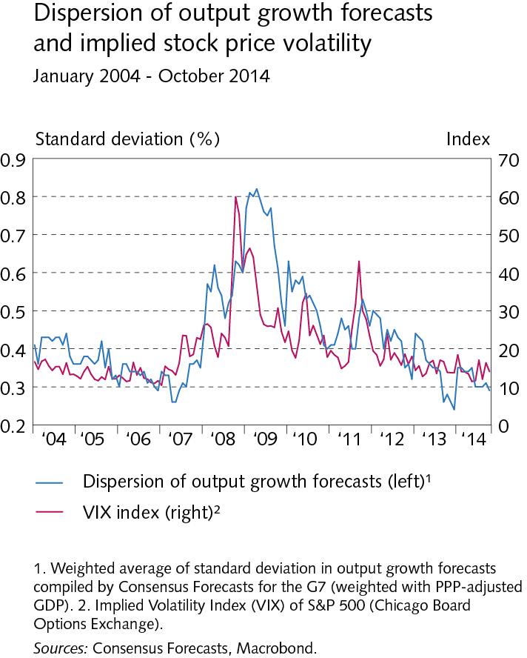
I Economic outlook and key uncertainties

Slide 15
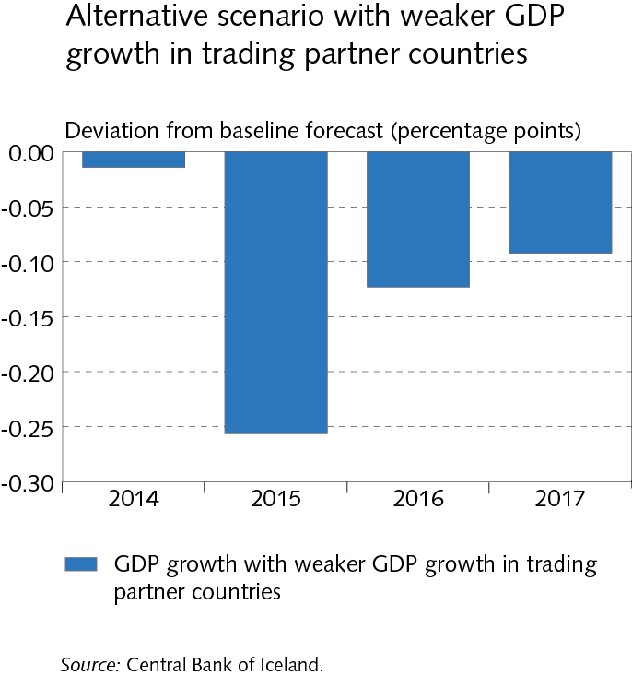
I Economic outlook and key uncertainties

Slide 16
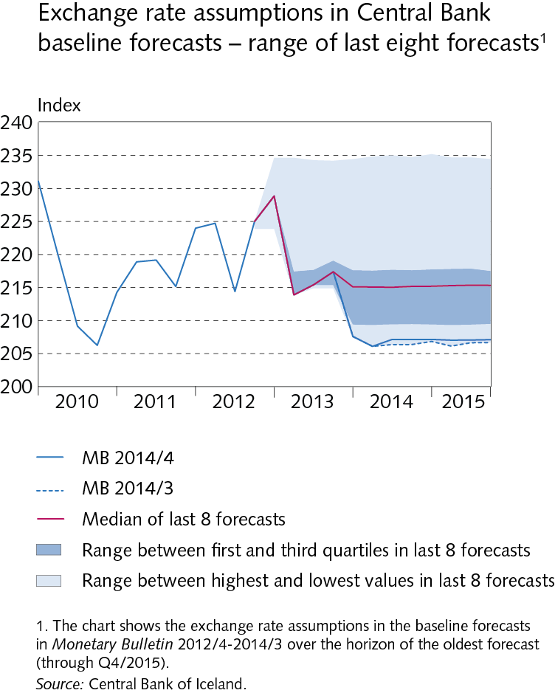
I Economic outlook and key uncertainties

Slide 17
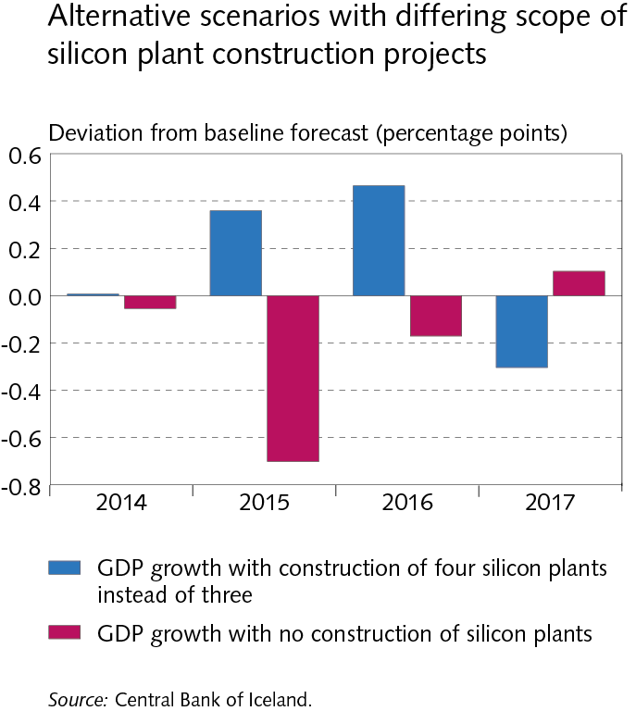
I Economic outlook and key uncertainties

Slide 18
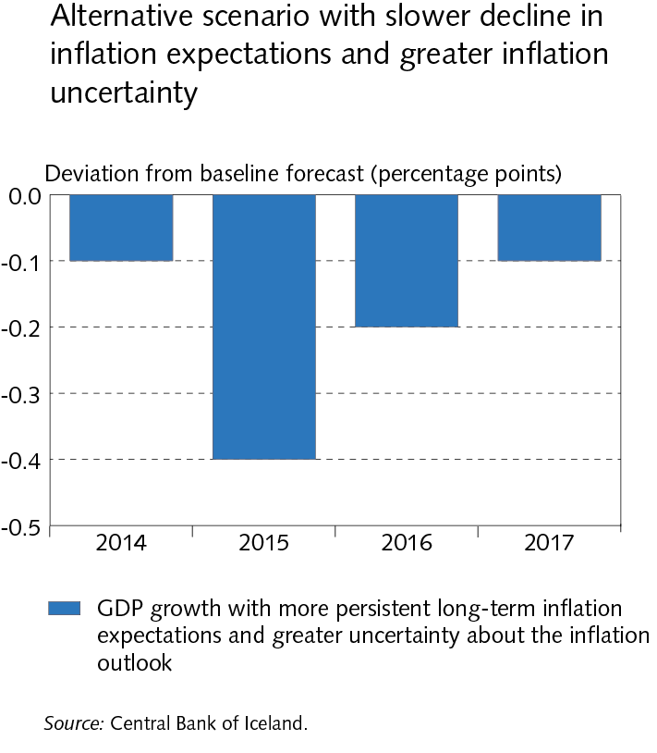
I Economic outlook and key uncertainties

Slide 19
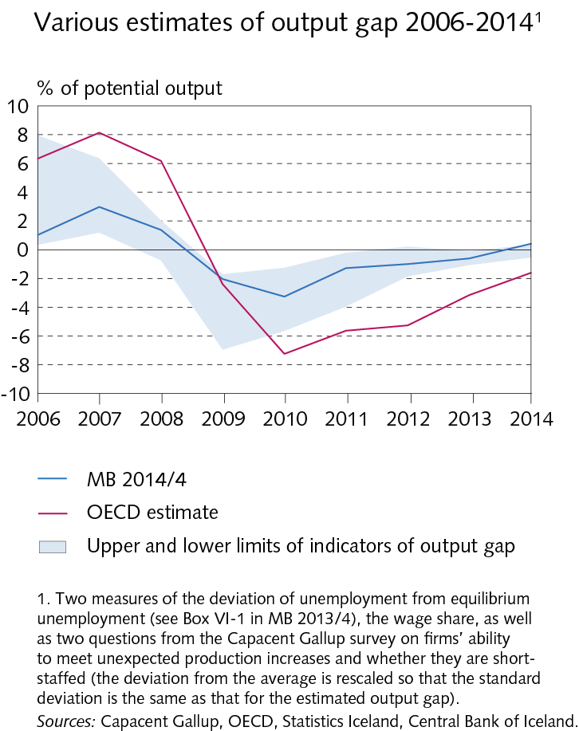
I Economic outlook and key uncertainties

Slide 20
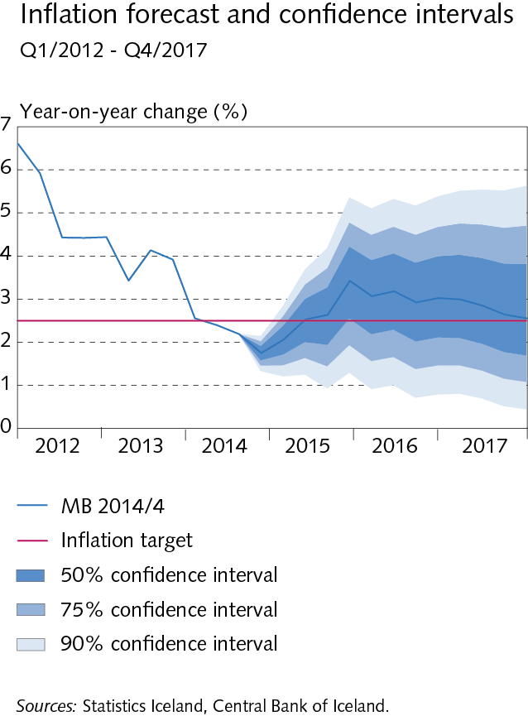
I Economic outlook and key uncertainties

Slide 21
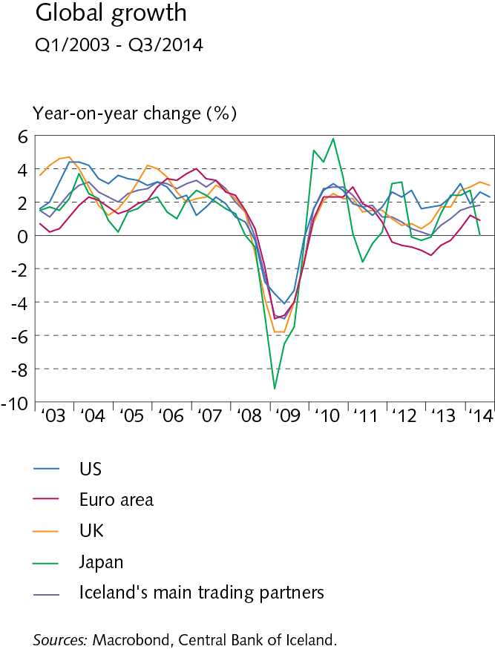
II The global economy and terms of trade

Slide 22
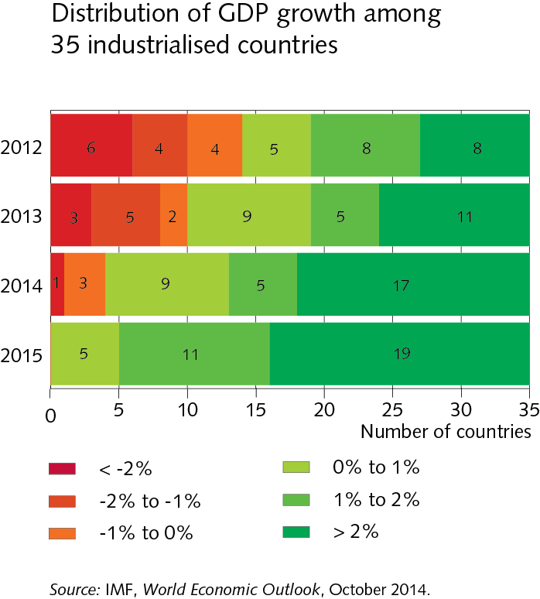
II The global economy and terms of trade

Slide 23
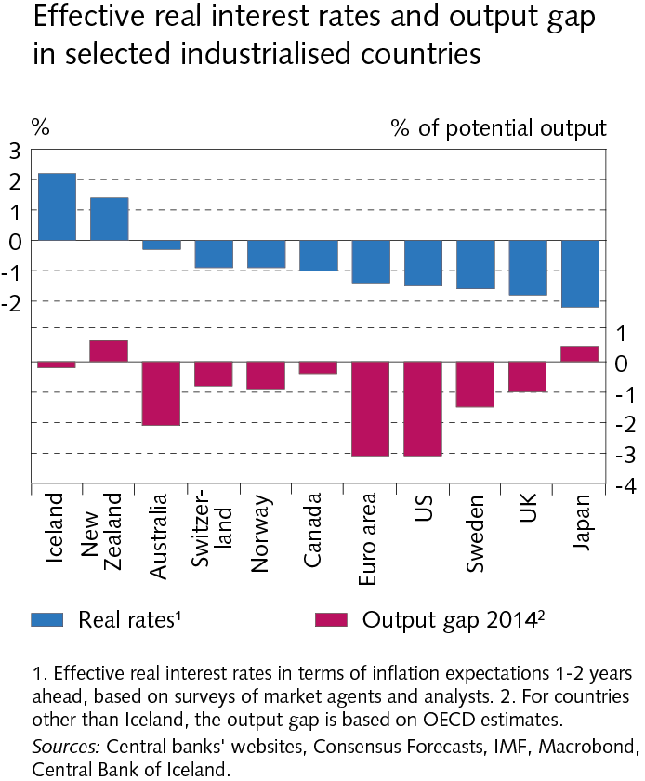
II The global economy and terms of trade

Slide 24
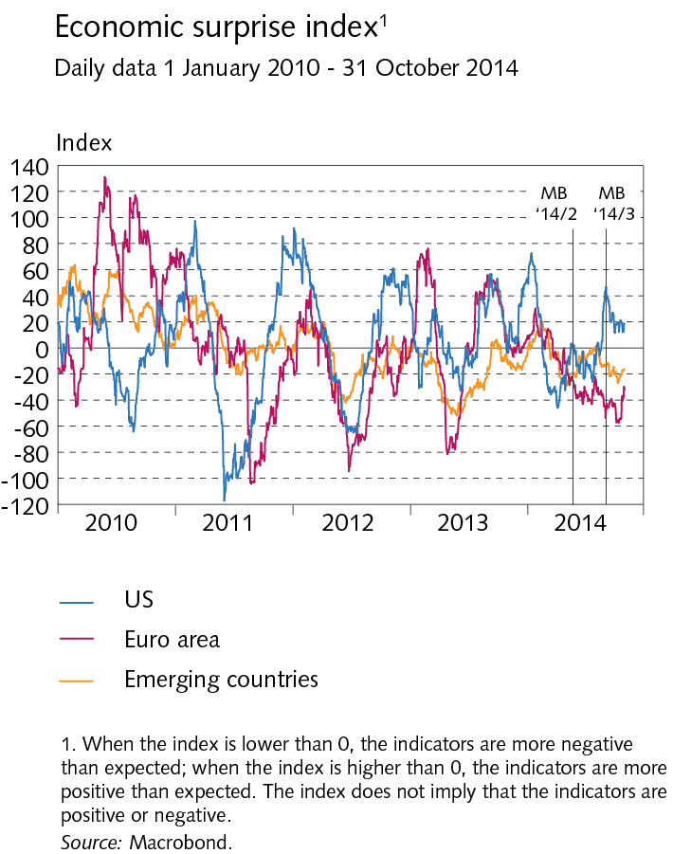
II The global economy and terms of trade

Slide 25
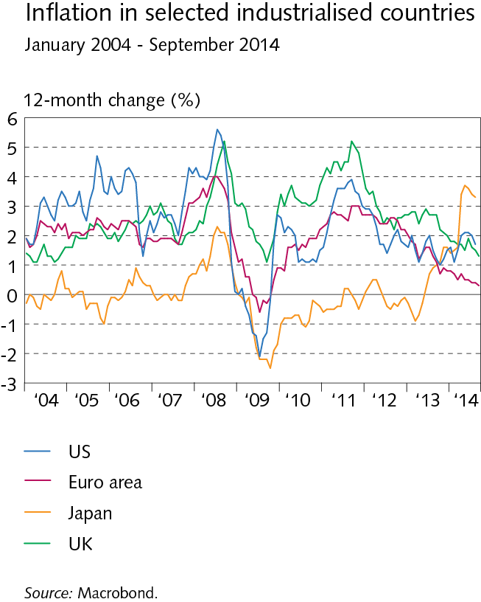
II The global economy and terms of trade

Slide 26
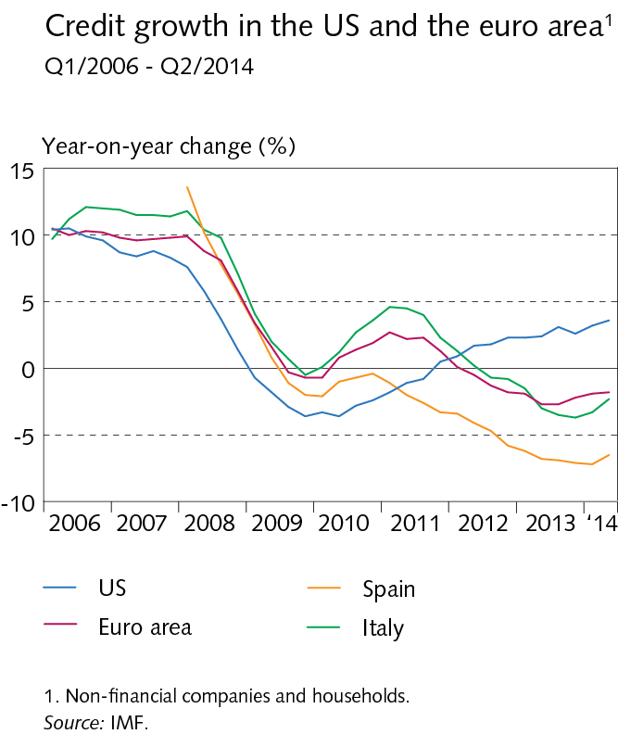
II The global economy and terms of trade

Slide 27
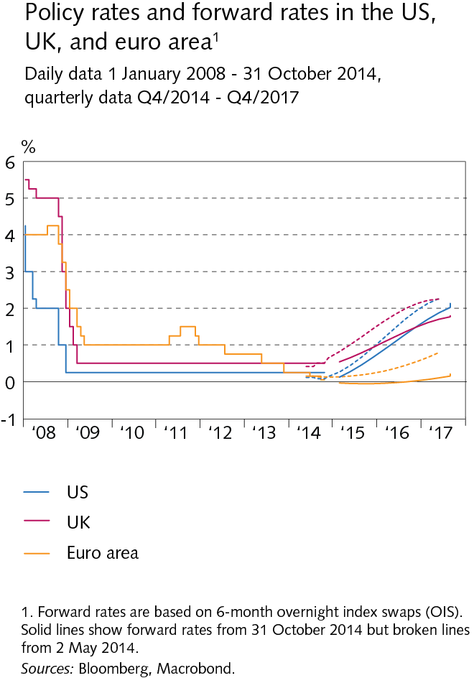
II The global economy and terms of trade

Slide 28
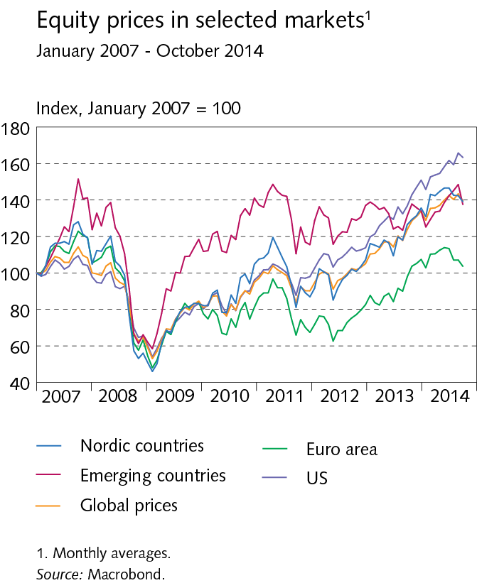
II The global economy and terms of trade

Slide 29
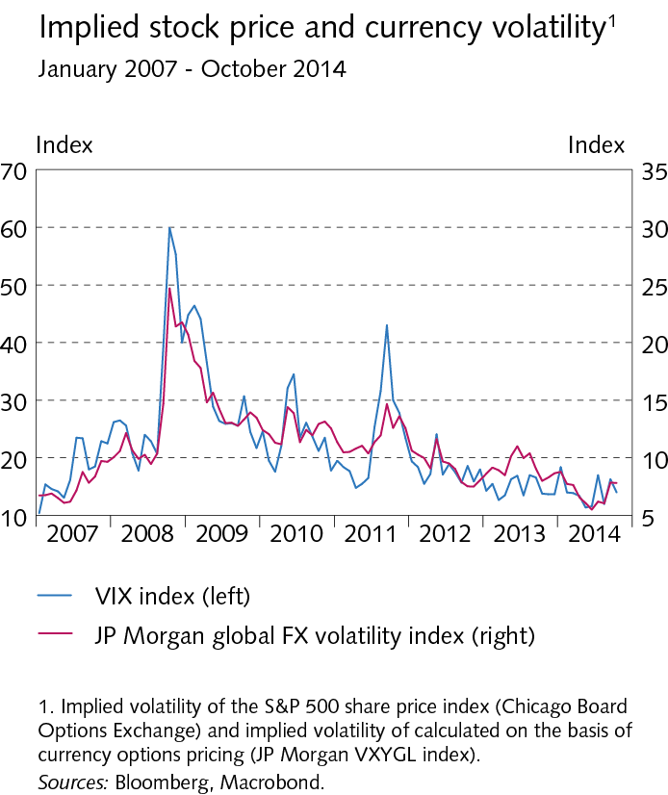
II The global economy and terms of trade

Slide 30
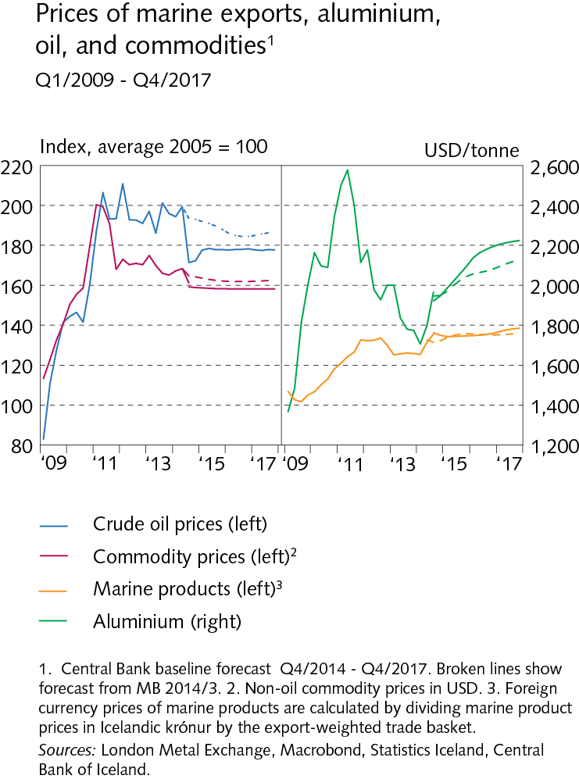
II The global economy and terms of trade

Slide 31
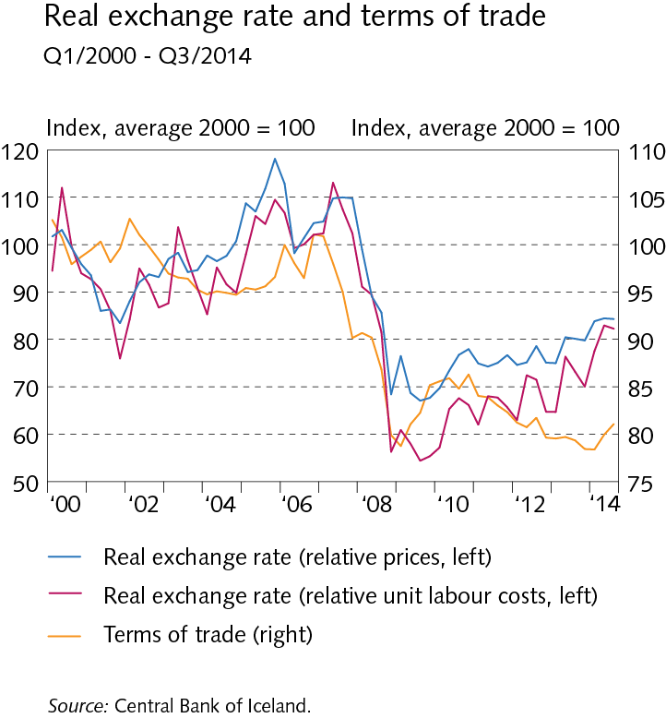
II The global economy and terms of trade

Slide 32
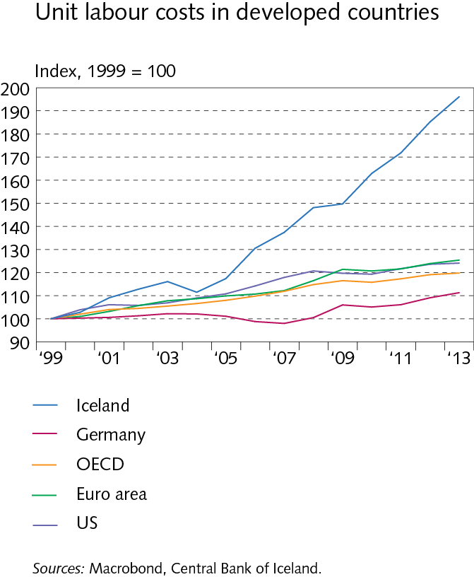
II The global economy and terms of trade

Slide 33
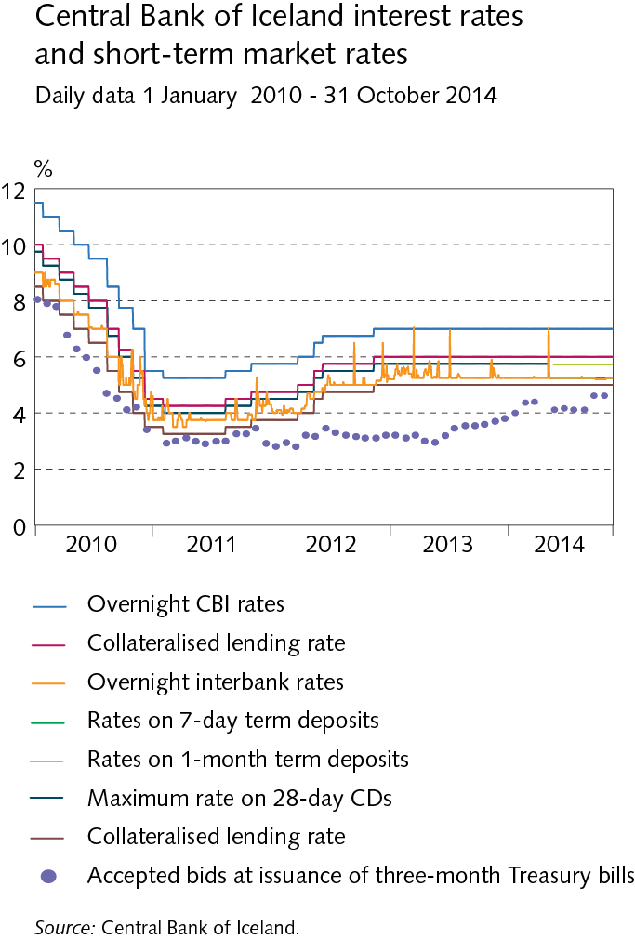
III Monetary policy and domestic financial markets

Slide 34
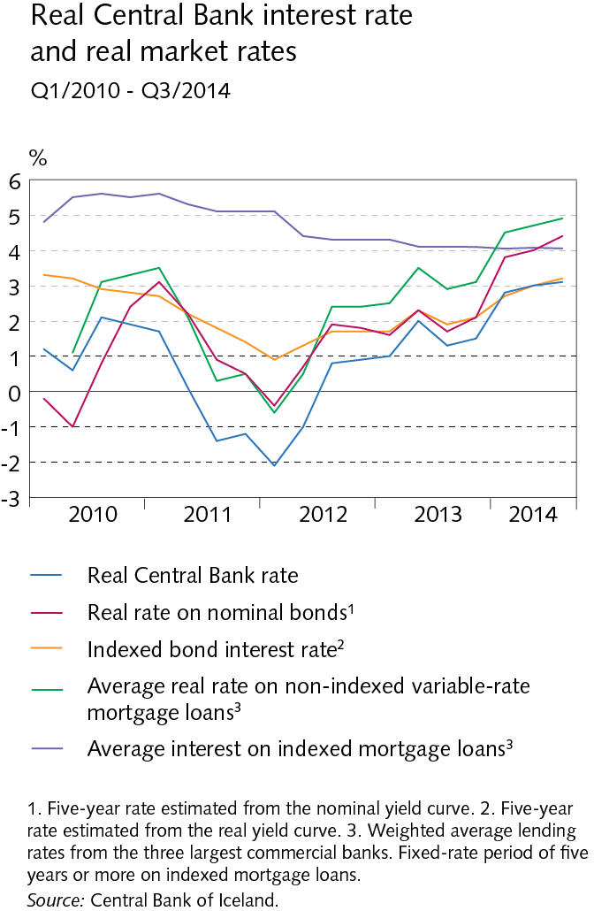
III Monetary policy and domestic financial markets

Slide 35
III Monetary policy and domestic financial markets

Slide 36
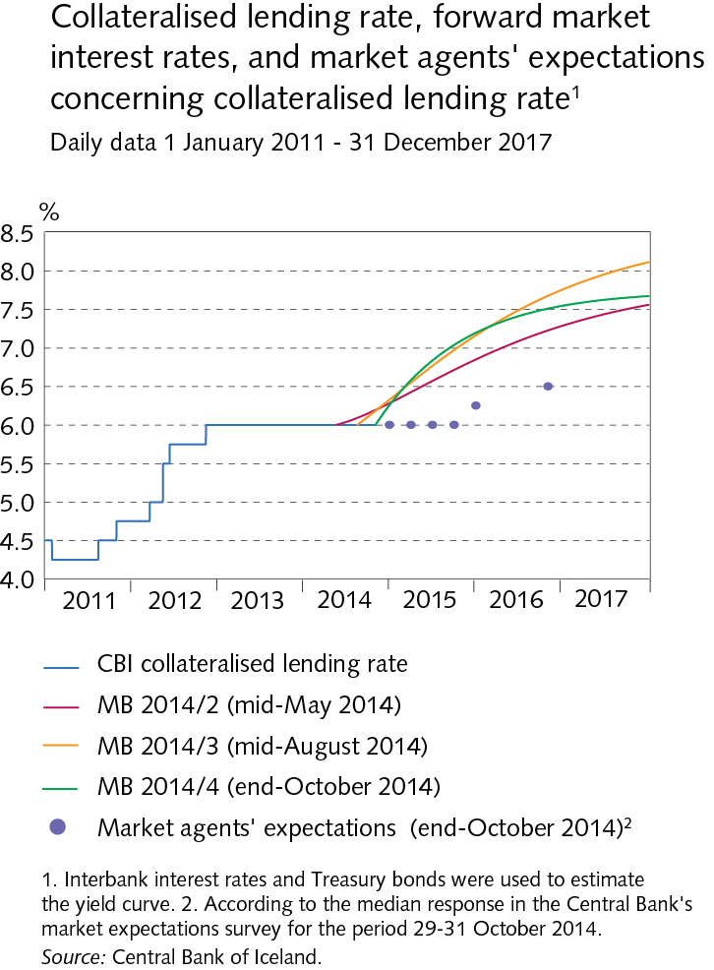
III Monetary policy and domestic financial markets

Slide 37
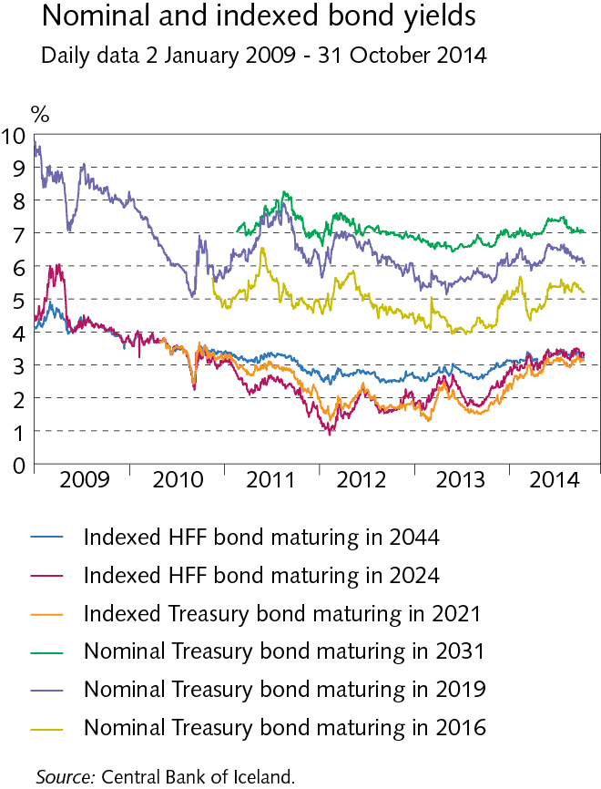
III Monetary policy and domestic financial markets

Slide 38
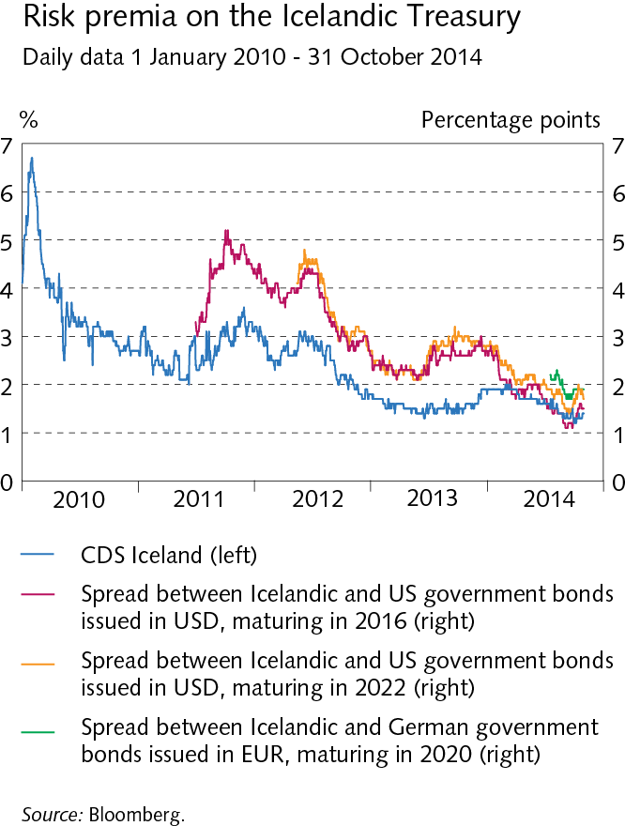
III Monetary policy and domestic financial markets

Slide 39
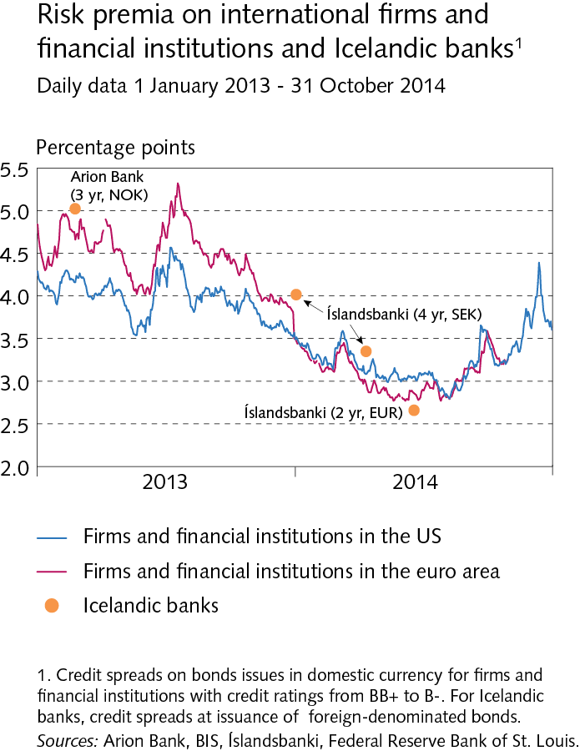
III Monetary policy and domestic financial markets

Slide 40
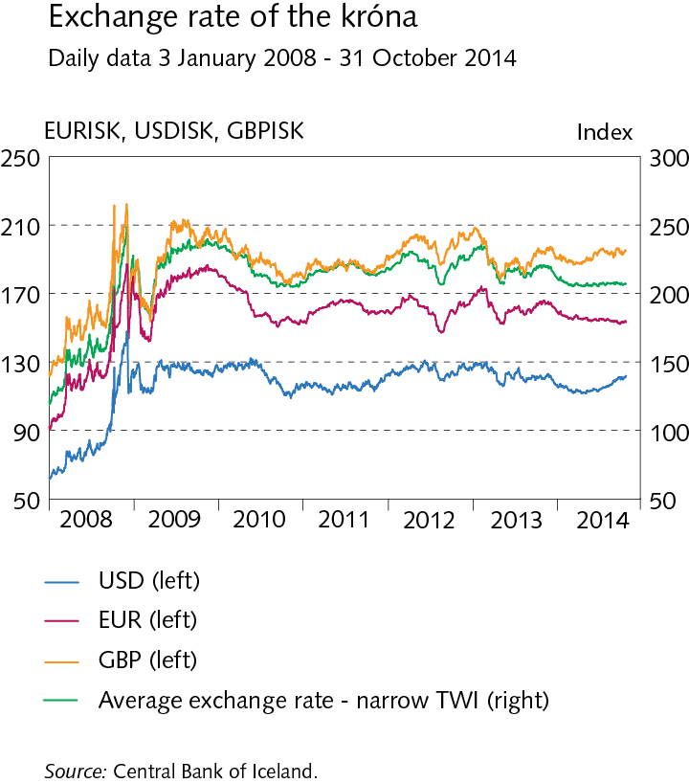
III Monetary policy and domestic financial markets

Slide 41
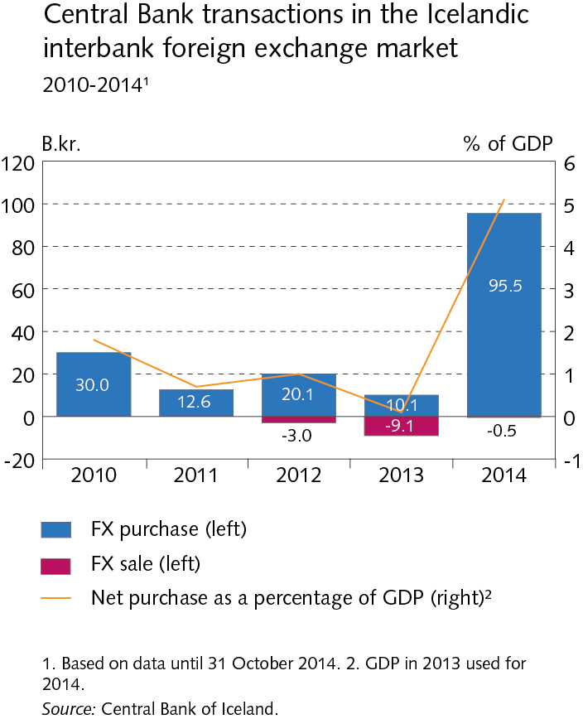
III Monetary policy and domestic financial markets

Slide 42
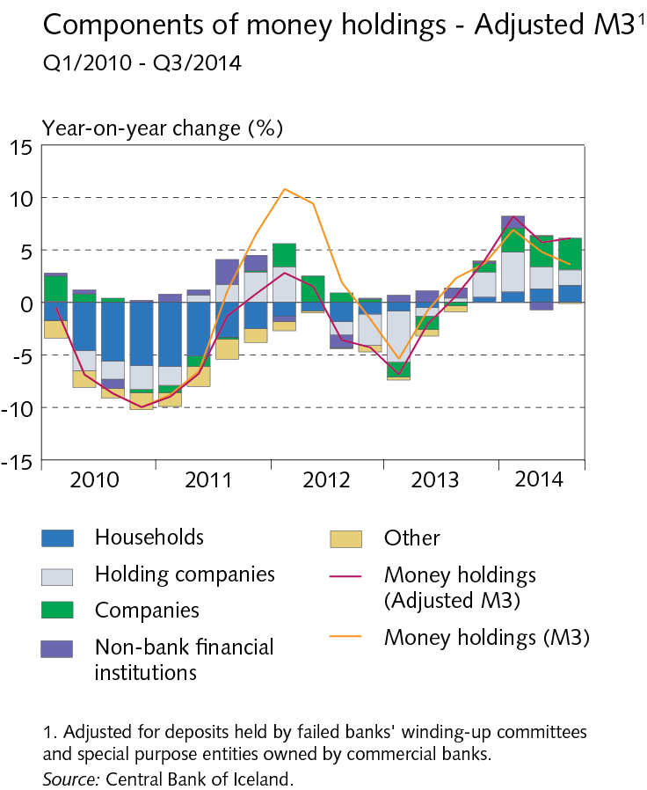
III Monetary policy and domestic financial markets

Slide 43
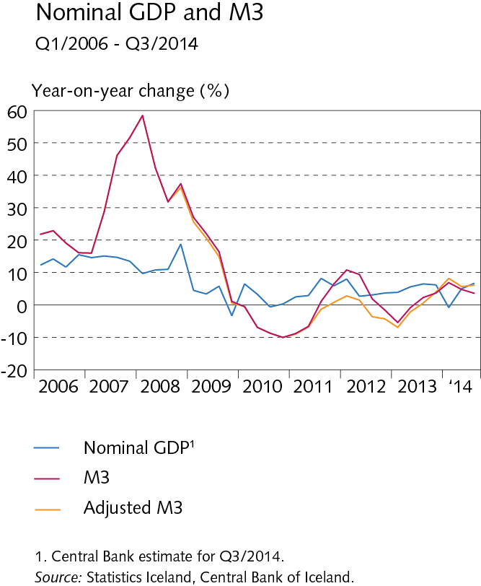
III Monetary policy and domestic financial markets

Slide 44
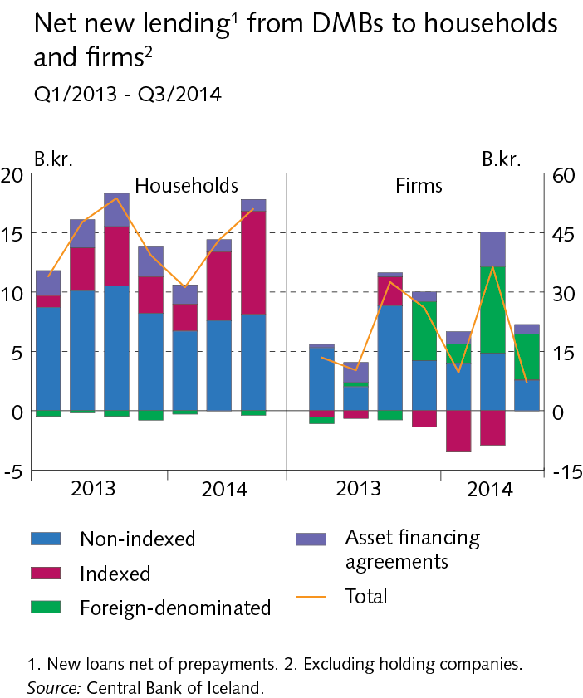
III Monetary policy and domestic financial markets

Slide 45
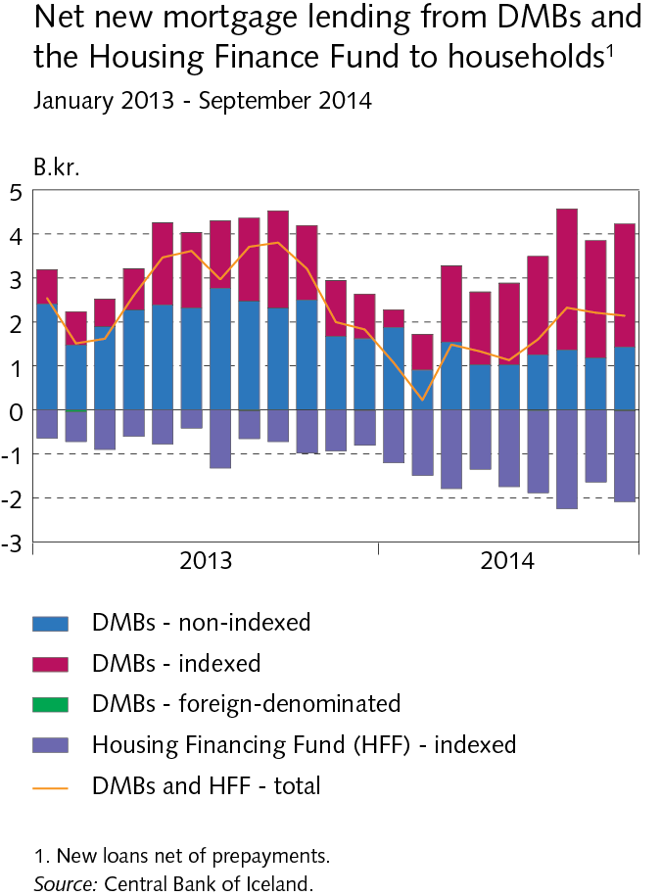
III Monetary policy and domestic financial markets

Slide 46
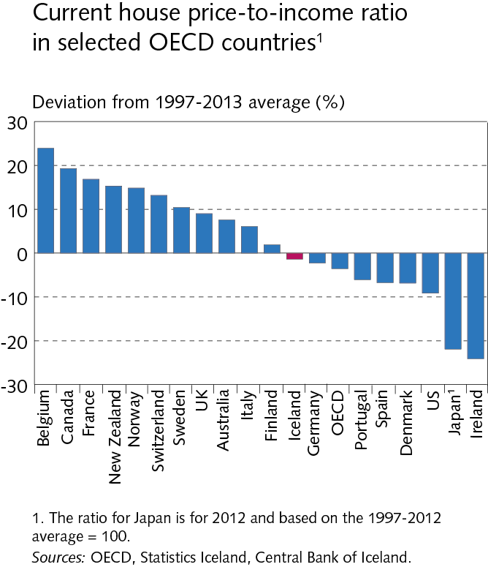
III Monetary policy and domestic financial markets

Slide 47
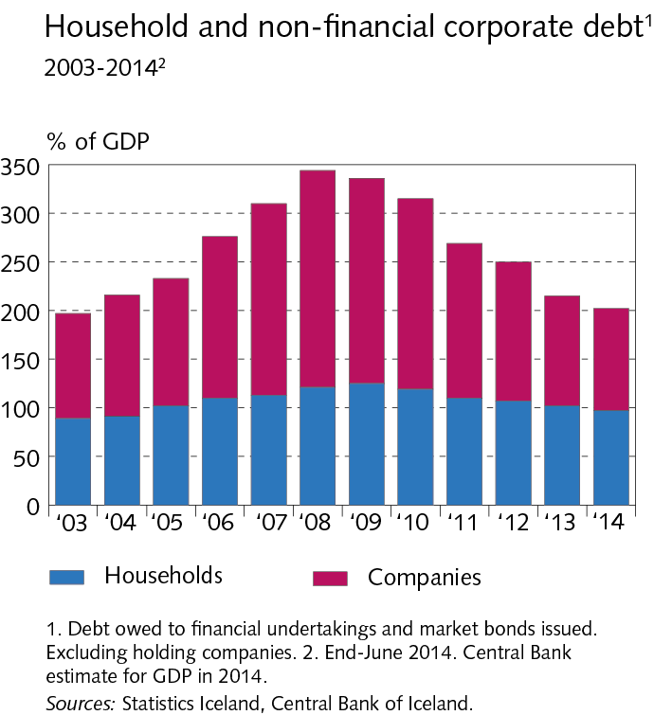
III Monetary policy and domestic financial markets

Slide 48
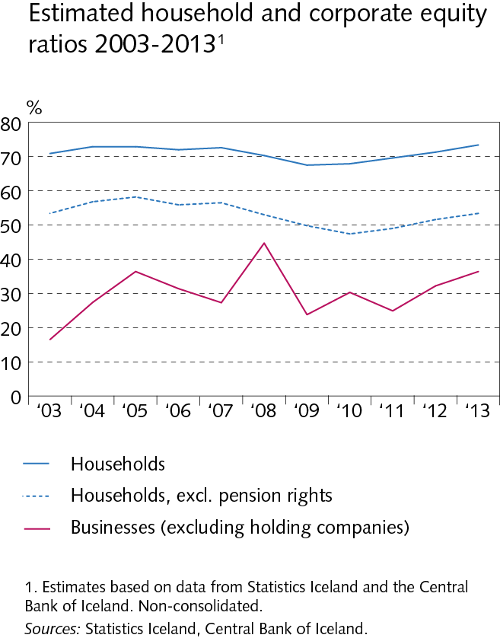
III Monetary policy and domestic financial markets

Slide 49
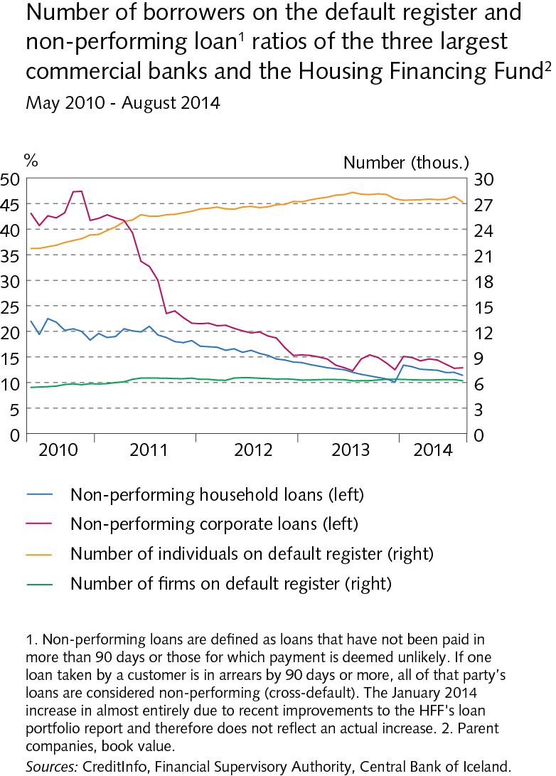
III Monetary policy and domestic financial markets

Slide 50
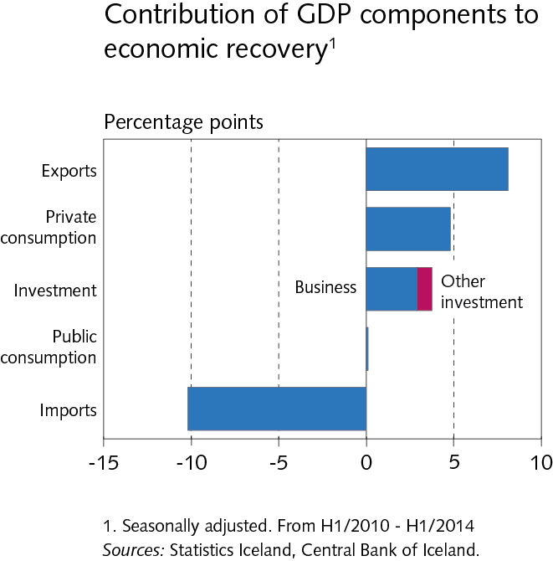
IV The domestic real economy

Slide 51
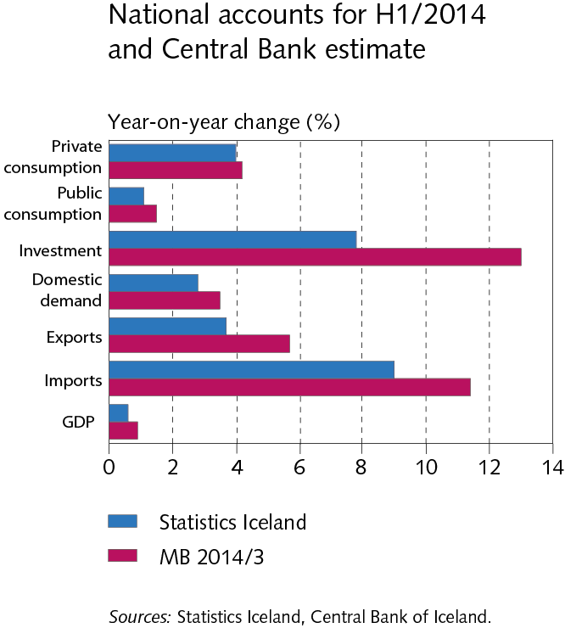
IV The domestic real economy

Slide 52
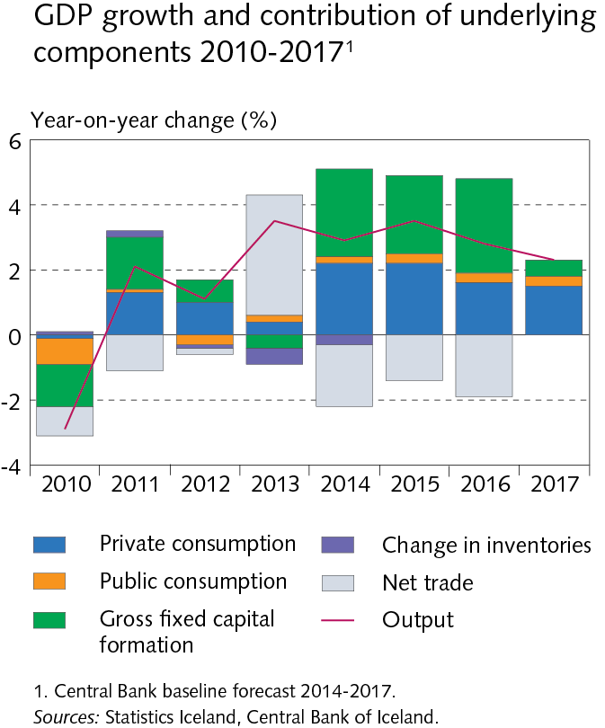
IV The domestic real economy

Slide 53

IV The domestic real economy

Slide 54

IV The domestic real economy

Slide 55

IV The domestic real economy

Slide 56

IV The domestic real economy

Slide 57

IV The domestic real economy

Slide 58

IV The domestic real economy

Slide 59

IV The domestic real economy

Slide 60

IV The domestic real economy

Slide 61

IV The domestic real economy

Slide 62

IV The domestic real economy

Slide 63

IV The domestic real economy

Slide 64

IV The domestic real economy

Slide 65

IV The domestic real economy

Slide 66

IV The domestic real economy

Slide 67

IV The domestic real economy

Slide 68

IV The domestic real economy

Slide 69

IV The domestic real economy

Slide 70

IV The domestic real economy

Slide 71

IV The domestic real economy

Slide 72

IV The domestic real economy

Slide 73

IV The domestic real economy

Slide 74

IV The domestic real economy

Slide 75

V Inflation

Slide 76

V Inflation

Slide 77

V Inflation

Slide 78

V Inflation

Slide 79

V Inflation

Slide 80

V Inflation

Slide 81

V Inflation

Slide 82

V Inflation

Slide 83

V Inflation

Slide 84

V Inflation

Slide 85

V Inflation

Slide 86

Box I New national accounts standards

Slide 87

Box I New national accounts standards

Slide 88

Box I New national accounts standards

Slide 89

Box I New national accounts standards

Slide 90

Box 3 The Central Bank of Iceland forecasting record

Slide 91

Box 3 The Central Bank of Iceland forecasting record

Slide 92

Box 3 The Central Bank of Iceland forecasting record

Slide 93

Box 3 The Central Bank of Iceland forecasting record

Slide 94

Box 3 The Central Bank of Iceland forecasting record

Slide 95

Box 3 The Central Bank of Iceland forecasting record

Slide 96

Box 3 The Central Bank of Iceland forecasting record

