Slide 1
Monetary Bulletin 2013/1
Powerpoint charts

Slide 2
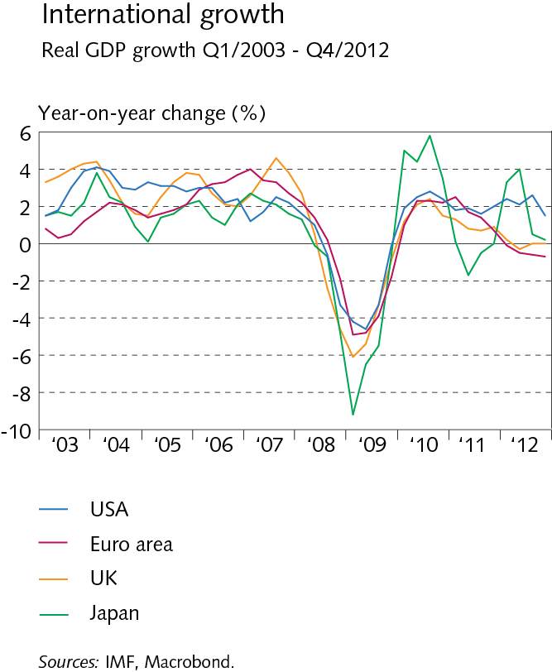
Global economic affairs and external trade

Slide 3
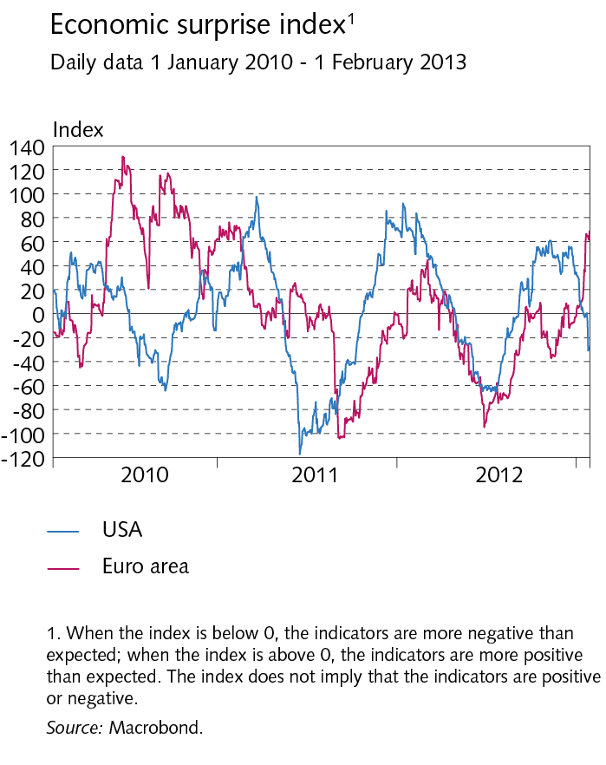
Global economic affairs and external trade

Slide 4
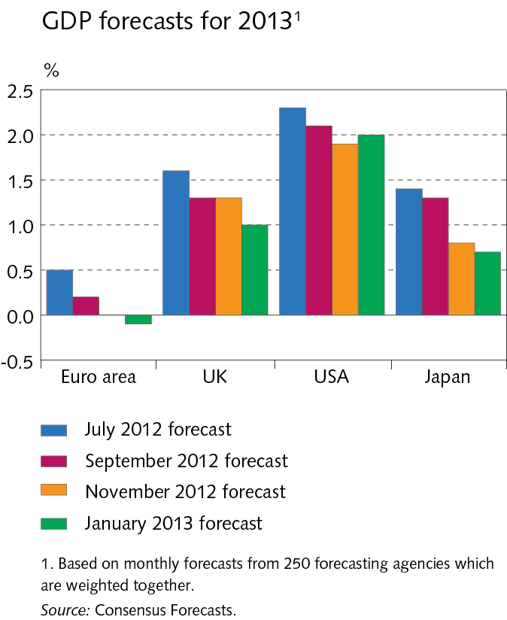
Global economic affairs and external trade

Slide 5
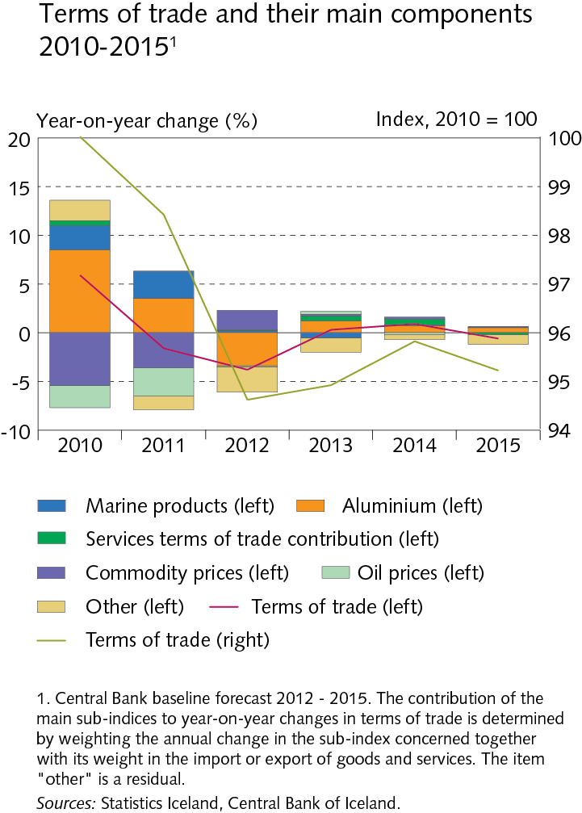
Global economic affairs and external trade

Slide 6
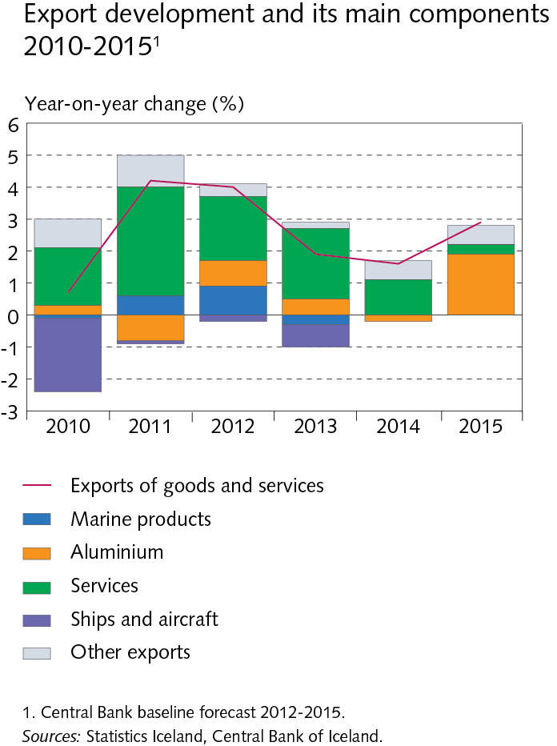
Global economic affairs and external trade

Slide 7
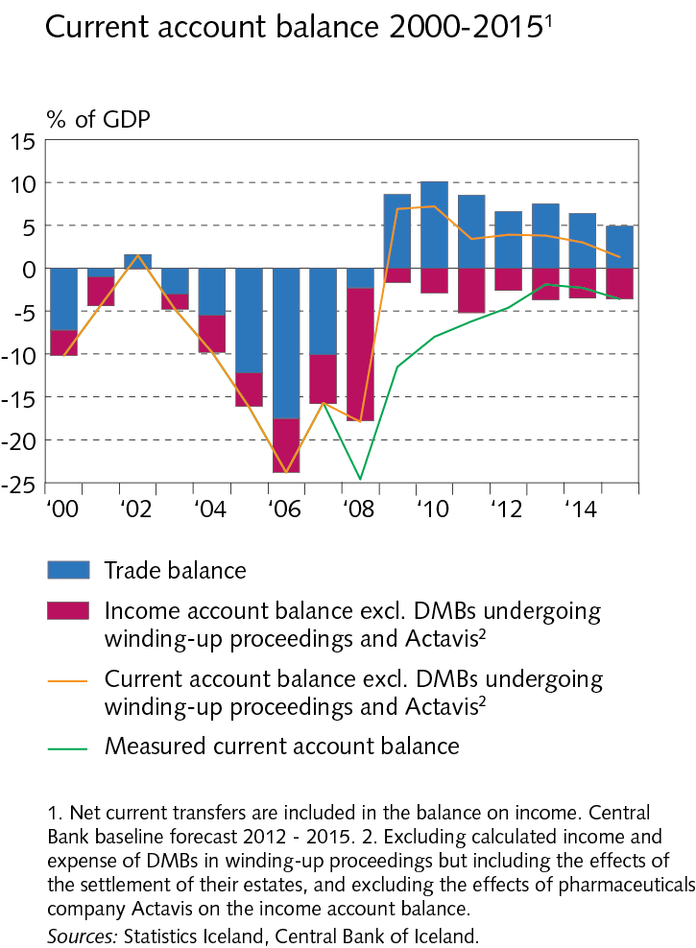
Global economic affairs and external trade

Slide 8
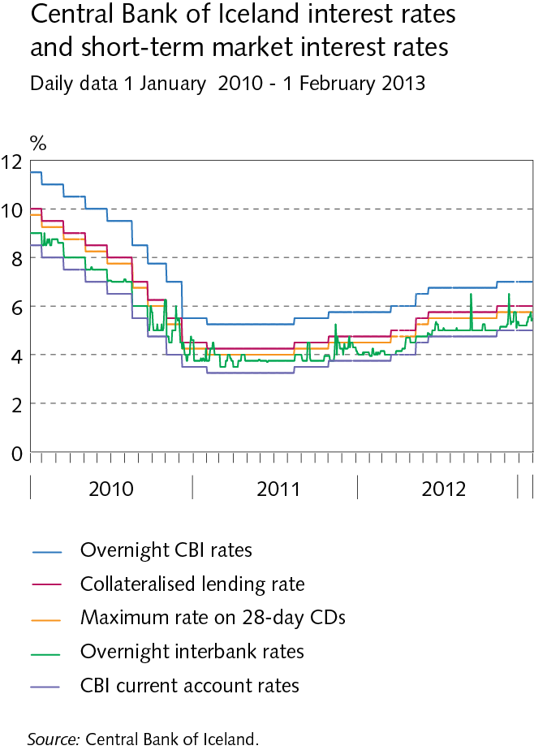
Domestic financial markets

Slide 9
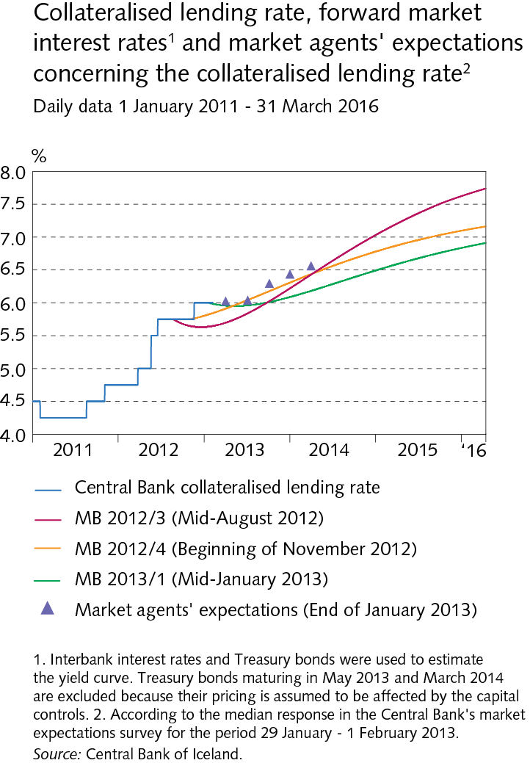
Domestic financial markets

Slide 10
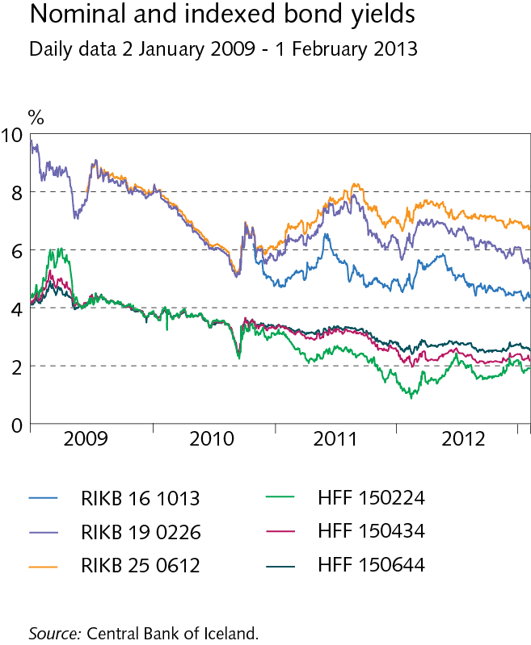
Domestic financial markets

Slide 11
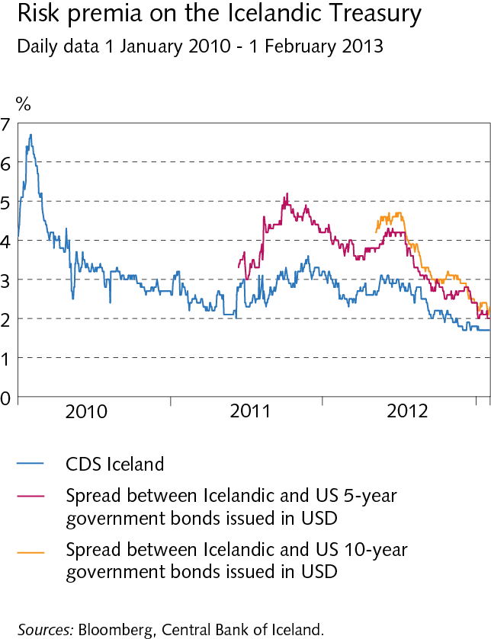
Domestic financial markets

Slide 12
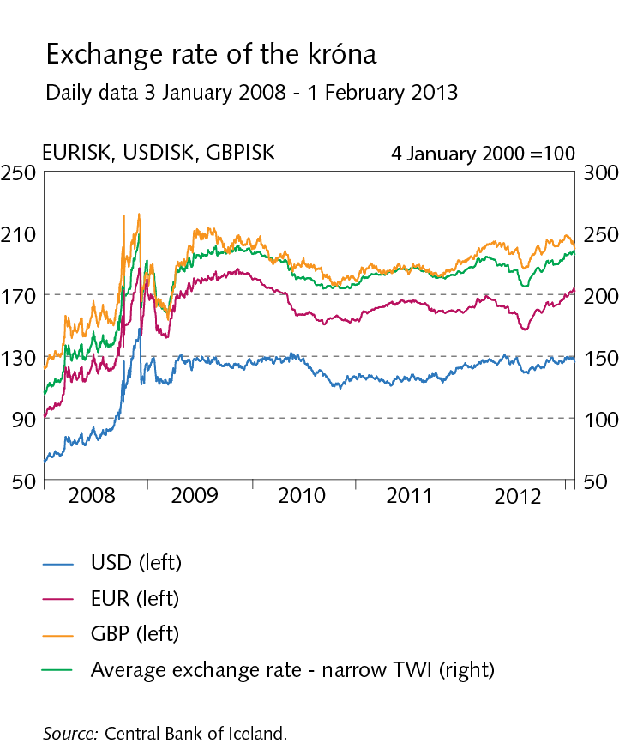
Domestic financial markets

Slide 13
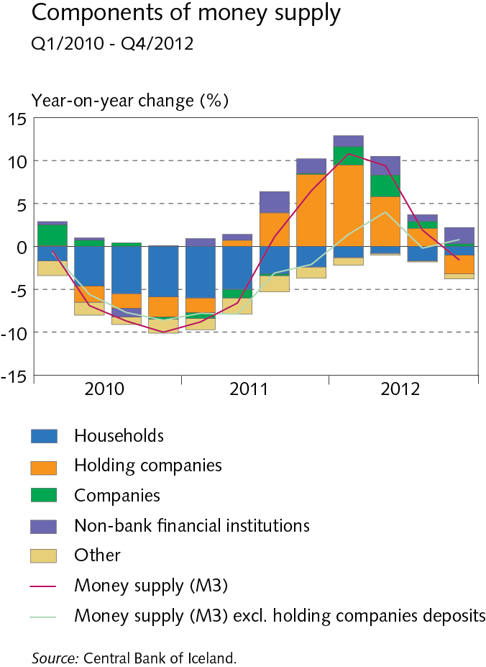
Domestic financial markets

Slide 14
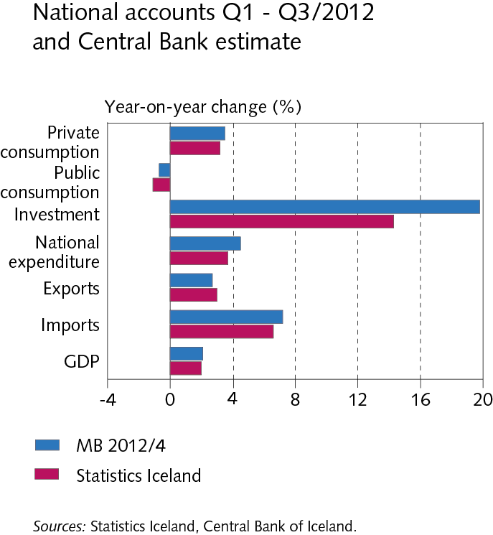
The domestic real economy

Slide 15
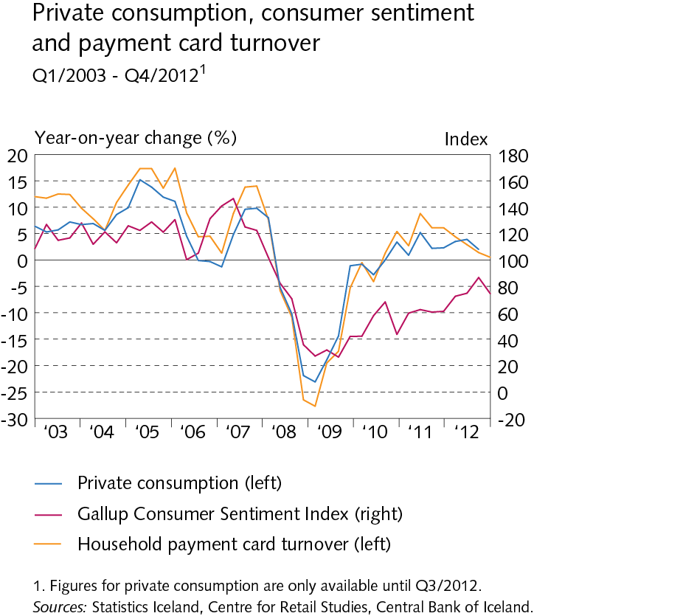
The domestic real economy

Slide 16
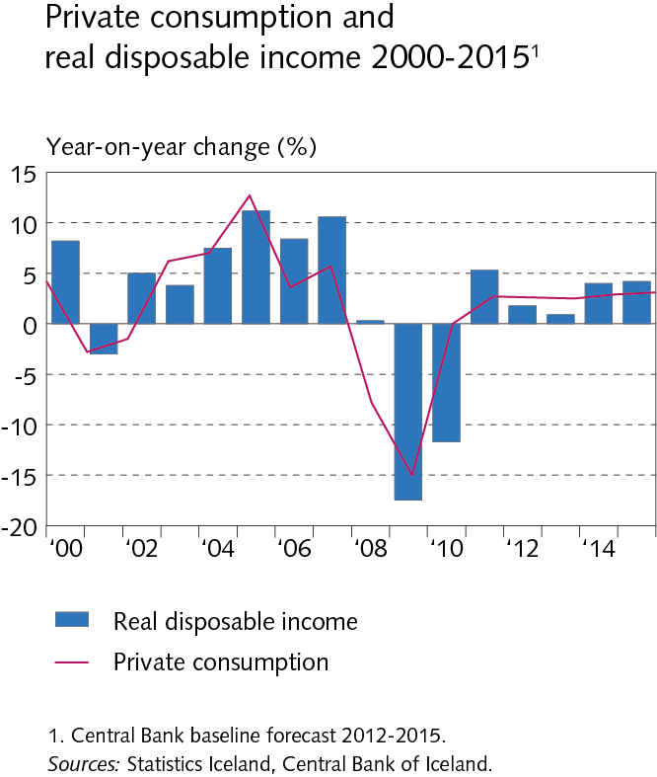
The domestic real economy

Slide 17
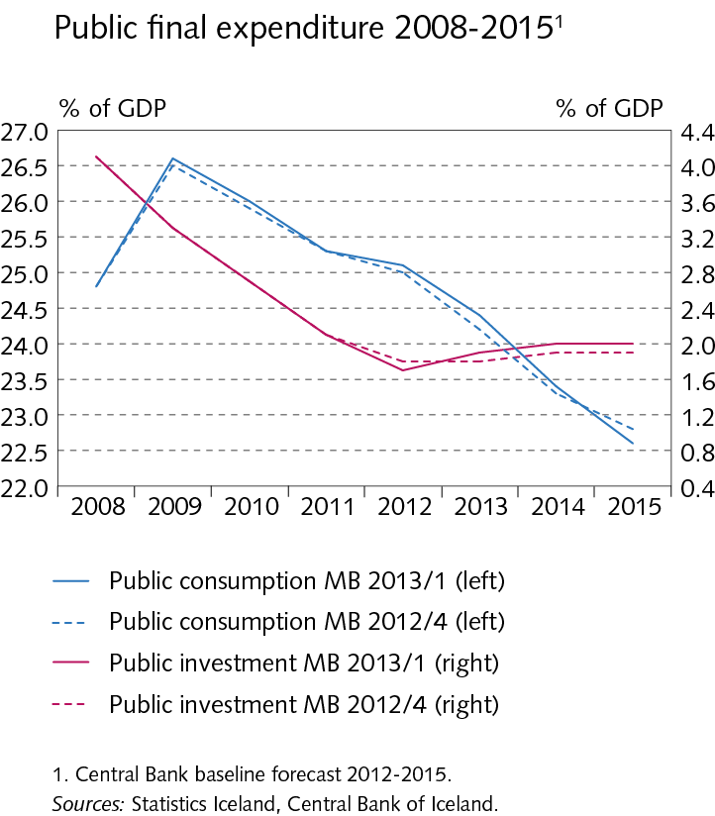
The domestic real economy

Slide 18
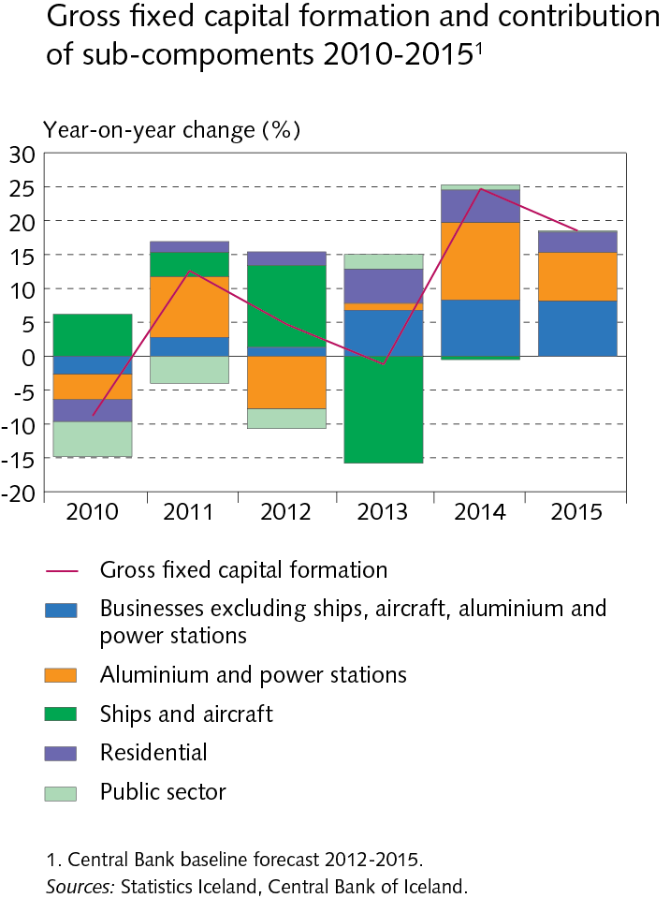
The domestic real economy

Slide 19
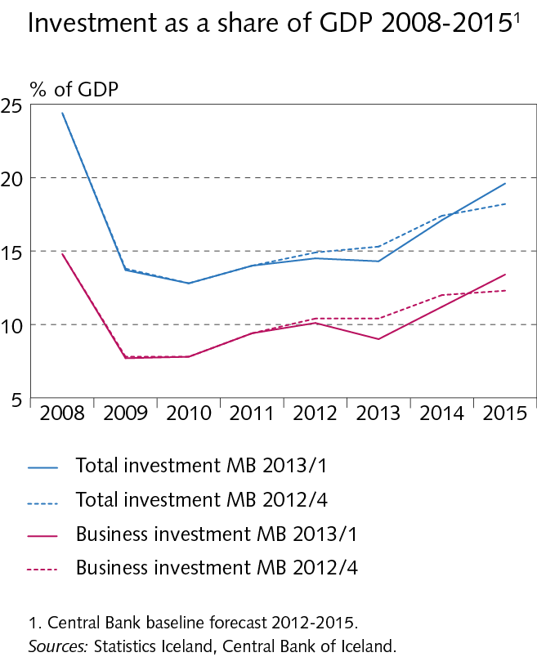
The domestic real economy

Slide 20
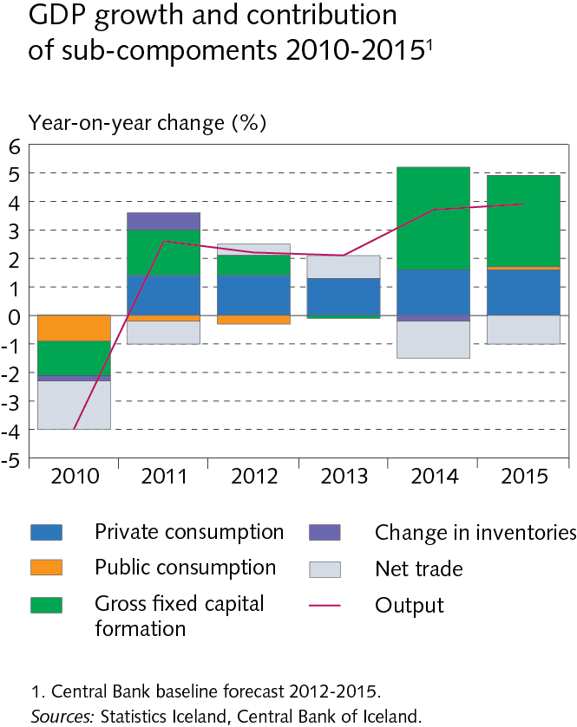
The domestic real economy

Slide 21
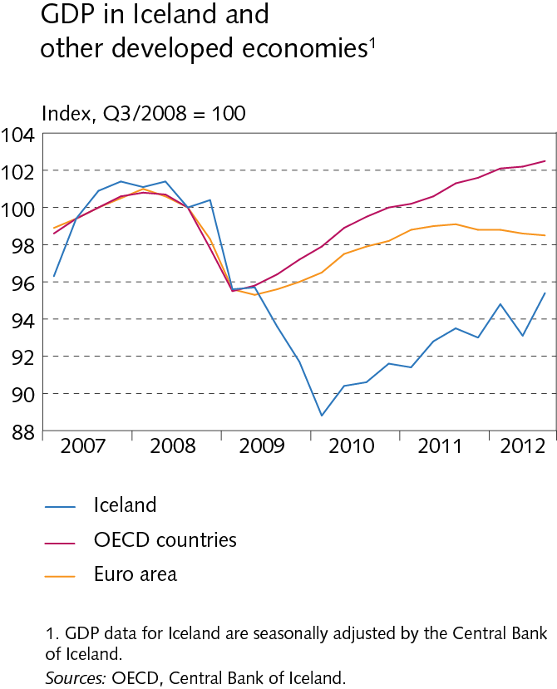
The domestic real economy

Slide 22
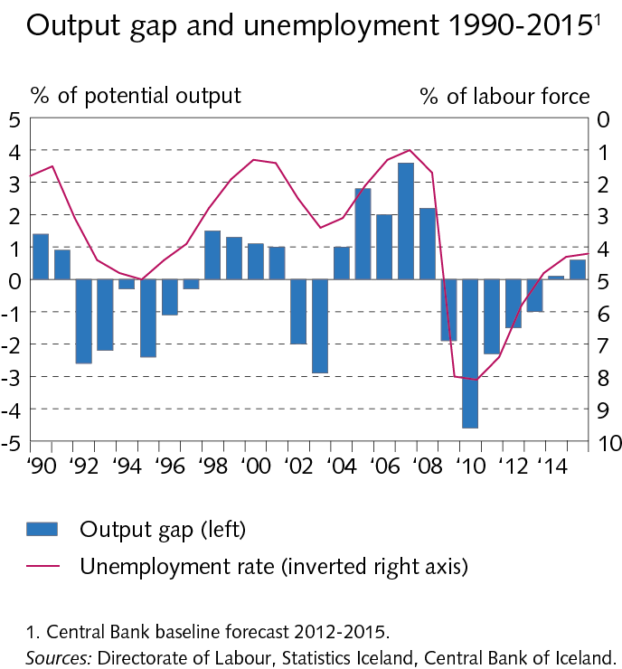
The domestic real economy

Slide 23
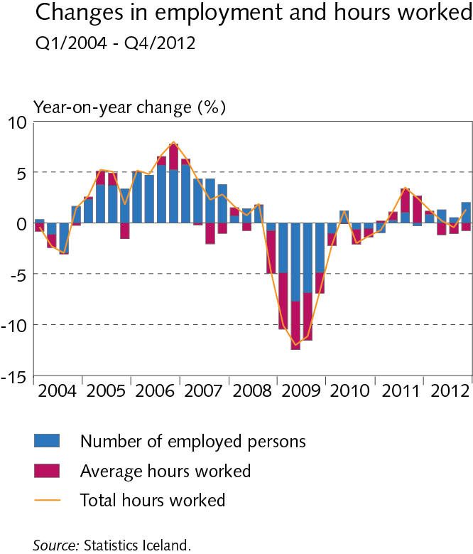
The domestic real economy

Slide 24
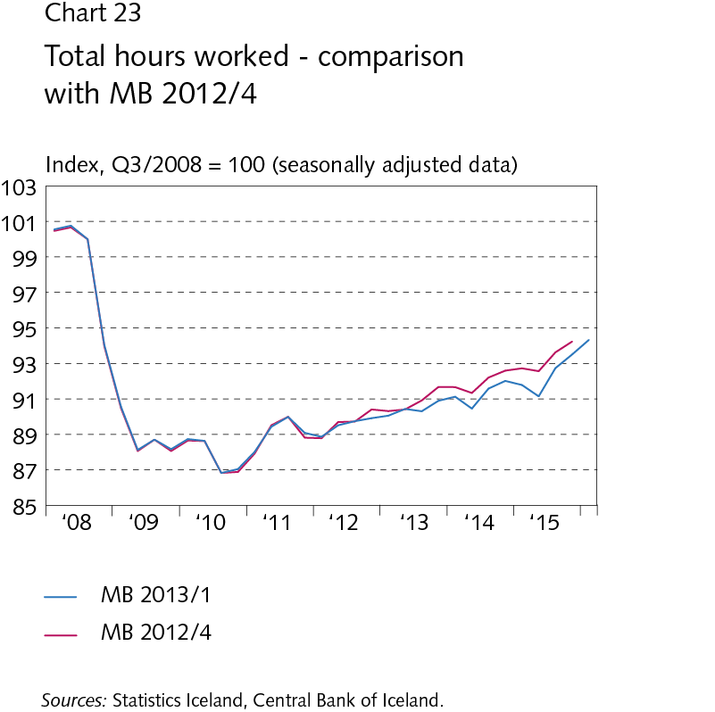
The domestic real economy

Slide 25
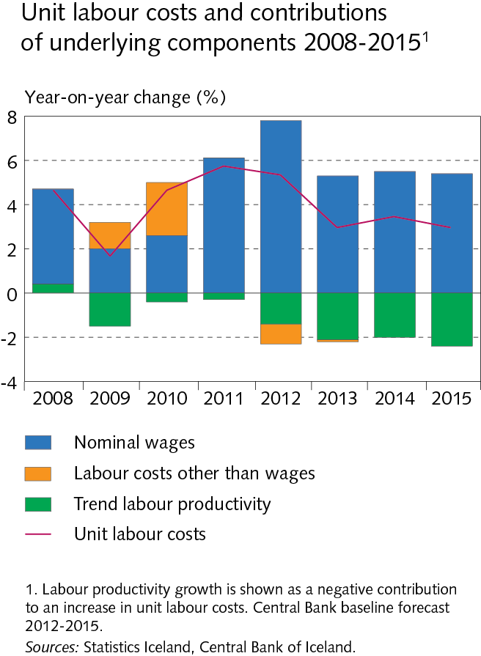
The domestic real economy

Slide 26
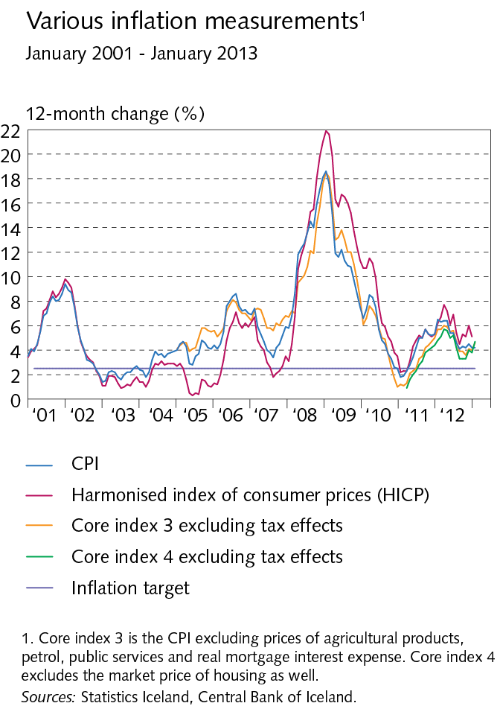
Inflation

Slide 27
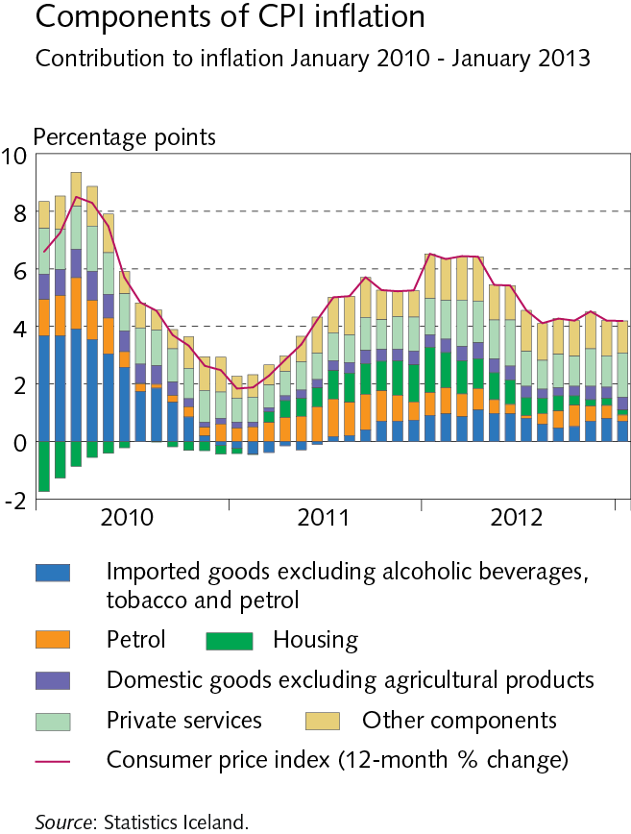
Inflation

Slide 28
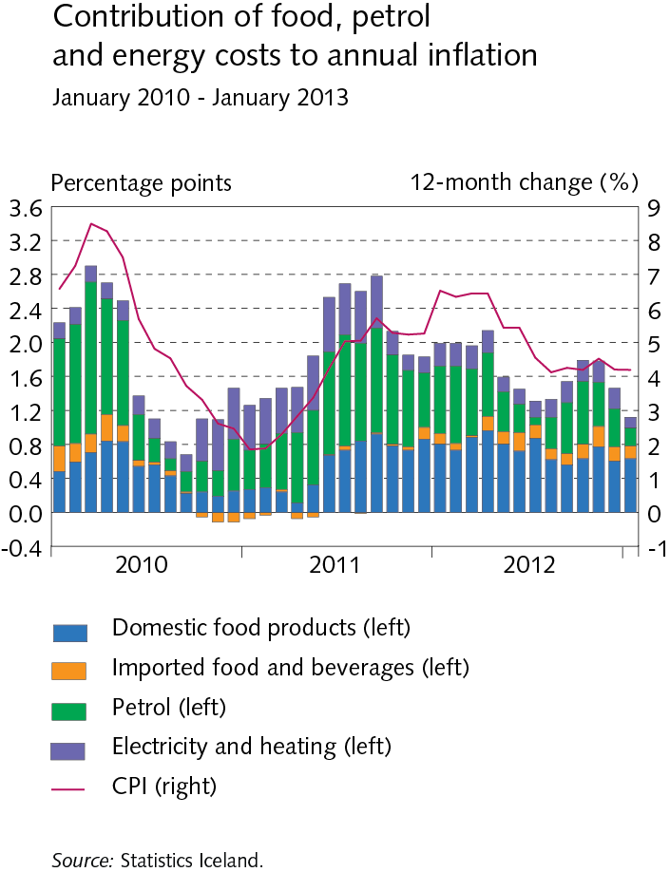
Inflation

Slide 29
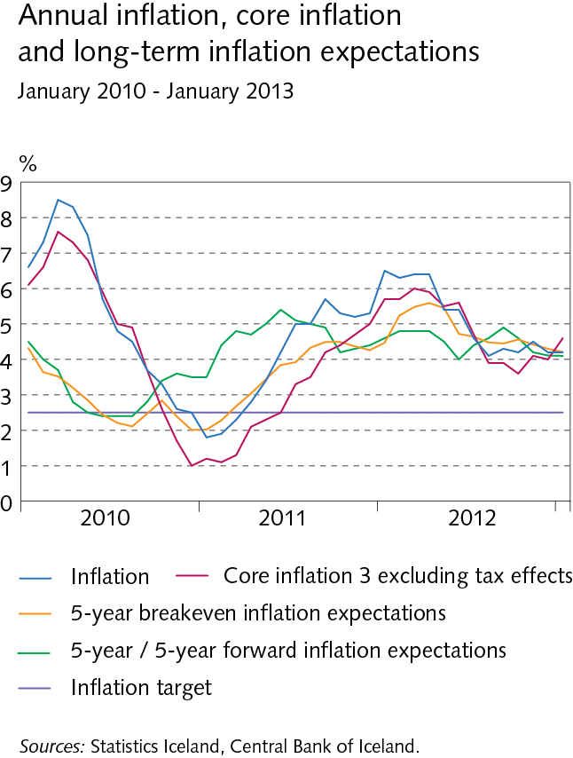
Inflation

Slide 30
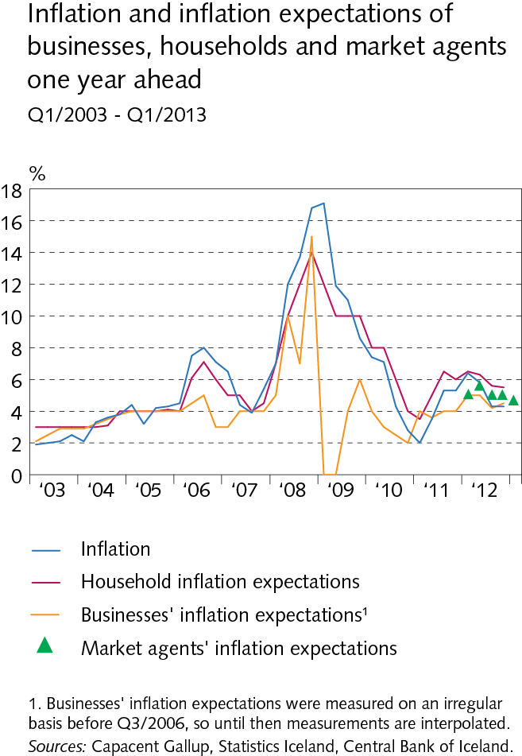
Inflation

Slide 31
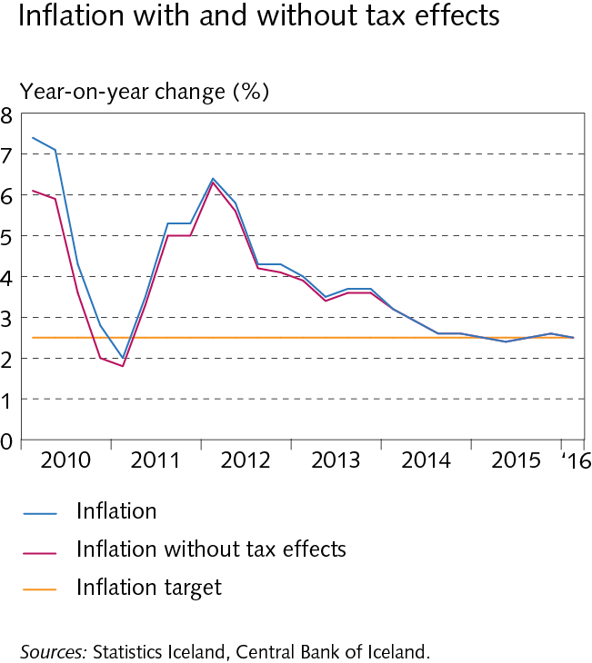
Inflation

Slide 32
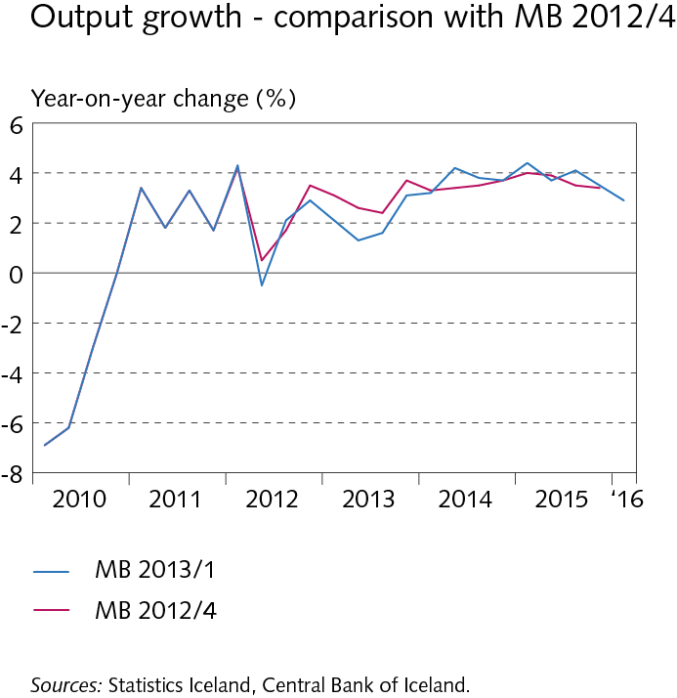
Baseline macroeconomic and inflation forecast

Slide 33
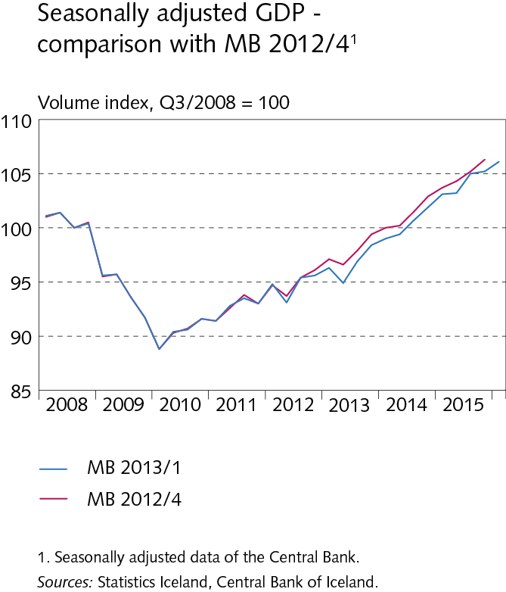
Baseline macroeconomic and inflation forecast

Slide 34
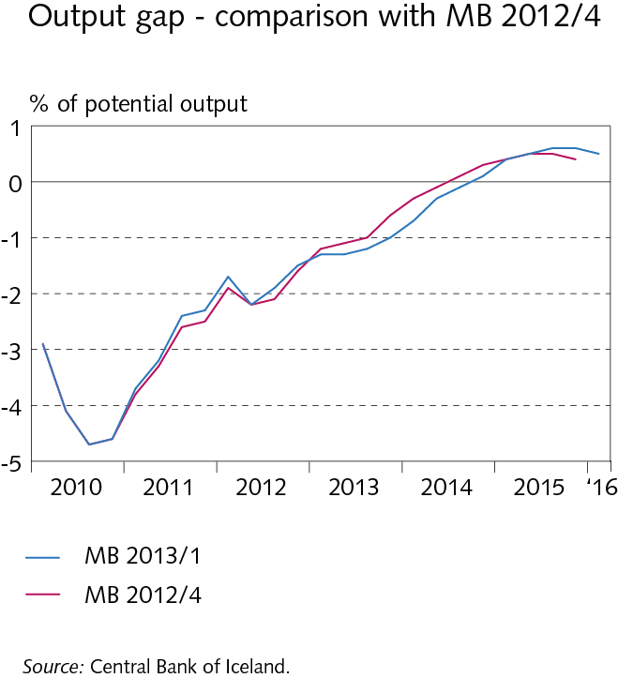
Baseline macroeconomic and inflation forecast

Slide 35
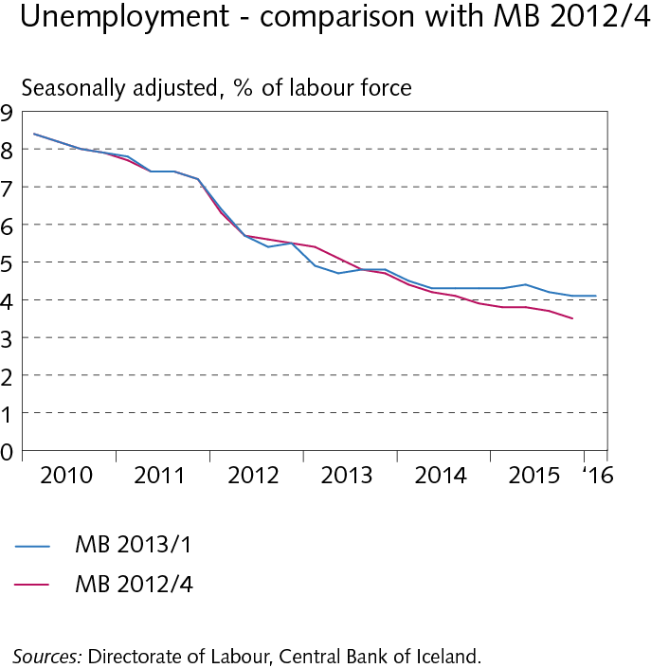
Baseline macroeconomic and inflation forecast

Slide 36
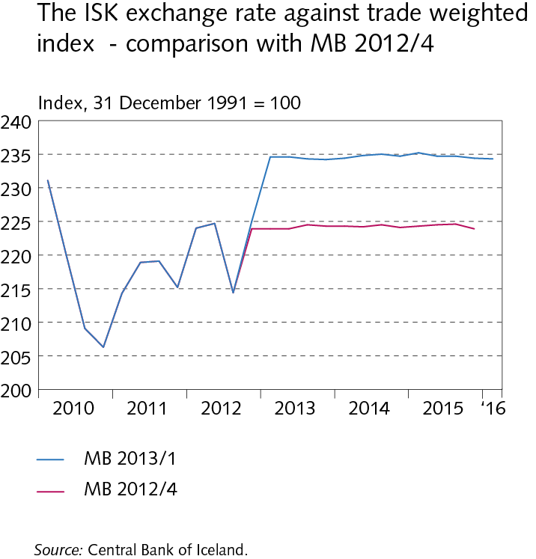
Baseline macroeconomic and inflation forecast

Slide 37
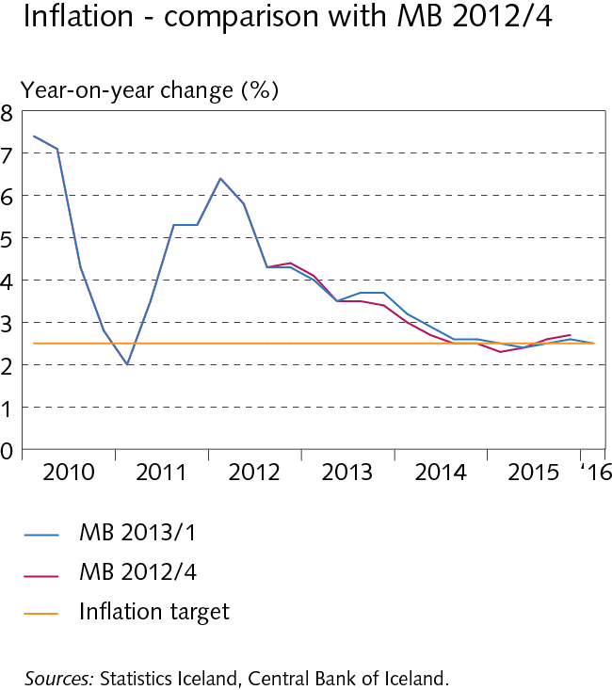
Baseline macroeconomic and inflation forecast

