Slide 1
Central Bank of Iceland
Financial stability 2013/1
Charts

Slide 2
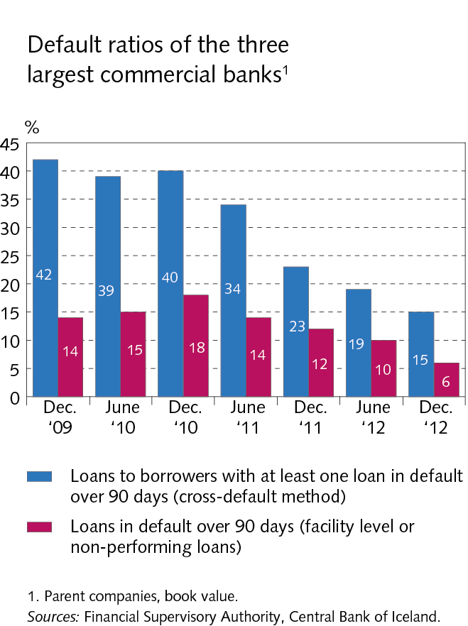
The financial system: outlook and major risks

Slide 3
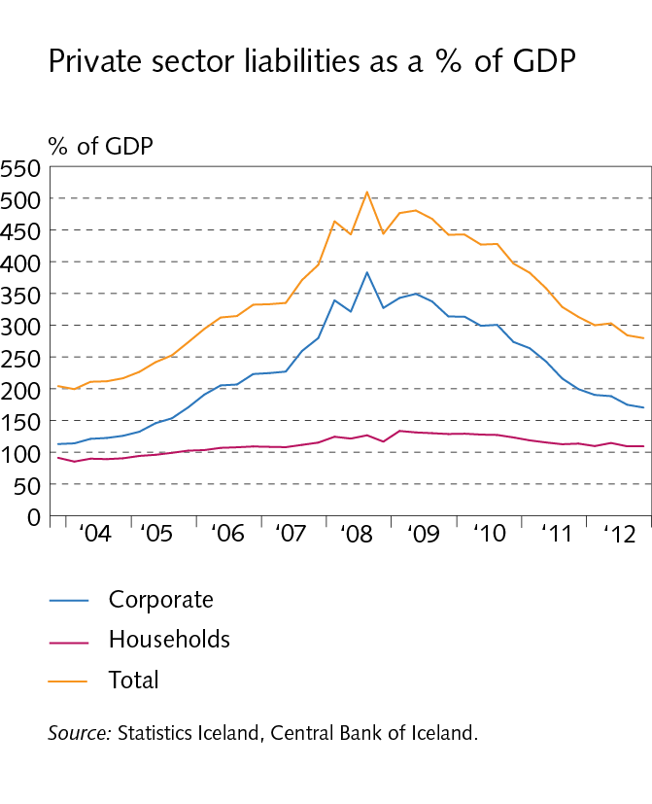
The financial system: outlook and major risks

Slide 4
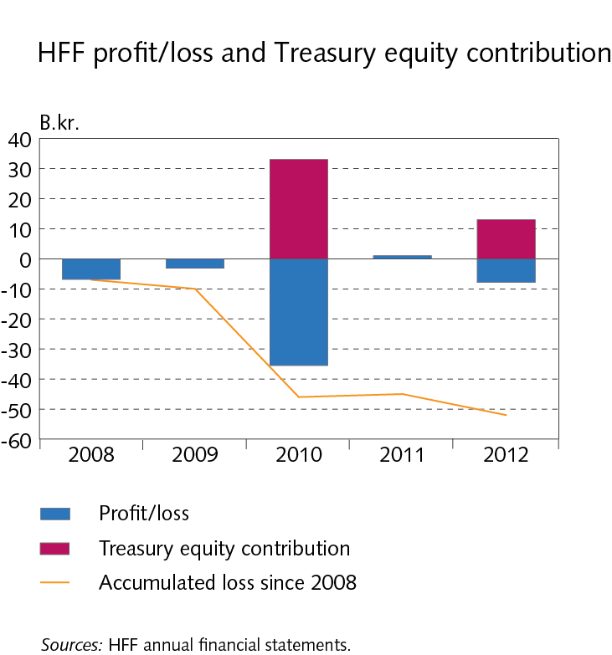
The financial system: outlook and major risks

Slide 5
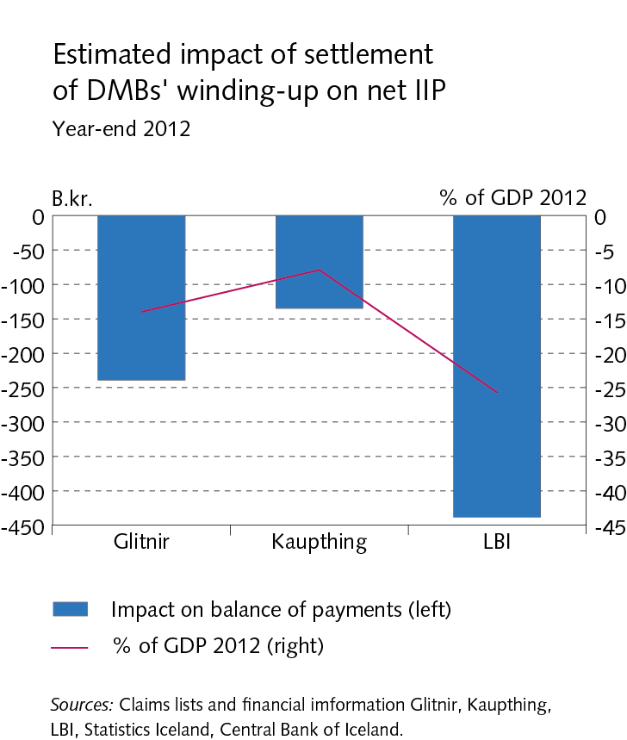
The financial system: outlook and major risks

Slide 6
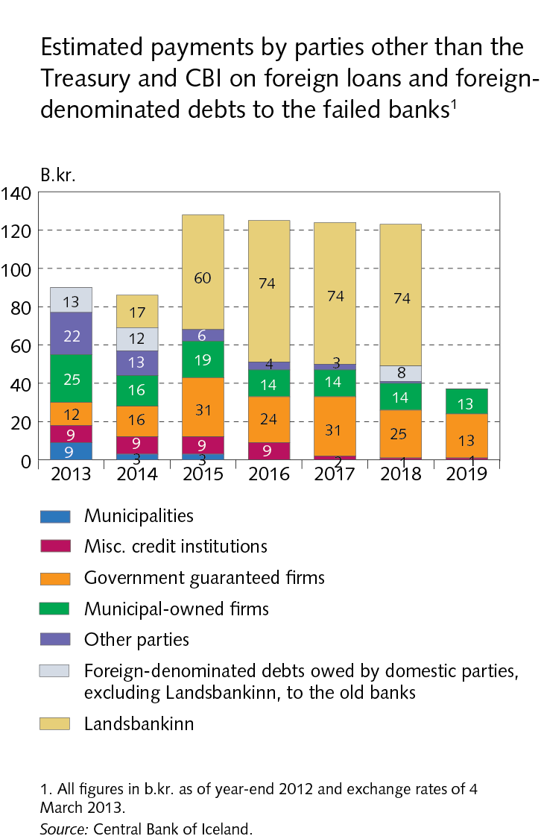
The financial system: outlook and major risks

Slide 7
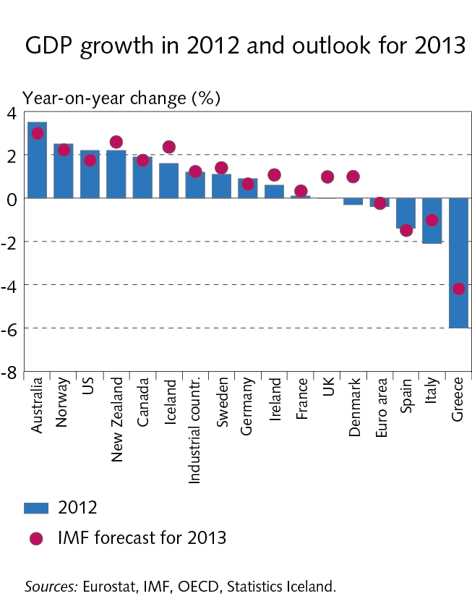
I Economic environment

Slide 8
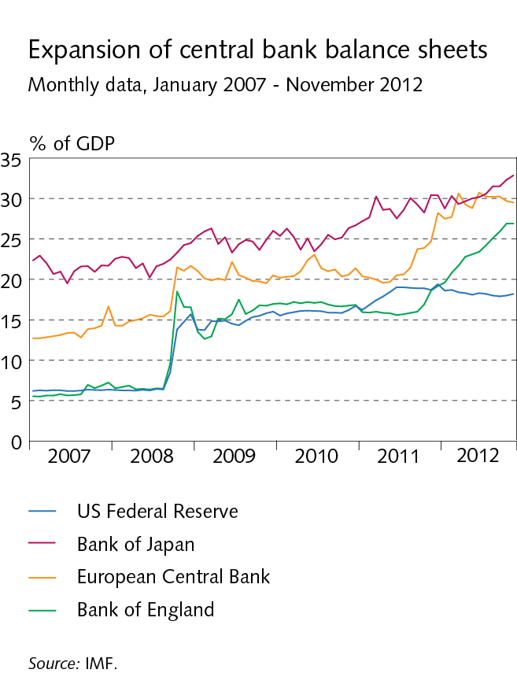
I Economic environment

Slide 9
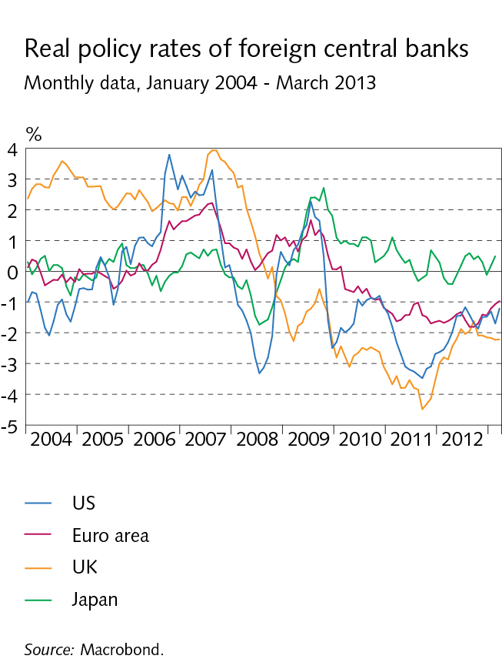
I Economic environment

Slide 10
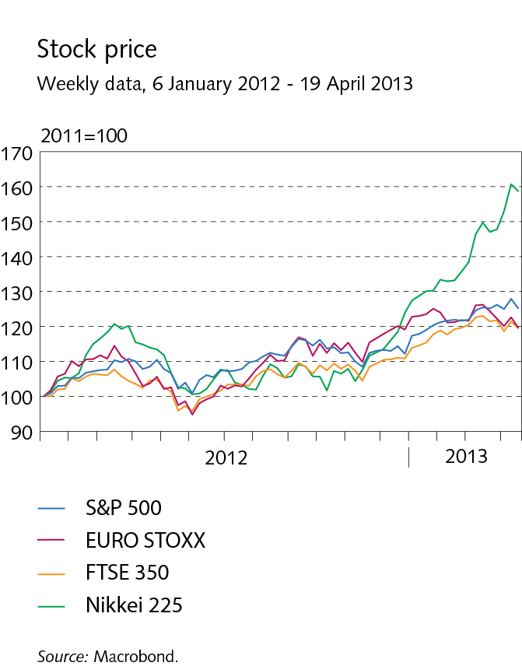
I Economic environment

Slide 11
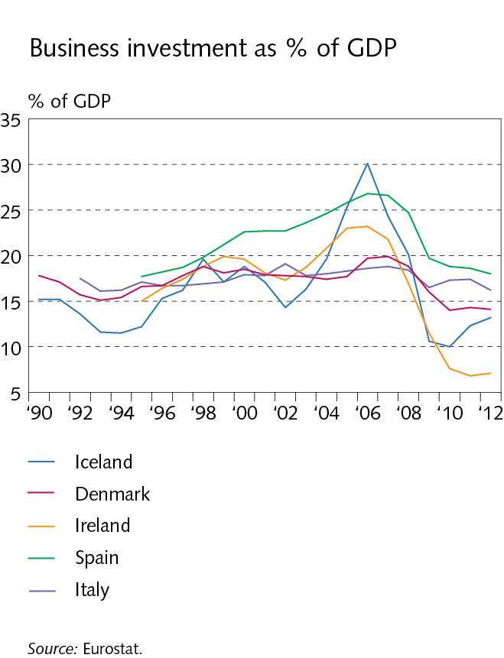
I Economic environment

Slide 12
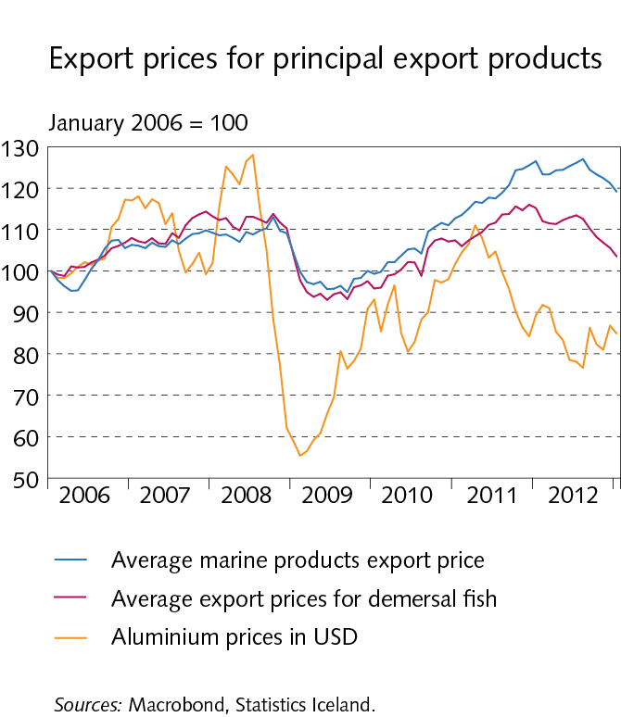
I Economic environment

Slide 13
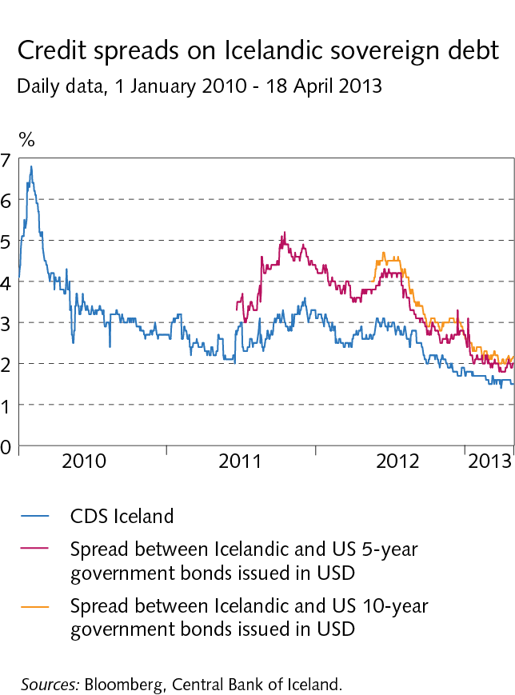
I Economic environment

Slide 14
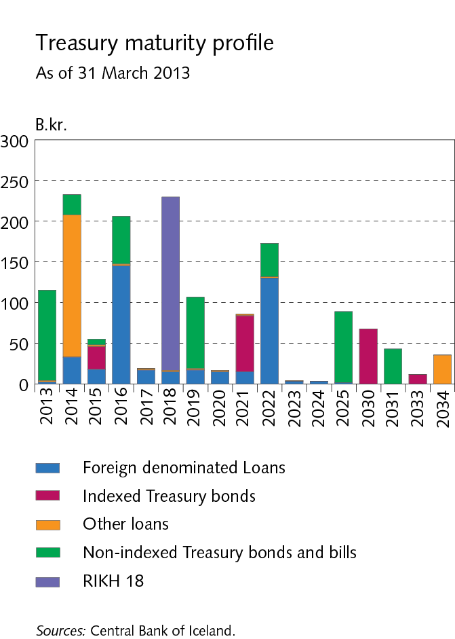
I Economic environment

Slide 15
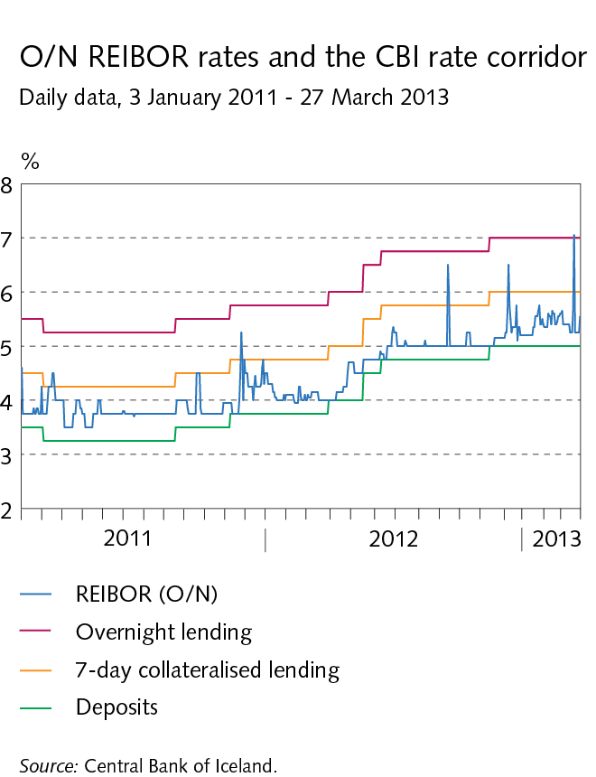
I Economic environment

Slide 16
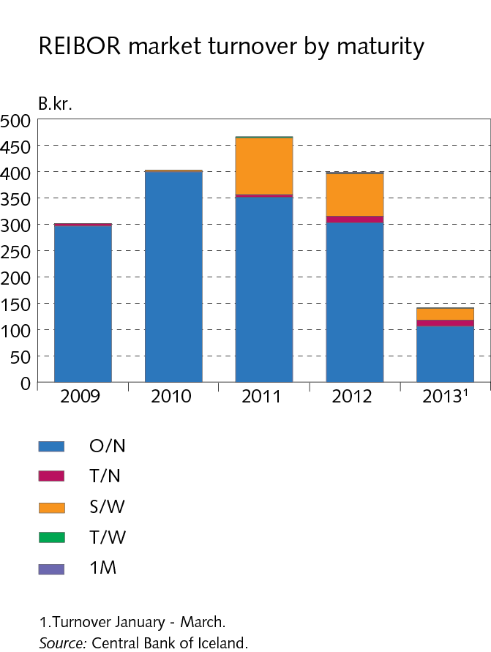
I Economic environment

Slide 17
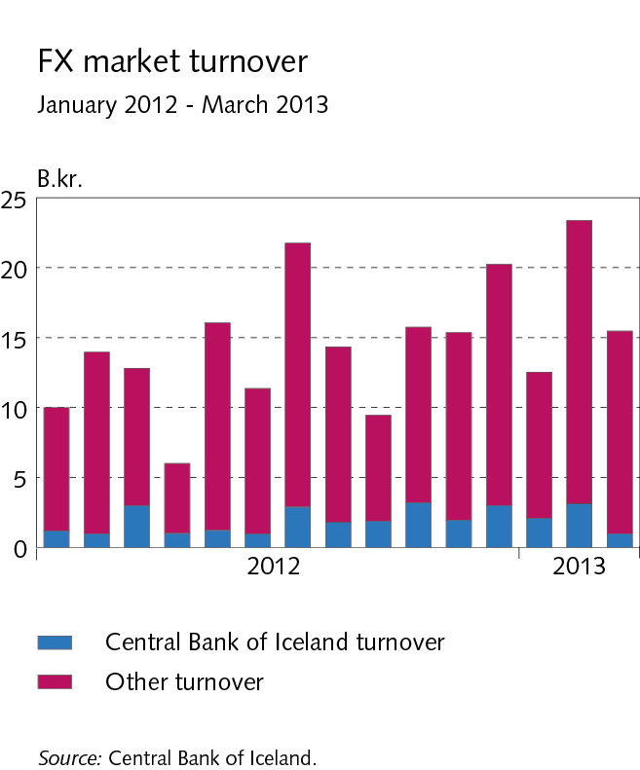
I Economic environment

Slide 18
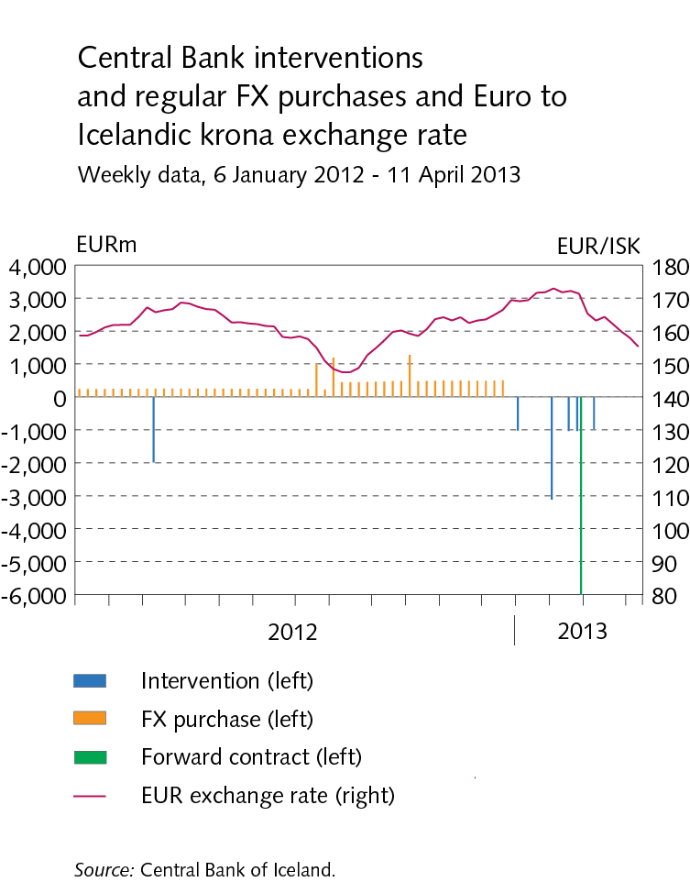
I Economic environment

Slide 19
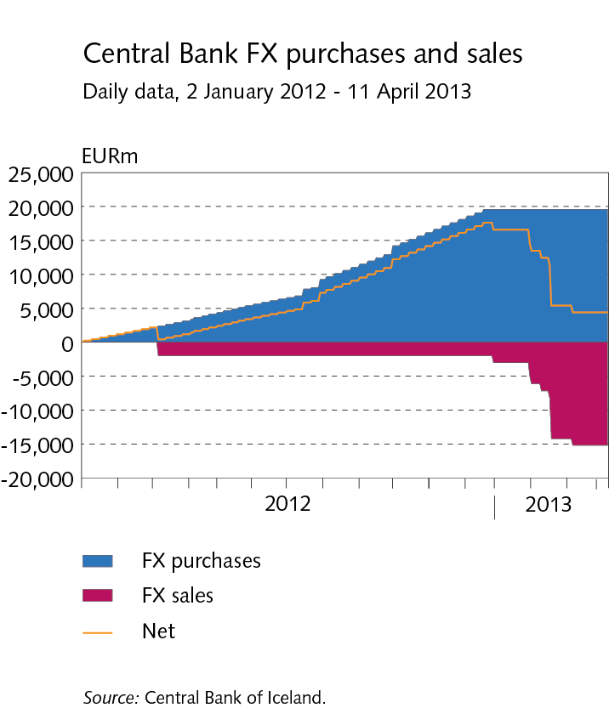
I Economic environment

Slide 20
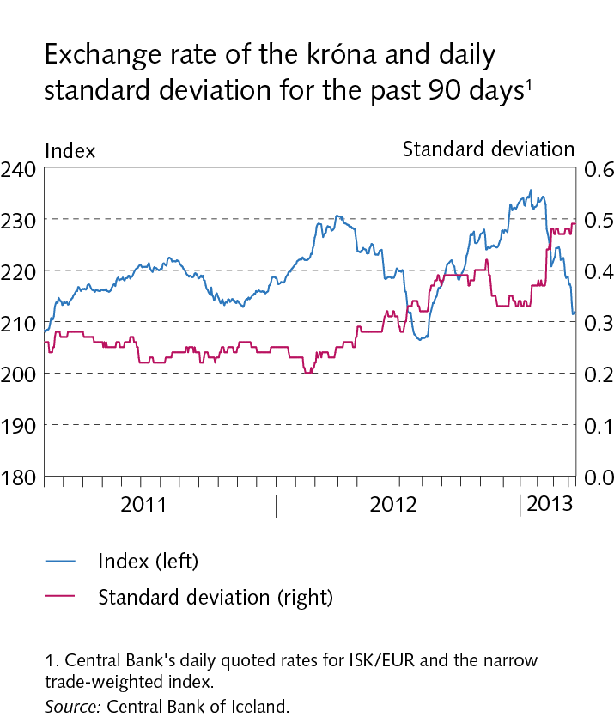
I Economic environment

Slide 21
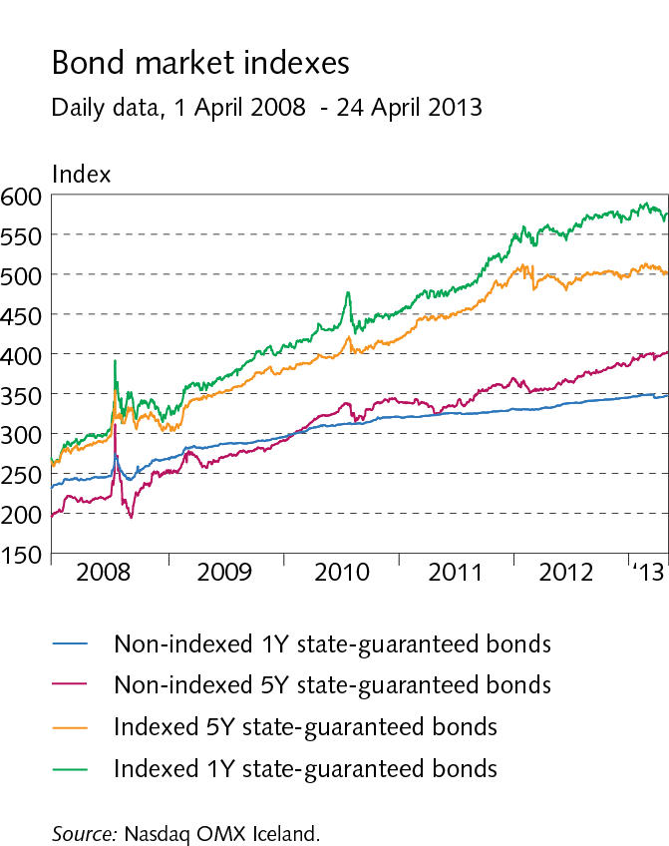
I Economic environment

Slide 22
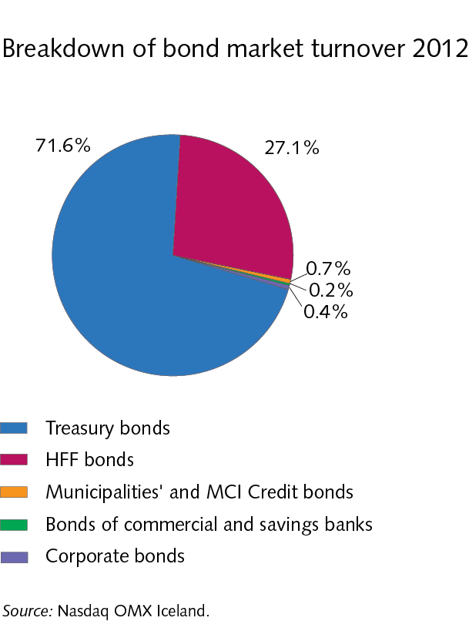
I Economic environment

Slide 23
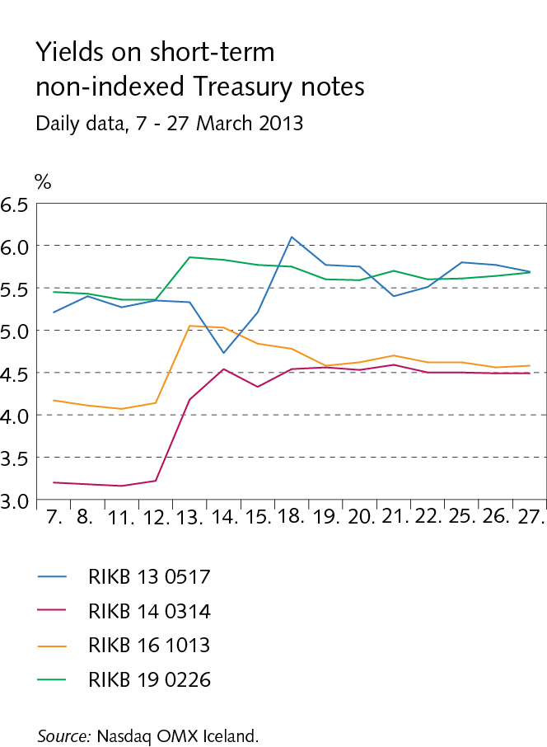
I Economic environment

Slide 24
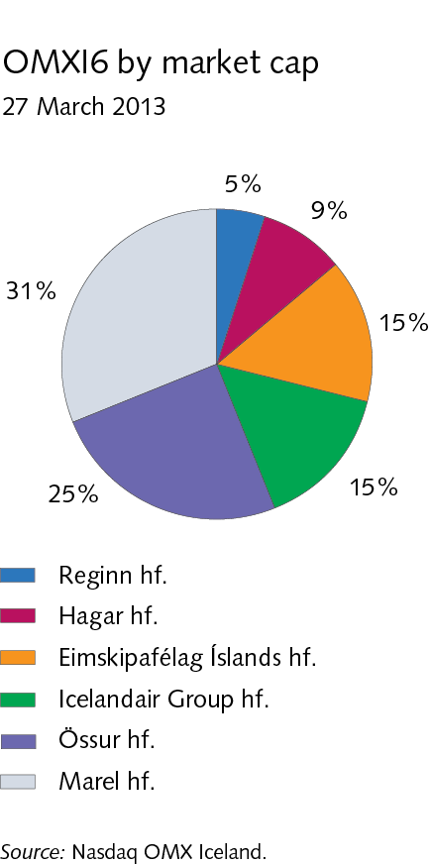
I Economic environment

Slide 25
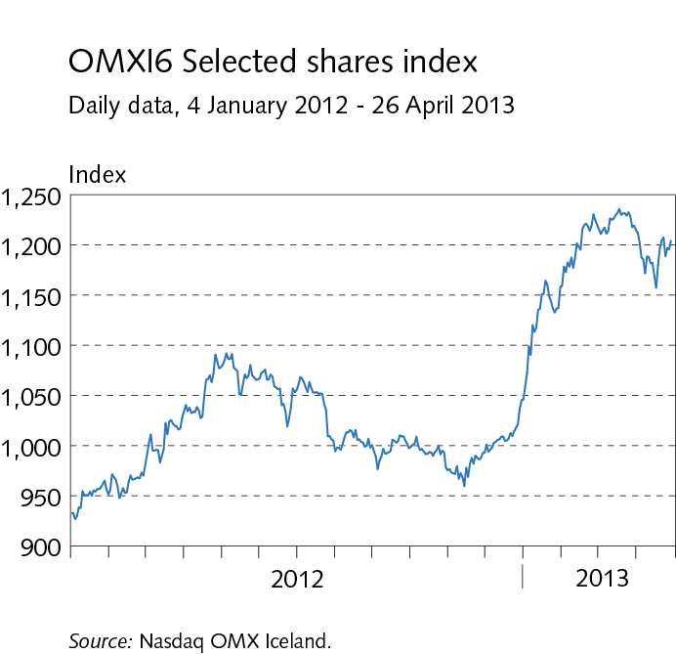
I Economic environment

Slide 26
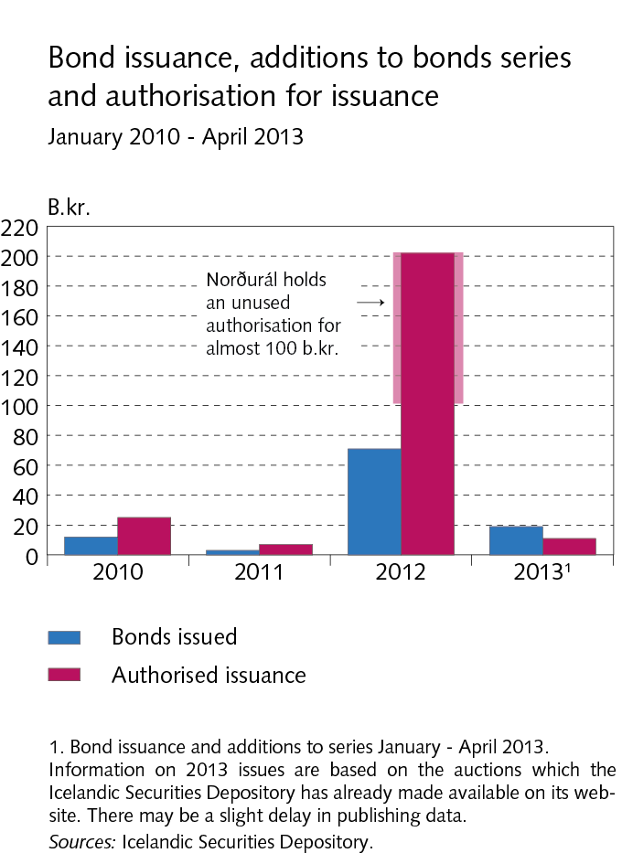
Box I-1 Corporate bond issuance

Slide 27
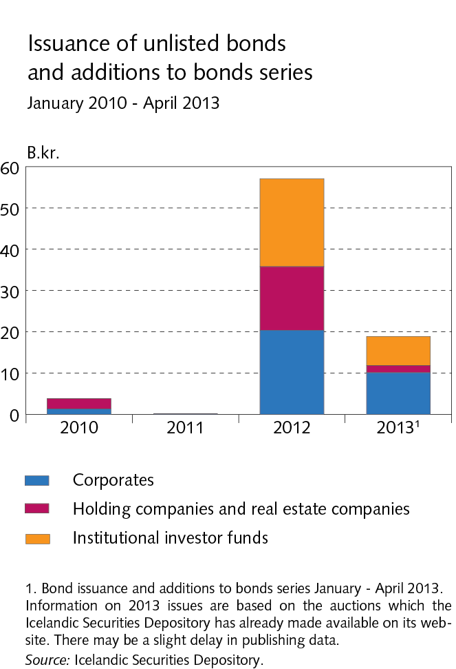
Box I-1 Corporate bond issuance

Slide 28
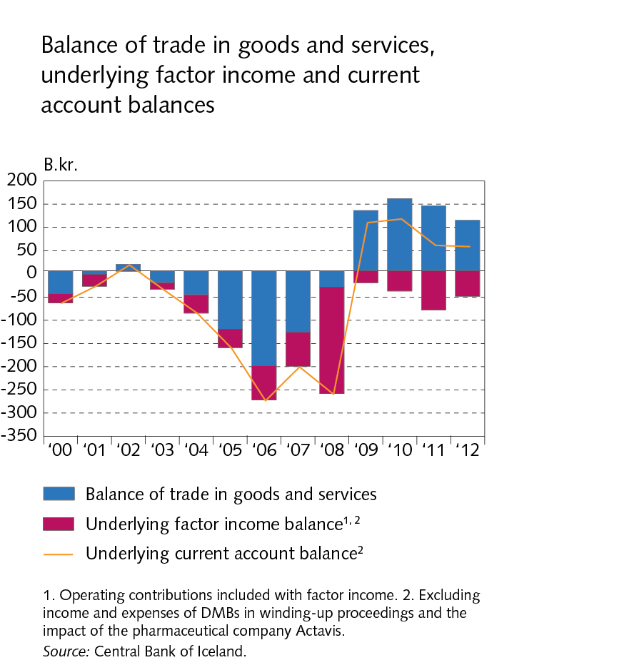
II External position

Slide 29
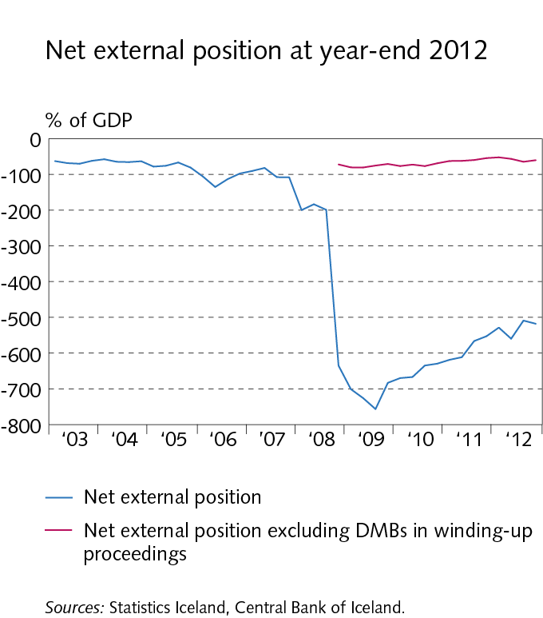
II External position

Slide 30
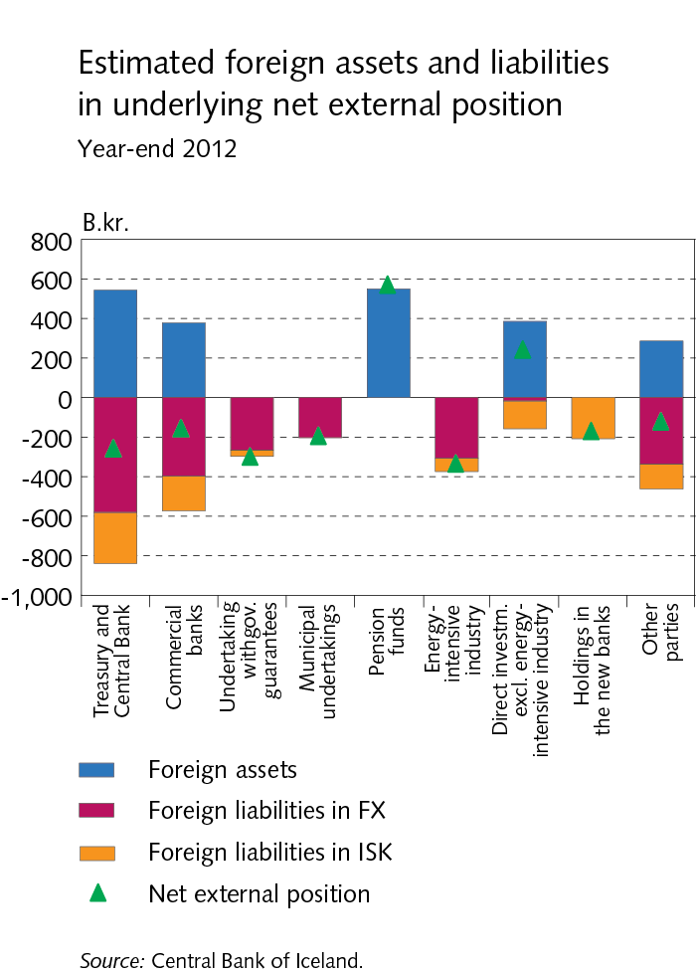
II External position

Slide 31
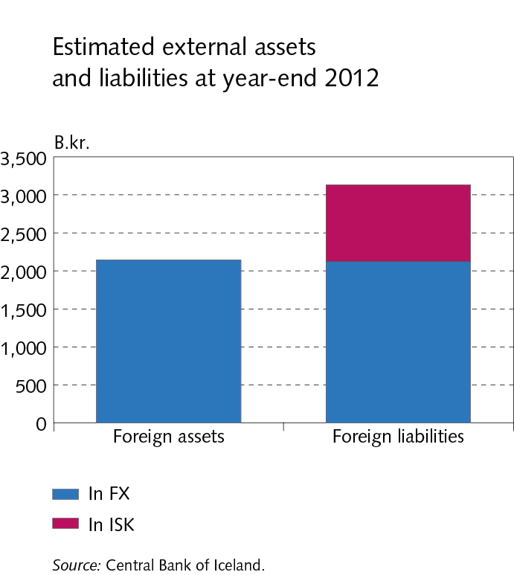
II External position

Slide 32
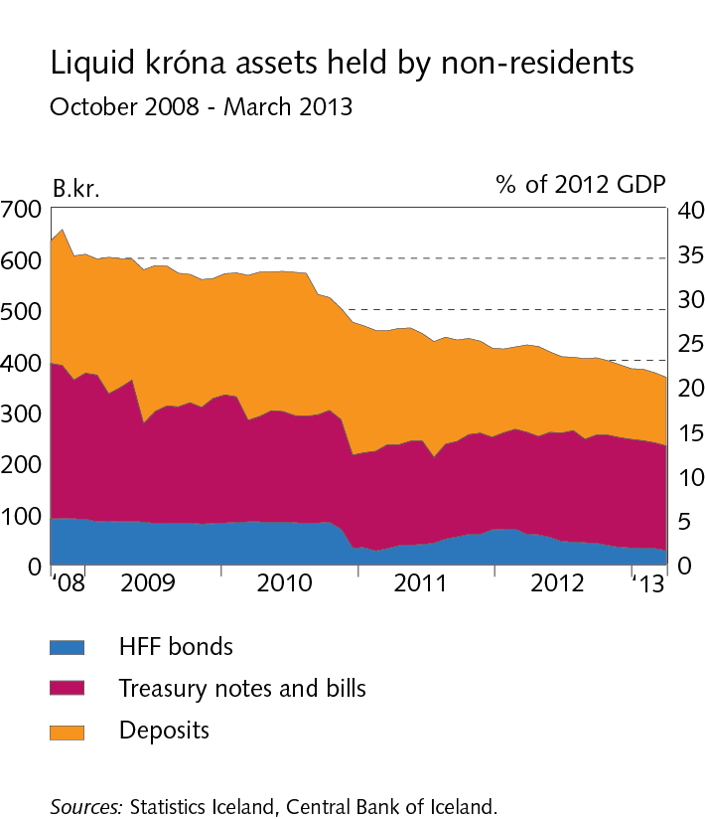
II External position

Slide 33
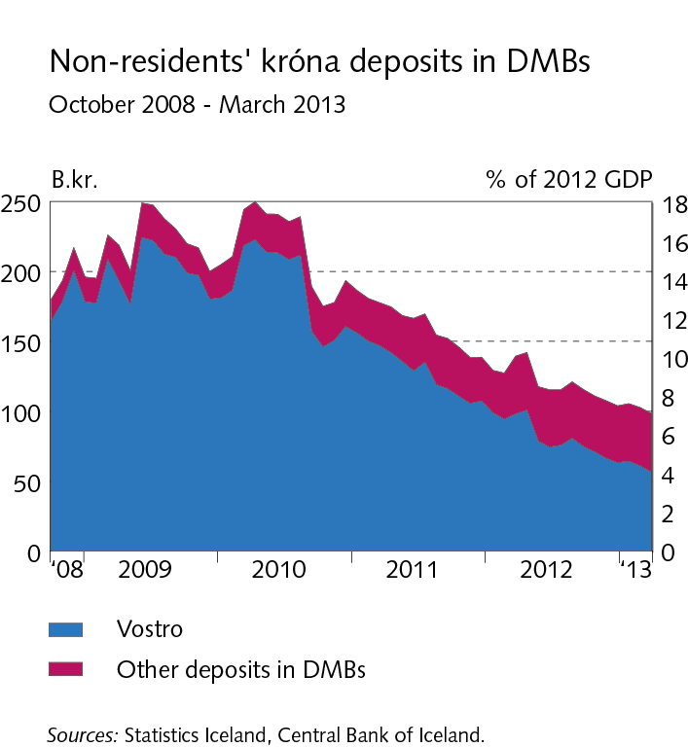
II External position

Slide 34
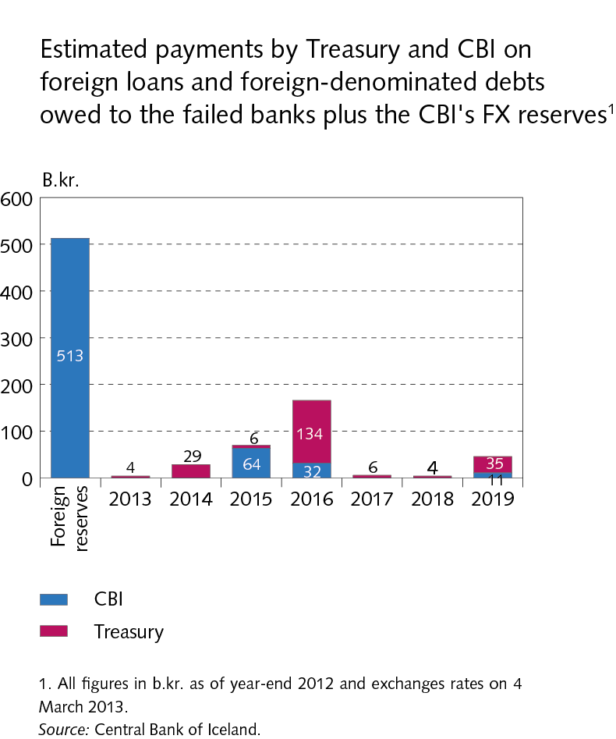
II External position

Slide 35
II External position

Slide 36
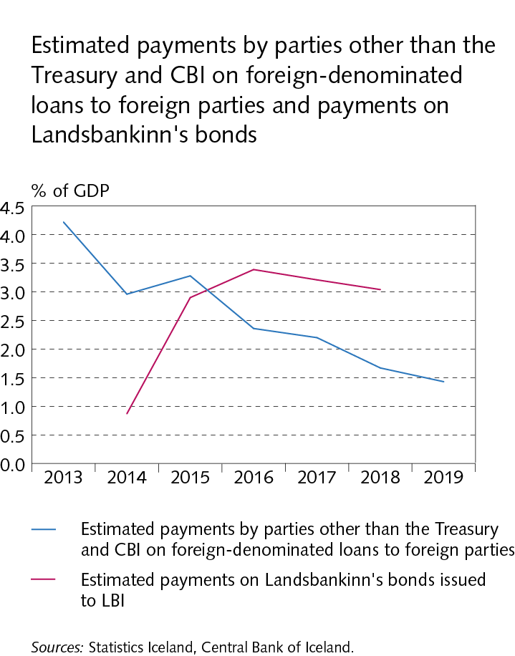
II External position

Slide 37
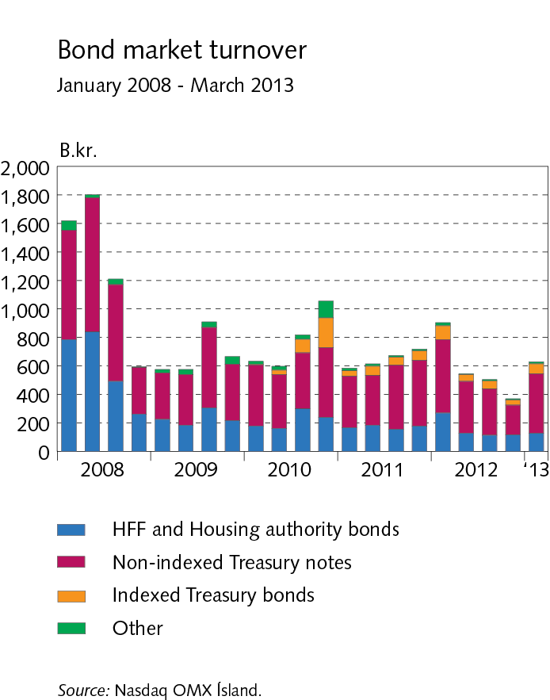
II External position

Slide 38
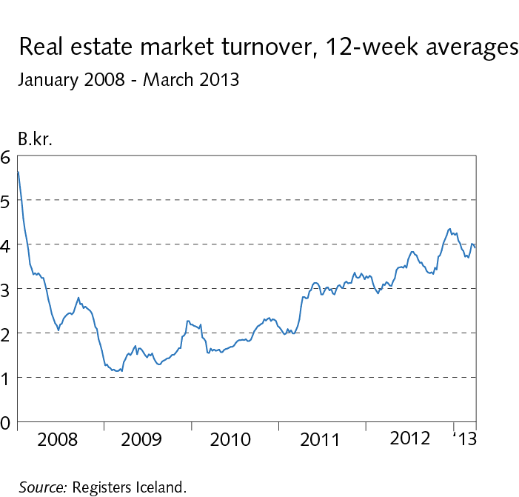
II External position

Slide 39
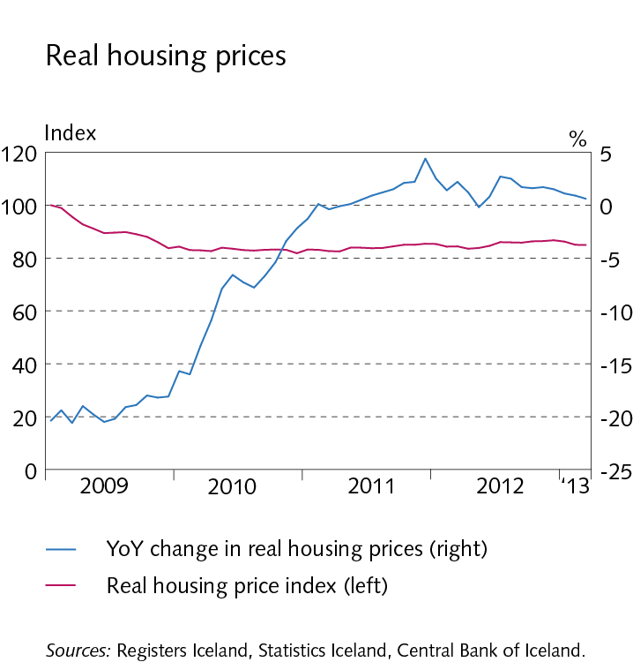
II External position

Slide 40
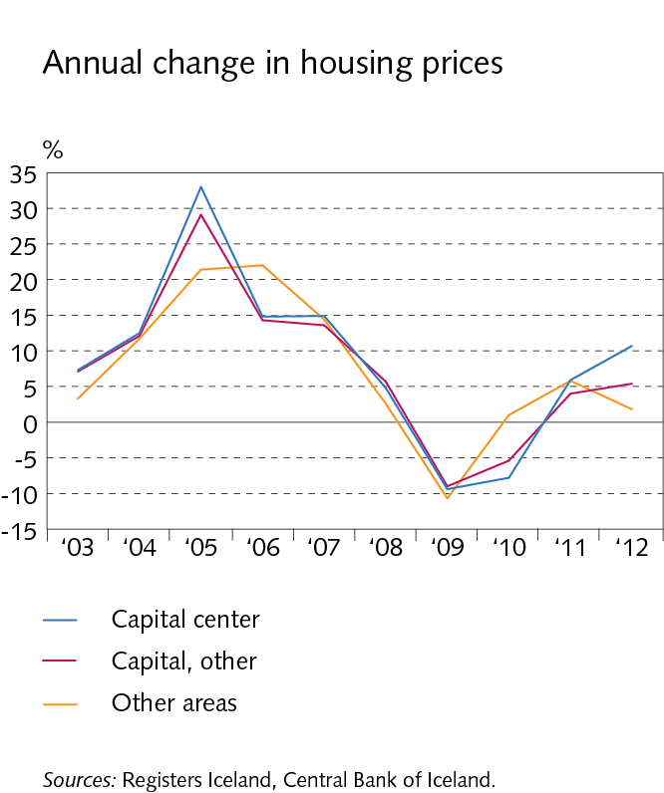
II External position

Slide 41
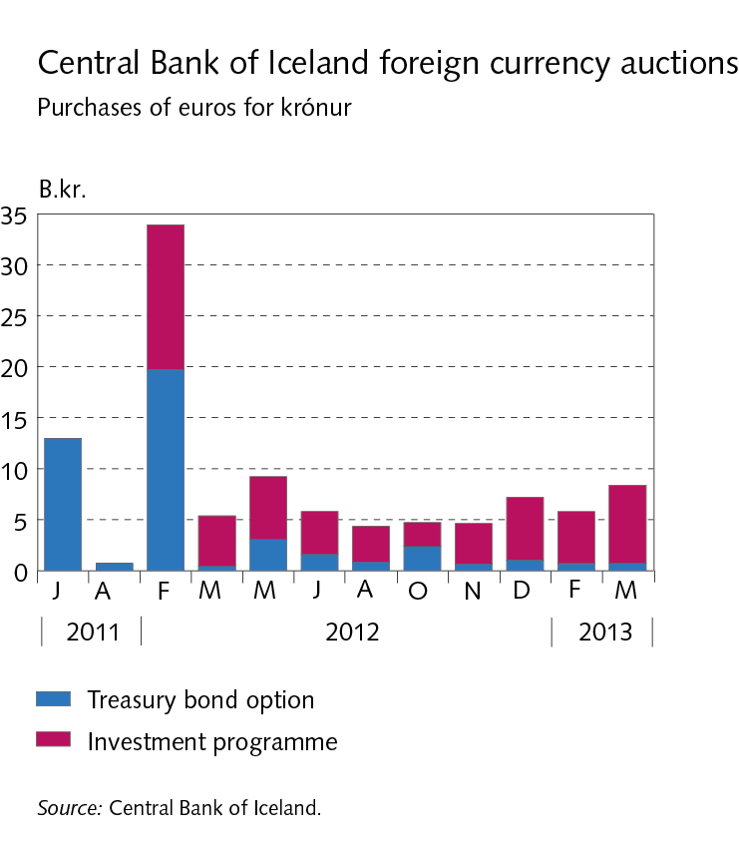
Box II-1 Central Bank’s foreign currency auctions

Slide 42
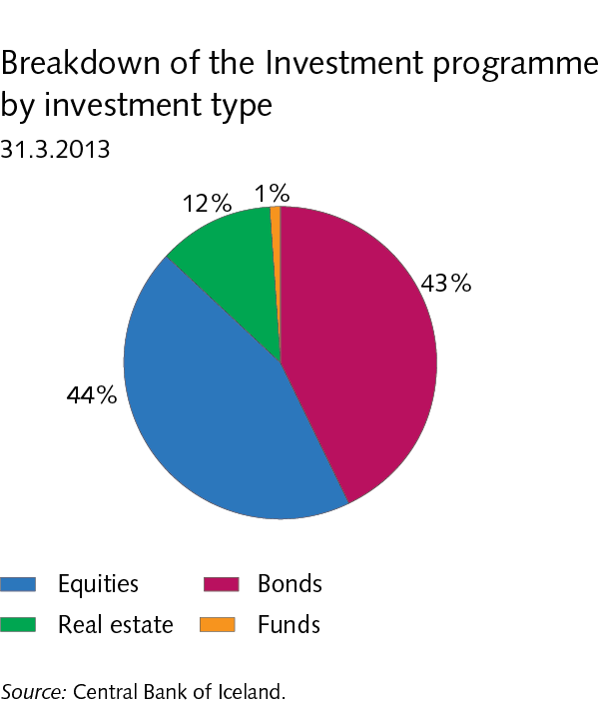
Box II-1 Central Bank’s foreign currency auctions

Slide 43
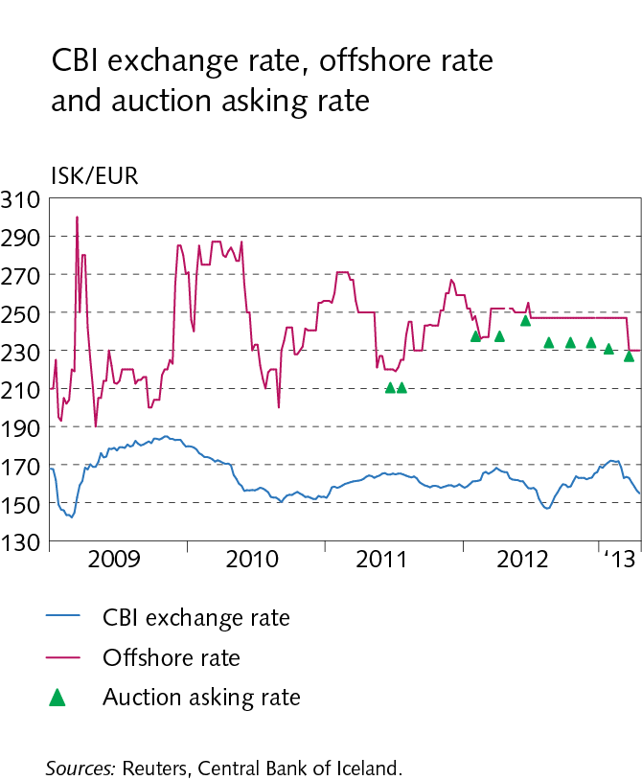
Box II-1 Central Bank’s foreign currency auctions

Slide 44
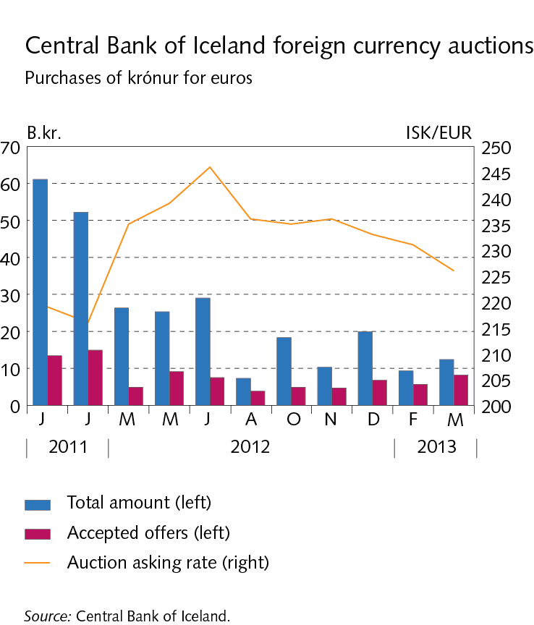
Box II-1 Central Bank’s foreign currency auctions

Slide 45
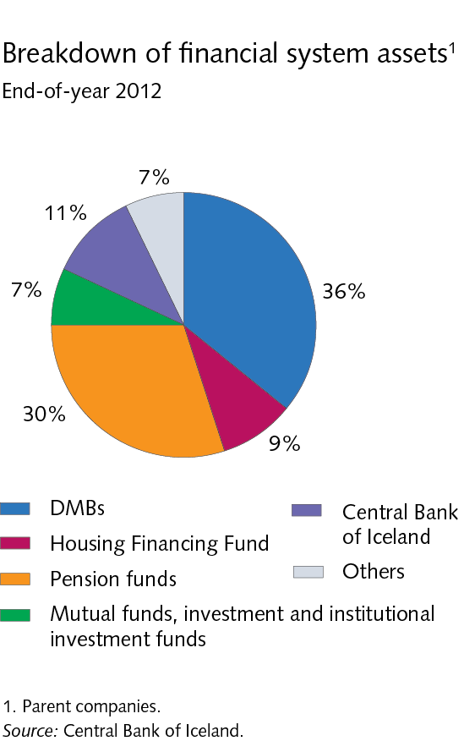
III Financial market entities

Slide 46
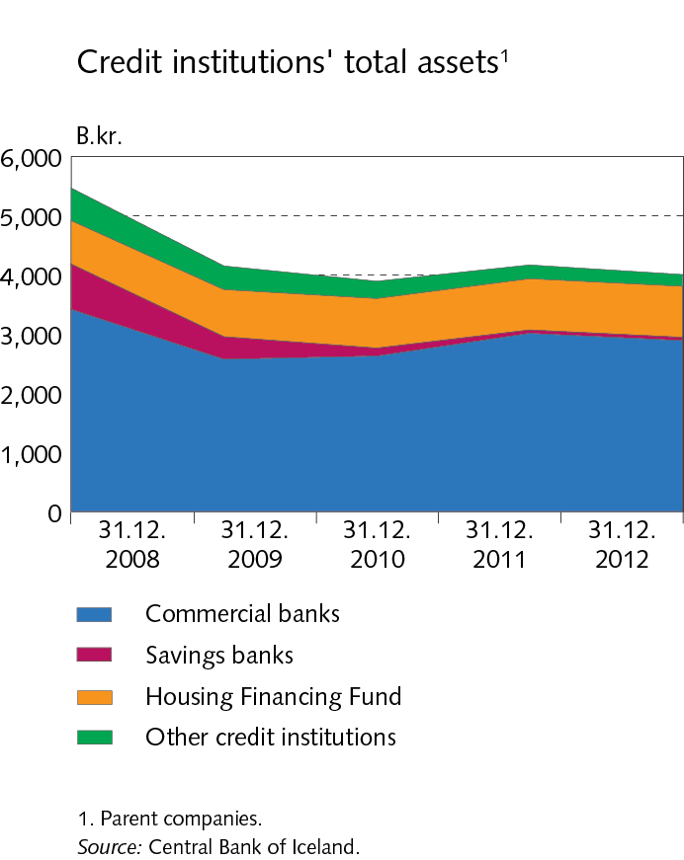
III Financial market entities

Slide 47
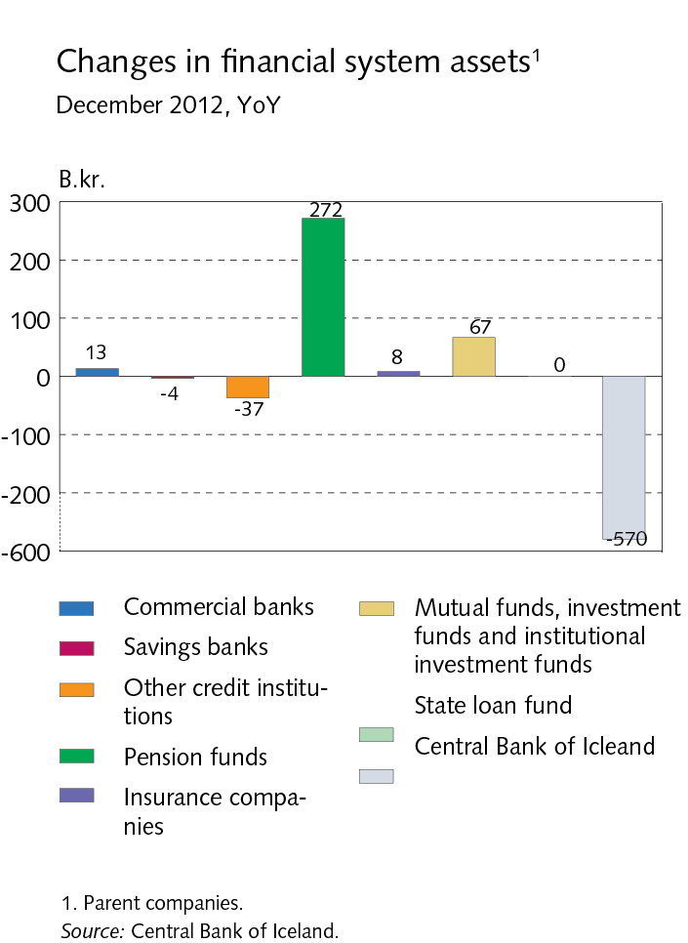
III Financial market entities

Slide 48
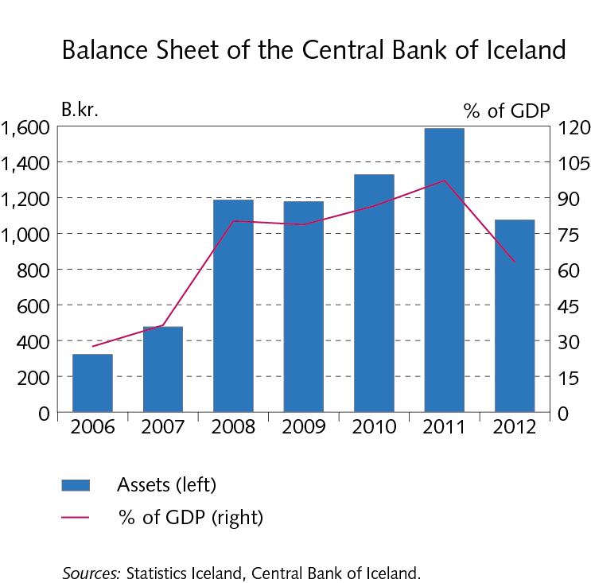
III Financial market entities

Slide 49
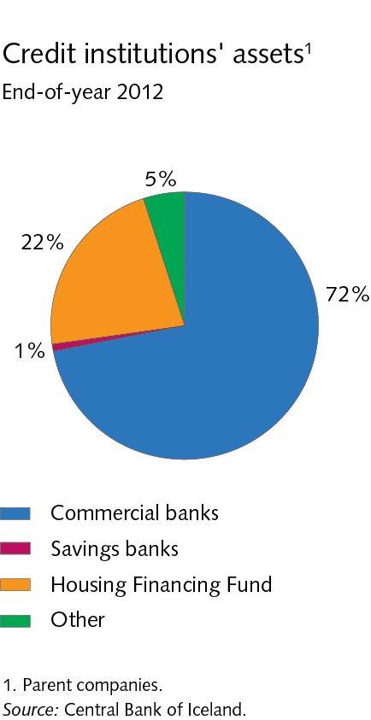
III Financial market entities

Slide 50
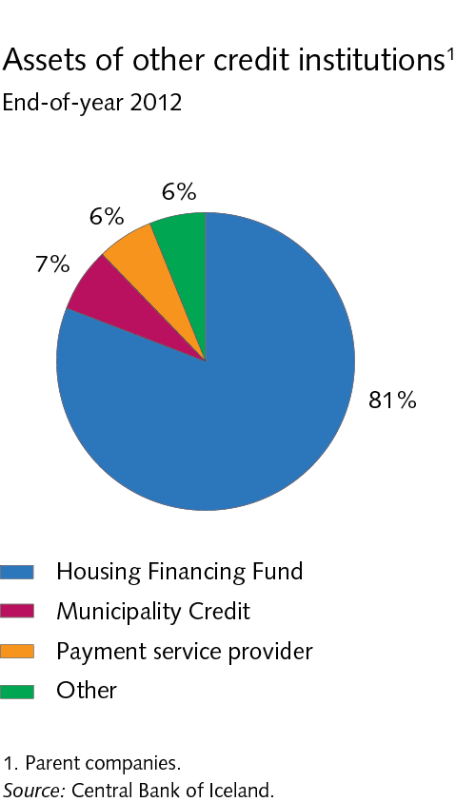
III Financial market entities

Slide 51
III Financial market entities

Slide 52
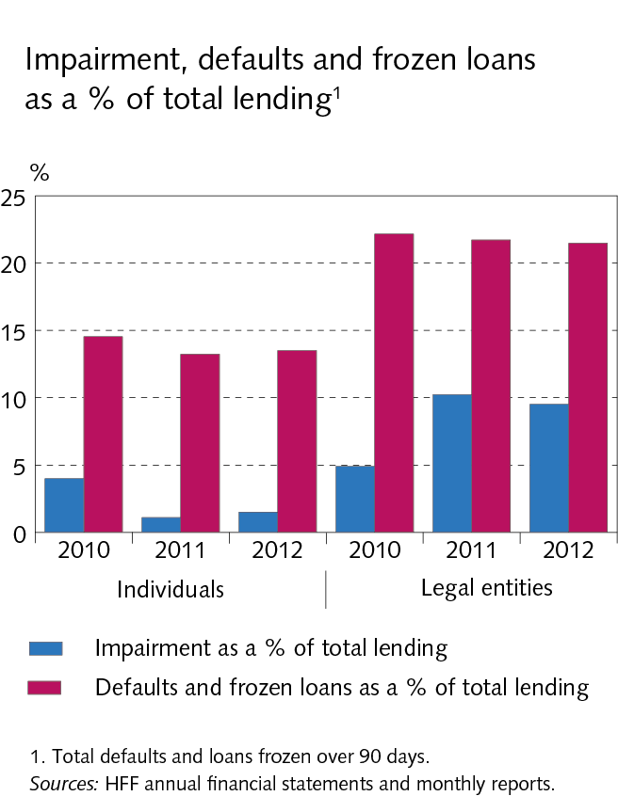
III Financial market entities

Slide 53
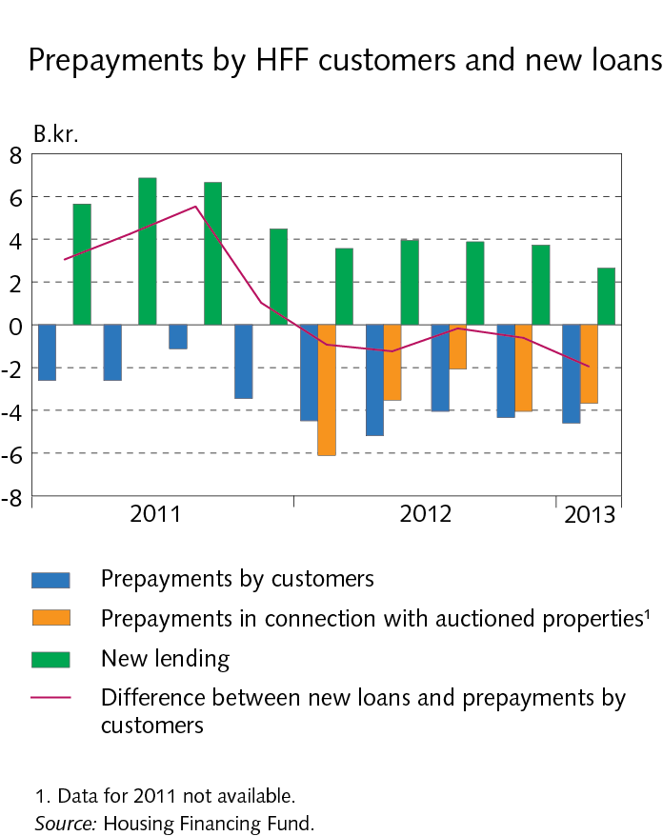
III Financial market entities

Slide 54
III Financial market entities

Slide 55
III Financial market entities

Slide 56
III Financial market entities

Slide 57
III Financial market entities

Slide 58
III Financial market entities

Slide 59
Box III-1 Housing Financing Fund

Slide 60
Box III-1 Housing Financing Fund

Slide 61
Box III-1 Housing Financing Fund

Slide 62
Box III-1 Housing Financing Fund

Slide 63
Box III-1 Housing Financing Fund

Slide 64
Box III-1 Housing Financing Fund

Slide 65
IV Assets of DMBs and borrowers’ situation

Slide 66
IV Assets of DMBs and borrowers’ situation

Slide 67
IV Assets of DMBs and borrowers’ situation

Slide 68
IV Assets of DMBs and borrowers’ situation

Slide 69
IV Assets of DMBs and borrowers’ situation

Slide 70
IV Assets of DMBs and borrowers’ situation

Slide 71
IV Assets of DMBs and borrowers’ situation

Slide 72
IV Assets of DMBs and borrowers’ situation

Slide 73
IV Assets of DMBs and borrowers’ situation

Slide 74
IV Assets of DMBs and borrowers’ situation

Slide 75
IV Assets of DMBs and borrowers’ situation

Slide 76
IV Assets of DMBs and borrowers’ situation

Slide 77
IV Assets of DMBs and borrowers’ situation

Slide 78
IV Assets of DMBs and borrowers’ situation

Slide 79
IV Assets of DMBs and borrowers’ situation

Slide 80
IV Assets of DMBs and borrowers’ situation

Slide 81
IV Assets of DMBs and borrowers’ situation

Slide 82
IV Assets of DMBs and borrowers’ situation

Slide 83
IV Assets of DMBs and borrowers’ situation

Slide 84
IV Assets of DMBs and borrowers’ situation

Slide 85
IV Assets of DMBs and borrowers’ situation

Slide 86
IV Assets of DMBs and borrowers’ situation

Slide 87
IV Assets of DMBs and borrowers’ situation

Slide 88
IV Assets of DMBs and borrowers’ situation

Slide 89
IV Assets of DMBs and borrowers’ situation

Slide 90
IV Assets of DMBs and borrowers’ situation

Slide 91
IV Assets of DMBs and borrowers’ situation

Slide 92
IV Assets of DMBs and borrowers’ situation

Slide 93
IV Assets of DMBs and borrowers’ situation

Slide 94
IV Assets of DMBs and borrowers’ situation

Slide 95
IV Assets of DMBs and borrowers’ situation

Slide 96
IV Assets of DMBs and borrowers’ situation

Slide 97
IV Assets of DMBs and borrowers’ situation

Slide 98
IV Assets of DMBs and borrowers’ situation

Slide 99
IV Assets of DMBs and borrowers´ situation

Slide 100
IV Assets of DMBs and borrowers’ situation

Slide 101
IV Assets of DMBs and borrowers’ situation

Slide 102
IV Assets of DMBs and borrowers’ situation

Slide 103
Box IV-1 Housing mortgages: Non-indexed vs. indexed

Slide 104
Box IV-1 Housing mortgages: Non-indexed vs. indexed

Slide 105
Box IV-1 Housing mortgages: Non-indexed vs. indexed

Slide 106
Box IV-1 Housing mortgages: Non-indexed vs. indexed

Slide 107
Box IV-1 Housing mortgages: Non-indexed vs. indexed

Slide 108
Box IV-1 Housing mortgages: Non-indexed vs. indexed

Slide 109
Box IV-1 Housing mortgages: Non-indexed vs. indexed

Slide 110
Box IV-2 Debt, income and debt service based on tax returns

Slide 111
Box IV-2 Debt, income and debt service based on tax returns

Slide 112
Box IV-2 Debt, income and debt service based on tax returns

Slide 113
Box IV-2 Debt, income and debt service based on tax returns

Slide 114
Box IV-2 Debt, income and debt service based on tax returns

Slide 115
Box IV-2 Debt, income and debt service based on tax returns

Slide 116
Box IV-2 Debt, income and debt service based on tax returns

Slide 117
Box IV-2 Debt, income and debt service based on tax returns

Slide 118
Box IV-2 Debt, income and debt service based on tax returns

Slide 119
Box IV-2 Debt, income and debt service based on tax returns

Slide 120
Box IV-2 Debt, income and debt service based on tax returns

Slide 121
Box IV-2 Debt, income and debt service based on tax returns

Slide 122
Box IV-2 Debt, income and debt service based on tax returns

Slide 123
V Funding and liquid funds

Slide 124
V Funding and liquid funds

Slide 125
V Funding and liquid funds

Slide 126
V Funding and liquid funds

Slide 127
V Funding and liquid funds

Slide 128
V Funding and liquid funds

Slide 129
V Funding and liquid funds

Slide 130
V Funding and liquid funds

Slide 131
Box V-1 New liquidity rules

Slide 132
VI Operations and equity

Slide 133
VI Operations and equity

Slide 134
VI Operations and equity

Slide 135
VI Operations and equity

Slide 136
VI Operations and equity

Slide 137
VI Operations and equity

Slide 138
VI Operations and equity

Slide 139
VI Operations and equity

Slide 140
VI Operations and equity

Slide 141
VI Operations and equity

Slide 142
Box VI-1 Indexation imbalance

Slide 143
Box VI-1 Indexation imbalance

Slide 144
Box VI-2 Countercyclical capital buffer

Slide 145
Box VI-2 Countercyclical capital buffer

Slide 146
Box VI-2 Countercyclical capital buffer

Slide 147
Box VI-2 Countercyclical capital buffer

Slide 148
Box VI-2 Countercyclical capital buffer

Slide 149
Box VI-2 Countercyclical capital buffer

Slide 150
Box VI-2 Countercyclical capital buffer

Slide 151
VII Settlement of the failed banks’ estates

Slide 152
VII Settlement of the failed banks’ estates

Slide 153
VII Settlement of the failed banks’ estates

Slide 154
VII Settlement of the failed banks’ estates

Slide 155
VII Settlement of the failed banks’ estates

Slide 156
VII Settlement of the failed banks’ estates

Slide 157
VII Settlement of the failed banks’ estates

Slide 158
VII Settlement of the failed banks’ estates

Slide 159
VII Settlement of the failed banks’ estates

Slide 160
Box VII-1 Claims on the failed banks, disbursements and the amount of outstanding claims

Slide 161
Box VII-2 Smaller financial undertakings in winding-up proceedings

Slide 162
Appendix I Nordic comparison

Slide 163
Appendix I Nordic comparison

Slide 164
Appendix I Nordic comparison

Slide 165
Appendix I Nordic comparison

Slide 166
Appendix I Nordic comparison

Slide 167
Appendix I Nordic comparison

