Slide 1
Central Bank of Iceland
Financial Stability report 2016/1
Charts

Slide 2
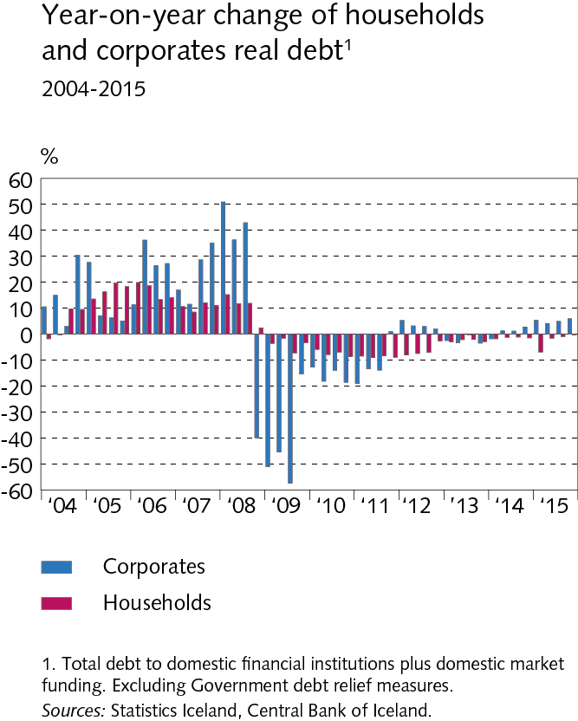
Outlook and key risks

Slide 3
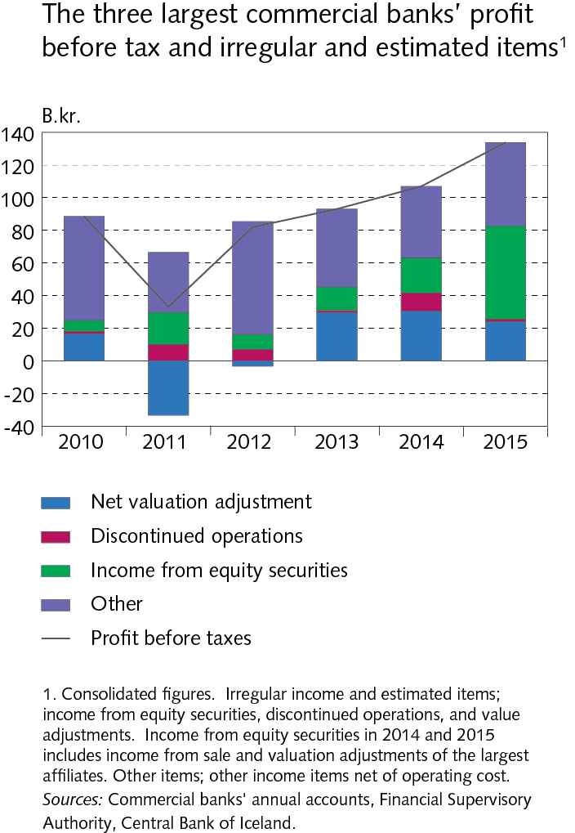
Outlook and key risks

Slide 4
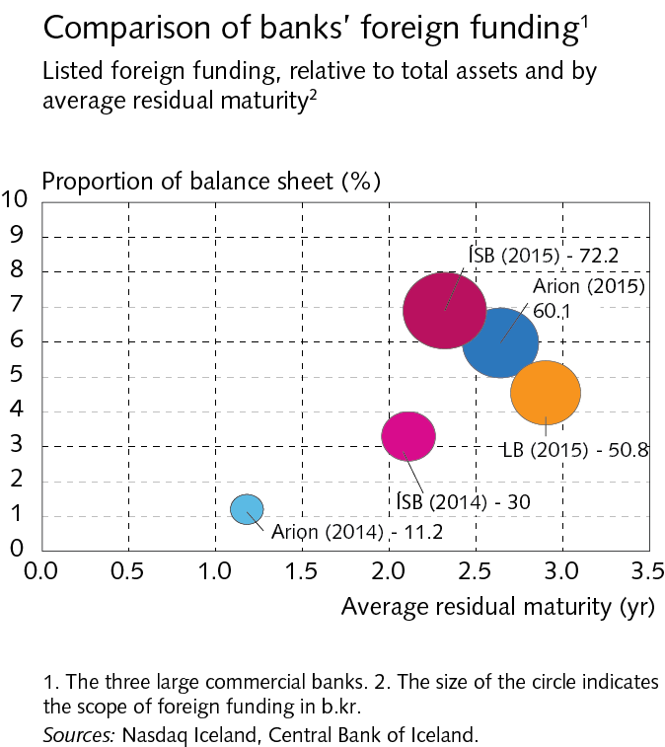
Outlook and key risks

Slide 5
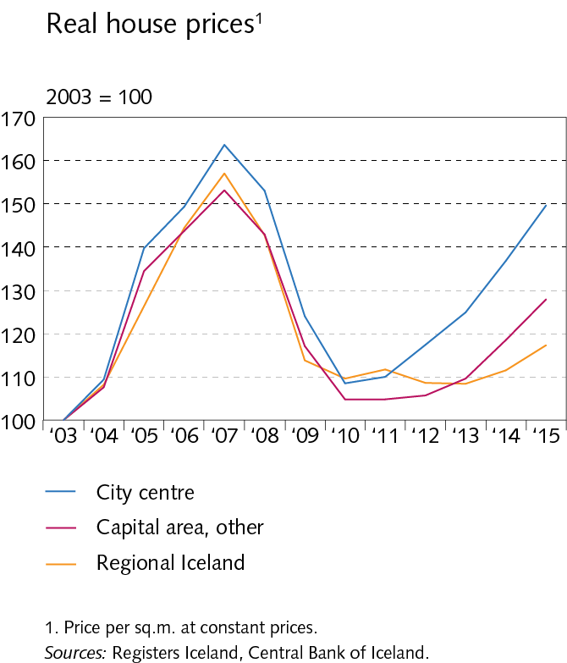
Outlook and key risks

Slide 6
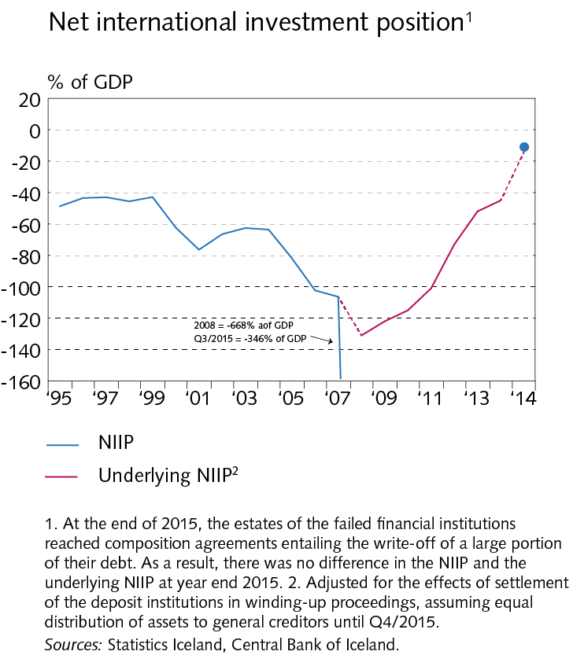
Outlook and key risks

Slide 7
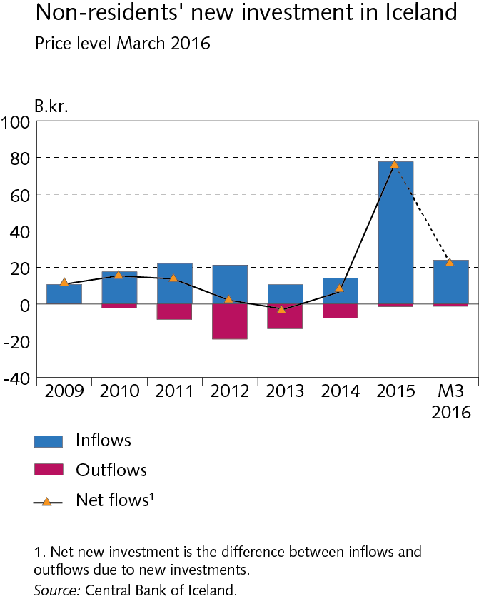
Outlook and key risks

Slide 8
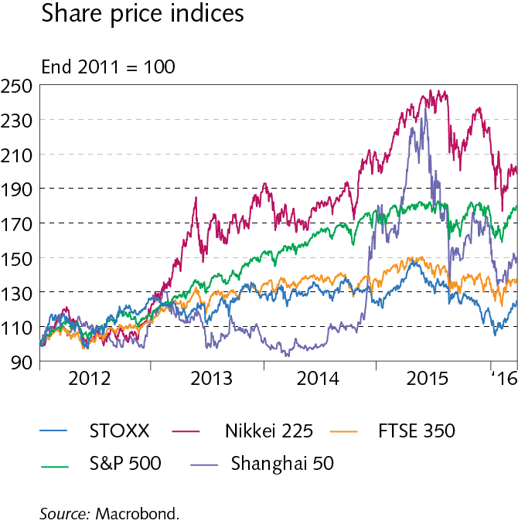
I Economic environment

Slide 9
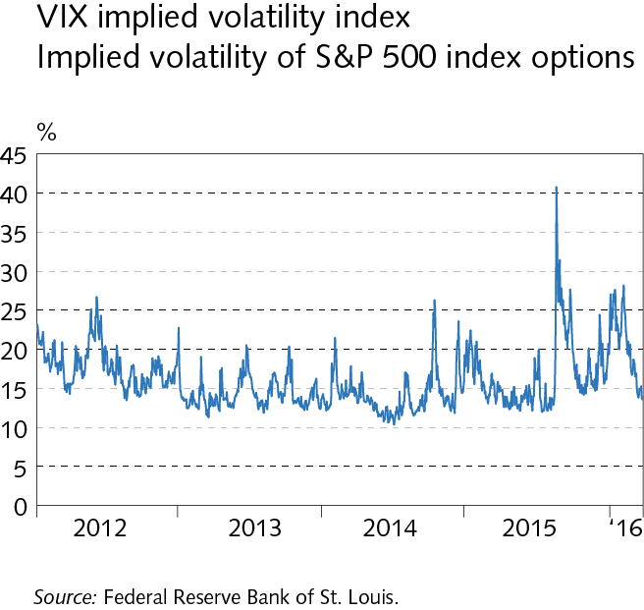
I Economic environment

Slide 10
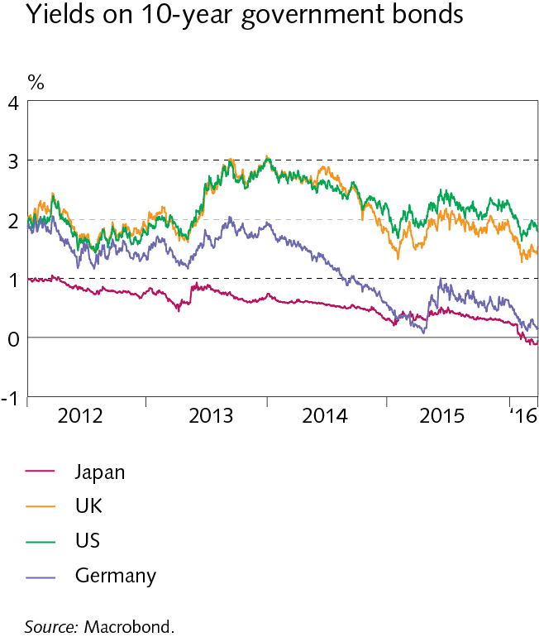
I Economic environment

Slide 11
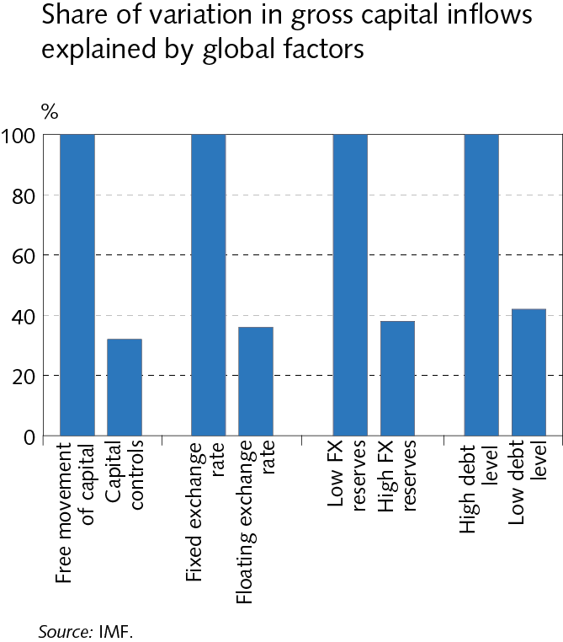
I Economic environment

Slide 12
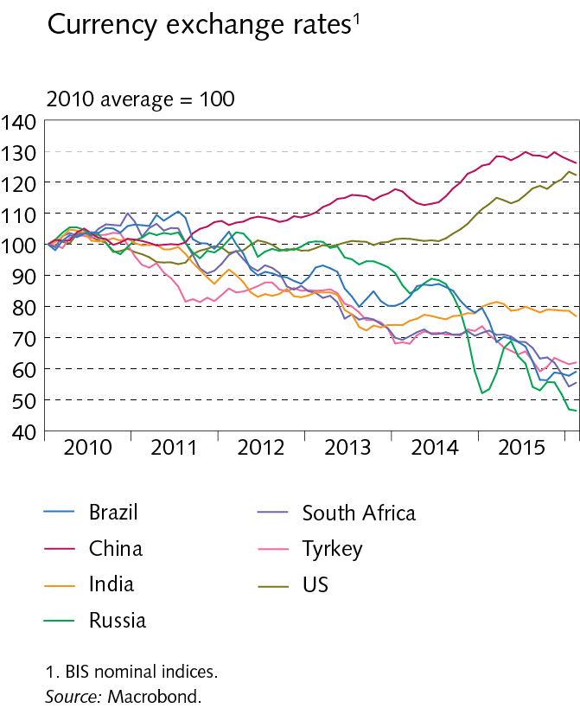
I Economic environment

Slide 13
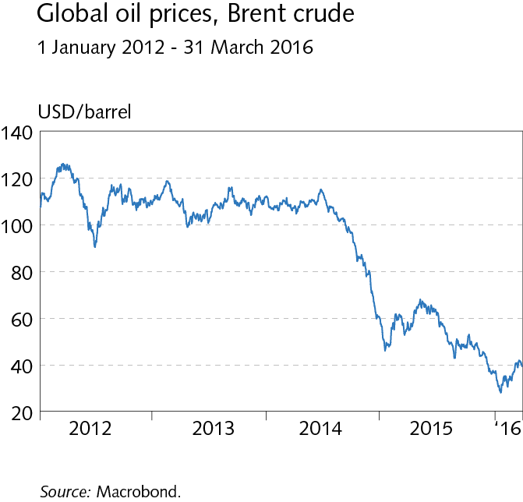
I Economic environment

Slide 14
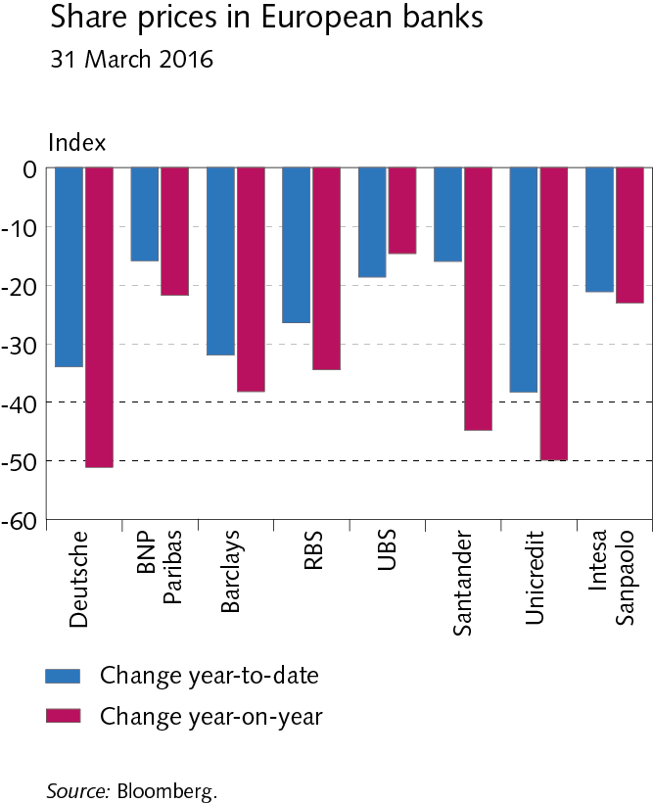
I Economic environment

Slide 15
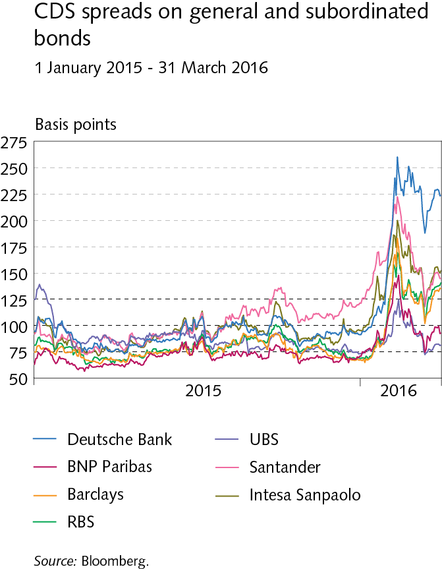
I Economic environment

Slide 16
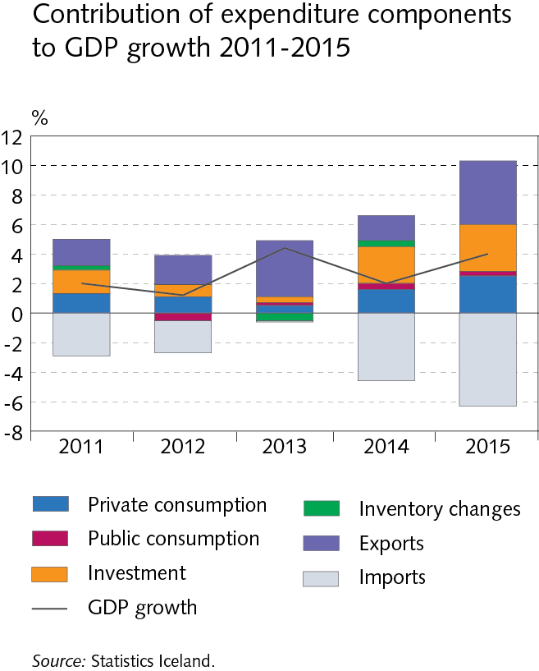
I Economic environment

Slide 17
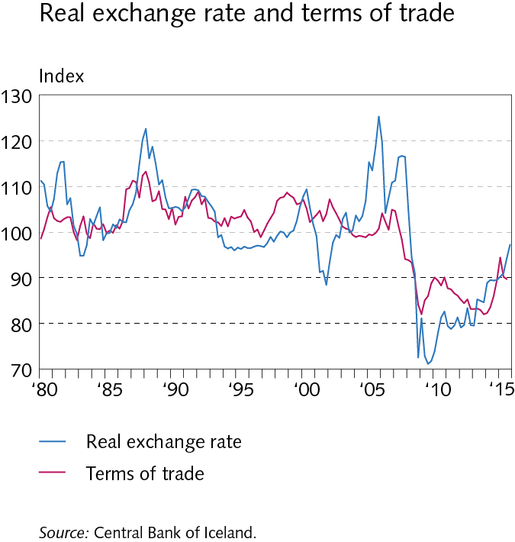
I Economic environment

Slide 18
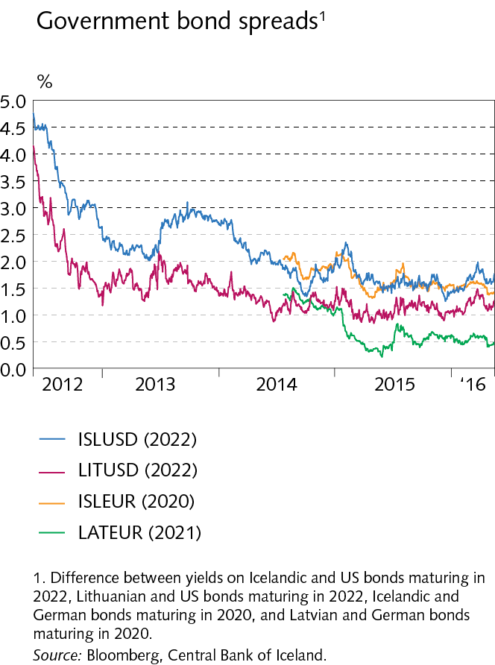
I Economic environment

Slide 19
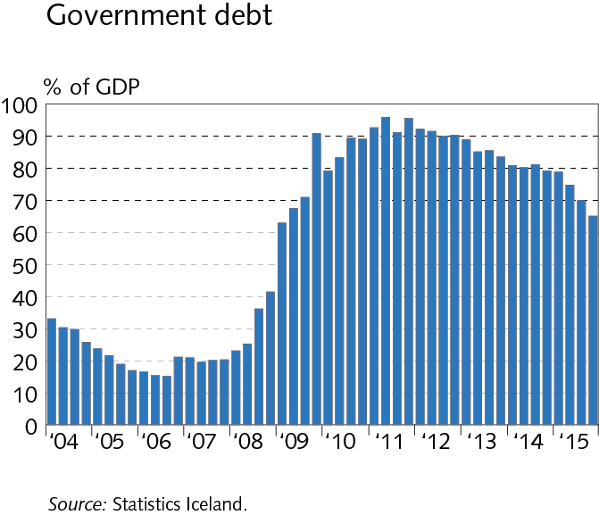
I Economic environment

Slide 20
I Economic environment

Slide 21
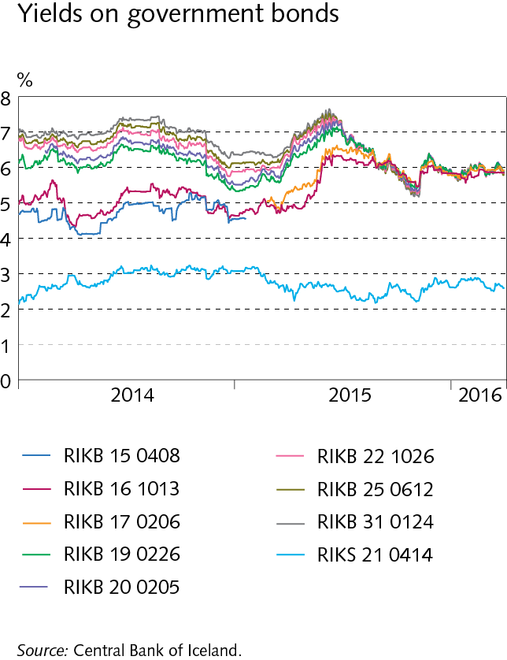
I Economic environment

Slide 22
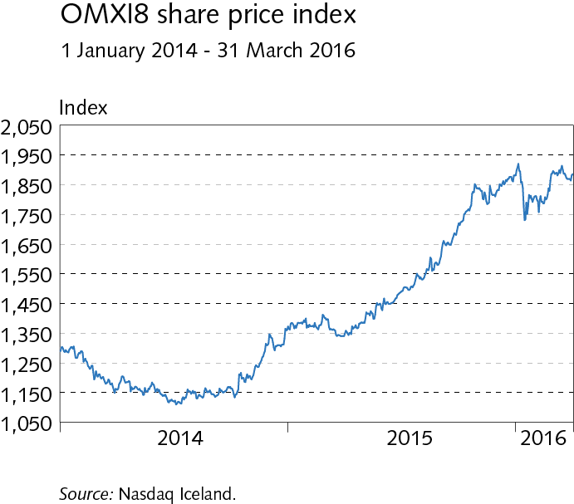
I Economic environment

Slide 23
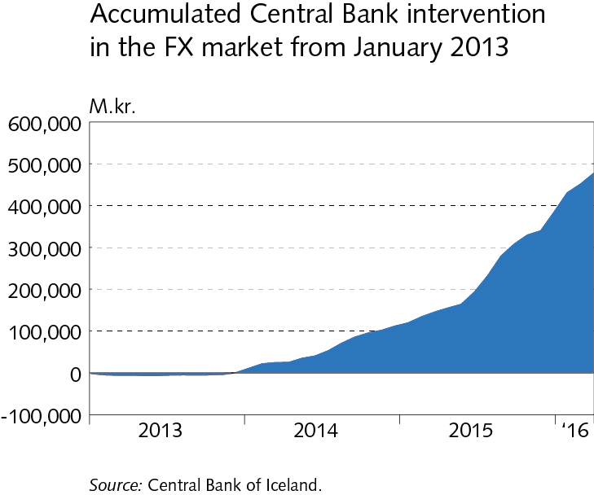
I Economic environment

Slide 24
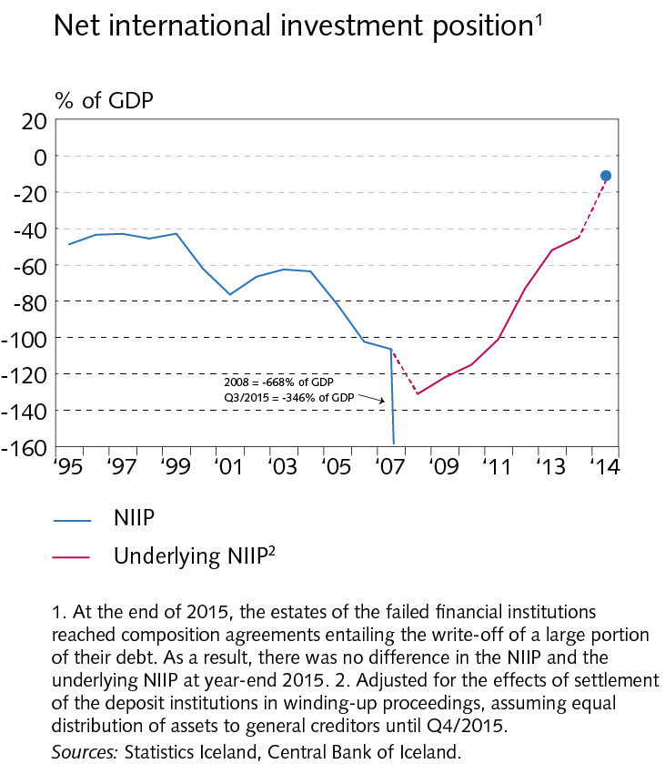
II External postition

Slide 25
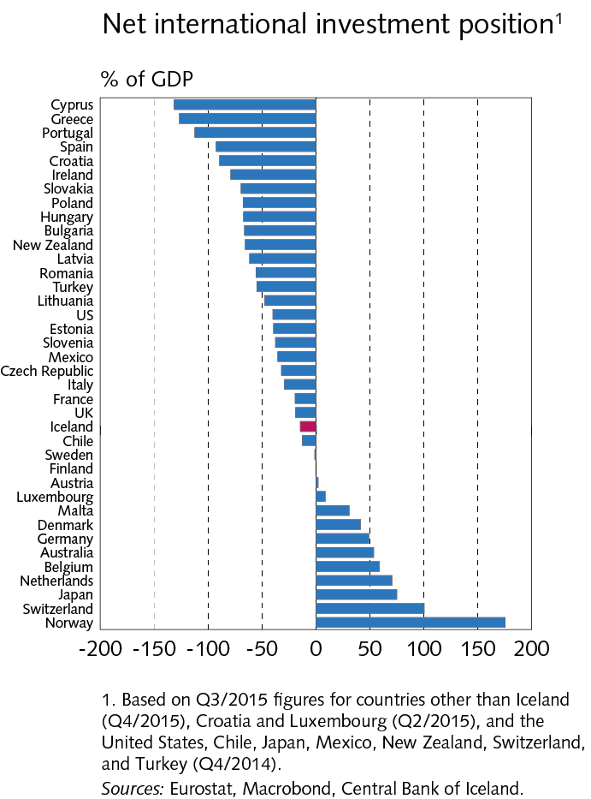
II External postition

Slide 26
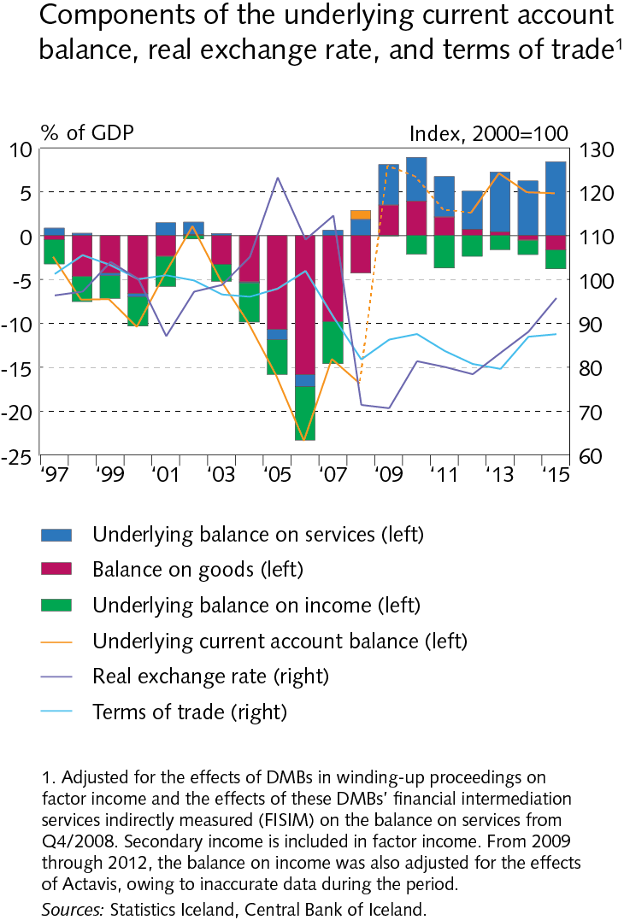
II External postition

Slide 27
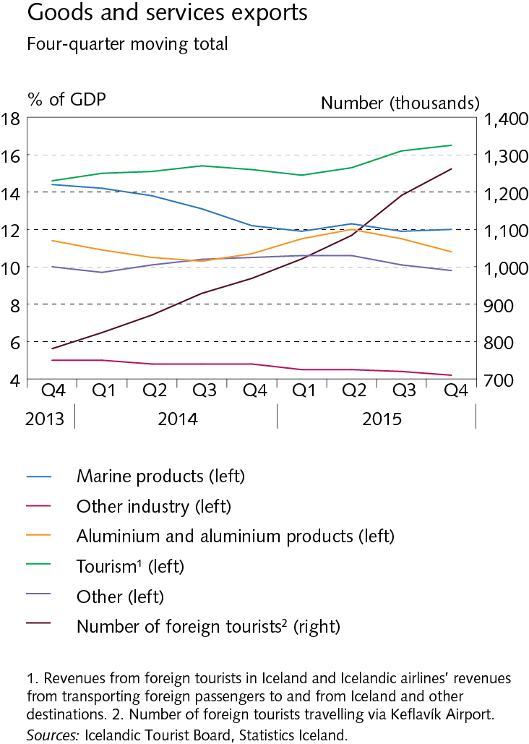
II External postition

Slide 28
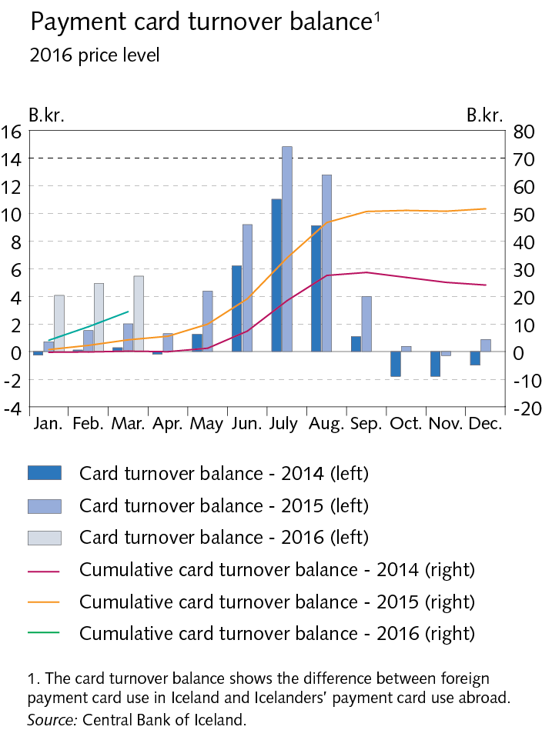
II External postition

Slide 29
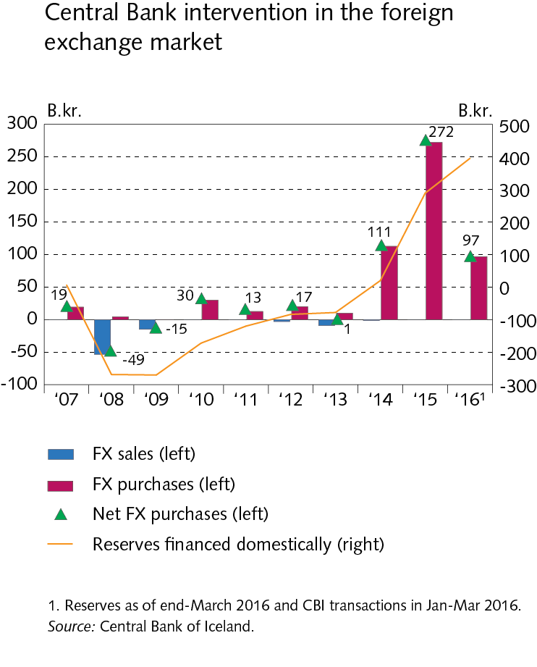
II External postition

Slide 30
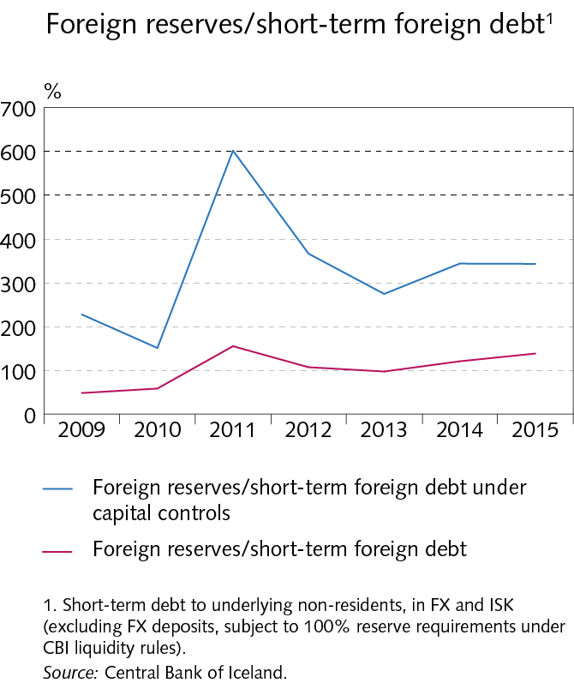
II External postition

Slide 31
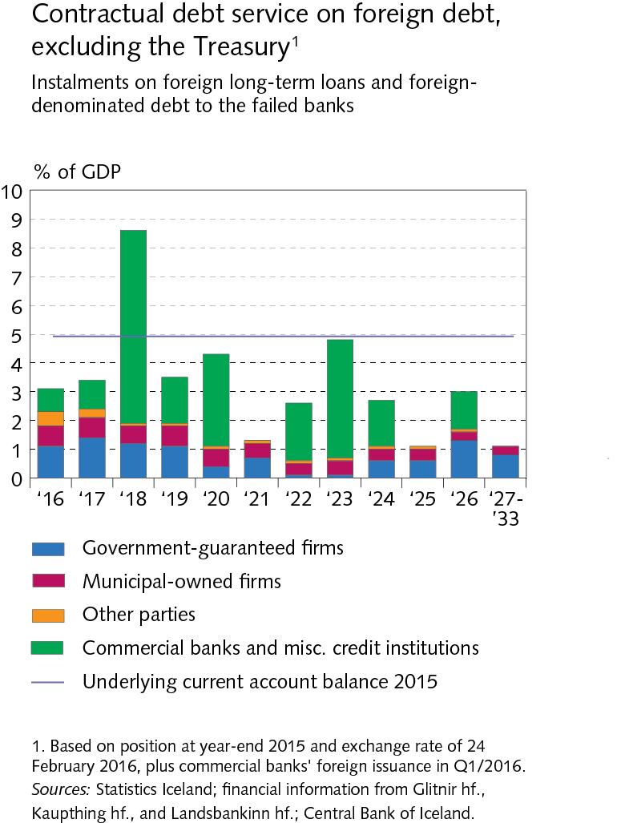
II External postition

Slide 32
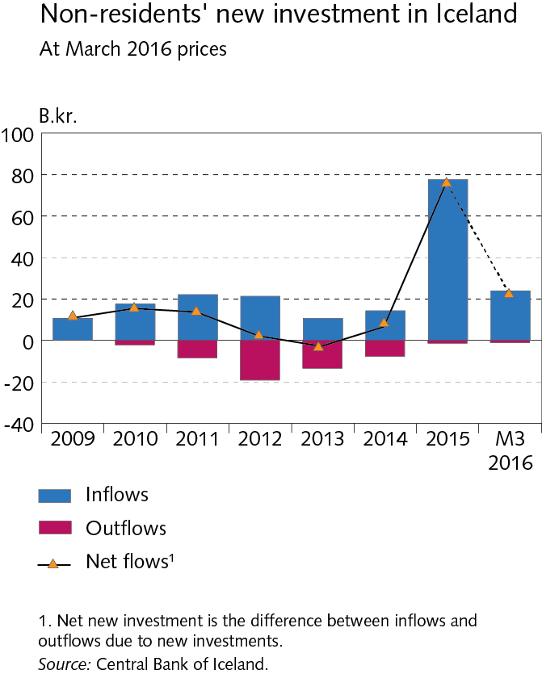
II External postition

Slide 33
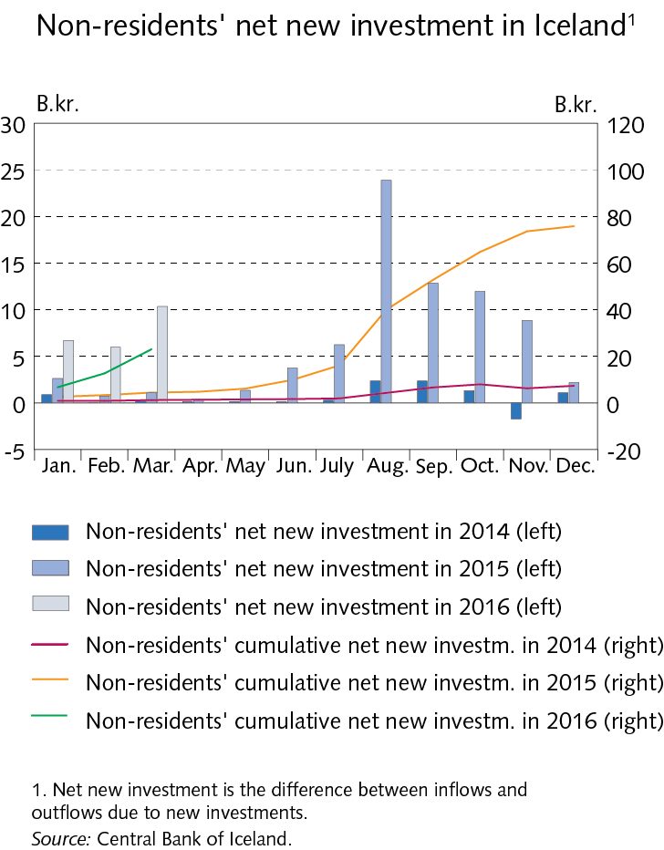
II External postition

Slide 34
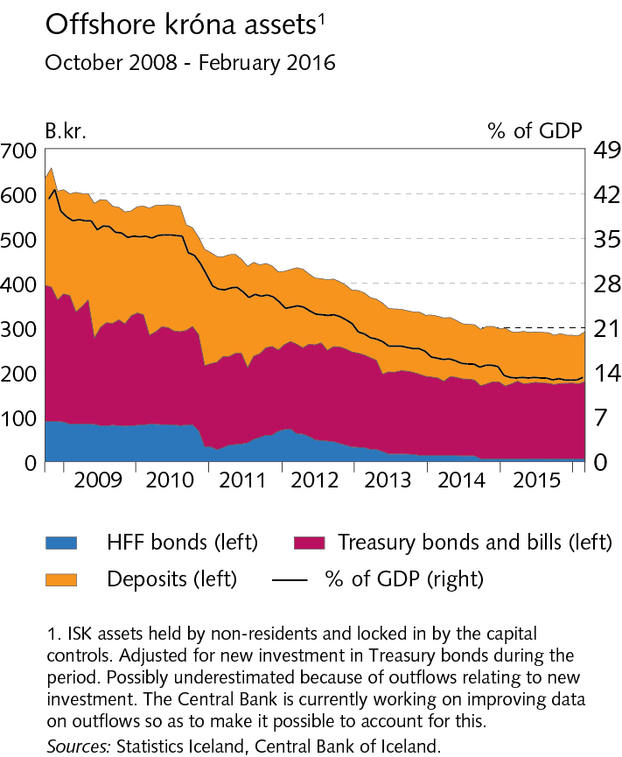
II External postition

Slide 35
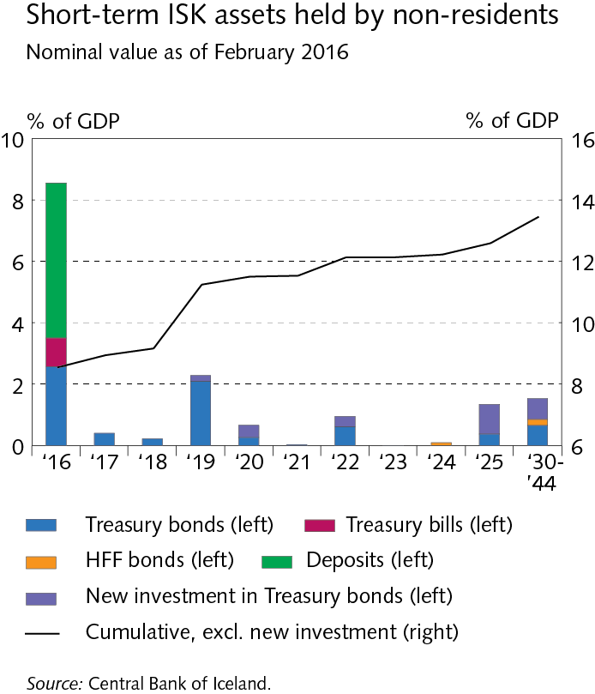
II External postition

Slide 36
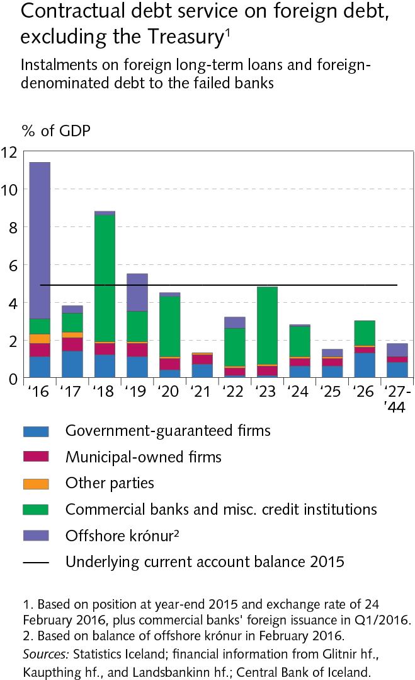
II External postition

Slide 37
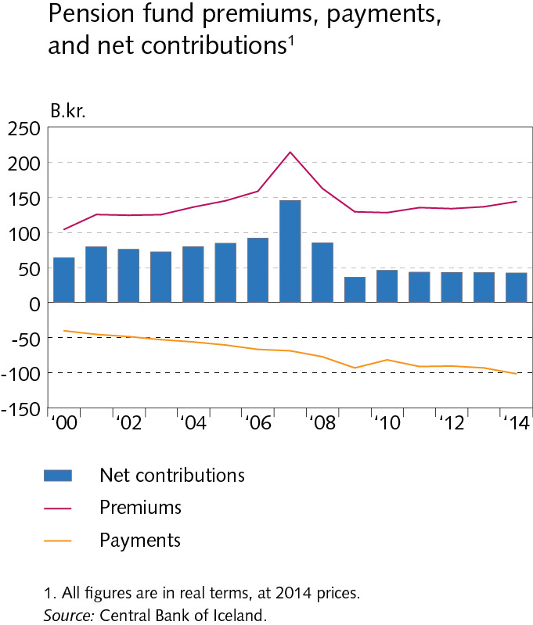
Box II-1

Slide 38
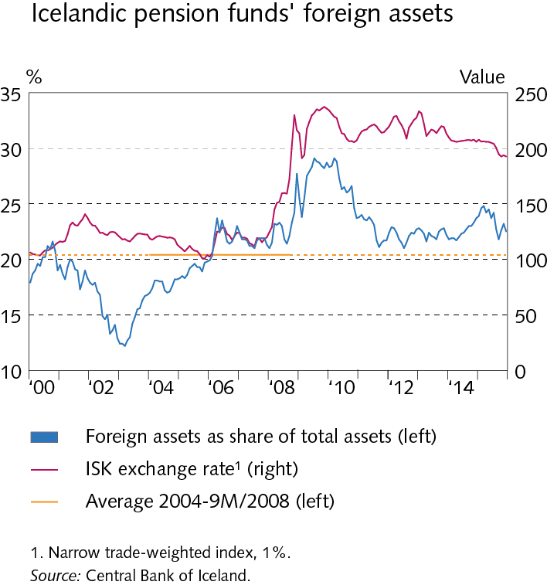
Box II-1

Slide 39
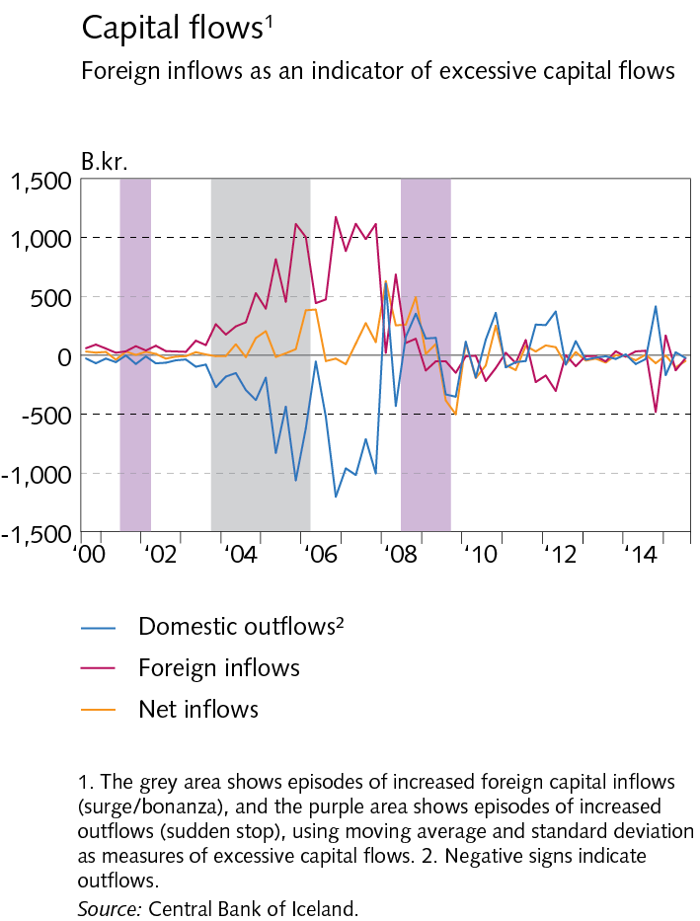
Box II-2

Slide 40
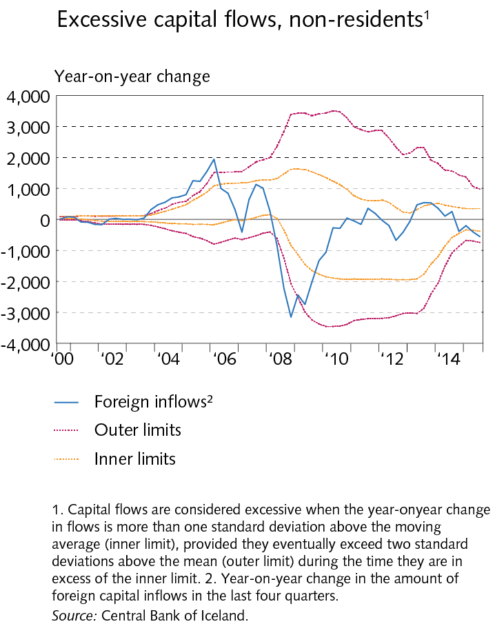
Box II-2

Slide 41
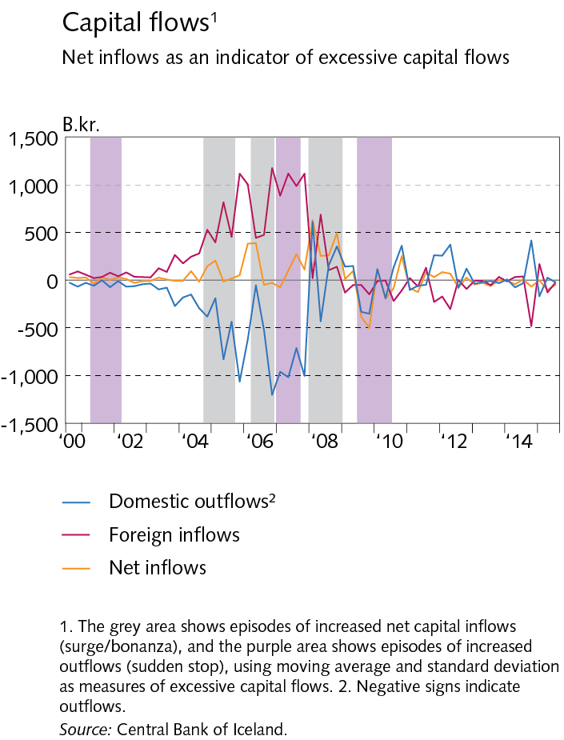
Box II-2

Slide 42
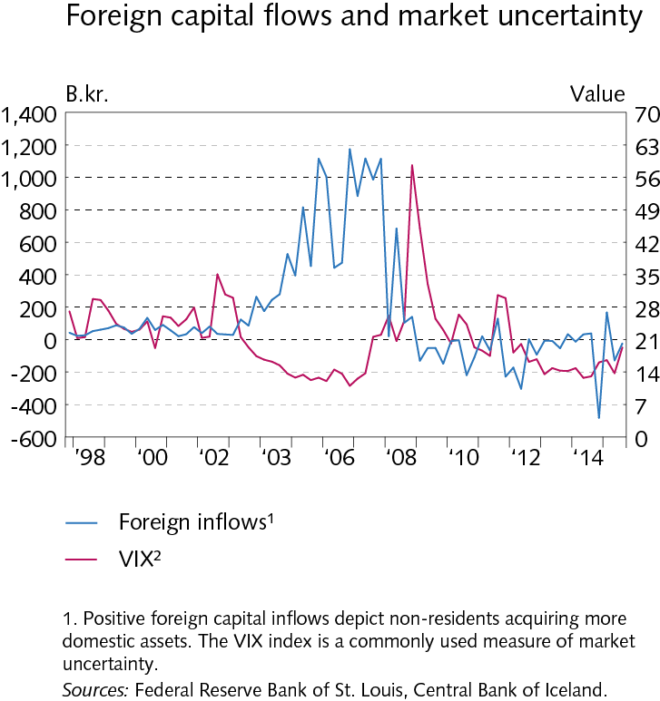
Box II-2

Slide 43
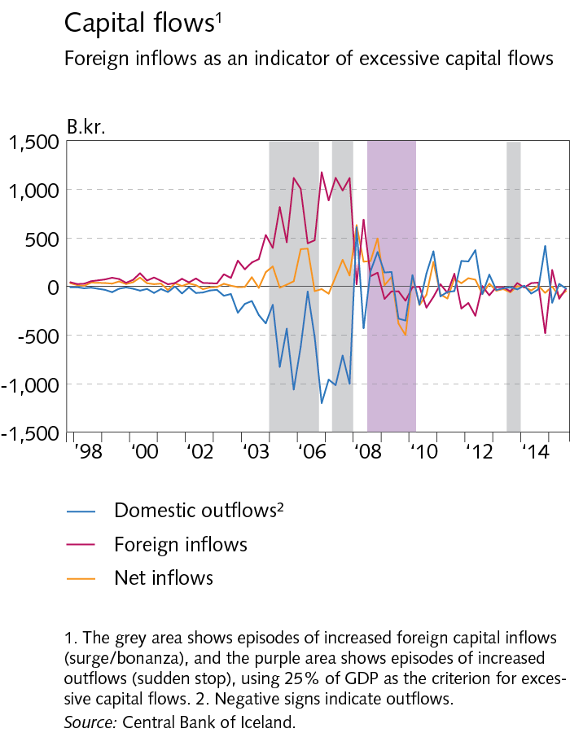
Box II-2

Slide 44
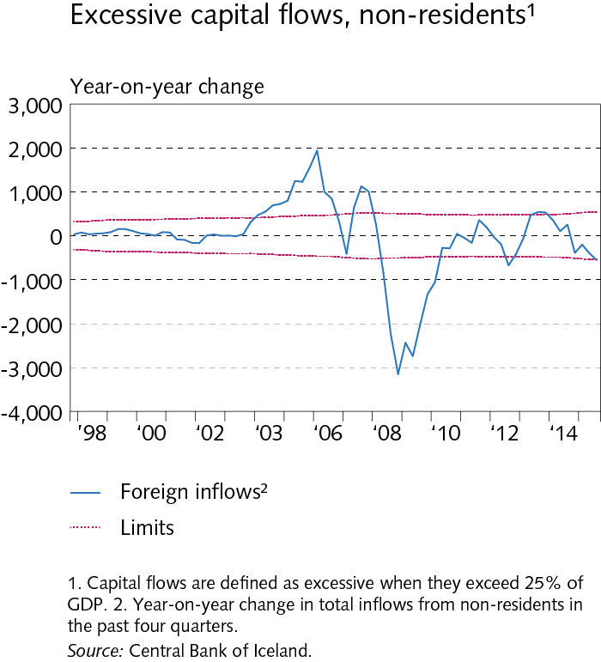
Box II-2

Slide 45
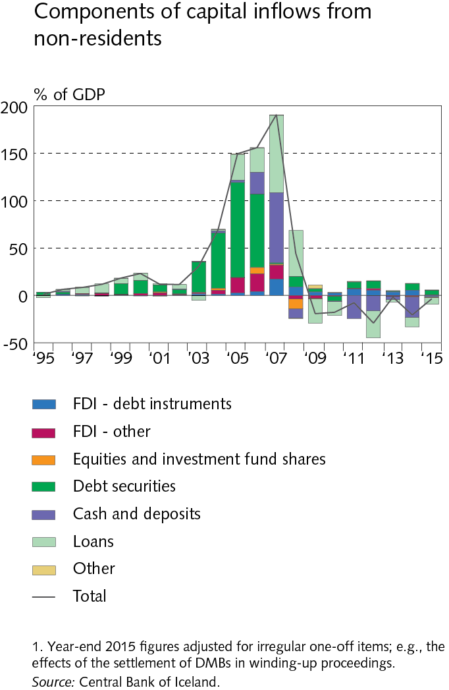
Box II-2

Slide 46
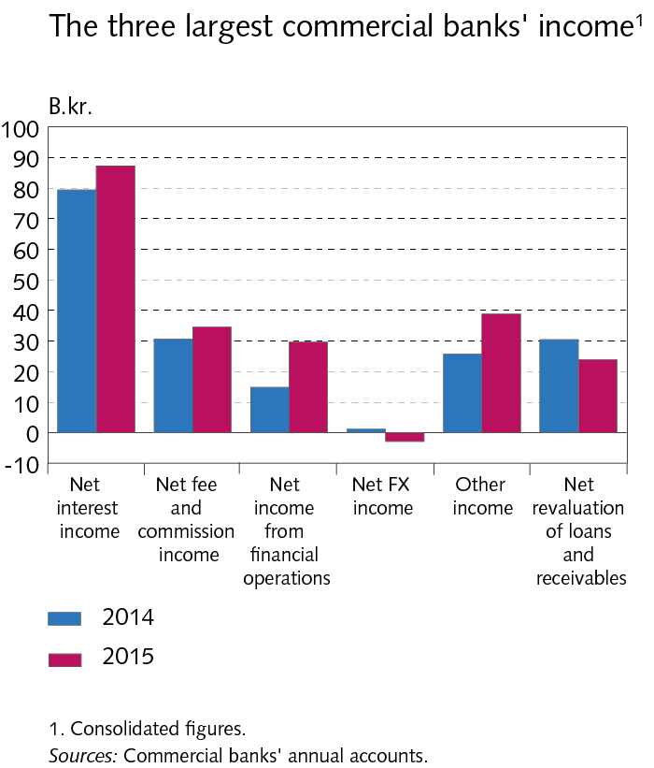
III Operations and equity

Slide 47
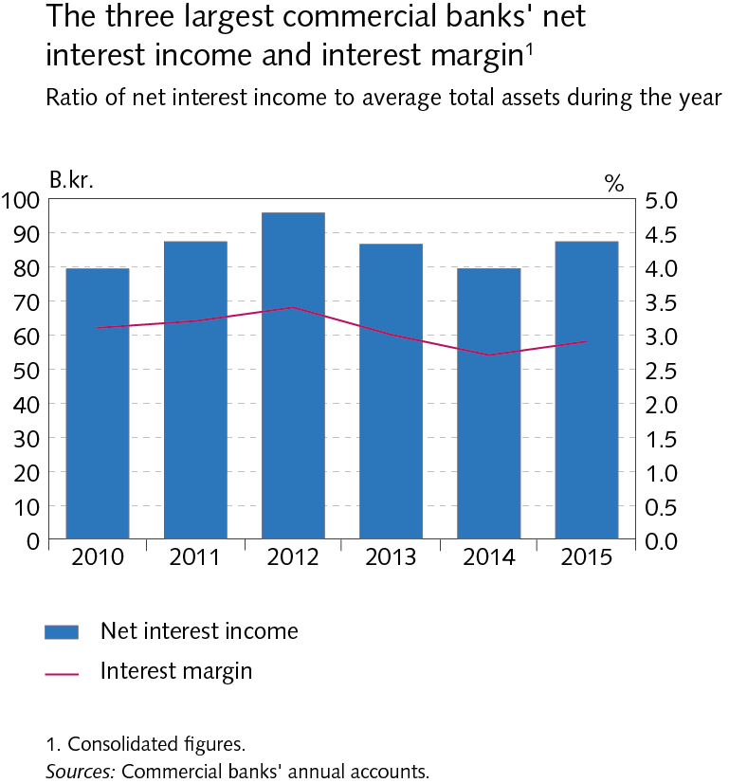
III Operations and equity

Slide 48
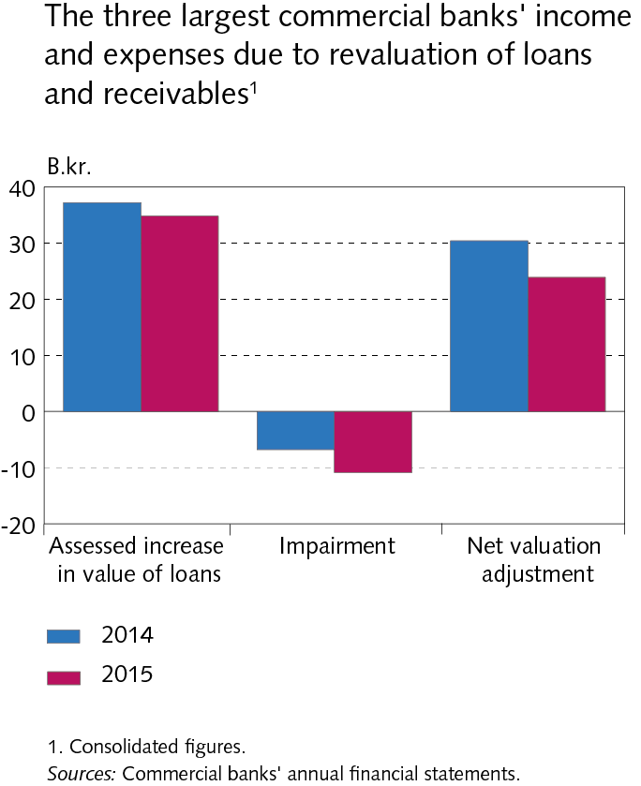
III Operations and equity

Slide 49
III Operations and equity

Slide 50
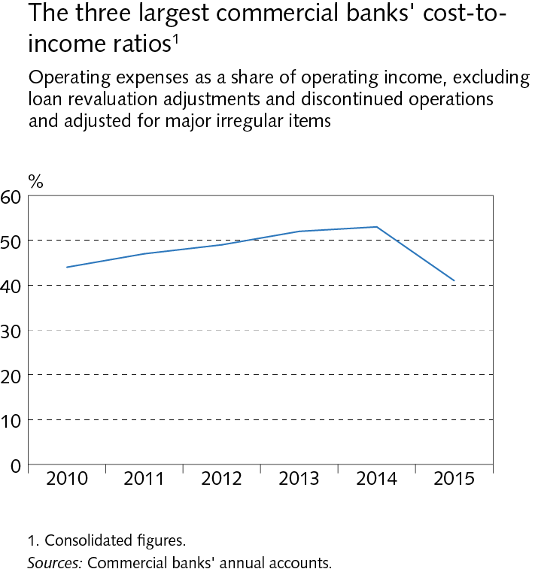
III Operations and equity

Slide 51
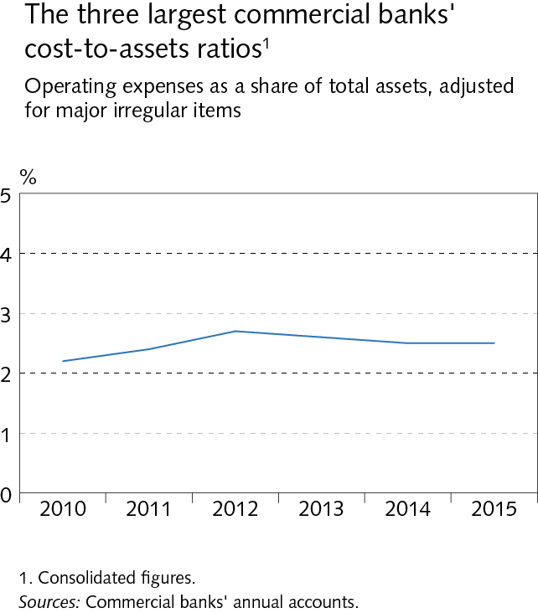
III Operations and equity

Slide 52
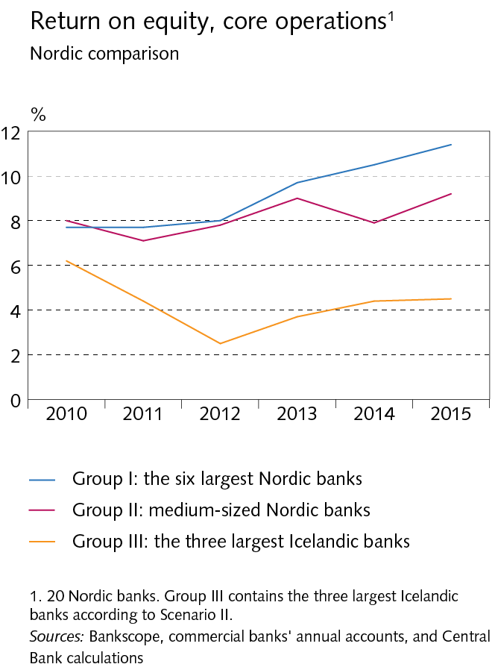
III Operations and equity

Slide 53
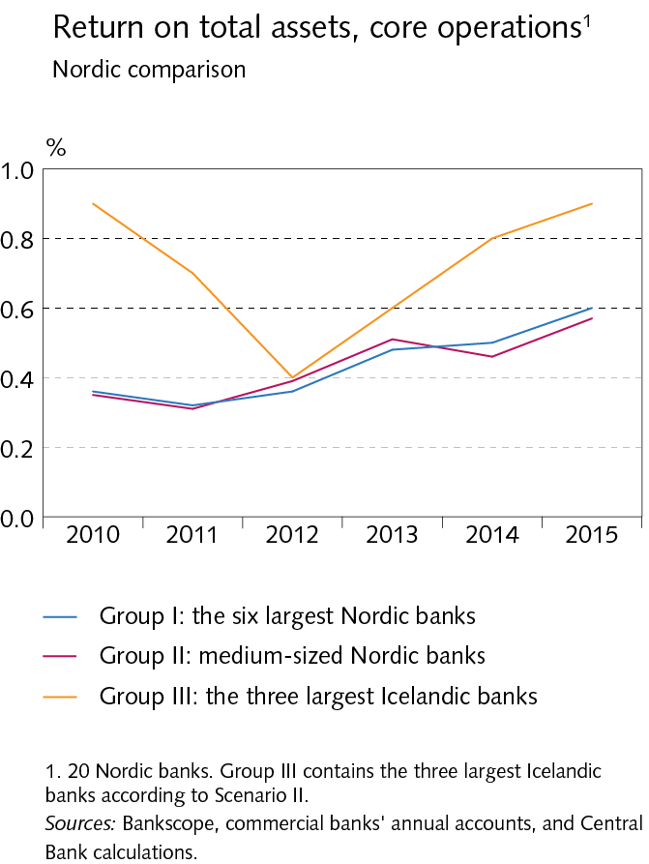
III Operations and equity

Slide 54
III Operations and equity

Slide 55
III Operations and equity

Slide 56
III Operations and equity

Slide 57
III Operations and equity

Slide 58
Box III-1

Slide 59
Box III-1

Slide 60
Box III-1

Slide 61
Box III-1

Slide 62
IV Funding and liquidity

Slide 63
IV Funding and liquidity

Slide 64
IV Funding and liquidity

Slide 65
IV Funding and liquidity

Slide 66
IV Funding and liquidity

Slide 67
IV Funding and liquidity

Slide 68
IV Funding and liquidity

Slide 69
IV Funding and liquidity

Slide 70
IV Funding and liquidity

Slide 71
IV Funding and liquidity

Slide 72
IV Funding and liquidity

Slide 73
IV Funding and liquidity

Slide 74
IV Funding and liquidity

Slide 75
IV Funding and liquidity

Slide 76
IV Funding and liquidity

Slide 77
V Financial system assets

Slide 78
V Financial system assets

Slide 79
V Financial system assets

Slide 80
V Financial system assets

Slide 81
V Financial system assets

Slide 82
V Financial system assets

Slide 83
V Financial system assets

Slide 84
V Financial system assets

Slide 85
V Financial system assets

Slide 86
V Financial system assets

Slide 87
V Financial system assets

Slide 88
V Financial system assets

Slide 89
V Financial system assets

Slide 90
V Financial system assets

Slide 91
V Financial system assets

Slide 92
Box V-1

Slide 93
Box V-1

Slide 94
VI Households and corporates

Slide 95
VI Households and corporates

Slide 96
VI Households and corporates

Slide 97
VI Households and corporates

Slide 98
VI Households and corporates

Slide 99
VI Households and corporates

Slide 100
VI Households and corporates

Slide 101
VI Households and corporates

Slide 102
VI Households and corporates

Slide 103
VI Households and corporates

Slide 104
VI Households and corporates

Slide 105
VI Households and corporates

Slide 106
VI Households and corporates

Slide 107
VI Households and corporates

Slide 108
VI Households and corporates

Slide 109
VI Households and corporates

Slide 110
VI Households and corporates

Slide 111
VI Households and corporates

Slide 112
VI Households and corporates

Slide 113
VI Households and corporates

Slide 114
VI Households and corporates

Slide 115
VI Households and corporates

Slide 116
VI Households and corporates

Slide 117
VI Households and corporates

Slide 118
VI Households and corporates

Slide 119
VI Households and corporates

Slide 120
Box VI-1

Slide 121
Box VI-1

Slide 122
Box VI-1

Slide 123
Box VI-2

Slide 124
Box VI-2

Slide 125
Box VI-2

Slide 126
Box VI-2

Slide 127
Box VI-2

Slide 128
Appendix I

Slide 129
Appendix I

Slide 130
Appendix I

Slide 131
Appendix I

Slide 132
Appendix I

Slide 133
Appendix V

Slide 134
Appendix V

Slide 135
Appendix V

Slide 136
Appendix V

Slide 137
Appendix V

Slide 138
Appendix V

